Slide 1
Alignment (I) Bioinformatics Applications (PLPTH813)
Sanzhen Liu
2/16/2017

Slide 2
Tools for NGS data and R
@SEQ_ID
ATCAACTGATGCATC
+SEQ_ID
!''*((((***+))%
FASTA/Q
Tools
FASTQC: a tools to overview data (quantity and quality)
seqtk: a FASTA/Q manipulation tool
Trimmomatic: an efficient trimming tool
own functions
apply families
basic statistical tests

Slide 3
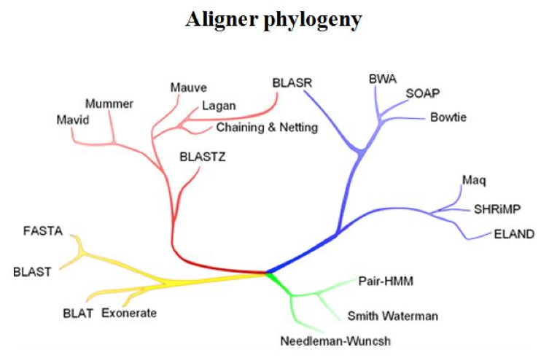
Alignment algorithms
Long sequences Short reads
Pairwise heuristic Sensitive aligners
http://evomicsorg.wpengine.netdna-cdn.com/wp-content/uploads/2014/01/alignCompare2.jpg

Slide 4
Outline
Alignment overview
Dot plot
Dynamic alignment
(example: local alignment)
BLAST

Slide 5
Sequence alignment
Sequence alignment is the approach of comparing the sequences of nucleotides or amino acids to identify regions of similarity.
Applications:
Measure relatedness between sequences
Identify homologous genes or duplication regions
Identify source of a sequence in a database
Locate the position of a sequence in the genome
etc.

Slide 6
Dot matrices in a single-base resolution
a
c
g
c
g
a
c
a
c
g

Slide 7
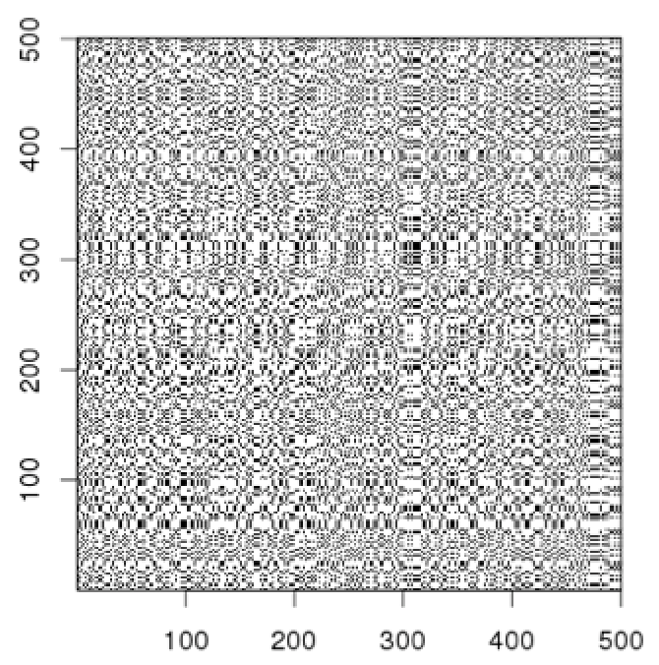
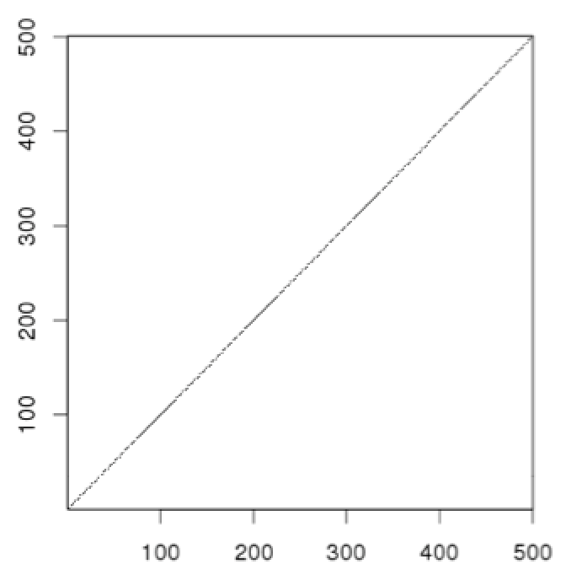
Dot plot comparison using windows
Dot matrices for long sequences can be noisy due to insignificant matches
e.g., Put a dot only if at least 9 out of 10 nucleotides are identical.
window size = 10
min matches = 9
Solution: use a window and a threshold
compare letter by letter within a window (have to choose window size)
require certain fraction of matches within window in order to display it with a dot

Slide 8
Dot plot with a window method
Window size = 4
Stringency = 3 (min matches)
a
c
g
c
g
a
c
a
c
g

Slide 9
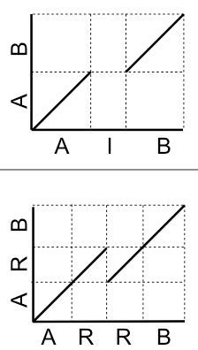
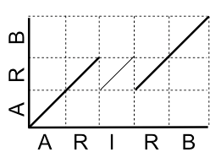
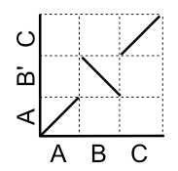
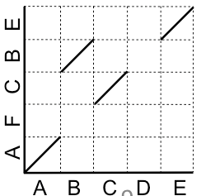
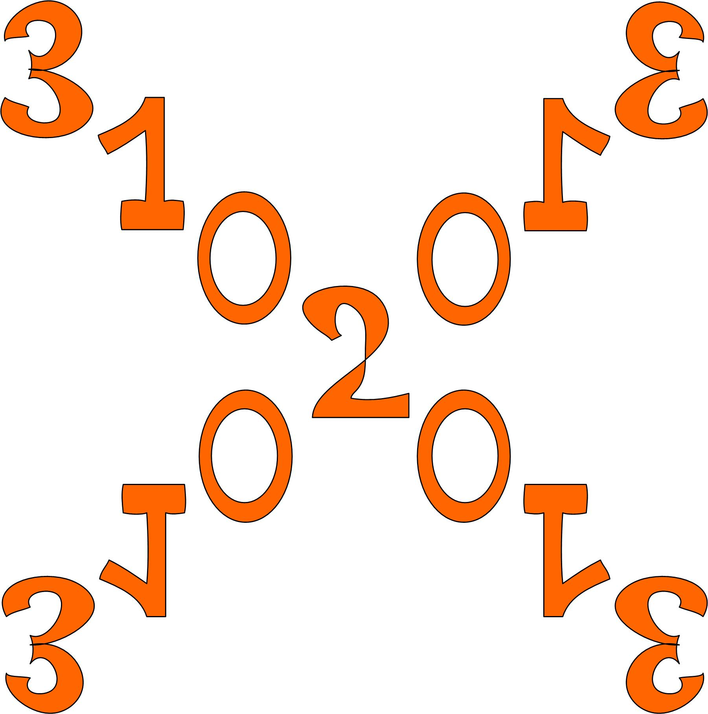
Dot-plots (examples)
deletion of "I" in query
query is identical to reference and contains no repeats
deletion of a "R" in query
query
reference
deletion of "IR" in query
?
palindrome
query
inverstion
Rearrangement with disagreement
reference

Slide 10
Outline
Alignment overview
Dot plot
Dynamic alignment
(example: local alignment)
BLAST

Slide 11
Local and global alignments
Local alignment: to find similar sequence regions between sequences
C T G T T G C T G C
T G C T G
Global alignment: to attempt to optimally align the entire length of two sequences.
C T G T T G C T G C
- T G - - - C T G -

Slide 12
Best (local) alignment
Question: How to determine which alignment is better?
Alignment 1: C T G T T G C T G C
T G C T G
Alignment 2: C T G T T G C T G C
T G - - - C T G
Need a scoring scheme:
e.g., match +1; mismatch -1; gap -2
then, a score can be assigned to each alignment

Slide 13
Best (local) alignment
match +1; mismatch -1; gap -2
Alignment 1: C T G T T G C T G C
T G C T G
1 2 1 2 3 score = 3
Alignment 2: C T G T T G C T G C
T G - - - C T G
1 2 0 -2 -4 -3 -2 -1 score = -1
match +1; mismatch -2; gap 0
Alignment 1: C T G T T G C T G C
T G C T G
1 2 0 1 1 score = 2
Alignment 2: C T G T T G C T G C
T G - - - C T G
1 2 0 0 0 3 4 5 score = 5

Slide 14
A classic algorithm for local alignment – Smith-Waterman
Local alignment
C T G T T G C T G C
T G C T G
List all possible alignments and to find a winner with the highest score?
Smith–Waterman (SW)
Using dynamic programming to find the best local alignment(s) between two sequences with respect to a scoring scheme

Slide 15
SW example
Scoring rule:
match +1; mismatch -1; gap -2 (γ)
Initialize top row and leftmost column to zero.
Fill in the table using the following formula
 | j | 1 | 2 | 3 | 4 | 5 | 6 | 7 | 8 | 9
i |  |  | C | T | G | T | T | G | C | T
1 |  | 0 | 0 | 0 | 0 | 0 | 0 | 0 | 0 | 0
2 | A | 0
3 | T | 0
4 | G | 0
5 | C | 0
6 | T | 0
7 | G | 0
8 | C | 0
9 | A | 0
C[i-1, j-1] | C[i-1, j]
C[i, j-1] | C[i, j]

Slide 16
SW example
Scoring rule:
match +1; mismatch -1; gap -2 (γ)
Initialize top row and leftmost column to zero.
Fill in the table using the following formula
 | j | 1 | 2 | 3 | 4 | 5 | 6 | 7 | 8 | 9
i |  |  | C | T | G | T | T | G | C | T
1 |  | 0 | 0 | 0 | 0 | 0 | 0 | 0 | 0 | 0
2 | A | 0 | 0
3 | T | 0
4 | G | 0
5 | C | 0
6 | T | 0
7 | G | 0
8 | C | 0
9 | A | 0
C[i-1, j-1] | C[i-1, j]
C[i, j-1] | C[i, j]
0 - 1
0 - 2
0 - 2
0

Slide 17
SW example
Scoring rule:
match +1; mismatch -1; gap -2 (γ)
Initialize top row and leftmost column to zero.
Fill in the table using the following formula
 | j | 1 | 2 | 3 | 4 | 5 | 6 | 7 | 8 | 9
i |  |  | C | T | G | T | T | G | C | T
1 |  | 0 | 0 | 0 | 0 | 0 | 0 | 0 | 0 | 0
2 | A | 0 | 0 | 0
3 | T | 0 | 0 | 1
4 | G | 0
5 | C | 0
6 | T | 0
7 | G | 0
8 | C | 0
9 | A | 0
C[i-1, j-1] | C[i-1, j]
C[i, j-1] | C[i, j]
0 + 1
0 - 2
0 - 2
0

Slide 18
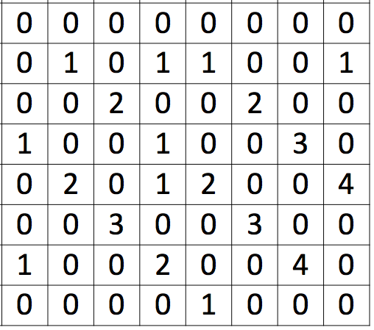
SW example
Scoring rule:
match +1; mismatch -1; gap -2 (γ)
Initialize top row and leftmost column to zero.
Fill in the table using the following formula
 | j | 1 | 2 | 3 | 4 | 5 | 6 | 7 | 8 | 9
i |  |  | C | T | G | T | T | G | C | T
1 |  | 0 | 0 | 0 | 0 | 0 | 0 | 0 | 0 | 0
2 | A | 0 | 0 | 0
3 | T | 0 | 0 | 1
4 | G | 0
5 | C | 0
6 | T | 0
7 | G | 0
8 | C | 0
9 | A | 0
C[i-1, j-1] | C[i-1, j]
C[i, j-1] | C[i, j]

Slide 19
SW example (cont.)
Question: to find the optimal local alignments between s and t.
s: CTGTTGCT
t: ATGCTGCA
 | j | 1 | 2 | 3 | 4 | 5 | 6 | 7 | 8 | 9
i |  |  | C | T | G | T | T | G | C | T
1 |  | 0 | 0 | 0 | 0 | 0 | 0 | 0 | 0 | 0
2 | A | 0 | 0 | 0 | 0 | 0 | 0 | 0 | 0 | 0
3 | T | 0 | 0 | 1 | 0 | 1 | 1 | 0 | 0 | 1
4 | G | 0 | 0 | 0 | 2 | 0 | 0 | 2 | 0 | 0
5 | C | 0 | 1 | 0 | 0 | 1 | 0 | 0 | 3 | 0
6 | T | 0 | 0 | 2 | 0 | 1 | 2 | 0 | 0 | 4
7 | G | 0 | 0 | 0 | 3 | 0 | 0 | 3 | 0 | 0
8 | C | 0 | 1 | 0 | 0 | 2 | 0 | 0 | 4 | 0
9 | A | 0 | 0 | 0 | 0 | 0 | 1 | 0 | 0 | 0
To obtain the optimum local alignment,
Identify the highest scores in the matrix.
Then, go backwards to the cell with the highest score of the positions of (i − 1, j), (i, j − 1), and (i − 1, j − 1)
This procedure is repeated until a cell with zero value is reached.
s: CTGTTGCT
||||||
t: ATGCTGCA
s: CTGTTGCT
||||
t: ATGCTGCA

Slide 20
Global alignment – Needleman-Wunsch
Global alignments attempt to optimally align the entire length of two sequences.
+10 for match, -2 for mismatch, -5 for gap
 | j | 1 | 2 | 3 | 4 | 5 | 6 | 7 | 8 | 9
i |  |  | C | T | G | T | T | G | C | T
1 |  | 0 | -5 | -10 | -15 | -20 | -25 | -30 | -35 | -40
2 | A | -5 | -2 | -7 | -12 | -17 | -22 | -27 | -32 | -37
3 | T | -10 | -7 | 8 | 3 | -2 | -7 | -12 | -17 | -12
4 | G | -15 | -12 | 3 | 18 | 13 | 8 | 3 | -2 | -7
5 | C | -20 | -5 | -2 | 13 | 16 | 11 | 6 | 13 | 8
6 | T | -25 | -10 | 5 | 0 | 23 | 26 | 21 | 16 | 23
7 | G | -30 | -15 | 0 | 15 | 18 | 21 | 36 | 31 | 26
8 | C | -35 | -20 | -5 | 10 | 13 | 16 | 31 | 46 | 41
9 | A | -40 | -25 | -10 | 5 | 8 | 11 | 26 | 41 | 44
s: CTGTTGCT
t: ATGCTGCA
s: CTG-TTGCT
|| |||
t: ATGC-TGCA

Slide 21
BLAST (Basic Local Alignment Search Tool)
The classic algorithm, Smith–Waterman algorithm, optimizes the similar measure. It ensured the best performance on accuracy and the most precise results with respect to its scoring scheme.
However, Smith–Waterman algorithm is time-consuming and computational burdensome. It is not practical to apply it to align a query sequence to a large database.
BLAST emphasizes on speed to make the algorithm practical on the huge genome databases.

Slide 22
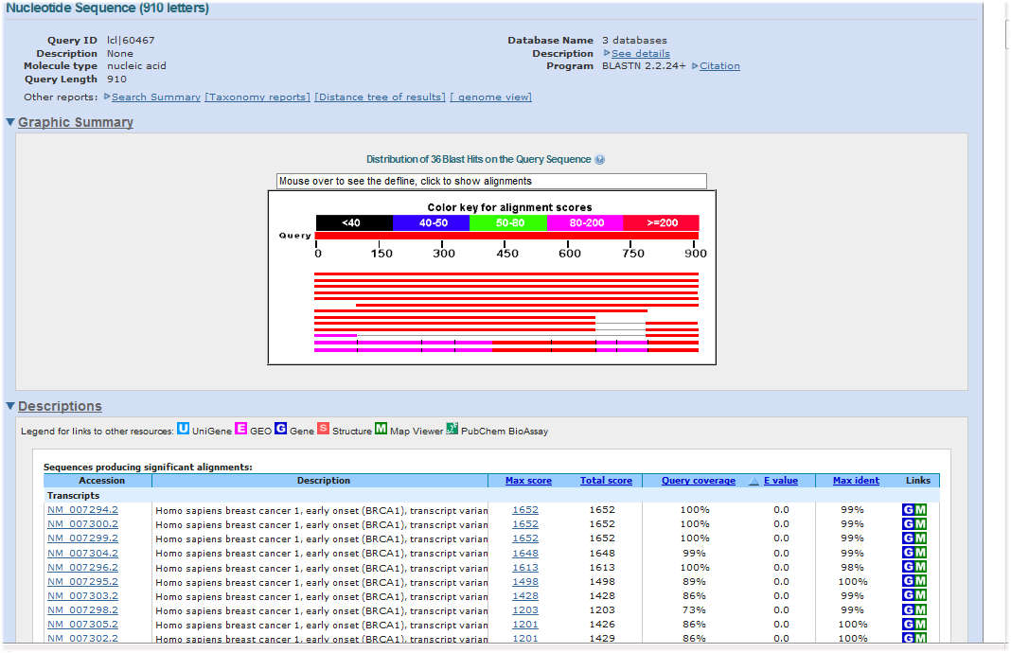
Question
Could you recall the procedure of a BLAST job to achieve the BLAST alignment results? And what does NCBI actually provide?
Notes:
Collect sequences to form a database
Provide a searching algorithm
Display the searching result

Slide 23
BLAST+
BLAST was first introduced by NCBI in 1989.
NCBI introduced BLAST+ in 2009, which is faster and allows more flexibility in output formats and in the search input.
It provides a variety of BLAST functions for both DNA and protein sequences.
For example:
blastp
blastp | Traditional BLASTP to compare a protein query to a protein database
blastp-short | BLASTP optimized for queries shorter than 30 residues
blastn
blastn | Traditional BLASTN requiring an exact match of 11
blastn-short | BLASTN program optimized for sequences shorter than 50 bases

Slide 24
BLAST algorithm
1. Make k-tuple words (seeds) of the query sequence.
CTGTTGCTCGTCTCGGGACTGT
CTG
TGT
GTT
…
2. List possible matching words for each k-tuple word & remove low-scoring words
k mismatch
CTG 0
ATG 1
TTG 1 high-scoring words
GTG 1
CAG 1
…
AAG 2
…
3. Compare the high-scoring words to the database sequences to identify exact matches
4. Extend the exact matches to both directions on the database sequences to obtain high-scoring segment pairs (HSPs)
Database sequence
HSP

Slide 25
Command line based BLAST
Step 1:
Computer/server
Install the “BLAST+” software package
Make databases of collected sequences
Step 2:
Run BLAST searching with your query sequences on the server

Slide 26
Step 1: Create a database
makeblastdb
A program to create a BLAST database
makeblastdb –in MG1655.fasta -out MG1655 -dbtype nucl
Database files were generated:
---output---
MG1655.nhr
MG1655.nin
MG1655.nsq
...

Slide 27
Step 2: BLAST a query to a DNA database
blastn
blastn -query MG1655dnaseq.fa –db MG1655
---output---
Query= MG1655_partial
Length=280
Score E
Sequences producing significant alignments: (Bits) Value
gi|556503834|ref|NC_000913.3| Escherichia coli str. K-12 substr... 518 1e-147
> gi|556503834|ref|NC_000913.3| Escherichia coli str. K-12 substr.
MG1655, complete genome
Length=4641652
Score = 518 bits (280), Expect = 1e-147
Identities = 280/280 (100%), Gaps = 0/280 (0%)
Strand=Plus/Plus
Query 1 TAGAAAATGCCCATGGCAAGAATAATACCGTCCAGAGCGAAATAACCCACGTTGTGCAGG 60
||||||||||||||||||||||||||||||||||||||||||||||||||||||||||||
Sbjct 10361 TAGAAAATGCCCATGGCAAGAATAATACCGTCCAGAGCGAAATAACCCACGTTGTGCAGG 10420
Query 61 TTAAGCAGAATGGTGGTCATGCCGAAGCCCATCAGGCCCAGCGGTGCCGGATTAGCCAAC 120
||||||||||||||||||||||||||||||||||||||||||||||||||||||||||||
Sbjct 10421 TTAAGCAGAATGGTGGTCATGCCGAAGCCCATCAGGCCCAGCGGTGCCGGATTAGCCAAC 10480
Query 121 TTAGTGTTGCCCATAATTCCTCAAAAATCATCATCGAATGAATGGTGAAATAATTTCCCT 180
||||||||||||||||||||||||||||||||||||||||||||||||||||||||||||
Sbjct 10481 TTAGTGTTGCCCATAATTCCTCAAAAATCATCATCGAATGAATGGTGAAATAATTTCCCT 10540
Query 181 GAATAACTGTAGTGTTTTCAGGGCGCGGCATAATAATCAGCCAGTGGGGCAGTGTCTACG 240
||||||||||||||||||||||||||||||||||||||||||||||||||||||||||||
Sbjct 10541 GAATAACTGTAGTGTTTTCAGGGCGCGGCATAATAATCAGCCAGTGGGGCAGTGTCTACG 10600
Query 241 ATCTTTTGAGGGGAAAATGAAAATTTTCCCCGGTTTCCGG 280
||||||||||||||||||||||||||||||||||||||||
Sbjct 10601 ATCTTTTGAGGGGAAAATGAAAATTTTCCCCGGTTTCCGG 10640

Slide 28
Select output format
blastn -query MG1655dnaseq.fa –db MG1655 –outfmt 6
query id | subject id | % identity | alignment length | mismatches | gap opens | q. start | q. end | s. start | s. end | evalue | bit score
MG1655_partial | gi|556503834|ref|NC_000913.3| | 100 | 280 | 0 | 0 | 1 | 280 | 10361 | 10640 | 1.00E-147 | 518

Slide 29
E-value
Score = 518 bits (280), Expect = 1e-147
Identities = 280/280 (100%), Gaps = 0/280 (0%)
Strand=Plus/Plus
Query 1 TAGAAAATGCCCATGGCAAGAATAATACCGTCCAGAGCGAAATAACCCACGTTGTGCAGG 60
||||||||||||||||||||||||||||||||||||||||||||||||||||||||||||
Sbjct 10361 TAGAAAATGCCCATGGCAAGAATAATACCGTCCAGAGCGAAATAACCCACGTTGTGCAGG 10420
…
Query 241 ATCTTTTGAGGGGAAAATGAAAATTTTCCCCGGTTTCCGG 280
||||||||||||||||||||||||||||||||||||||||
Sbjct 10601 ATCTTTTGAGGGGAAAATGAAAATTTTCCCCGGTTTCCGG 10640
E-value is a parameter that describes the number of hits that one can "expect" to see by chance when searching a database of a particular size. It is used to describe the significance (instead of a p-value) of each sequence alignment hit.
For example, E-value = 1 means that in a database of the similar size 1 match with a similar score would be obtained simply by chance.
The lower the E-value, the more "significant" the match is.

Slide 30
Score and Bit scores
Score = 518 bits (280), Expect = 1e-147
Identities = 280/280 (100%), Gaps = 0/280 (0%)
Strand=Plus/Plus
Query 1 TAGAAAATGCCCATGGCAAGAATAATACCGTCCAGAGCGAAATAACCCACGTTGTGCAGG 60
||||||||||||||||||||||||||||||||||||||||||||||||||||||||||||
Sbjct 10361 TAGAAAATGCCCATGGCAAGAATAATACCGTCCAGAGCGAAATAACCCACGTTGTGCAGG 10420
…
Query 241 ATCTTTTGAGGGGAAAATGAAAATTTTCCCCGGTTTCCGG 280
||||||||||||||||||||||||||||||||||||||||
Sbjct 10601 ATCTTTTGAGGGGAAAATGAAAATTTTCCCCGGTTTCCGG 10640
In the context of sequence alignments, a score is a numerical value that describes the overall quality of an alignment.
The bit-score is a rescaled alignment score to indicate the alignment quality, which is independent of the size of the search database.
The higher the score/bit-score, the better alignment is.
Notes:
bit score lets you estimate the magnitude of the search space you would have to
look through before you would expect to find an score as good as or better than this one by
chance.
Ex: If the bit-score is 30, you would have to score, on average, about 2^30 = 1 billion independent segment
pairs to find a score this score by chance. Each additional bit doubles the size of the search space.

Slide 31
BLAST+ remote service
blastn -query MG1655dnaseq.fa –db nt –outfmt 6 –remote
501 hits
blastn -query MG1655dnaseq.fa –db nt –outfmt 6 -evalue 1e-100 –remote
168 hits

Slide 32
Extract sequences or subsequences
blastdbcmd
Extract sequences from the database
# Use Gi ID to search*
blastdbcmd –db MG1655 -entry 556503834 -range 150-220
---output---
>gi|556503834|ref|NC_000913.3|:150-220 Escherichia coli str. K-12 substr. MG1655, complete genome
AGCGCACAGACAGATAAAAATTACAGAGTACACAACATCCATGAAACGCATTAGCACCACCATTACCACCA
* Database formatting needs to be a little different:
makeblastdb –in MG1655.fasta -out MG1655 -dbtype nucl –parse_seqids

Slide 33
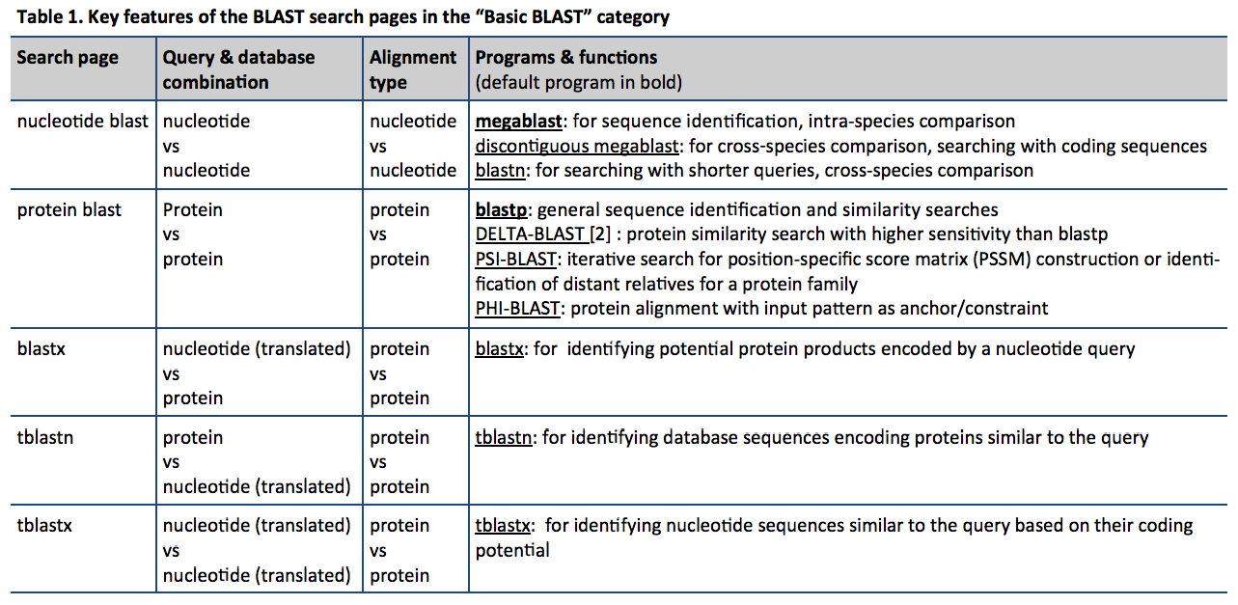
BLAST tools

Slide 34
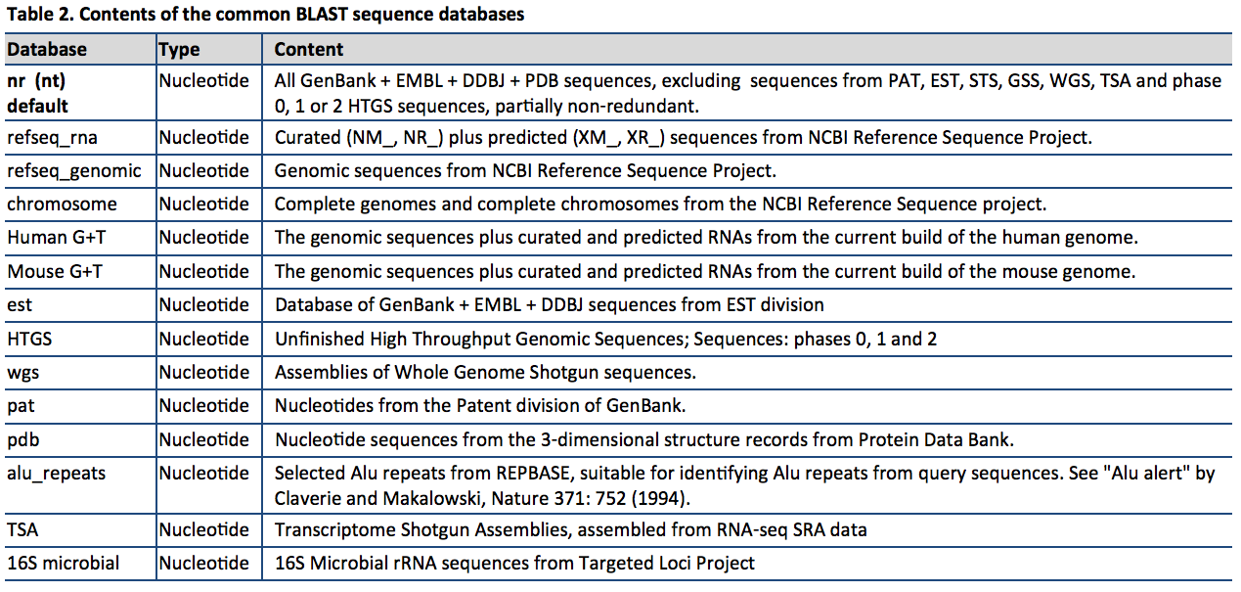
DNA nucleotide database

Slide 35
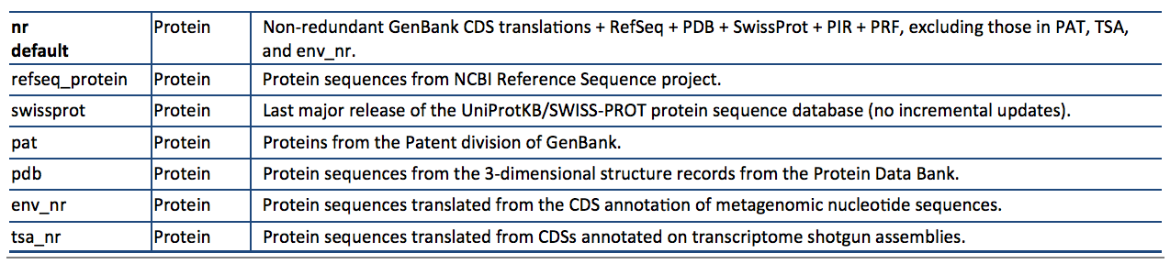
Protein database
ftp://ftp.ncbi.nlm.nih.gov/pub/factsheets/HowTo_BLASTGuide.pdf

