Slide 1
Genomic variants Bioinformatics Applications (PLPTH813)
Sanzhen Liu
3/30/2017

Slide 2
Goal of today’s lab
GATK
tview to visualize SNPs
Cyberduck for data transferring
IGV to visualize SNPs

Slide 3
directories
# create a new directory for today's practice
mkdir Lab08_variants
cd Lab08_variants
mkdir GATK
mkdir reference
mkdir data

Slide 4
To-do analysis
Discover variants of two E.coli strains DH10B and MG1655 relative to a reference genome
Reference genome: E.coli K-12 MG1655
Illumina data sets: DH10B and MG1655

Slide 5
Make links to data
# E.coli K-12 MG1655 reference
cd reference
ln -s /homes/liu3zhen/teaching/BA17/Lab08_variants/references* .
cd ..
# Alignment data:
cd data
ln -s /homes/liu3zhen/teaching/PLPTH613/Lab08_variants/data/* .
cd ..
# DH10B.parse.bam
# DH10B.parse.bam.bai
# MG1655.parse.bam
# MG1655.parse.bam.bai

Slide 6
BWA alignment (show scripts)
######################################
### index
bwa index MG1655.fasta
######################################
######################################
### alignment
######################################
### specify input files
ref=MG1655.fasta
pe1=x.pair1.fq
pe2=x.pair2.fq
### alignment
# bwa mem -T 40 $ref $pe1 $pe2 1>aln.sam 2>aln.log
bwa mem -T 40 –R '@RG\tID:S1\tSM:DH10B' $ref $pe1 $pe2 1>aln.sam 2>aln.log

Slide 7
Examine alignments
samtools flagstat ./data/DH10B.parse.bam
samtools flagstat ./data/MG1655.parse.bam
936747 + 0 in total (QC-passed reads + QC-failed reads)
0 + 0 secondary
2 + 0 supplementary
0 + 0 duplicates
936747 + 0 mapped (100.00%:-nan%)
936745 + 0 paired in sequencing
471775 + 0 read1
464970 + 0 read2
933933 + 0 properly paired (99.70%:-nan%)
934412 + 0 with itself and mate mapped
2333 + 0 singletons (0.25%:-nan%)
0 + 0 with mate mapped to a different chr
0 + 0 with mate mapped to a different chr (mapQ>=5)
tips: samtools flags 147
PAIRED,PROPER_PAIR,REVERSE,READ2

Slide 8
Prior to GATK, the reference genome needs to be indexed
In the directory of "references"
### index 1
java -jar /homes/liu3zhen/local/jars/picard.jar \
CreateSequenceDictionary \
R=Ecoli_k12_MG1655.fasta \
O=Ecoli_k12_MG1655.dict
### index 2
samtools faidx Ecoli_k12_MG1655.fasta
Check the output

Slide 9
GATK to SNP discovery
In the directory of "GATK"
### using UnifiedGenotyper from GATK to call SNPs&INDELs.
java -Xmx2g -jar /homes/liu3zhen/local/jars/GenomeAnalysisTK.jar \
-T UnifiedGenotyper \
-R ../references/Ecoli_k12_MG1655.fasta \
-I ../data/DH10B.parse.bam \
-I ../data/MG1655.parse.bam \
-glm BOTH \
--num_threads 4 \
-ploidy 1 \
-o snp.both.vcf
~ 5 min

Slide 10
Variant filtering
java -Xmx6g -jar /homes/liu3zhen/local/jars/GenomeAnalysisTK.jar \
-T SelectVariants \
-R ../references/Ecoli_k12_MG1655.fasta \
--variant snp.both.vcf \
-select 'QD >= 2.0' \
-select 'DP >= 3.0' \
--restrictAllelesTo BIALLELIC \
-selectType SNP \
-o selected.snp.vcf
INFO:
AC=1;AF=0.500;AN=2;BaseQRankSum=1.216;DP=45;Dels=0.00;FS=4.
307;HaplotypeScore=0.4958;MLEAC=1;MLEAF=0.500;MQ=60.00;MQ0=0;MQRankSum=-0.429;QD=23.44;ReadPosRankSum=-0.127;SOR=1.387
for example: QD: Variant Confidence/Quality by Depth

Slide 11
VCF to table
# Working directory: xxx/Lab08_variants/GATK
java -Xmx6g -jar /homes/liu3zhen/local/jars/GenomeAnalysisTK.jar \
-T VariantsToTable \
-R ../references/Ecoli_k12_MG1655.fasta \
-F CHROM -F POS -F REF -F ALT -F AC -F AF \
--genotypeFields "GT" \
--allowMissingData \
--variant selected.snp.vcf \
-o selected.snp.txt
# Input: VCF
# Output: a table format
# Fields: CHROM POS REF ALT AC(allele counts) AF(Allele frequency)

Slide 12
tview to check SNPs
samtools tview ./data/DH10B.parse.bam \
./references/Ecoli_k12_MG1655.fasta \
-p U00096:1643679
samtools tview ./data/MG1655.parse.bam \
./reference/Ecoli_k12_MG1655.fasta \
-p U00096:1643679
try more sites:
1. U00096:1357202
2. U00096:4296380

Slide 13
Data transferring
transfer data from Beocat to your laptops
scp <eid>@beocat.cis.ksu.edu:<path_to_data> .
or Cyberduck

Slide 14
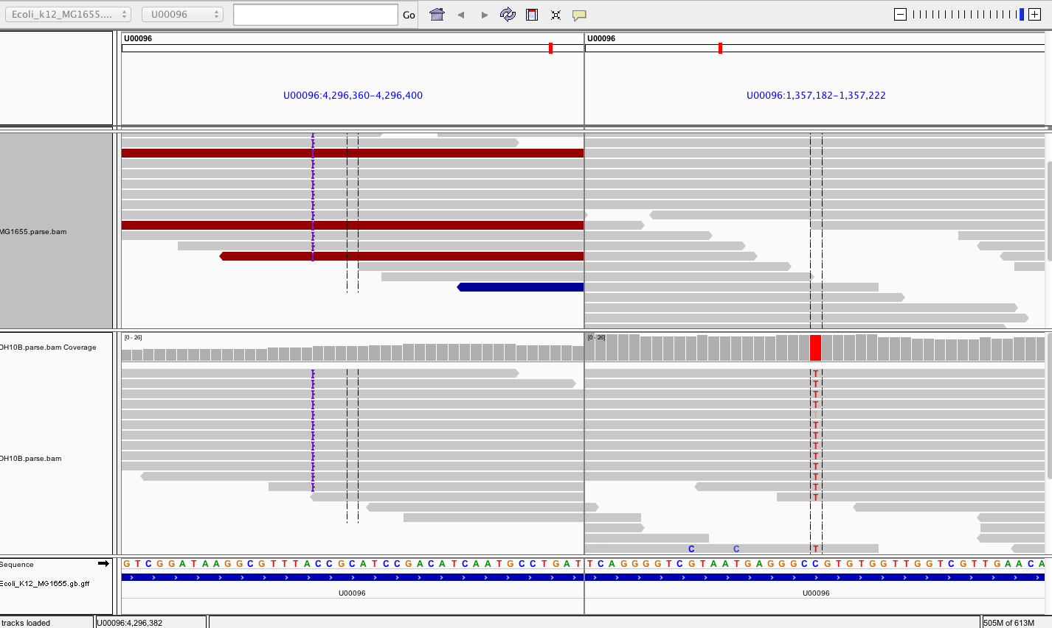
IGV to check SNPs
U00096:xxxxxx U00096: xxxxxxx (separated by a blank space)

