Slide 1
Genomic variants Bioinformatics Applications (PLPTH813)
Sanzhen Liu
2/23/2017

Slide 2
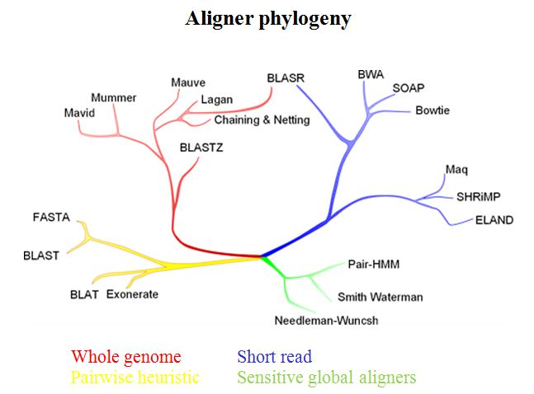
Alignment algorithms
review
“sorted or indexed” genome
Genome sequences
memory
one by one
reads
alignments
evomicsorg.wpengine.netdna-cdn.com/wp-content/uploads/2014/01/alignCompare2.jpg

Slide 3
SAM and BAM alignment format
review
SAM stands for Sequence Alignment/Map format that is a generic alignment format for storing read alignments against reference sequence.
The BAM format, the binary representation of SAM, contains exactly the same information as SAM,
The SAM/BAM, together with SAMtools, separates the alignment step from downstream analyses, enabling a generic and modular approach to the analysis of genomic sequencing data.
Table. file size of two example files
File type | Storage usage
SAM | 313 M
BAM | 97 M
Notes:
Example of extended CIGAR and the pileup output.
(a) Alignments of one pair of reads and three single-end reads.
(b) The corresponding SAM file. The ‘@SQ’ line in the header section gives the order of reference sequences. Notably, r001 is the name of a read pair. According to FLAG 163 (=1 + 2 + 32 + 128), the read mapped to position 7 is the second read in the pair (128) and regarded as properly paired (1 + 2); its mate is mapped to 37 on the reverse strand (32). Read r002 has three soft-clipped (unaligned) bases. The coordinate shown in SAM is the position of the first aligned base. The CIGAR string for this alignment contains a P (padding) operation which correctly aligns the inserted sequences. Padding operations can be absent when an aligner does not support multiple sequence alignment. The last six bases of read r003 map to position 9, and the first five to position 29 on the reverse strand. The hard clipping operation H indicates that the clipped sequence is not present in the sequence field. The NM tag gives the number of mismatches. Read r004 is aligned across an intron, indicated by the N operation.
(c) Simplified pileup output by SAMtools. Each line consists of reference name, sorted coordinate, reference base, the number of reads covering the position and read bases. In the fifth field, a dot or a comma denotes a base identical to the reference; a dot or a capital letter denotes a base from a read mapped on the forward strand, while a comma or a lowercase letter on the reverse strand.

Slide 4
Outline
Overview of genomic variants
Data for variant discovery
Bioinformatics of variant discovery
the methods for variant (SNP) validation

Slide 5
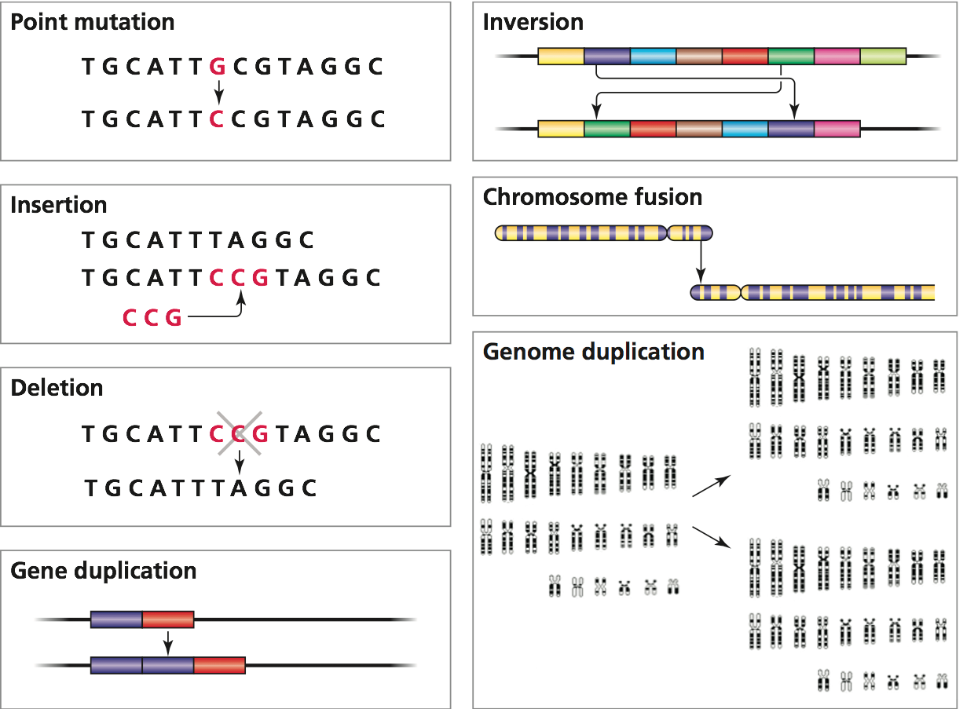
Genomic variants (ploymorphism)
1. SNP
2. INDEL
3. genomic structural variation
copy number variation (presence-absence variation)
other re-arrangements

Slide 6
Genomic variants - SNPs
SNP is a single nucleotide polymorphism.
Frequencies of SNPs are depended on species. For example, millions of SNPs have been discovered in human.
Most SNPs are bi-allelic. (mutation rate per site is about 10⁻⁸)
Most have no effects on cell function but some could have important phenotypic consequence.

Slide 7
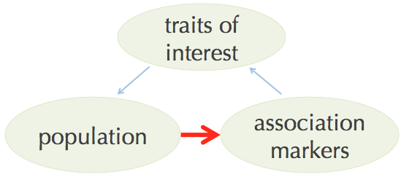
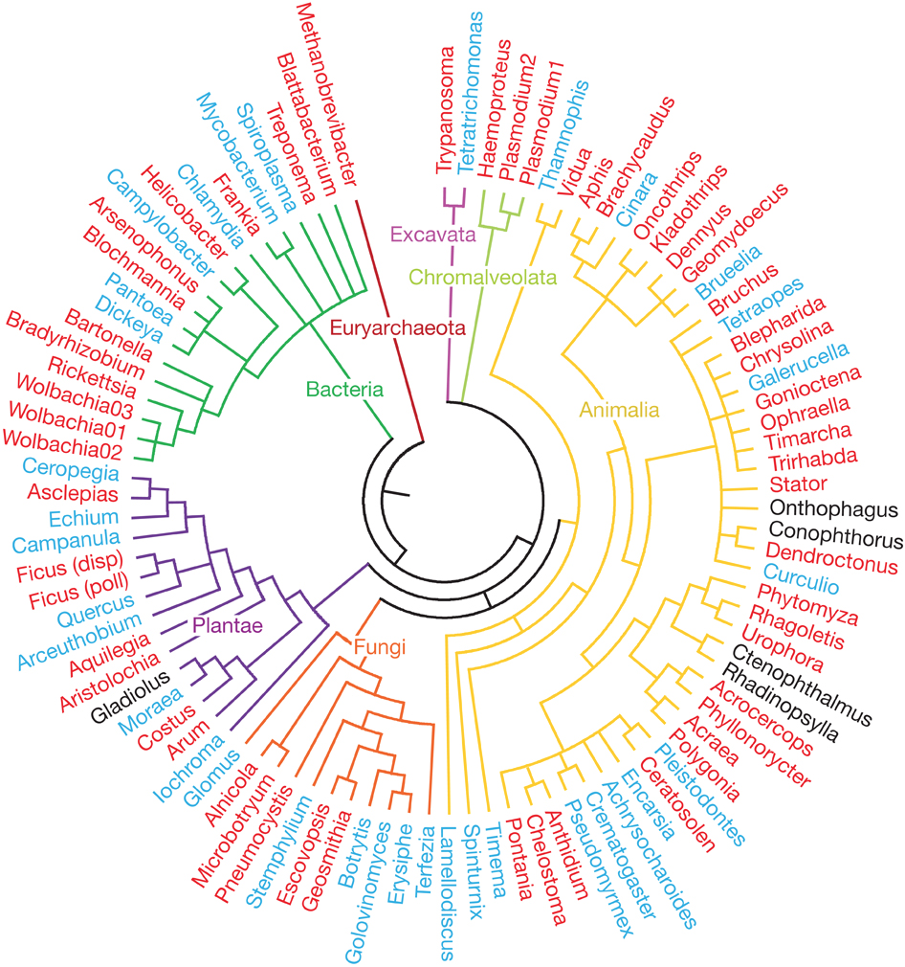
Applications of SNPs
Genetic markers to map the genetic controlling of traits (quality traits, quantitative traits, gene expression, etc)
Genetic markers to construct genetic maps
Markers to construct phylogenetic trees

Slide 8
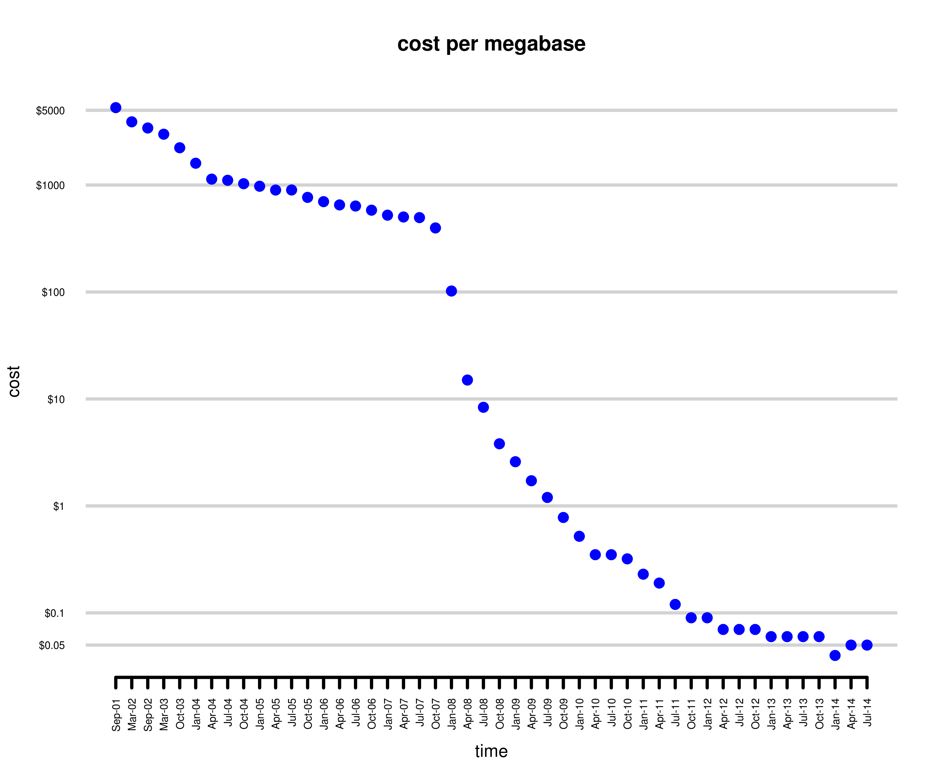
Next-Generation Sequencing to generate data for variant discovery
GATCTGCGTCATACGGAAT
GATCTGCGTGATACGGAAT
GATCTGCGTCATACGGAAT
GATCTGCGTGATACGGAAT
GATCTGCGTGATACGGAAT
GATCTGCGTGATACGGAAT
GATCTGCGTCATACGGAAT
GATCTGCGTCATACGGAAT
GATCTGCGTGATACGGAAT
GATCTGCGTCATACGGAAT
-----------------C/G----------------
$5,000
Plumping of sequencing cost
$0.05
2001
2014
Notes:
The revolution of sequencing allows for affordable genotyping.

Slide 9
Approaches for data generation
Whole genome sequencing (WGS): high genome coverage but costly for large genomes
Exome-capture sequencing: target on genic regions but still expensive to perform large number of samples
RNA sequencing (RNA-Seq): obtain data on genic regions and provide expression information
Genotyping-By-Sequencing (GBS): cost-efficient and high-throughput approach

Slide 10
Data to variant (SNP) discovery
Data: sequencing reads
Reference-based approach
Alignment-based SNP discovery (standard)
Assembly-based SNP discovery
Reference-free approach
Usually used in the sequencing projects with sequencing data from multiple individuals

Slide 11
Alignment-based SNP discovery
…GATCTGCGTCATACGGAAT… (reference)
GATCTGCGTGATACGGAAT
GATCTGCGTCATACGGAAT
GATCTGCGTGATACGGAAT
GATCTGCGTGATACGGAAT
GATCTGCGTGATACGGAAT
GATCTGCGTCATACGGAAT
GATCTGCGTCATACGGAAT
GATCTGCGTGATACGGAAT
GATCTGCGTCATACGGAAT
--------------------C/G--------------------
reads

Slide 12
Alignment-based SNP discovery, cont.
General procedure
Reads cleanup (adaptor, quality trimming, e.g., trimmomatic)
Reads aligned to the reference genome with aligners
1. BWA, Bowtie (DNA-Seq reads)
2. GSNAP, Tophat (RNA-Seq reads)
Post-alignment filtering and convert SAM (alignment file) to BAM
SNP calling with software packages: Samtools, GATK, VarScan2
Use population information or some criteria to filter SNP sets
an example of the alignment of a RNA-Seq read using GSNAP
HISEQ:163:C4YWTACXX:1:1101:8654:2286 16 chromosome_1 1765703 40 16M97N85M * 0 0 TGGCAACATTGTTAAGCTCTGGCGTGATAAATTGCCCTGTCAGCAAGCAGATGGCAGGCAATGTGCAATAGGCGAAGAGCGGGATAGATGTCCAAGGGTAT DDDDDDDDDDDDDDDDDDDBDDCEEEFEFFFFFHHHJJIJJJJJJJJJJJJJJJJJJJJJJJJJJIJJJJJJHEJJJJJJJJJJJJJJHHHHHFFFFFCCC MD:Z:73C27 NH:i:1 HI:i:1 NM:i:1 SM:i:40 XQ:i:40 X2:i:0 XO:Z:UU XS:A:- PG:Z:A

Slide 13
Interpretation of the BWA alignment
SAM output:
HWI-ST897:104:C015GACXX:6:1101:12678:20443 163 U00096 1888286 60 64M1D20M = 1888358 170 GCCAACAGCCGCGACTTCCTGTACGCCAGGATGCTGCATGACGACATCTTCAATCTCGTTGGGAAGACGTTAAAAACGGAAACC CCCFFFFFHHFHHJJJJJJJ JHIJHIJIIJIJJJJJIJJJJIJJHHFFFFFFEEEEEEDDDDDDA5,53,8<?CC(50?8BD3? NM:i:2 AS:i:72 XS:i:0 RG:Z:S1
CIGAR: 64M1D20M
NM: edit distance
edit distance is a way to quantify the dissimilarity of two strings (e.g., words) by counting the minimum number of edits (substitution, insertion, and deletion) required to transform one string into the other.
fact -> fit (2)
AACCT -> AAACT (1)
AACCT -> ACCTA (?)
Notes:
2

Slide 14
Polymorphism based on Alignment + reference genome
SAM output (BWA):
HWI-ST897:104:C015GACXX:6:1101:12678:20443 163 U00096 1888286 60 64M1D20M = 1888358 170 GCCAACAGCCGCGACTTCCTGTACGCCAGGATGCTGCATGACGACATCTTCAATCTCGTTGGGAAGACGTTAAAAACGGAAACC CCCFFFFFHHFHHJJJJJJJ JHIJHIJIIJIJJJJJIJJJJIJJHHFFFFFFEEEEEEDDDDDDA5,53,8<?CC(50?8BD3? NM:i:2 AS:i:72 XS:i:0 RG:Z:S1
mapping position and CIGAR determine the alignment
Query 1 GCCAACAGCCGCGACTTCCTGTACGCCAGGATGCTGCATGACGACATCTTCAATCTCGTT 60
||||||||||||||||||||||||||||||||||||||||||||||||||||||||||||
Sbjct 1888286 GCCAACAGCCGCGACTTCCTGTACGCCAGGATGCTGCATGACGACATCTTCAATCTCGTT 1888345
Query 61 GGGA-AGACGTTAAAAACGGAAACC 84
|||| ||||||||||| ||||||||
Sbjct 1888346 GGGATAGACGTTAAAACCGGAAACC 1888370

Slide 15
Alignment-based SNP discovery: GATK (1)
The Genome Analysis Toolkit (GATK) is a software package developed at the Broad Institute to primarily focus on variant discovery and genotyping.
Input data: BAM files and reference genome
Required tools: Picard and Samtools
Code example:
java –jar GenomeAnalysisTK.jar \
-T UnifiedGenotyper \
-R your_reference \
-I your_bam \
-glm BOTH
### BOTH = SNP + INDEL

Slide 16
GATK (2)
VCF (Variant Call Format) output
https://samtools.github.io/hts-specs/VCFv4.2.pdf
isolate 1
isolate 2
#CHROM | POS | ID | REF | ALT | QUAL | FILTER | INFO | FORMAT | DH10B | MG1655
ref1 | 89089 | . | C | A | 782.76 | . | … | GT:AD:DP:GQ:MLPSAC:MLPSAF:PL | 1:0,18:18:99:1:1.00:781,0 | 0:27,0:27:99:0:0.00:0,1149
ref1 | 89103 | . | G | C | 690.76 | . | … | GT:AD:DP:GQ:MLPSAC:MLPSAF:PL | 1:0,16:16:99:1:1.00:689,0 | 0:29,0:29:99:0:0.00:0,1253
ref1 | 89143 | . | A | G | 448.76 | . | … | GT:AD:DP:GQ:MLPSAC:MLPSAF:PL | 1:0,11:11:99:1:1.00:447,0 | 0:27,0:27:99:0:0.00:0,1165
ref1 | 89145 | . | G | T | 405.76 | . | … | GT:AD:DP:GQ:MLPSAC:MLPSAF:PL | 1:0,10:10:99:1:1.00:404,0 | 0:28,0:28:99:0:0.00:0,1215
GT: AD : DP: GQ: MLPSAC: MLPSAF: PL
1 : 0,18: 18: 99: 1 : 1.00 : 781,0
GT=Genotype (0 or 1)
AD=Allelic depths for the ref and alt alleles
DP=Approximate read depth
GQ=Genotype Quality
MLPSAC=Maximum likelihood expectation (MLE) for the alternate allele count
MLPSAF=Maximum likelihood expectation (MLE) for the alternate allele fraction
PL=Normalized, Phred-scaled likelihoods for genotypes
Prob(0) = 10^(-781/10) = 7.9e-79 Prob(1) = 10^(-0/10) = 1

Slide 17
GATK (3)
VCFtools can be used to filter SNPs.
java GenomeAnalysisTK.jar \
-T SelectVariants \
-R your_reference \
--variant your_vcf \
-select 'DP >= 3.0' \
--restrictAllelesTo BIALLELIC \
--selectTypeToInclude SNP
Filter variants based on the experimental purpose and genetic features

Slide 18
Falsely discovered SNPs
Can you think about what could result in falsely discovered SNPs using alignment-based SNP methods?
Notes:
Sequence errors
Reference errors
Alignment issues

Slide 19
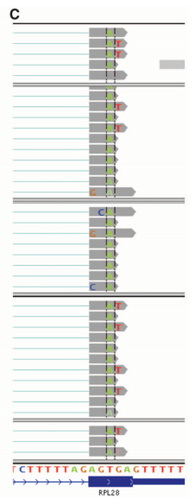

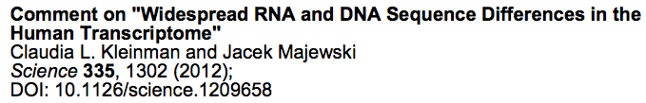
Alignment-based SNP discovery: alignment issues
Misalignments
Genome duplications
Highly divergent regions
Examples:
The misalignments of RNA-Seq data or DNA-Seq data led to this discovery

Slide 20
Assembly-based SNP discovery
Cortex (Iqbal et al., 2012 Nature Genetics)
de novo assembly and graphic comparison for variant discovery
Fermi (Li H, 2012 Bioinformatics)
de novo assembly to unitigs* and then alignment to the reference genome for variant discovery
(Conceptually, unitigs are confident contigs)
Discovar (Neil et al., 2014 Nature Genetics)
Region de novo assembly to contigs and then alignment to the reference genome for variant discovery

Slide 21
Variant annotation
Gene coding regions
Synonymous: changes that do not alter the encoded amino acid
Non-synonymous
Missense: changes that alter encoded amino acid
Nonsense: changes that produce a stop codon from an amino acid codon, resulting in a shortened protein
Frameshift (caused by insertion/deletion)
Splicing sites
Of an intron, a donor site (5' end of the intron) and an acceptor site (3' end of the intron) are required for splicing.

Slide 22
Variant annotation - SnpEff
SnpEff is a variant annotation and effect prediction tool. It annotates and predicts the effects of variants on genes.
Input data:
Genome annotation database
Variant data: VCF file
Running:
java -jar snpEff.jar GRCh37.75 my.vcf
Cingolani P, et al., DM. Fly (Austin). 2012 Apr-Jun;6(2):80-92.

Slide 23
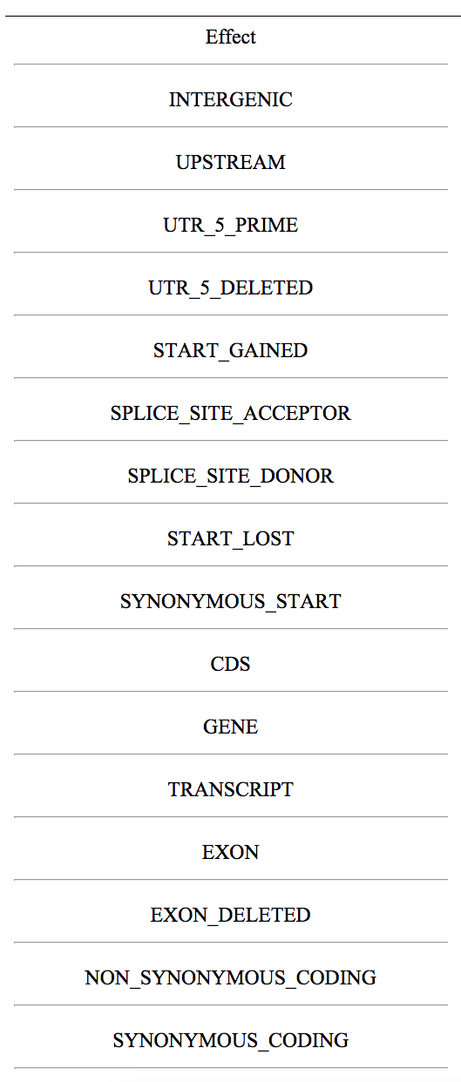
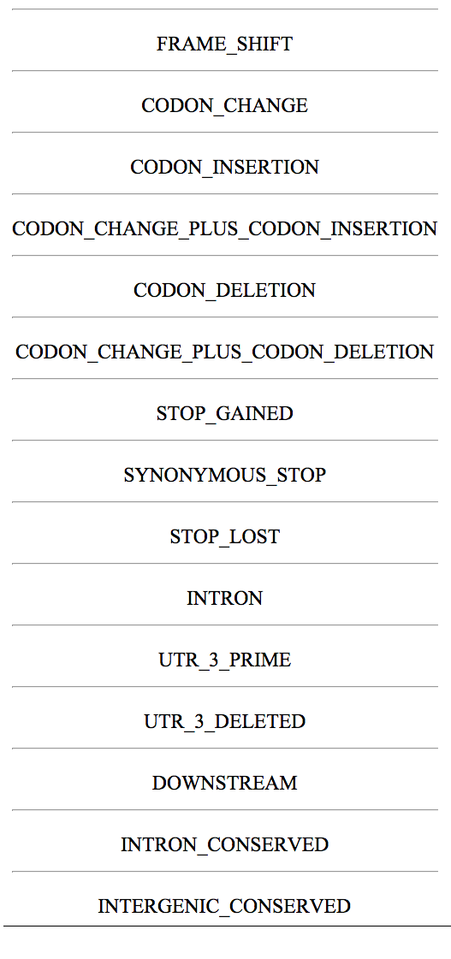
Detailed effect list from SnpEff

Slide 24
SNP genotyping
Large-scale (thousands to approximate 1 million)
Illumina Beadchip (beads hybridization based)
Affymetrix SNP array (microarray-hybridization-based)
Medium-scale (hundreds of markers)
Fluidigm (Microfluidic-based)
Sequenom iPLEX (mass spectrometry method)
Small-scale
High Resolution Melt (HRM (melting))
KASP
Taqman

Slide 25
SNP validation
Cross-checking using different datasets or platforms
Genetic mapping of SNPs
Expectation from certain genome materials (e.g., bacterial genome and inbred lines)

Slide 26
Summary
The strategy to generate data for SNP discovery is depended on experimental purpose, genetic features of the population, timetable, and budget.
A standard approach for SNP discovery is through mapping reads to the reference sequences, thereby identifying variants between reads and reference. The most popular method is GATK.
More flexible and cost-efficient SNP validation approaches need to be developed to leverage variant discovery.

