Slide 1
NGS alignments Bioinformatics Applications (PLPTH813)
Sanzhen Liu
3/2/2017

Slide 2
Goal of today’s lab
BWA alignment
SAMtools
IGV
Data transfer

Slide 3
Login Beocat
ssh -l <eID> beocat.cis.ksu.edu
password
http://support.beocat.cis.ksu.edu/BeocatDocs/index.php/SGEBasics
http://support.beocat.cis.ksu.edu/BeocatDocs/index.php/AdvancedSGE

Slide 4
Genome sequence data
E.coli K-12 MG1655 reference genome sequence
# create a new directory for today's practice
mkdir bwa
cd bwa
mkdir db
cd db
cp /homes/liu3zhen/teaching/BA17/Lab06_BLAST/db/MG1655.fasta .

Slide 5
Step 1: Create a BWA database
bwa index
A program to create a BWA database
bwa
bwa index
### index
bwa index MG1655.fasta

Slide 6
Illumina data
# check the current directory
pwd
cd ..
mkdir alignment
cd alignment
data location
/homes/liu3zhen/teaching/datasets/MG1655_illumina/
MG1655.pair1.fq
MG1655.pair2.fq

Slide 7
BWA alignment
bwa mem
bwa mem
vi align.sh
---------------------------------------------------
### specify input files
ref=../db/MG1655.fasta
pe1=/homes/liu3zhen/teaching/datasets/MG1655_illumina/MG1655.pair1.fq
pe2=/homes/liu3zhen/teaching/datasets/MG1655_illumina/MG1655.pair2.fq
### alignment
bwa mem -T 40 $ref $pe1 $pe2 1>aln.sam 2>aln.log
---------------------------------------------------
bash align.sh

Slide 8
Examine alignments
@SQ SN:gi|556503834|ref|NC_000913.3| LN:4641652
@PG ID:bwa PN:bwa VN:0.7.12-r1039 CL:bwa mem -T 40 ../db/MG1655.fasta /homes/liu3zhen/teaching/PLPTH613/datasets/MG1655_illumina_data/MG1655.pair1.fq /homes/liu3zhen/teaching/PLPTH613/datasets/MG1655_illumina_data/MG1655.pair2.fq
EAS600_70:5:1:3215:930 99 gi|556503834|ref|NC_000913.3| 2767401 60 100M = 2767797 498NTGATATTAACTTGTCCAATATGATCAAATAGCATTAACCCCCCCTCACAACGTCCTGCATAGGGAACACGTTTTCCCCTGTGCACCCACGACTAAATTT !++*+87777@@@@@@@@@@@@@@@@@@@@<::<<99989::32222298&)--28888589179@@@@@############################## NM:i:1 MD:Z:0A99 AS:i:99 XS:i:0
EAS600_70:5:1:3215:930 147 gi|556503834|ref|NC_000913.3| 2767797 60 102M = 2767401 -498 AATCAGTTAACCCACTACGAGCCAGTGATCGGCATCATGGGTAAAACTGGGGCGGGAAAGAGTAGCCTTTGCAATGCCCTGTTTGCCGGTGAAGTATCGCCG EB<EEEBBEBEA@8@8>EEBEEB>EED3BE@IIIHHFFIIHFIIIIIHIIIGIIIIHIIHEIIIIHIIIIIIGIGIIGIIIIIIIIIIIIIIIIIIIIGII# NM:i:0 MD:Z:102 AS:i:102 XS:i:0
samtools flagstat aln.sam

Slide 9
Conversion between SAM and BAM
samtools view
### show header
samtools view -H aln.sam
### convert sam to bam
samtools view -b aln.sam -o aln.bam
head aln.bam

Slide 10
Alignment sorting
### Sort BAM:
samtools sort aln.bam alnsort
### convert to SAM
samtools view alnsort.bam > alnsort.sam
Question:
What was the basis for the sorting?

Slide 11
Problem
Could you use the help document to figure out how to sort bam by read names?

Slide 12
Alignment Index
# Index sorted BAM:
samtools index alnsort.bam

Slide 13
tview
samtools tview alnsort.bam ../db/MG1655.fasta
1 11 21 31 41 51 61 71
AGCTTTTCATTCTGACTGCAACGGGCAATATGTCTCTGTGTGGATTAAAAAAAGAGTGTCTGATAGCAGCTTCTGAACTGGTTA
....................................................................................
................................................ ,,,,,,,,,,,,,,,,,,,,,,,,,,,,,,,,,,
............................................... ,,,,,,,,,,,,,,,,,,,,,,,,,,
....................................................................................
............................................................................ G
....................................................................................
....................................................................................
................................................... ,,,,,,,,,,,,,,,,,,,,,,,,
....................................................................................
1st line: the genome coordinates
2nd line: the reference sequence
3rd line: the consensus sequence
the rest: reads
? for the help
arrow keys to move cursor
space key to "turn pages"
type "g" to quick go to a specified position:
e.g.,
gi|556503834|ref|NC_000913.3|:10000
Notes:
In this view, the first line shows the genome coordinates, the second line shows the reference sequence, and the third line shows the consensus sequence determined from the aligned reads. Throughout tview, a . indicates a match to the reference genome.

Slide 14
depth
### check sequencing depth in each position
samtools depth alnsort.bam | more
example:
gi|556503834|ref|NC_000913.3| 100 23
gi|556503834|ref|NC_000913.3| 101 23
gi|556503834|ref|NC_000913.3| 102 23

Slide 15
scp
scp user@hostname:directory/remotefile localfile
scp <eid>@beocat.cis.ksu.edu:<path/files> .
# copy file from Beocat to laptop:
scp <eid>@beocat.cis.ksu.edu:<path_to>/align.sh .
# copy file from laptop to Beocat:
scp <file> <eid>@beocat.cis.ksu.edu:<path_to>

Slide 16

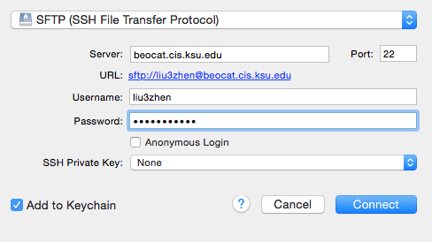
Cyberduck

Slide 17
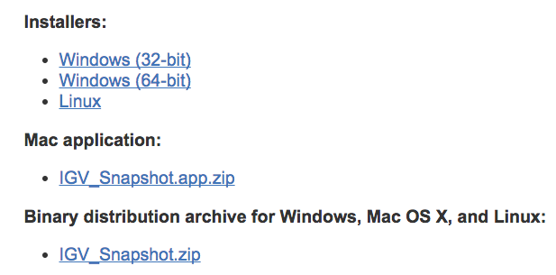
Integrative Genomics Viewer (IGV)
IGV download
http://www.broadinstitute.org/software/igv/download_snapshot

Slide 18
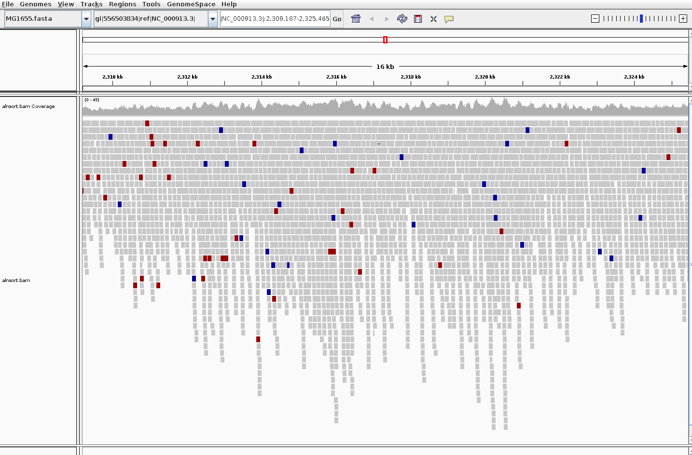
IGV to visualize alignments

Slide 19
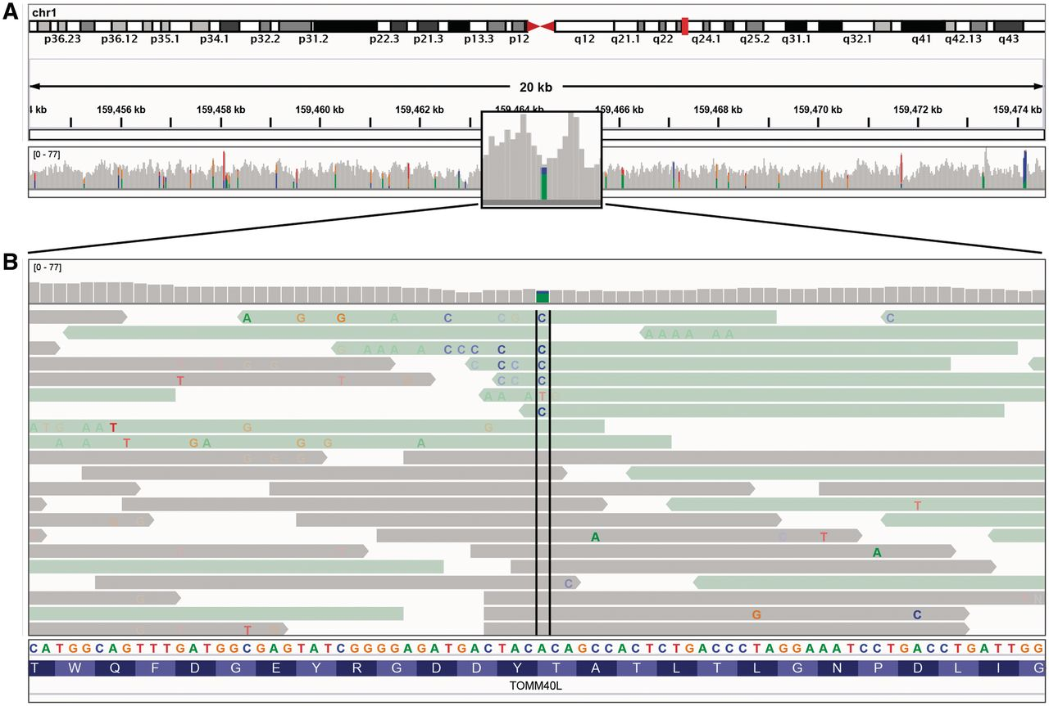
Color scheme
IGV uses color and transparency to highlight interesting events in the alignment data.
Zooming in past the alignment visibility threshold will also add color bars to the gray coverage track at locations where a large number of read bases mismatch the reference—helpful in identifying putative SNPs.
Thorvaldsdóttir H et al. Brief Bioinform 2013;14:178-192
Notes:
Read alignment views at 20 kb and base pair resolution. IGV displays varying level of data detail depending on the zoom level, and uses color and transparency to highlight interesting events in the data. (A) Reads are summarized as a coverage plot. Positions with a significant number of mismatches with respect to the reference are highlighted with color bars indicative of both the presence of mismatches and the allele frequency. (B) Individual base mismatches are displayed with alpha transparency proportional to quality. In this example, the reads have been sorted and colored by strand.

