Slide 1

Megakkart Ecommerce plan for ‘Super Festive Sale’

Slide 2


MISSION STATEMENT
Analyze and provide predictive model from historical data of businesses to discover interesting transactional patterns of different customers and their demographics and other interesting insights to increase revenue for ‘Super Festive Sale’

Slide 3

CONTENTS
Business overview
Data collection
Data preparation
Exploratory data analysis
Modelling
Model Evaluation
Model deployment

Slide 4


OUR COMPANY
Megakkart is
largest ecommerce platform of CountryX , One stop shop for all your needs.

Slide 5

01
BUSINESS OBJECTIVE

Slide 6

Megakkart being the largest ecommerce platform has come up with the Super Saver sale to reach the goal of INR
500 crores for annual GMV sales.

Slide 7

FIVE HUNDRED CRORES
TARGET

Slide 8

02
DATA COLLECTION

Slide 9
Data is collected by sampling the customers interaction with Megakkart ecommerce website of last one year.

Slide 10
Feature Descriptions:
Administrative: The number of administrative pages that the user visited.
Administrative_Duration: This is the amount of time spent by the user on administrative pages.
Informational: The number of informational pages that the user visited.
Informational_Duration: Is the amount of time spent by the user on informational pages
ProductRelated: The number of product-related pages the user visited.
ProductRelated_Duration: This is the amount of time spent by the user on product-related pages.
BounceRates: The percentage of visitors who enter the website through that page and exit without triggering any additional tasks.
ExitRates: The percentage of pageviews on the website that ends at that specific page.
PageValues: The average value of the page averaged over the value of the target page and/or the completion of an eCommerce transaction.

Slide 11
SpecialDay: This value represents the closeness of the browsing date to special days or holidays (eg Mother's Day or Valentine's day) in which the transaction is more likely to be finalized. More information about how this value is calculated below. Month: Contains the month the pageview occurred, in string form. OperatingSystems: An integer value representing the operating system that the user was on when viewing the page. Browser: An integer value representing the browser that the user was using to view the page. Region: An integer value representing which region the user is located in. TrafficType: An integer value representing what type of traffic the user is categorized into. VisitorType: A string representing whether a visitor is New Visitor, Returning Visitor, or Other. Weekend: A boolean representing whether the session is on a weekend. Revenue: A boolean representing whether or not the user completed the purchase.

Slide 12

03
DATA PREPARATION

Slide 13
Data cleaning was required on obtained dataset to increase overall productivity and allow for the highest quality information in decision-making.

Slide 14
> For consistent and Correct data for analysis, unnecessary columns removed. > For consistent and Correct data for analysis, unnecessary rows removed. > For consistent and Correct data for analysis scaling was performed on data set. > For proper formatting data type is converted to relevant data type > Data records where page view was 0 but duration was valid, were replaced with nearest neighbor values . >

Slide 15
04
EXPLORATORY DATA ANALYSIS

Slide 16
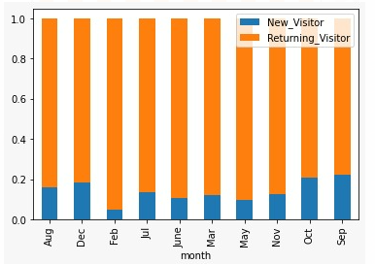
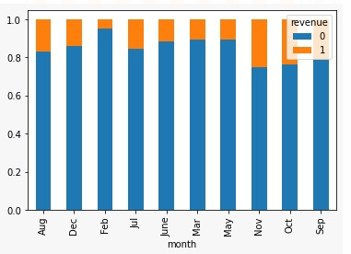
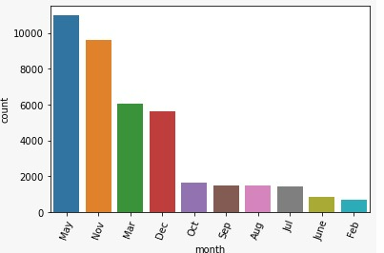
Data

Slide 17

We can draw following inference from previous graphs – > Only 20% or less new visitors can be seen throughout the year. > Despite being a festive month we are unable to acquire good number visitors/sales in February. Infact, it is the lowest. > The highest number of visitors can be seen in May. However, November is the highest revenue generating month with second most number of visitors . Both are festive months. > It is been seen that in the month of February, there is highest percentage of returning visitors out of total visitors, but revenue generation is very low

Slide 18
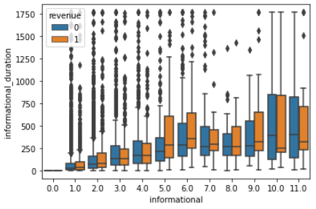
More the informational pages visited, more the visitors are inclined to do purchase.

Slide 19
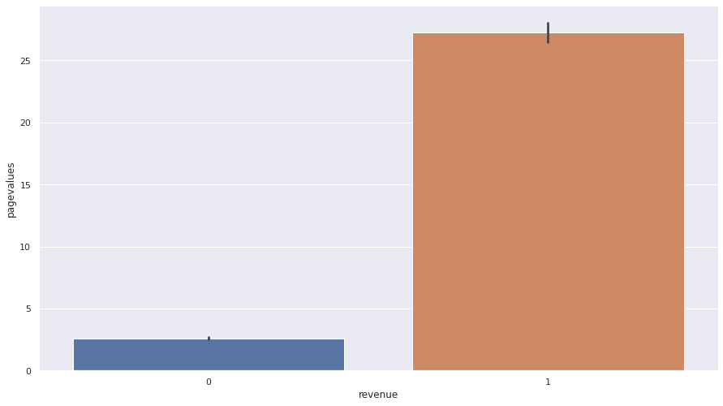
> Higher the pagevalue of pages, higher is the chance of revenue generation. Hence when customer visits a page with low page value, they should be referred to similar productswith high page value.

Slide 20
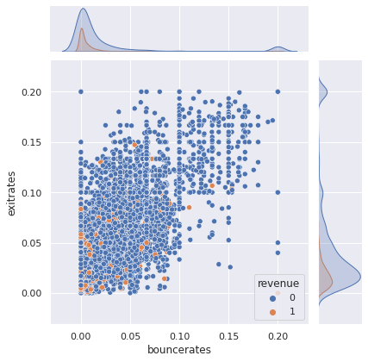
Maximum revenue concentration is at lower bounce rate and lower exit rate, which is expected. Sessions where customers visit pages with higher exit/bounce rates needs to be hooked(show relevant ads, give offers etc.)

Slide 21
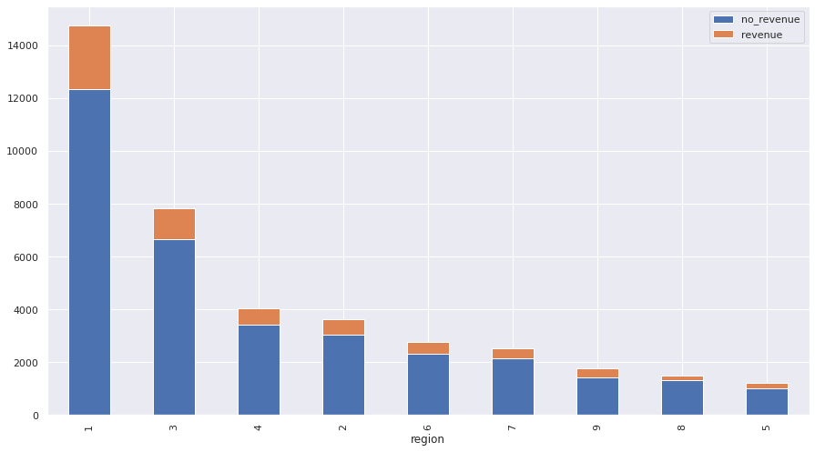
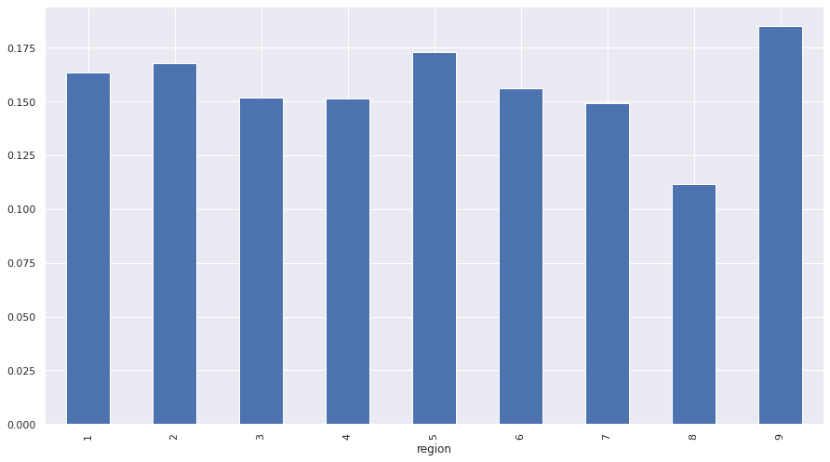
> Region 1 has highest number of visitors. but region 9 has highest percentage of successful transactions despite having less number of visitors. > Region 8 has the lowest rate of revenue generation and needs to be taken care of.

Slide 22

MODELLING
05

Slide 23
Modelling Algorithms
Logistic regression estimates the probability of an event occurring, such as voted or didn’t vote, based on a given dataset of independent variables. Since the outcome is a probability, the dependent variable is bounded between 0 and 1.
Decision Tree is a Supervised learning technique that can be used for both classification and Regression problems
SVM algorithms use a set of mathematical functions that are defined as the kernel. The function of kernel is to take data as input and transform it into the required form.

Slide 24

MODEL EVALUATION
06

Slide 25
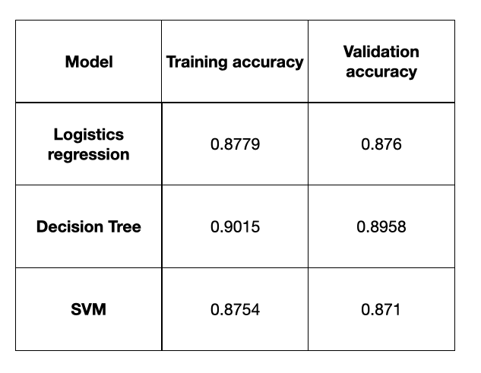
Accuracy comparison of models

Slide 26
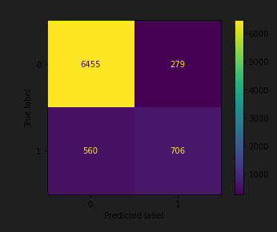
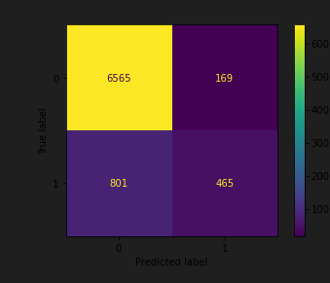
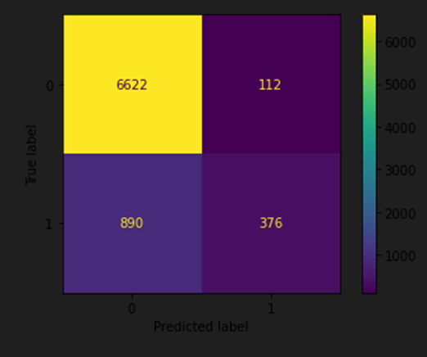
Confusion Matrix
Decision Tree Logistics regression SVM
Y-Axis True Label
X-Axis Predicted Label

Slide 27
MODEL DEPLOYMENT
07

Slide 28
Decision Tree accuracy score is utmost compared to others , so we finally chose to go with same .
All the required resources are uploaded to –
https://forms.gle/Kb6Awm9DrVeSK1cg7

Slide 29
THANKS!

