Slide 1
BIG DATA – HADOOP AND COMPONENTS
PREPARED BY
ANTONY RAVINSTA

Slide 2
Big Data
Big data refers to a collection of data sets so large and complex.
It’s size range from few dozen tera bytes to many peta bytes of data in a single set.
It becomes difficult to capture and process using on-hand database management tools or traditional data processing applications.
Difficulties of processing large data set include:
Capturing, Searching, Analysis, Storing, Sharing, Research, Visualization, Privacy Violation.

Slide 3
Characteristics of Big Data
The concept gained momentum in the early 2000s when industry analyst Doug Laney articulated the now-mainstream definition of big data as the three Vs:
Volume
Velocity
Variety
Two additional dimensions are added in later stage:
Variability
Veracity

Slide 4
Definition of 5Vs
Volume: The quantity of generated and stored data. The size of the data determines the value and potential insight- and whether it can actually be considered big data or not.
Variety: The type and nature of the data. This helps people who analyze it to effectively use the resulting insight.
Velocity: The speed at which the data is generated and processed to meet the demands and challenges that lie in the path of growth and development.
Variability: Variability refers to data whose meaning is constantly changing.
Veracity: The quality of captured data can vary greatly, affecting the accurate analysis.

Slide 5
Why is Big Data Important?
The importance of big data doesn’t revolve around how much data you have, but what you do with it. You can take data from any source and analyze it to find answers that enable
1) cost reduction
2) time reduction
3) new product development and optimized offerings,
4) smart decision making.
When we combine big data with high-powered analytics, we can accomplish business-related tasks such as:
Determining root causes of failures, issues and defects in near-real time.
Generating coupons at the point of sale based on the customer’s buying habits.
Recalculating entire risk portfolios in minutes
Sentiment Analysis to analyze feedback of customer

Slide 6
Sectors using Big Data
Business Development
Banking Sector
Share Market
E-commerce
Government (ex: Aadhar card, 2014 elections)
Retail (ex: Day to day transactions and report)
Social Media
Airlines
Information Technologies

Slide 7

Hadoop is an open source framework from Apache and is used to store process and analyze data which are very huge in volume.
Hadoop is written in Java
It is used for batch/offline processing.
It is being used by Facebook, Yahoo, Google, Twitter, LinkedIn and many more.

Slide 8
Hadoop Modules
HDFS: Hadoop Distributed File System. Google published its paper GFS and on the basis of that HDFS was developed. It states that the files will be broken into blocks and stored in nodes over the distributed architecture.
Yarn: Yet another Resource Negotiator is used for job scheduling and manage the cluster.
Map Reduce: This is a framework which helps Java programs to do the parallel computation on data using key value pair. The Map task takes input data and converts it into a data set which can be computed in Key value pair. The output of Map task is consumed by reduce task and then the out of reducer gives the desired result.
Hadoop Common: These Java libraries are used to start Hadoop and are used by other Hadoop modules.

Slide 9
Advantage of Hadoop
Fast: In HDFS the data distributed over the cluster and are mapped which helps in faster retrieval. It is able to process terabytes of data in minutes and Peta bytes in hours.
Scalable: Hadoop cluster can be extended by just adding nodes in the cluster.
Cost Effective: Hadoop is open source and uses commodity hardware to store data so it really cost effective as compared to traditional relational database management system.
Resilient to failure: HDFS has the property with which it can replicate data over the network, so if one node is down or some other network failure happens, then Hadoop takes the other copy of data and use it. Normally, data are replicated thrice but the replication factor is configurable.

Slide 10
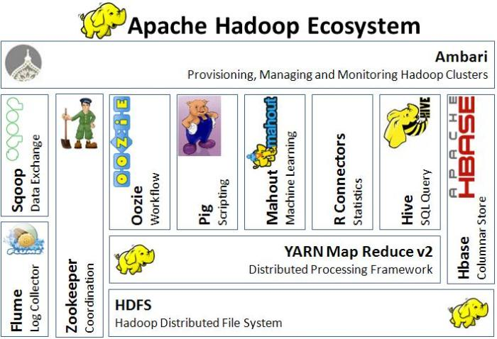

Slide 11
Main Components of Hadoop
Hadoop Distributed File System (HDFS):Hadoop comes with a distributed file system called HDFS. In HDFS data is distributed over several machines and replicated to ensure their durability to failure and high availability to parallel application.
Hadoop MapReduce/Yarn: A framework for job scheduling and cluster resource management. A YARN-based system for parallel processing of large data sets.

Slide 12
Small Overview about components
Other Hadoop-related projects at Apache include:
HBase: A scalable, distributed database that supports structured data storage for large tables.
Hive: A data warehouse infrastructure that provides data summarization and ad hoc querying.
Pig: A high-level data-flow language and execution framework for parallel computation.
Flume: A distributed, reliable, and available service for efficiently collecting, aggregating, and moving large amounts of streaming event data.
ZooKeeper: A high-performance coordination service for distributed applications.

Slide 13
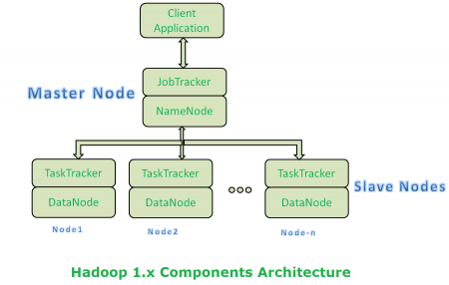
Hadoop Architecture 1.x
In MapReduce 1, there are two types of daemon that control the job execution process: a jobtracker and one or more tasktrackers.
The jobtracker coordinates all the jobs run on the system by scheduling tasks to run on tasktrackers.
Tasktrackers run tasks and send progress reports to the jobtracker, which keeps a record of the overall progress of each job.
If a task fails, the jobtracker can reschedule it on a different tasktracker
The jobtracker takes care of both job scheduling (matching tasks with tasktrackers) and task progress monitoring (keeping track of tasks, restarting failed or slow tasks, and doing task bookkeeping, such as maintaining counter totals).

Slide 14
Limitations of Architecture 1.x
It is only suitable for Batch Processing of Huge amount of Data, which is already in Hadoop System.
It is not suitable for Real-time Data Processing and data Streaming.
It supports up to 4000 Nodes per Cluster.
It has a single component : Job Tracker to perform many activities like Resource Management, Job Scheduling, Job Monitoring, Re-scheduling Jobs etc.
Job Tracker is the single point of failure.
It does not support Multi-tenancy Support.
It supports only one Name Node and One Namespace per Cluster.
It runs only Map/Reduce jobs.
Each tasktracker is configured with a static allocation of fixed-size “slots,” which are divided into map slots and reduce slots at configuration time. A map slot can only be used to run a map task, and a reduce slot can only be used for a reduce task.
That means once it assigns resources to Map/Reduce jobs, it cannot re-use them even though some slots are idle.
For Example:- Suppose, 10 Map and 10 Reduce Jobs are running with 10 + 10 Slots to perform a computation. All Map Jobs are doing their tasks but all Reduce jobs are idle. We cannot use these Idle jobs for other purpose.

Slide 15
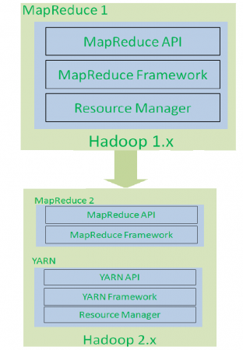
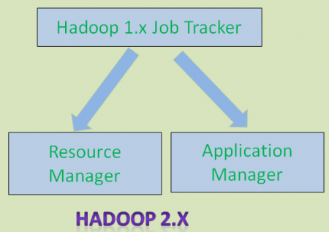
Re-Architecture of 1.x

Slide 16
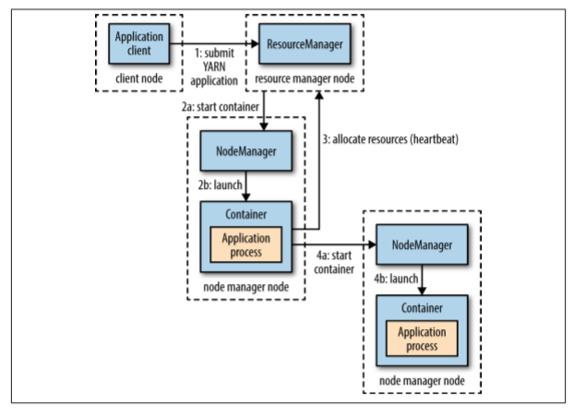
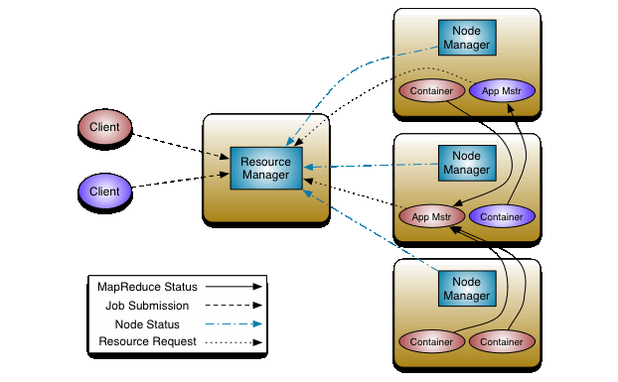
Hadoop Architecture – 2.x

Slide 17
Components
The fundamental idea of YARN is to split up the functionalities of resource management and job scheduling/monitoring into separate daemons.
YARN provides its core services via two types of long-running daemon: a resource manager (one per cluster) to manage the use of resources across the cluster, and node managers running on all the nodes in the cluster to launch and monitor containers.
A container executes an application-specific process with a constrained set of resources (memory, CPU, and so on).
The main components of Hadoop 2.x architecture is,
Resource Manager
Node Manager
Application Master
Container
Scheduler

Slide 18
Advantages of 2.x
comparison of MapReduce 1 and YARN components
MapReduce 1 YARN
Jobtracker Resource manager, application master, timeline server
Tasktracker Node manager
Slot Container
Hadoop 2.x YARN Benefits
Highly Scalability - it is designed to scale up to 10,000 nodes and 100,000 tasks.
Highly Availability – Data replication
Utilization - YARN are fine grained, so an application can make a request for what it needs, rather than for an indivisible slot
Supports Multi-Tenancy - It is even possible for users to run different versions of MapReduce on the same YARN cluster, which makes the process of upgrading MapReduce more manageable

Slide 19
Resource Manager and Node Manager, Container
Resource Manager: The Resource Manager is the ultimate authority that arbitrates resources among all the applications in the system. The Resource Manager has two main components:
Scheduler
Applications Manager.
Node Manager: It is the per-machine framework agent who is responsible for containers, monitoring their resource usage (CPU, memory, disk, network) and reporting the same to the Resource Manager/Scheduler.
Application Master: The per-application Application Master is, in effect, a framework specific library and is tasked with negotiating resources from the Resource Manager and working with the Node Manager(s) to execute and monitor the tasks.
Container: A container executes an application-specific process with a constrained set of resources (memory, CPU, and so on). Application master run a computation in a container.

Slide 20
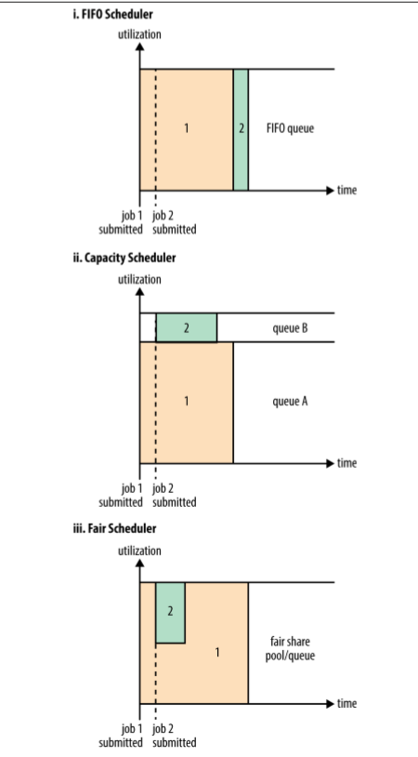
Scheduler
In the real world, however, resources are limited, and on a busy cluster, an application will often need to wait to have some of its requests fulfilled.
It is the job of the YARN scheduler to allocate resources to applications according to some defined policy
FIFO Scheduler: work based on queue. it’s not suitable for shared clusters. Large applications will use all the resources in a cluster, so each application has to wait its turn.
On a shared cluster it is better to use the Capacity Scheduler or the Fair Scheduler. Both of these allow longrunning jobs to complete in a timely manner, while still allowing users who are running concurrent smaller ad hoc queries to get results back in a reasonable time.
Capacity Scheduler (ii in Figure 4-3), a separate dedicated queue allows the small job to start as soon as it is submitted.
Fair Scheduler : it will dynamically balance resources between all running jobs. Just after the first (large) job starts, it is the only job running, so it gets all the resources in the cluster. When the second (small) job starts, it is allocated half of the cluster resources so that each job is using its fair share of resources.

Slide 21

HDFS (Hadoop Distributed File System)
HDFS is a filesystem designed for storing very large files with streaming data access patterns, running on clusters of commodity hardware.
Very large files “Very large” means files that are hundreds of megabytes, gigabytes, or terabytes in size. There are Hadoop clusters running today that store petabytes of data.
2 Streaming data access HDFS is built around the idea that the most efficient data processing pattern is a write-once, read-many-times(WORM) pattern. A dataset is typically generated or copied from source, and then various analyses are performed on that dataset over time.
Commodity hardware Hadoop doesn’t require expensive, highly reliable hardware

Slide 22

HDFS Architecture

Slide 23
Block
HDFS, has the concept of a block, Block Size—128 MB by default
files in HDFS are broken into block-sized chunks, which are stored as independent units.
Blocks fit well with replication for providing fault tolerance and availability.
To insure against corrupted blocks and disk and machine failure, each block is replicated to a small number of physically separate machines (typically three).
If a block becomes unavailable, a copy can be read from another location in a way that is transparent to the client.
A block that is no longer available due to corruption or machine failure can be replicated from its alternative locations to other live machines to bring the replication factor back to the normal level
The Name Node periodically receives a Heartbeat and a Block report from each of the Data Nodes in the cluster. Receipt of a Heartbeat implies that the Data Node is functioning properly. A Block report contains a list of all blocks on a Data Node.

Slide 24
Name nodes and Data Nodes
An HDFS cluster has two types of nodes operating in a master−worker pattern: a namenode (the master) and a number of datanodes (workers).
Name Node: maintains the filesystem tree and the metadata for all the files and directories in the tree. This information is stored persistently on the local disk in the form of two files: the namespace image and the edit log.
Datanodes are the workhorses of the filesystem. They store and retrieve blocks when they are told to (by clients or the namenode), and they report back to the namenode periodically with lists of blocks that they are storing.

Slide 25
Secondary NameNode
---if the machine running the namenode were obliterated, all the files on the filesystem would be lost---
Secondary Name Node:
It does not act as a namenode.
Its main role is to periodically merge the namespace image with the edit log to prevent the edit log from becoming too large.
The secondary namenode usually runs on a separate physical machine because it requires plenty of CPU and as much memory as the namenode to perform the merge.
It keeps a copy of the merged namespace image, which can be used in the event of the namenode failing.
However, the state of the secondary namenode lags that of the primary, so in the event of total failure of the primary, data loss is almost certain. The usual course of action in this case is to copy the namenode’s metadata files that are on NFS to the secondary and run it as the new primary.

Slide 26
Rack Awareness in Hadoop
Usually Hadoop clusters of more than 30-40 nodes are configured in multiple racks. Communication between two data nodes on the same rack is efficient than the same between two nodes on different racks.
In large clusters of Hadoop, in order to improve network traffic while reading/writing HDFS files, Name Node chooses data nodes which are on the same rack or a near by rack to read/write request (client node).
Name Node achieves this rack information by maintaining rack ids of each data node. This concept of choosing closer data nodes based on racks information is called Rack Awareness in Hadoop.
A default Hadoop installation assumes all the nodes belong to the same rack.

Slide 27
Data Replication
A common way of avoiding data loss is through replication: redundant copies of the data are kept by the system so that in the event of failure, there is another copy available
The Replication factoris configurable per file. Default replication factor is 3.
When running with a single datanode, HDFS can’t replicate blocks to three datanodes, so it would perpetually warn about blocks being under-replicated
dfs.replication, to 1 so that HDFS doesn’t replicate filesystem blocks by the default factor of three.

Slide 28

MAP REDUCE
It is the core component of processing in a Hadoop Ecosystem as it provides the logic of processing. In other words, MapReduce is a software framework which helps in writing applications that processes large data sets using distributed and parallel algorithms inside Hadoop environment.
In a MapReduce program, Map() and Reduce() are two functions.
The Map function performs actions like filtering, grouping and sorting.
While Reduce function aggregates and summarizes the result produced by map function.
The result generated by the Map function is a key value pair (K, V) which acts as the input for Reduce function.

Slide 29
Map Reduce Classes
Mapper: Mapper maps input key/value pairs to a set of intermediate key/value pairs. The Hadoop Map Reduce framework spawns one map task for each Input Split generated by the Input Format for the job.
Reducer: Reducer reduces a set of intermediate values which share a key to a smaller set of values. The number of reduces for the job is set by the user via Job.setNumReduceTasks(int).
Combiner: The combiner function doesn’t replace the reduce function. But it can help cut down the amount of data shuffled between the mappers and the reducers, and for this reason alone it is always worth considering whether you can use a combiner function in your MapReduce job
Partitioner: The default partitioner is HashPartitioner, which hashes a record’s key to determine which partition the record belongs in. Each partition is processed by a reduce task, so the number of partitions is equal to the number of reduce tasks for the job

Slide 30

Hive
Hive, a framework for data warehousing on top of Hadoop.
Apache Hive for providing data summarization, query and analysis.
Hive gives an SQL-like interface to query data stored in various databases and file systems that integrate with Hadoop.
It has 2 basic components: Hive Command Line and JDBC/ODBC driver.
The Hive Command line interface is used to execute HQL commands.
While, Java Database Connectivity (JDBC) and Object Database Connectivity (ODBC) is used to establish connection from data storage.
Secondly, Hive is highly scalable.

Slide 31

PIG
Pig gives a platform for building data flow for ETL (Extract, Transform and Load), processing and analyzing huge data sets.
Pig Latin, the language and the pig runtime, for the execution environment. You can better understand it as Java and JVM.
It supports pig latin language, which has SQL like command structure.
10 line of pig latin = approx. 200 lines of Map-Reduce Java code
The compiler internally converts pig latin to MapReduce. It produces a sequential set of MapReduce jobs, and that’s an abstraction (which works like black box).
PIG was initially developed by Yahoo.
Two modes of Pig:
Local Mode
Map reduce Mode

Slide 32

HBase
HBase is a distributed column-oriented database built on top of HDFS.
HBase is the Hadoop application to use when you require real-time read/write random access to very large datasets.
it would be more accurate if it were described as a column-family-oriented store. Because tuning and storage specifications are done at the column family level, it is advised that all column family members have the same general access pattern and size characteristics.
HBase keeps a special catalog table named hbase:meta, within which it maintains the current list, state, and locations of all user-space regions afloat on the cluster.

Slide 33
OOZIE
Consider Apache Oozie as a clock and alarm service inside Hadoop Ecosystem. For Apache jobs, Oozie has been just like a scheduler. It schedules Hadoop jobs and binds them together as one logical work.
There are two kinds of Oozie jobs:
Oozie workflow: These are sequential set of actions to be executed. You can assume it as a relay race. Where each athlete waits for the last one to complete his part.
Oozie Coordinator: These are the Oozie jobs which are triggered when the data is made available to it. Think of this as the response-stimuli system in our body.
In the same manner as we respond to an external stimulus, an Oozie coordinator responds to the availability of data and it rests otherwise.

Slide 34
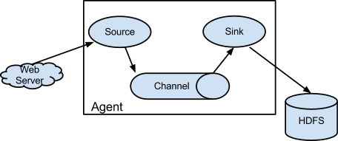

Flume
Ingesting data is an important part of our Hadoop Ecosystem.
The Flume is a service which helps in ingesting unstructured and semi-structured data into HDFS.
It gives us a solution which is reliable and distributed and helps us in collecting, aggregating and moving large amount of data sets.
It helps us to ingest online streaming data from various sources like network traffic, social media, email messages, log files etc. in HDFS.
There is a Flume agent which ingests the streaming data from various data sources to HDFS.
The flume agent has 3 components: source, sink and channel.
Source: it accepts the data from the incoming streamline and stores the data in the channel.
Channel: it acts as the local storage or the primary storage. A Channel is a temporary storage between the source of data and persistent data in the HDFS.
Sink: Then, our last component i.e. Sink, collects the data from the channel and commits or writes the data in the HDFS permanently

Slide 35
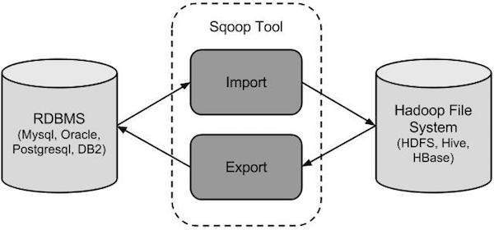
Sqoop
Apache Sqoop is a tool designed for efficiently transferring bulk data between Apache Hadoop and structured datastores such as relational databases.
You can use Sqoop to import data from external structured datastores into Hadoop Distributed File System or related systems like Hive and HBase.
Conversely, Sqoop can be used to extract data from Hadoop and export it to external structured datastores such as relational databases and enterprise data warehouses.

Slide 36

Zookeeper
Apache Zookeeper is the coordinator of any Hadoop job which includes a combination of various services in a Hadoop Ecosystem.
Apache Zookeeper coordinates with various services in a distributed environment.
Before Zookeeper, it was very difficult and time consuming to coordinate between different services in Hadoop Ecosystem.
The services earlier had many problems with interactions like common configuration while synchronizing data.
Even if the services are configured, changes in the configurations of the services make it complex and difficult to handle.
The grouping and naming was also a time-consuming factor.
Due to the above problems, Zookeeper was introduced. It saves a lot of time by performing synchronization, configuration.

Slide 37
Case Study H1B-visa
The H1B is an employment-based, non-immigrant visa category for temporary foreign workers in the united states.
For a foreign national to apply for h1b visa, an us employer must offer a job and petition for h1b visa with the us immigration department.
This is the most common visa status applied for and held by international students once they complete college/ higher education (masters, ph.D.) And work in a full-time position.
We will be performing analysis on the h1b visa applicants between the years 2011-2016
The dataset has nearly 3 million of records.
The dataset is in structured form.

Slide 38
Thank You

