Slide 1

Uploading Data from SAS to Databricks
Seamless integration for efficient data management
Notes:
AI-generated content may be incorrect. ---

Slide 2
Overview
Notes:
Agenda

Slide 3

Agenda
Data Format Comparison
Compare SAS datasets with JSON formats to understand their structure and use cases in data uploads.
Databricks Storage Options
Overview of different storage options available in Databricks for efficient data management and access.
SAS Upload Code Examples
Demonstrate SAS code examples showcasing various methods to upload data to Databricks.
Efficiency Considerations
Discuss factors affecting performance, scalability, and usability to select the best upload strategy.
Notes:
This presentation covers key considerations when uploading data from SAS to Databricks. The agenda includes a comparison between SAS datasets and JSON formats, an overview of storage options in Databricks, SAS code examples for different upload methods, and efficiency considerations for choosing the best approach. Each section provides insights into performance, scalability, and usability to help guide optimal data transfer strategies.

Slide 4
Data Format Comparison
Notes:
SAS Datasets vs JSON

Slide 5
SAS Datasets vs JSON
Feature | SAS Dataset (.sas7bdat) | JSON
Native Compatibility | Native to SAS; can be read easily | Needs parsing in Databricks
File Size | Usually smaller; binary | Larger; verbose text
Read/Write Speed | Faster for bulk upload | Slower for large datasets
Schema Handling | Fixed schema | Flexible schema
Databricks Integration | Needs SAS/ACCESS or export | Can load directly into Spark
Best Use Case | Large tabular datasets | Semi-structured or API output
Conclusion | .sas7bdat is more efficient | JSON for nested data
Notes:
When transferring data from SAS to Databricks, choosing between SAS datasets (.sas7bdat) and JSON format significantly impacts performance and usability. SAS datasets are natively compatible with SAS and offer faster read/write speeds due to their binary structure. They typically have smaller file sizes and fixed schemas, making them ideal for structured data analytics. However, integrating SAS datasets with Databricks requires either the SAS/ACCESS Interface to ODBC or exporting to intermediary formats like CSV or Parquet. On the other hand, JSON is a flexible format suitable for semi-structured or hierarchical data. It can be directly loaded into Spark DataFrames in Databricks, but its verbose nature results in larger file sizes and slower processing for large datasets. JSON is best used when dealing with API outputs or nested data structures. Overall, for large, structured datasets such as clinical or financial data, SAS datasets are more efficient for bulk transfer and analytics, while JSON serves niche use cases involving complex data structures.

Slide 6
Storage Options in Databricks
Notes:
DBFS, Volumes, and Tables

Slide 7

DBFS, Volumes, and Tables
Databricks File System (DBFS)
DBFS acts as a mounted file system for staging data before processing, simple to use but less optimized for repeated queries.
Persistent Cloud Volumes
Volumes provide scalable, persistent storage backed by cloud object stores, supporting Delta Lake for large dataset access.
Optimized Delta Tables
Tables stored as Delta or Parquet files support ACID, schema enforcement, and deliver best performance for queries and updates.
Recommended Usage Scenarios
Use Delta Tables for analytics and incremental updates; DBFS and Volumes serve well for staging and intermediate storage.
Notes:
Databricks offers multiple storage options for managing uploaded data: DBFS (Databricks File System), Volumes, and Tables (Delta or Parquet). DBFS acts like a mounted file system and is suitable for staging data before processing. It is simple to use but not optimized for repeated queries unless converted to Delta format. Volumes provide persistent storage backed by cloud object stores like S3, ADLS, or GCS. They are scalable and support Delta Lake, making them ideal for large datasets accessed by multiple jobs. However, they require setup and mount configuration. Tables in Databricks, stored as Delta or Parquet files, are optimized for analytics and support ACID transactions, schema enforcement, and updates. They offer the best performance for querying and incremental updates. For analytical workloads, writing directly to Delta Tables is recommended. DBFS and Volumes are better suited for temporary staging or intermediate storage during data pipelines.

Slide 8
Implementation Examples
Notes:
SAS Code for Uploading Data

Slide 9
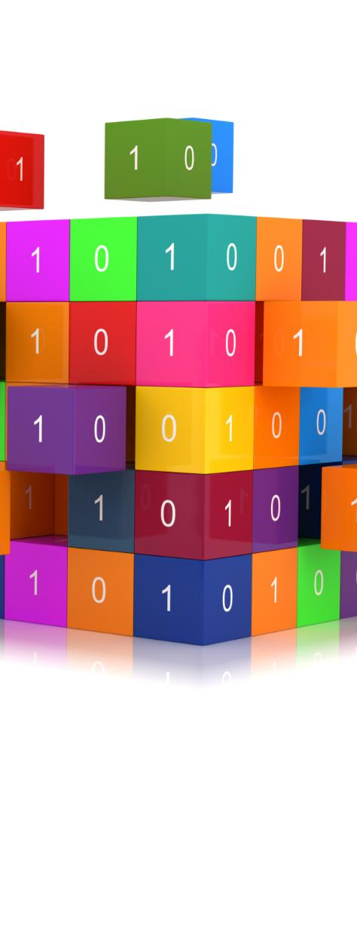
SAS Code for Uploading Data
Uploading SAS Dataset via ODBC
Use SAS/ACCESS Interface with ODBC to upload SAS datasets directly to Databricks File System (DBFS).
Exporting and Reading JSON Data
Export SAS datasets to JSON and load into Databricks using Spark's JSON reader for flexible data integration.
CSV Export and Spark Reading
Export SAS data as CSV, transfer to DBFS, and read with Spark for schema inference and header recognition.
Writing Data to Delta Tables
Write Spark data frames to Delta Lake tables using overwrite mode to update Databricks data storage.
Notes:
To test different upload approaches from SAS to Databricks, several code examples can be used. For uploading a SAS dataset to DBFS, use the SAS/ACCESS Interface with an ODBC connection: `libname mydblib odbc dsn='DatabricksDSN'; data mydblib.my_table; set sashelp.class; run;`. To export a SAS dataset to JSON, use: `libname myjson json 'C:\temp\class.json'; data myjson.class; set sashelp.class; run;`. In Databricks, this JSON can be read using Spark: `df = spark.read.json("/dbfs/mnt/data/class.json")`. For CSV export, use `proc export data=sashelp.class outfile="C:\temp\class.csv" dbms=csv replace; run;`, then copy to DBFS and read with: `df = spark.read.csv("dbfs:/mnt/data/class.csv", header=True, inferSchema=True)`. Finally, to write to a Delta Table: `df.write.format("delta").mode("overwrite").saveAsTable("default.class_delta")`. These examples demonstrate various paths for integrating SAS data into Databricks workflows.

Slide 10
Efficiency Considerations
Notes:
File Format, Storage, and Workflow

Slide 11
File Format, Storage, and Workflow
File Format Comparison
SAS dataset format is small and fast for structured data, JSON is flexible but slower, CSV balances universality and performance.
Storage Options
DBFS suits intermediate staging, Volumes offer persistent scalable storage, Delta Tables optimize performance for analytics and updates.
Recommended Workflows
Workflows vary by data type: structured data uses .sas7bdat, semi-structured uses JSON, and CSV offers a middle ground.
Notes:
Efficiency in uploading data from SAS to Databricks depends on the chosen file format, target storage, and workflow. SAS datasets (.sas7bdat) are small and fast for structured data, while JSON is flexible but larger and slower. CSV offers a universal format with moderate performance. For storage, DBFS is suitable for intermediate staging, Volumes are best for persistent and scalable storage, and Delta Tables provide optimal performance for analytics and updates. Recommended workflows include: SAS → .sas7bdat → DBFS → Spark → Delta Table for structured data; SAS → JSON → DBFS → Spark → Delta Table for semi-structured data; and SAS → CSV → DBFS/Volumes → Spark → Delta Table as a middle-ground approach. These considerations help balance performance, scalability, and usability in data integration tasks.

Slide 12
Workflow Visualization
Notes:
SAS to Delta Table Workflow

Slide 13

SAS to Delta Table Workflow
Data Export from SAS
Data is exported from SAS in formats like .sas7bdat, JSON, or CSV for compatibility with Databricks.
Data Upload to Storage
Exported data is uploaded to DBFS or Volumes acting as intermediate or persistent storage within Databricks.
Spark Data Processing
Spark reads and processes the uploaded data into a structured format suitable for analytics within Databricks.
Writing to Delta Table
Processed data is written into Delta Tables for optimized querying and scalable analytics workflows.
Notes:
The workflow for uploading data from SAS to Databricks typically involves several stages. Starting from SAS, data is exported in a suitable format such as .sas7bdat, JSON, or CSV. This data is then uploaded to DBFS or Volumes, which serve as intermediate or persistent storage. Spark within Databricks reads the data and processes it into a structured format. Finally, the data is written into a Delta Table for optimized analytics and querying. This workflow ensures efficient data handling and supports scalable data pipelines. Visualizing this process helps teams understand the integration steps and choose the best path based on their data characteristics and analytical goals.

