Slide 1

GitHub Basic Commands Tutorial
Essential commands for managing Git repositories
Notes:
AI-generated content may be incorrect. ---

Slide 2
Introduction to GitHub and Git
Notes:
Overview of GitHub and Version Control

Slide 3

Overview of GitHub and Version Control
GitHub Platform Role
GitHub hosts and manages Git repositories, supporting collaboration and version control for developers worldwide.
Version Control Benefits
Version control systems track changes, allow reversion to prior states, and enable simultaneous feature development without conflicts.
Essential Git Commands
Key Git commands include initializing repositories, cloning projects, staging changes, committing updates, and syncing with remotes.
Notes:
GitHub is a widely used platform for hosting and managing Git repositories, enabling collaborative development and version control. Version control systems like Git allow developers to track changes, revert to previous states, and work on multiple features simultaneously without conflicts. GitHub enhances Git by providing a web-based interface, issue tracking, pull requests, and integration with CI/CD tools. Beginners should understand that GitHub is not Git itself but a service built on top of Git. This tutorial introduces essential Git commands that form the foundation for managing repositories effectively. By mastering these commands, users can initialize repositories, clone projects, stage changes, commit updates, and synchronize work with remote repositories. Understanding these basics is crucial for efficient collaboration and maintaining code integrity in team environments.

Slide 4
Core Git Commands
Notes:
git init and git clone, git add and git commit, git push and git pull, git status and git branch

Slide 5

git init and git clone
git init command
Initializes a new Git repository locally to start tracking project changes from scratch.
git clone command
Copies an existing remote repository to the local machine including full project history.
Starting Git Workflow
These commands enable developers to create new projects or collaborate on existing codebases effectively.
Notes:
The `git init` command initializes a new Git repository in the current directory, creating the necessary metadata to start tracking changes. This is typically used when starting a new project from scratch. For example, running `git init` in a project folder sets up the repository locally. On the other hand, `git clone` is used to copy an existing repository from a remote source, such as GitHub, to your local machine. This command is essential when you want to contribute to an existing project or use its code as a base. The syntax `git clone <repository_url>` downloads the entire repository history, ensuring you have all branches and commits. These commands form the entry point for working with Git and GitHub, allowing developers to either create new repositories or collaborate on existing ones.

Slide 6

git add and git commit
Staging Changes with git add
The git add command stages changes, moving them to the staging area for the next commit.
Recording Changes with git commit
The git commit command records staged changes into the repository history with a descriptive message.
Version Control Workflow
Together, git add and git commit track and document modifications systematically in version control.
Notes:
After making changes to files, you need to stage them for commit using `git add`. This command moves changes from the working directory to the staging area, preparing them for inclusion in the next commit. For example, `git add file.txt` stages a single file, while `git add .` stages all changes. Once staged, `git commit` records these changes in the repository's history. A commit should include a descriptive message, such as `git commit -m 'Added new feature'`, to explain the purpose of the changes. Commits create snapshots of your project, enabling you to revert or review changes later. Together, these commands ensure that modifications are systematically tracked and documented, forming the backbone of version control workflows.

Slide 7

git push and git pull
git push Functionality
Uploads local commits to a remote repository, sharing changes with collaborators effectively.
git pull Functionality
Fetches and merges changes from remote to local branch, keeping local copy up to date.
Team Collaboration
Regular use of git pull prevents conflicts and synchronizes work among team members.
Notes:
The `git push` command uploads local commits to a remote repository, such as GitHub, making your changes available to collaborators. Typically, you specify the remote name and branch, for example, `git push origin main`. Conversely, `git pull` fetches changes from the remote repository and merges them into your local branch, ensuring your copy is up to date. This is crucial when working in teams, as it synchronizes work across multiple contributors. Regularly pulling updates prevents conflicts and keeps your local environment aligned with the latest project state. These commands enable seamless collaboration by bridging local development and shared repositories.

Slide 8

git status and git branch
Overview of git status
The git status command shows the current state of files as modified, staged, or untracked for next commits.
Managing branches with git branch
Git branch lists, creates, and manages separate development lines, enabling isolated feature or bug fix work.
Importance of branching
Branching helps maintain a clean main codebase by isolating new features or fixes until ready.
Notes:
The `git status` command provides an overview of the current state of your working directory and staging area. It shows which files are modified, staged, or untracked, helping you decide what to commit next. For example, running `git status` after editing files will display their status relative to the last commit. The `git branch` command manages branches, which are separate lines of development within a repository. You can list branches, create new ones (`git branch feature-xyz`), or switch between them using `git checkout`. Branching is essential for isolating work on new features or bug fixes without affecting the main codebase. Together, these commands offer visibility and flexibility, enabling structured and organized development workflows.

Slide 9
Visual Workflow and Branching
Notes:
Understanding Git Workflow, Branching Strategies and Illustration

Slide 10
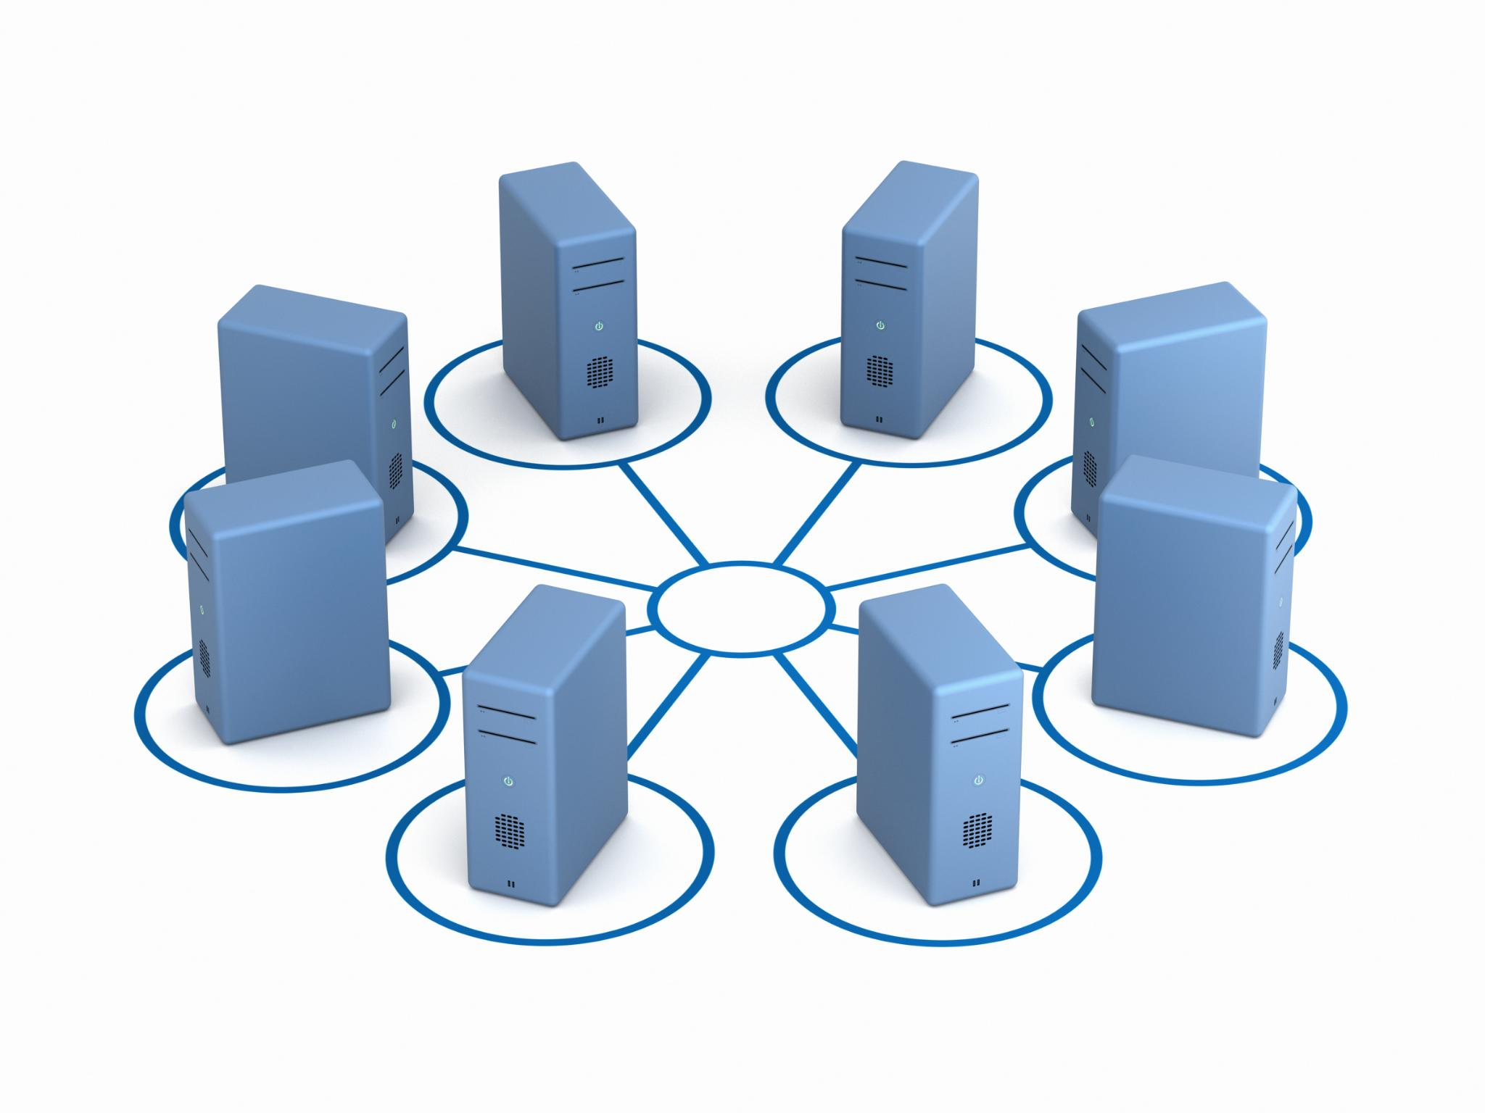
Understanding Git Workflow
Core Git Areas
Git workflow includes working directory, staging area, and repository for managing file changes effectively.
Staging and Committing
Use 'git add' to stage changes and 'git commit' to record them, ensuring organized version control.
Remote Synchronization
'git push' and 'git pull' synchronize local repository with remote, enabling collaborative workflows.
Notes:
Git's workflow revolves around three key areas: the working directory, the staging area, and the repository. Changes start in the working directory, where files are edited. Using `git add`, changes move to the staging area, preparing them for a commit. Finally, `git commit` records these changes in the repository. Visualizing this process helps beginners understand how commands interact and why staging is necessary before committing. Diagrams often depict arrows between these areas, illustrating the flow of changes. Additionally, remote repositories add another layer, where `git push` and `git pull` synchronize local and remote states. Understanding this workflow ensures efficient and error-free version control practices.

Slide 11
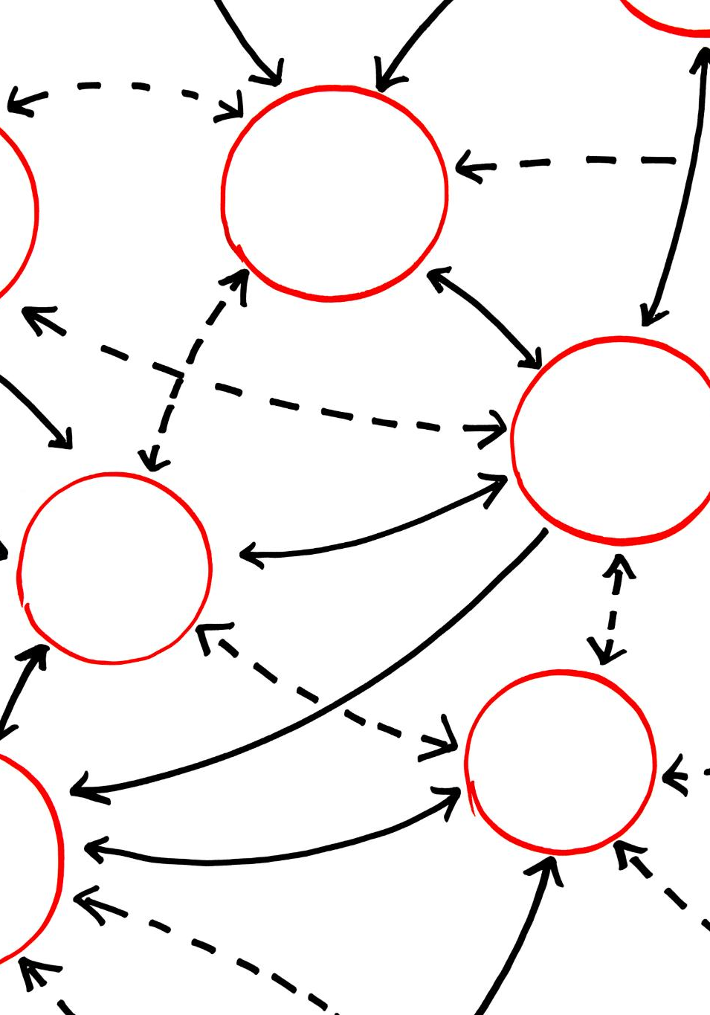
Branching Strategies and Illustration
Independent Feature Development
Branching lets developers work on features or fixes separately from the main codebase, ensuring isolated progress.
Merging and Branch Deletion
Completed branches merge back into the main branch, and then are deleted to keep the codebase organized.
Visual Branching Illustration
Tree-like visuals show the main branch as trunk and feature branches as offshoots, clarifying development flow.
Benefits of Branching
Branching reduces conflicts, supports experimentation, and enables organized workflows for collaborative projects.
Notes:
Branching allows developers to work on features or fixes independently of the main codebase. A common strategy is to create a new branch for each feature, merge it back into the main branch after completion, and delete it to maintain cleanliness. Visual illustrations often show a tree-like structure, with the main branch as the trunk and feature branches as offshoots. This representation clarifies how parallel development occurs and why merging is necessary. Branching reduces conflicts and enables experimentation without disrupting stable code. Understanding branching is vital for collaborative projects, as it supports organized workflows and continuous integration.

Slide 12
Conclusion
Notes:
Key Takeaways and Next Steps

Slide 13
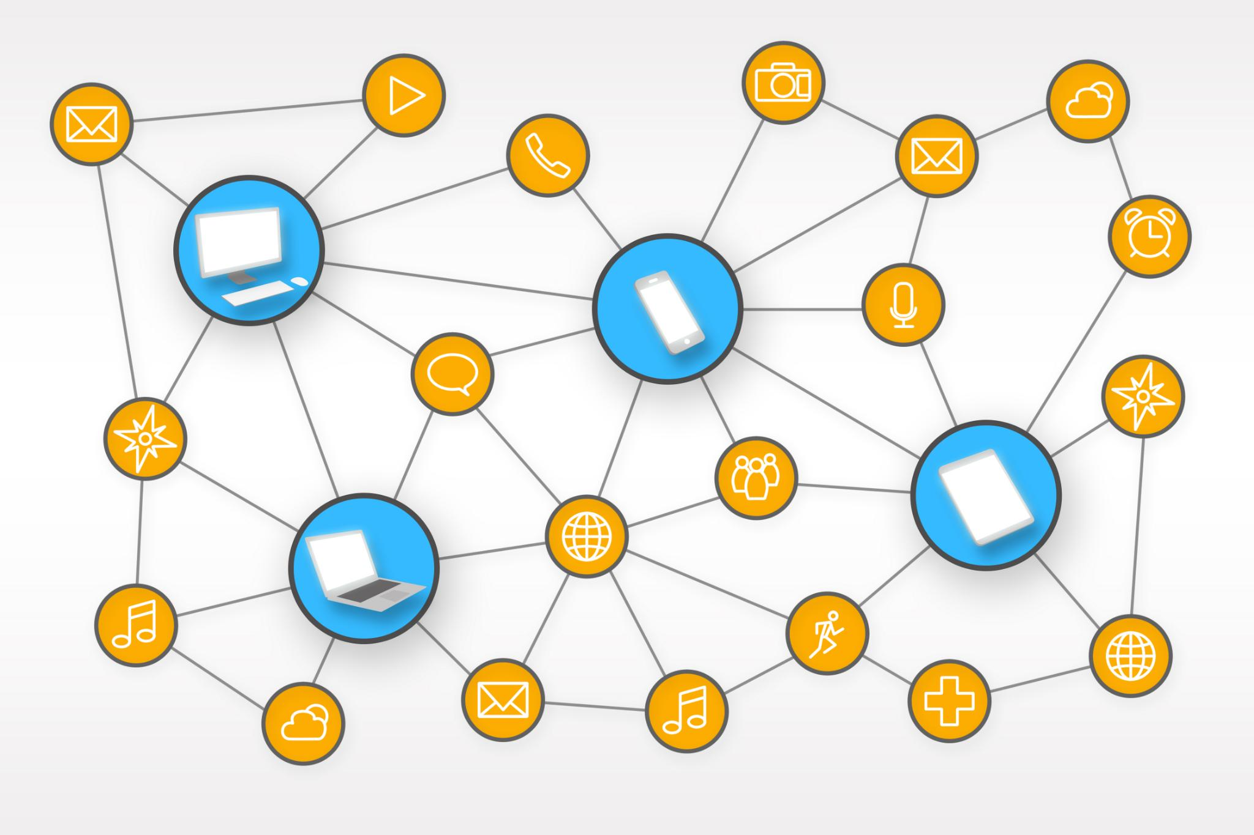
Key Takeaways and Next Steps
Core Git Commands
Understand essential Git commands that form the foundation of version control workflows.
Workflows and Branching
Visualize workflows and branching strategies to improve comprehension and reduce errors.
Practice and Advanced Features
Apply Git commands in projects and explore advanced features like merging and rebasing.
Best Practices and Continuous Learning
Adopt best practices for commit messages and branch naming to enable efficient collaboration.
Notes:
Mastering GitHub basics involves understanding core commands, workflows, and branching strategies. Commands like `git init`, `git clone`, `git add`, `git commit`, `git push`, `git pull`, `git status`, and `git branch` form the foundation of version control. Visualizing workflows and branching structures enhances comprehension and reduces errors. Beginners should practice these commands in real projects, explore advanced features like merging and rebasing, and adopt best practices for commit messages and branch naming. Continuous learning and hands-on experience will ensure proficiency in Git and GitHub, enabling efficient collaboration and robust code management.

