Slide 1
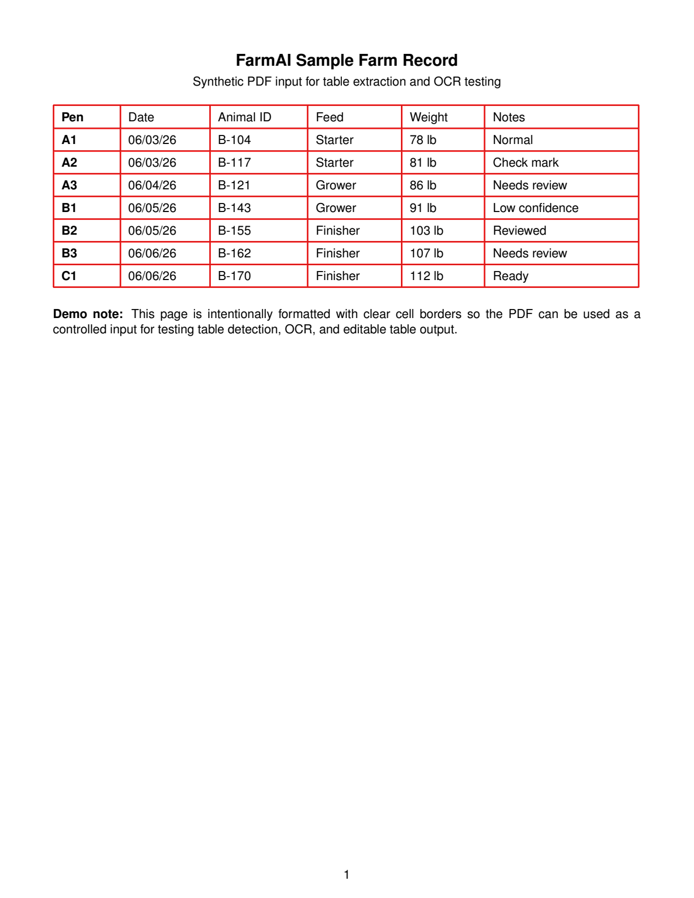
FarmAI: Demo
A walkthrough of the HTML demo workflow: scan, detect, OCR, review, and export.
1. PDF input -> 2. Table detection -> 3. OCR cells -> 4. Human review
Demo opens on the source farm record PDF and editable table.
Top navigation lets reviewers inspect each pipeline stage.
OCR output is editable, confidence-aware, and exportable as CSV.

Slide 2
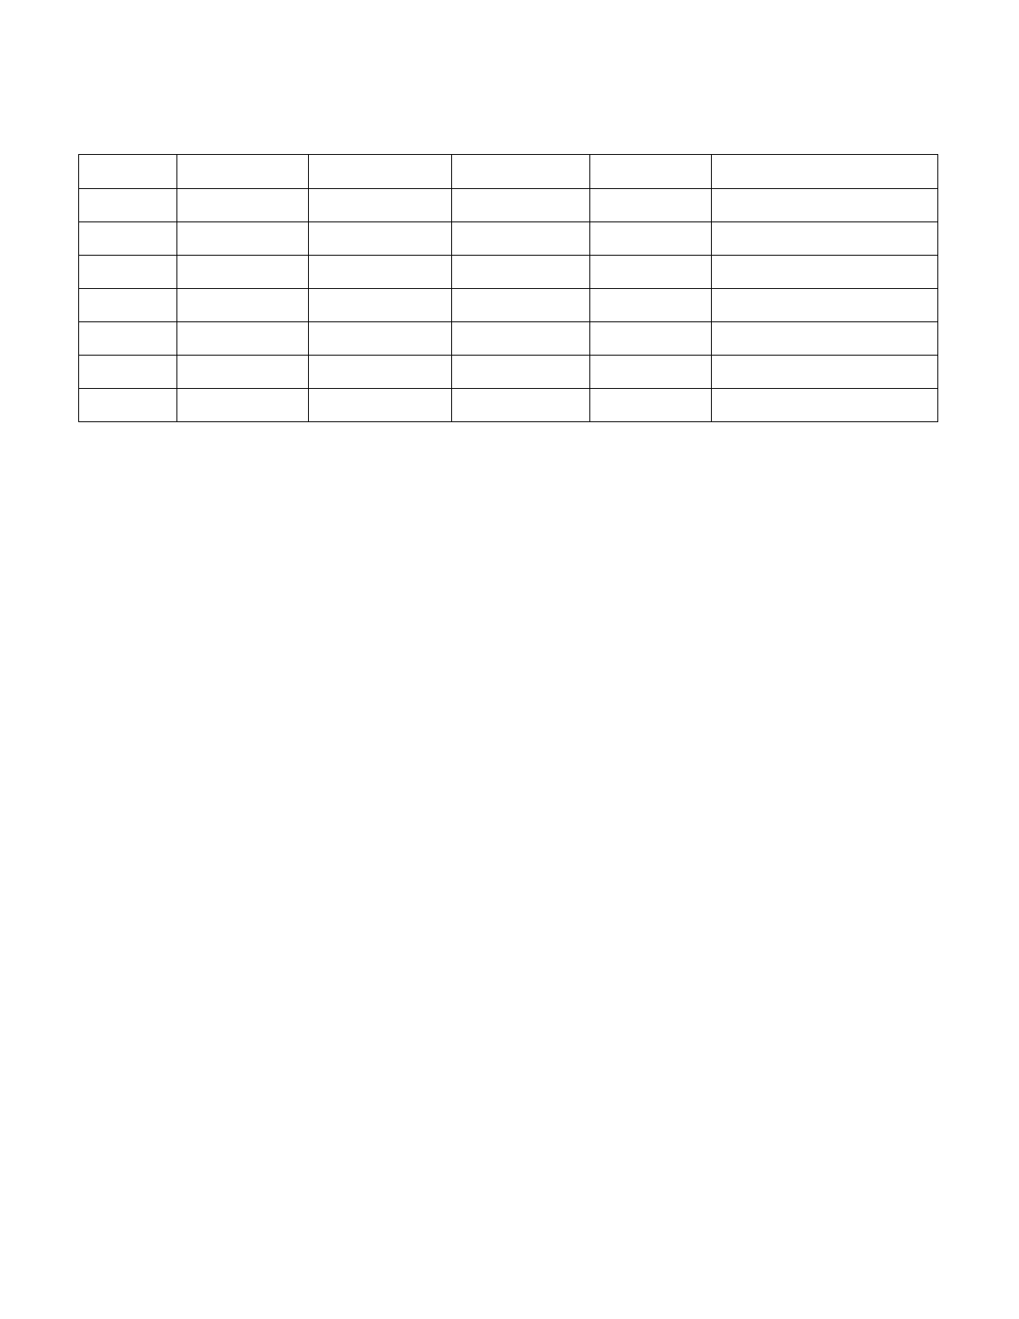
1. PDF Input
The demo starts with the original scanned farm record on the left.
Source document stays visible for traceability.
Reviewers can compare extracted values against the original page.
The default HTML view keeps this PDF + editable table layout.

Slide 3
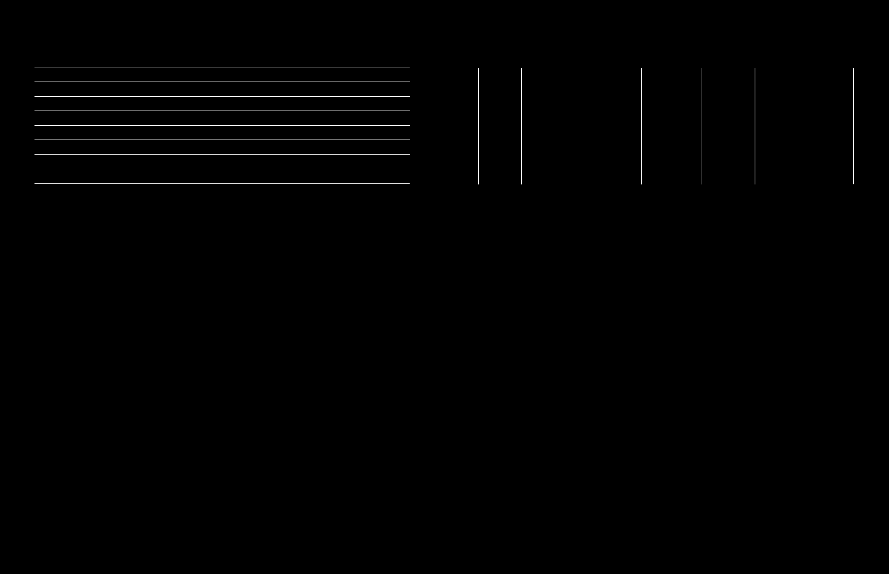
2. Table Detection
Clicking Table Detection switches to visual inspection outputs.
Left: line detection output shows the located row and column structure.
Right: overlay output shows detected table cells on the page.
Line detection
Table overlay

Slide 4
3. OCR Cells
Clicking OCR Cells returns to the editable table view with the overlay on the left.
48 cells detected 92% average confidence 5 cells flagged
Table headers and cell text load from table_ocr_farm_record_table_p1.json.
Low-confidence cells are highlighted for reviewer attention.
Cells remain directly editable before export.

Slide 5
4. Human Review and CSV Export
The final step is a lightweight correction loop before download.
Reviewer corrects OCR mistakes directly in the table.
Reset sample restores the OCR JSON data.
Download CSV exports the current edited values.
The workflow keeps visual evidence beside the editable result.
Reset sample
Download CSV

