Slide 1
THE SCHOLAR
E-Library

Slide 2
Introduction
An E-Library , (i.e. database management system)
Users can manage their book selection in different categories
User to user communication ( via sharing recommended book between one another )
Search engine that helps users to find their required book ( via relevant options display and exact match searching)
Open , read and keep bookmarks of pages reached for future reference

Slide 3
Features of The Scholar
User sign up and login feature
Tracking users books, articles and bookmarks as designated by the user
Sharing recommendations between users
Searching for books and articles provided via two steps( Relevant Search & Exact match Search)
Real time display of date and time
Reviewing system for books/articles

Slide 4
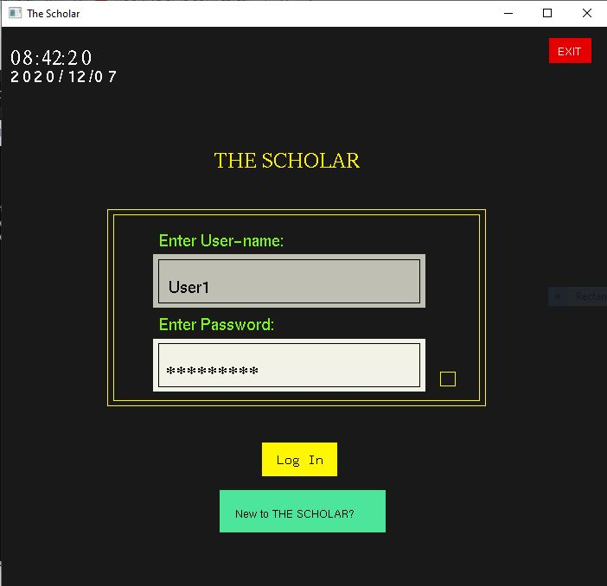
User signup & login
Login and sign up are done by utilizing file and directory handling
Users file holds the already existing users and their required data
Validators are used for IfUserExist() in login and password character validator in signup

Slide 5
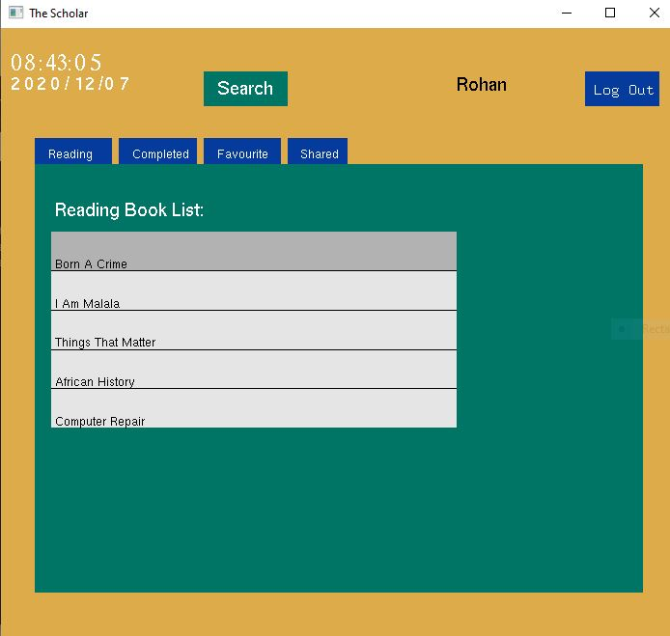
Book Tracking features
Reading Section : holds user’s currently reading books
Completed Section: holds user’s completed books
Favorite Section: holds user’s favorite books
Share Section: holds books recommended by other users
All above features are achieved by file handling processes

Slide 6
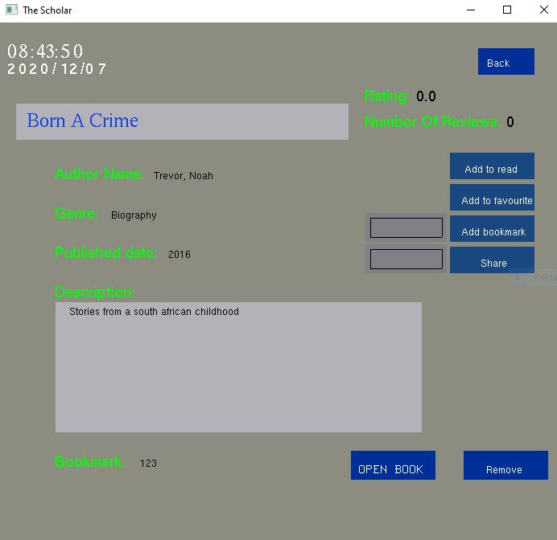
Book detail page
This part includes the details of a book and options of what to do with it

Slide 7
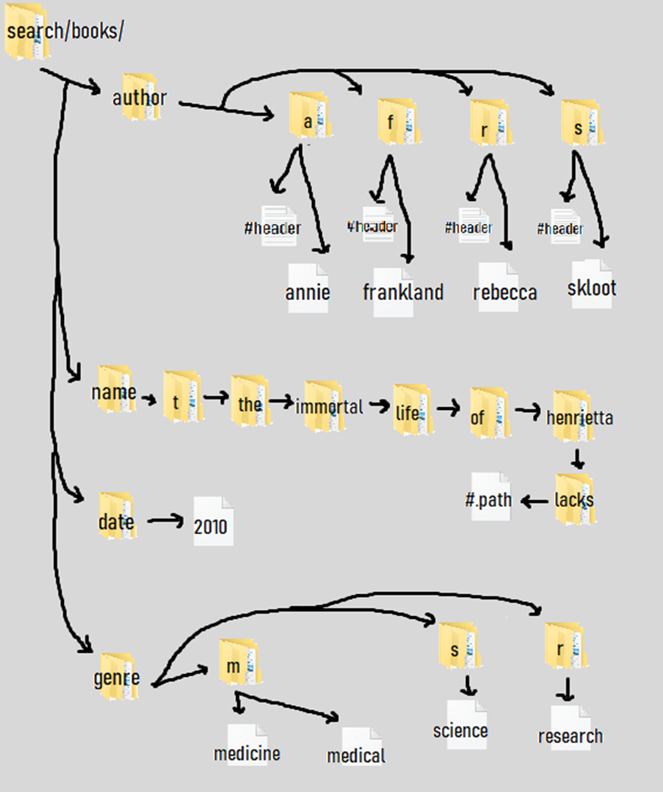
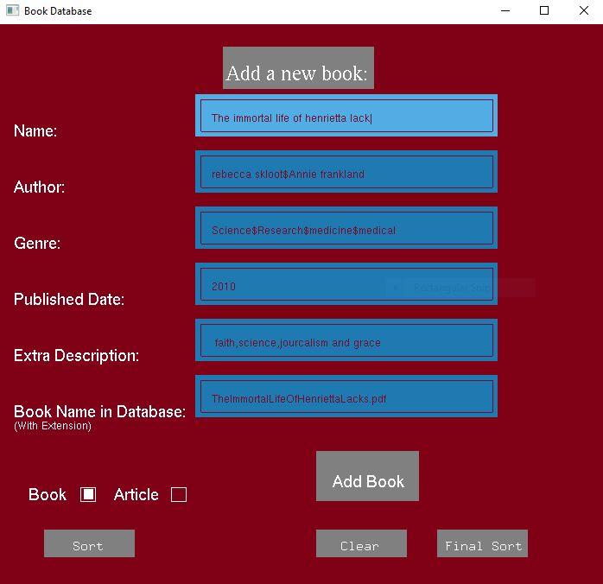

Slide 8
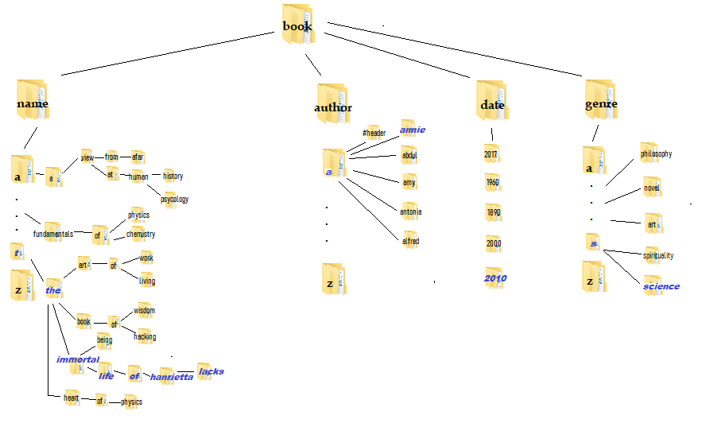

Slide 9
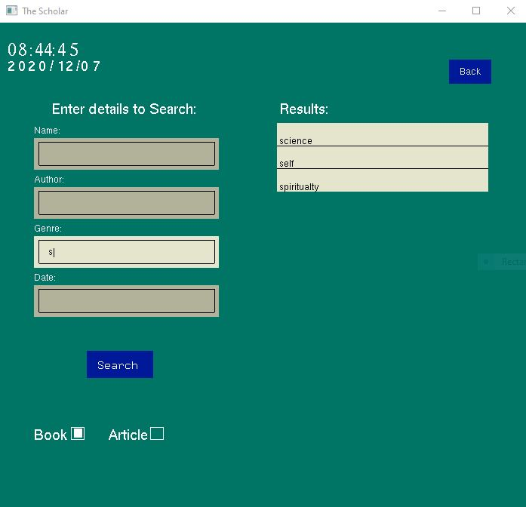
Searching feature
The searching is composed of two searches:
Relevant option search: this search is done while typing and gives relevant options for currently typing keyword
Full match search: this search is done when search button is pressed and gives only the exact match

Slide 10
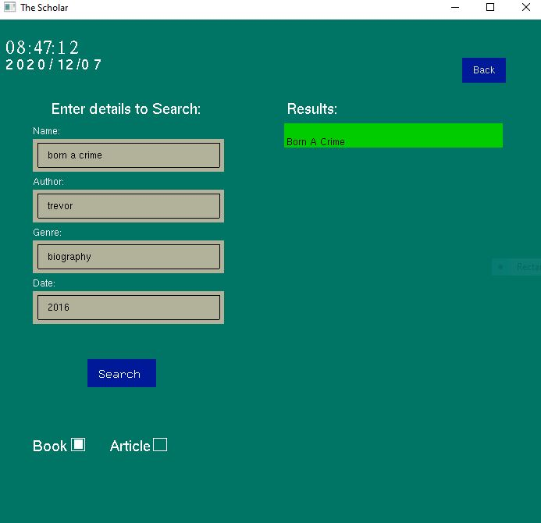
Searching
1. The searching for full match is done by priority, order is :
Author > Name > Genre > Date
2. The search involving only date and genre are loaded as parts, utilizing previous and next buttons to traverse list

Slide 11
Searching
Name:
Primary Categorization based on first character( a to z )
Break into words & Make trie structure based on each word
Sequential Searching under each level
Author:
Primary Categorization based on first character( a to z )
Binary Searching on preprocessed(sorted) header file
Sort performed using:
Heap Sort : When large number of new book entries are entered
Insertion Sort : Add in previous sorted database
Date:
Sequential Searching
Genre:
Primary Categorization based on first character( a to z )
Sequential Searching

Slide 12
Problems faced
Dividing individual tasks and merging individual code
Some features of OpenGL ( free glut) could not be utilized to full potential due to lack of our complete knowledge of the topic

Slide 13
Conclusion
We were able to create a fully functioning e-library as we had initially planned
Different sorting and searching concepts were utilized very well and we obtained good results as expected
Increased our knowledge of the OpenGL library , enabling us to make a UI application in C++

Slide 14
Thank you
Any questions

