Slide 1
EPAM Frontend Web Development Training
name:-Ravi Pandey supervisor: Sandeep kaur
Reg no:-11910459

Slide 2
EPAM EPAM Systems, Inc. is an American company that specializes in software engineering services, digital platform engineering, and digital product design, operating out of Newtown, Pennsylvania. EPAM is a founding member of the MACH Alliance.

Slide 3
HISTORY
In 1993, Arkadiy Dobkin and Leo Lozner founded EPAM, a global software engineering services company, in New Jersey, USA and Minsk, Belarus.
In 2002, EPAM was ranked publicly for the first time as a fast-growing company by Deloitte & Touche.In the same year, the company became the first Russian player on the London Stock Exchange.
In 2012, EPAM was listed on New York Stock Exchange under the moniker EPAM, becoming the first company from Belarus on NYSE.

Slide 4

CEO-EPAM
Arkadiy Dobkin

Slide 5
Front End Web Development
A front-end developer builds the front-end portion of websites and web applications—the part users see and interact with. A front-end developer creates websites and applications using web languages such as HTML, CSS, and JavaScript,React that allow users to access and interact with the site or app. The main responsibility of a Front-End Developer is the User interface.Simply put, create things that the user sees.

Slide 6
Skills learnt During Training
• Teamwork • HTML
• Problem solving • CSS
• Co-ordination • JavaScript
• Interpersonal Skills
• Time Management

Slide 7
Front-end developers work with various technologies, tools, and languages, including:
HTML (HyperText Markup Language): The standard markup language used to create the structure and layout of web pages.
CSS (Cascading Style Sheets): A stylesheet language used to control the presentation, formatting, and appearance of web pages, such as colors, fonts, and layout.
JavaScript: A programming language that allows developers to add interactivity, animations, and other dynamic elements to websites and web applications.

Slide 8
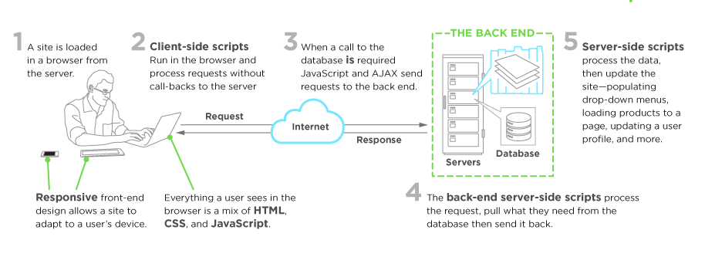
Step how its work

Slide 9
Project Assigned in this training
GradeBook
The Gradebook stores all information about student progress in the course.
In this project I have made eight columns.which store the information about students.
NO | Name | Ticket’s Number | Rating Grade | Exam Grade | Final Grade | Status | Details

Slide 10
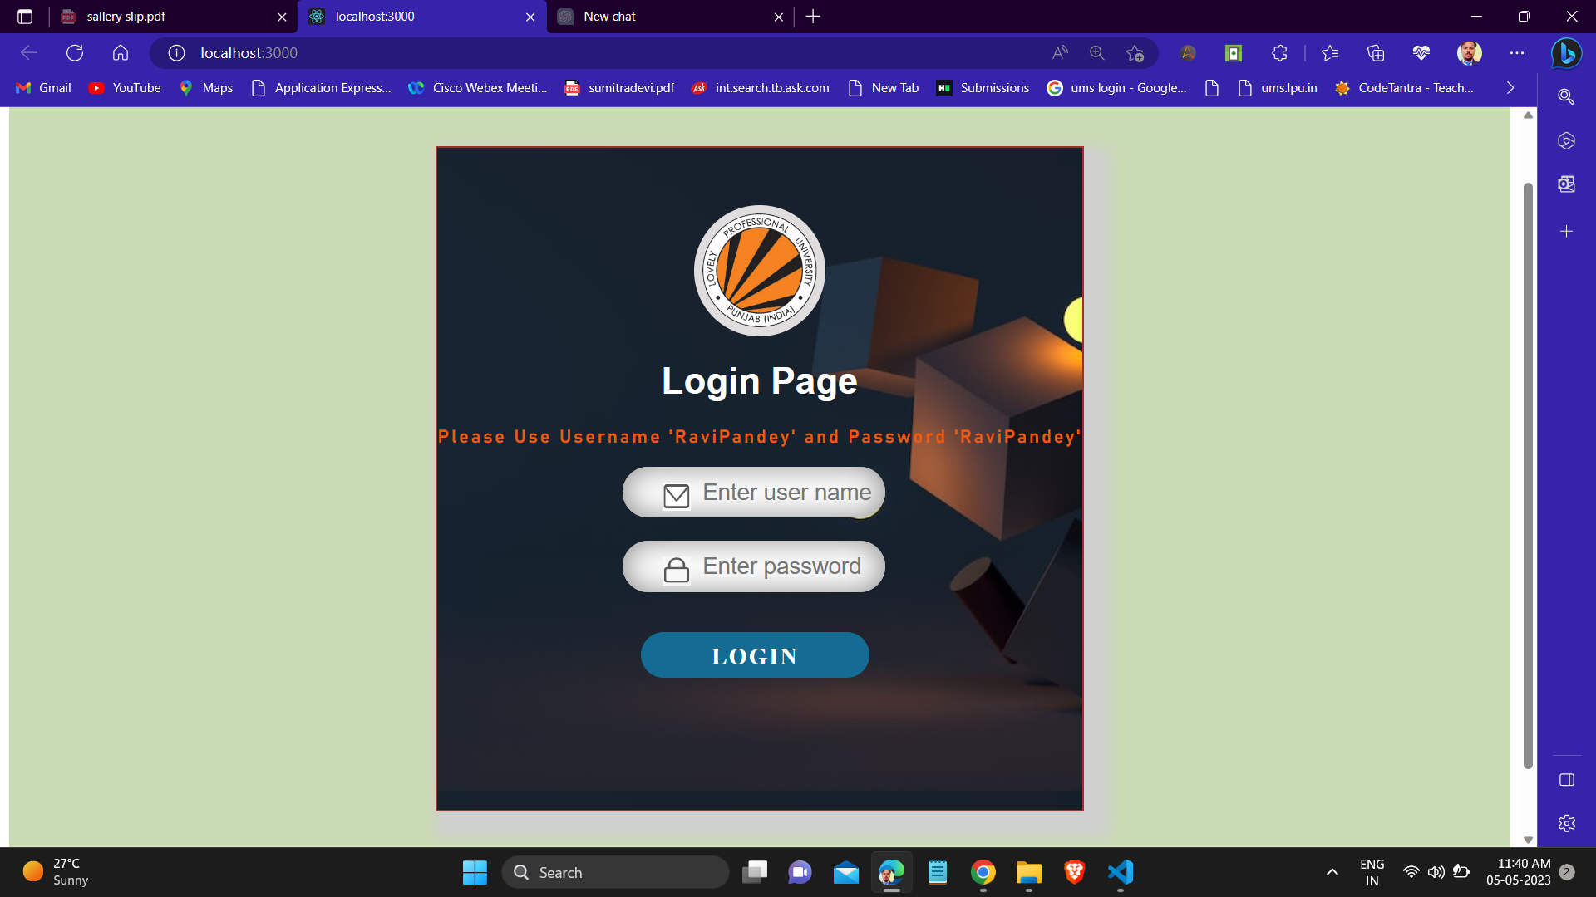
Project Screenshort

Slide 11
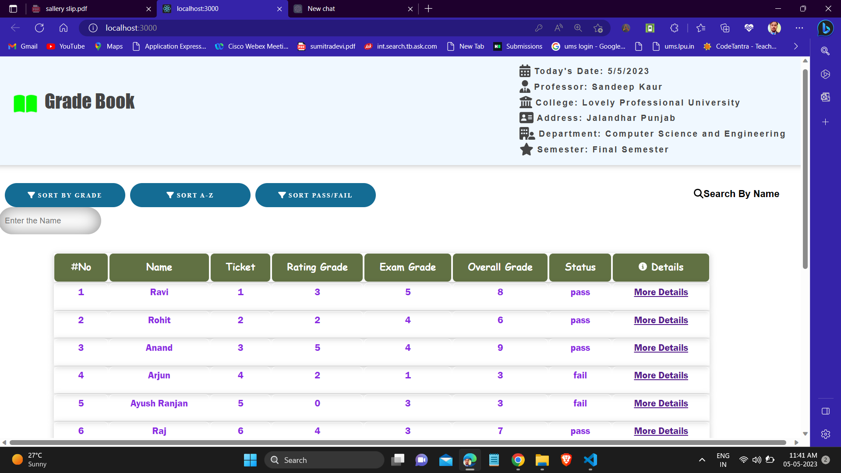

Slide 12
