Slide 1
Indus Institute of Technology and Engineering
Subject:- Software Group Project (CE0727)
AI/ML - Based House Price Prediction
Prepared By
Ravi Patel
IU2341050103
Kenil Patel
IU2341050105
Vishnu Jikadara
IU2341050114
Guided By
Dhwani Hakani Ma’am
Submission Date
11-July-2026

Slide 2
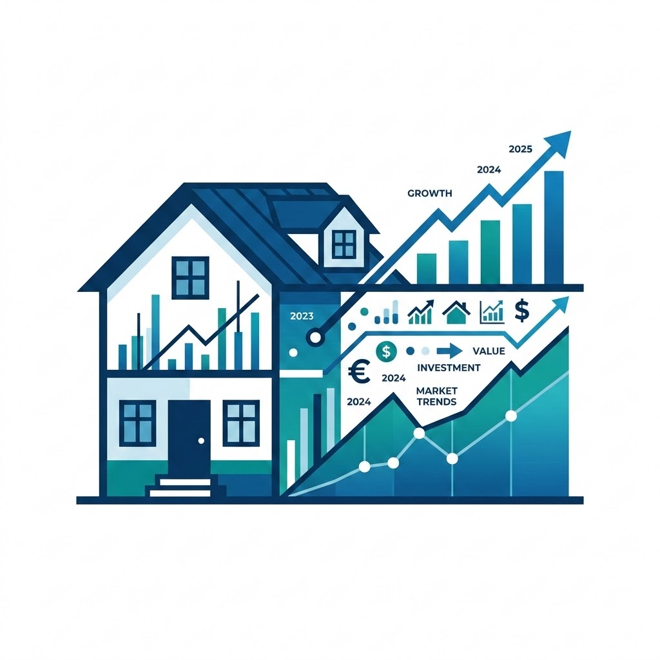
AI/ML - Based House Price Prediction & Property Recommendation System
Machine learning standardizes complex house price estimations to replace inconsistent manual methods.
CHALLENGES IN CURRENT METHODS
PROPOSED ML SOLUTION
Our system leverages Machine Learning algorithms to objectively analyze property features and predict fair market values.
FUTURE SCOPE
The architecture will expand beyond simple prediction to offer intelligent, personalized property recommendations based on user preferences.
Highly Variable Factors
Real estate pricing depends on highly variable factors, including specific location, total square footage, BHK configuration, and available amenities.
Subjective Expert Reliance
Manual price estimation relies heavily on subjective expert knowledge, making it highly inconsistent and time-consuming for average buyers and sellers.
Transitioning from subjective manual methods to objective Machine Learning models standardizes pricing, ensuring consistency and accuracy across all transaction types.

Slide 3
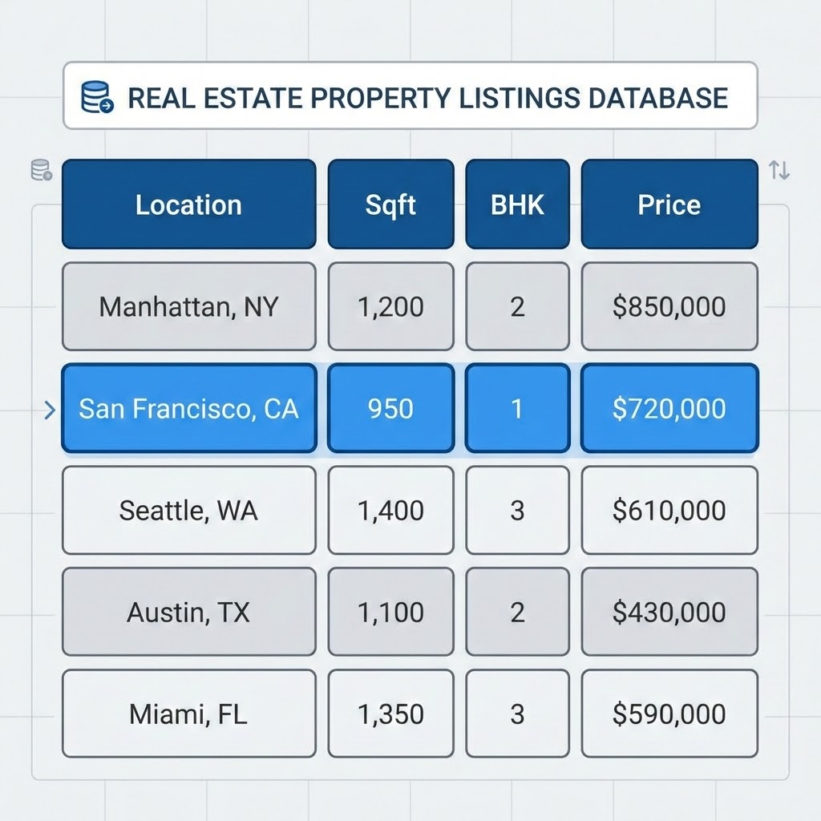
AI/ML - Based House Price Prediction & Property Recommendation System
The Bengaluru House Price Dataset Provides Key
Structural & Locational Features for Modeling
The project utilizes the comprehensive Bengaluru House Price Dataset for training and evaluation.
Key Independent Features Analyzed
■Location: The specific neighborhood or area within Bengaluru.
■Sqft: Total square footage of the property.
■BHK: Number of bedrooms, hall, and kitchen configurations.
■Bath: Number of bathrooms.
■Balcony: Number of attached balconies.
Target Variable
House Price: The final continuous variable our machine learning models will be trained to predict. All columns were rigorously studied to determine exact meaning and data types.

Slide 4
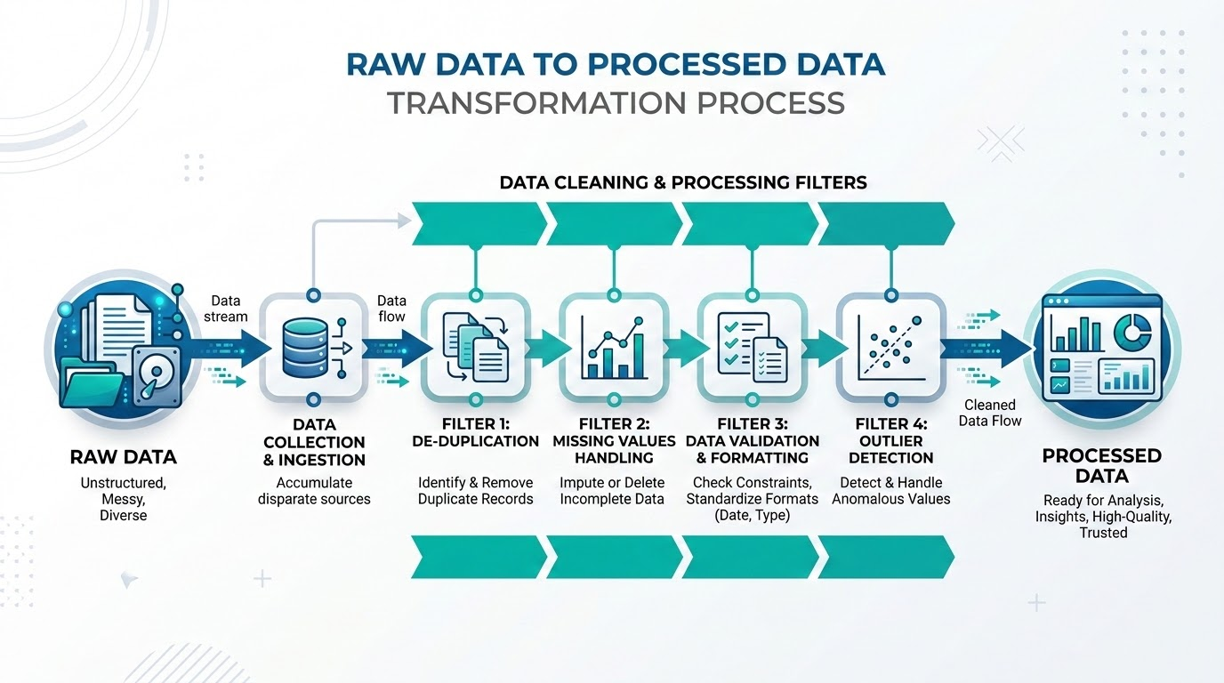
AI/ML - Based House Price Prediction & Property Recommendation System
Rigorous data cleaning ensures a standardized and reliable dataset for accurate analysis.
01
Removed Duplicates
Eliminated redundant rows to prevent model bias.
02
Handled Missing Values
Imputed or dropped null entries to maintain data integrity.
03
Standardized Measurements
Resolved inconsistencies in the 'total_sqft' column, converting ranges and mixed formats into uniform numeric values.
04
Type Conversion
Converted categorical and string variables into appropriate numeric data types for algorithmic processing.
OUTCOME
The result is a highly structured, clean dataset fully optimized for the exploratory data analysis and model training phases.

Slide 5
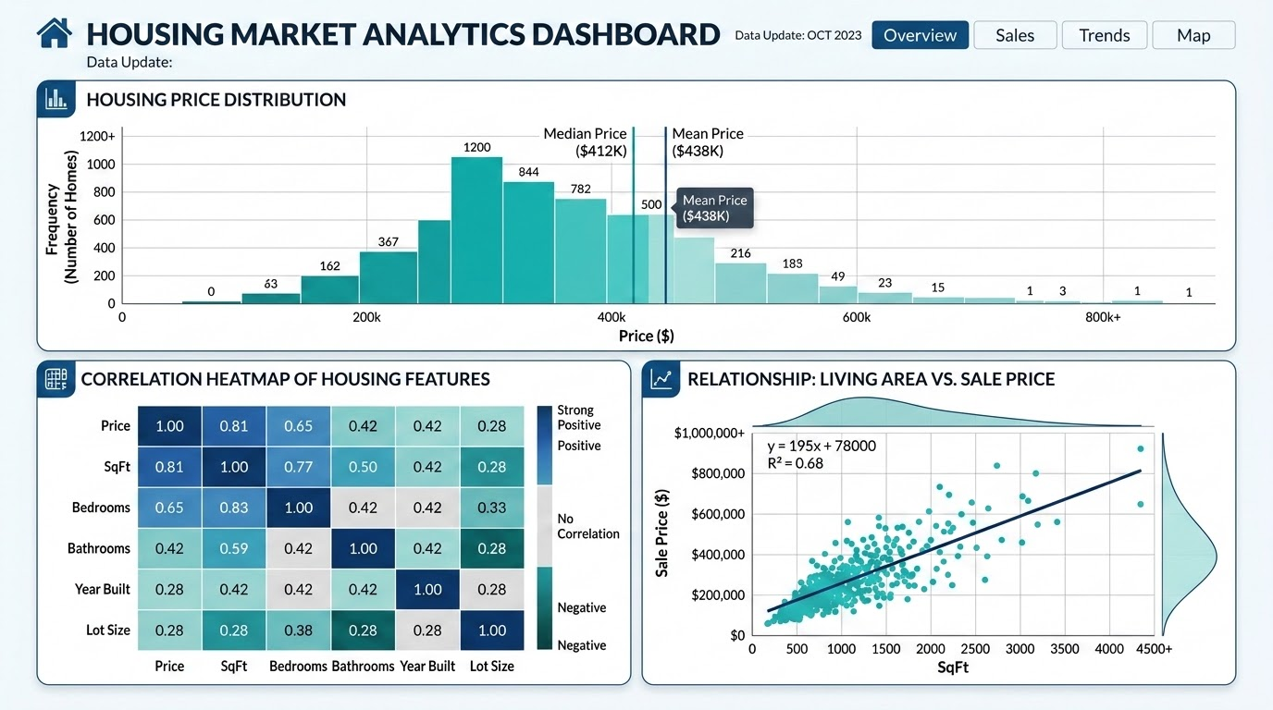
AI/ML - Based House Price Prediction & Property Recommendation System
Exploratory Data Analysis reveals critical price distributions and feature relationships using visual libraries.
Price Distribution
Evaluated the spread and skewness of house prices across the dataset.
Location Impact
Compared average pricing variations across different Bengaluru neighborhoods.
Feature Correlation
Analyzed how independent variables like square footage and BHK strongly correlate with the final price.
Tools: Matplotlib & Seaborn
Leveraged Python's Matplotlib and Seaborn libraries to generate comprehensive visual representations of these complex data relationships.
Outlier Detection
Identified extreme anomalies in property prices and sizes that could skew model accuracy.

Slide 6
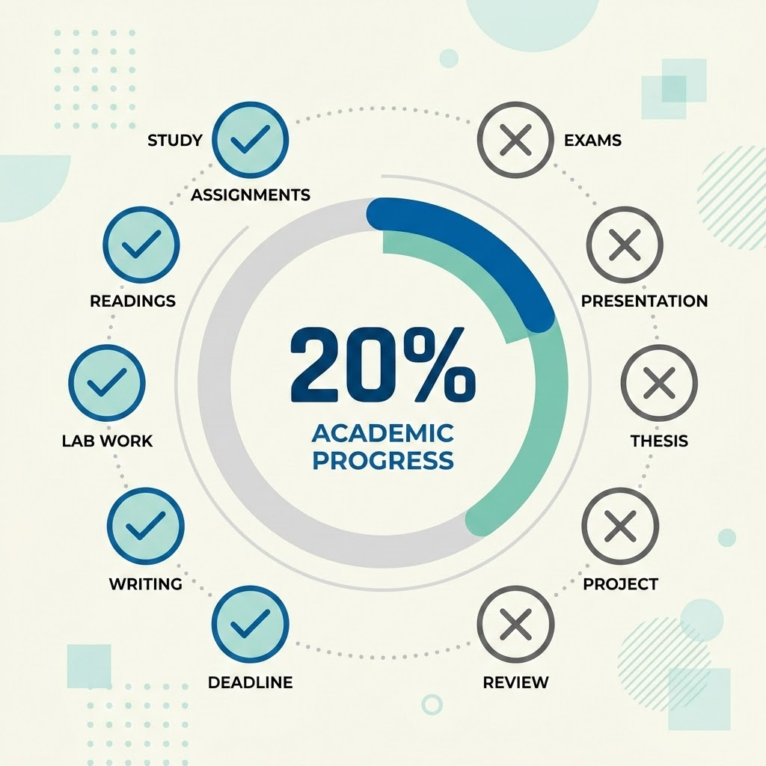
AI/ML - Based House Price Prediction & Property Recommendation System
The project has successfully completed the initial 20% phase, delivering a clean dataset and comprehensive EDA.
Milestones Achieved
20%
PROJECT LIFE CYCLE PROGRESS
Approximately 20% of the total project lifecycle has been successfully executed.
Project Title Approved
Project title finalized and approved by the academic committee.
Raw Dataset Acquired
Raw dataset successfully collected and imported into the development environment.
Data Preparation & Analysis Complete
Comprehensive data cleaning and Exploratory Data Analysis (EDA) phases are fully completed.
CURRENT DELIVERABLES
A fully sanitized and structured dataset ready for machine learning ingestion.
A detailed EDA Jupyter Notebook documenting all statistical findings and visualizations.

Slide 7

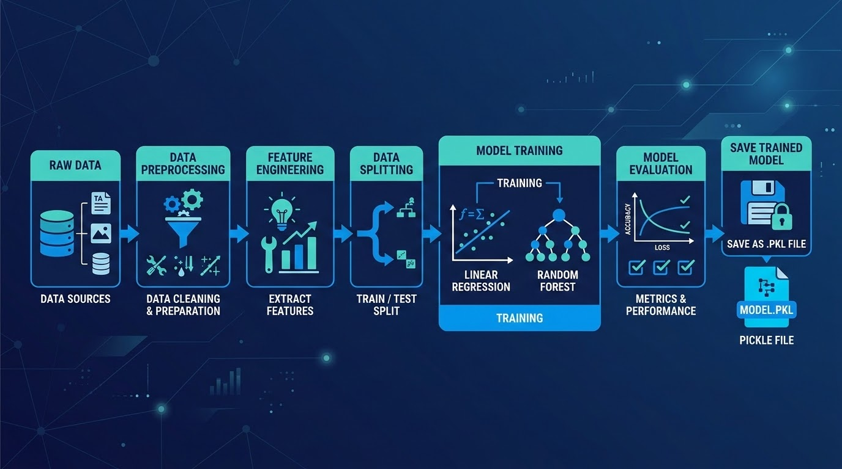
AI/ML - Based House Price Prediction & Property Recommendation System
PR3 Technical Roadmap
The next project phase focuses on feature engineering and training advanced machine learning models.
01
Feature Engineering
Applying categorical encoding and numerical scaling to optimize inputs.
02
Data Splitting
Executing a rigorous Train-Test split to ensure valid model evaluation.
03
Model Training
Implementing multiple algorithms, including Linear Regression, Decision Trees, Random Forest, and XGBoost.
04
Evaluation & Deployment
Comparing model accuracy metrics to select the best performer, followed by saving the final model as a structured .pkl file for future integration.

Slide 8
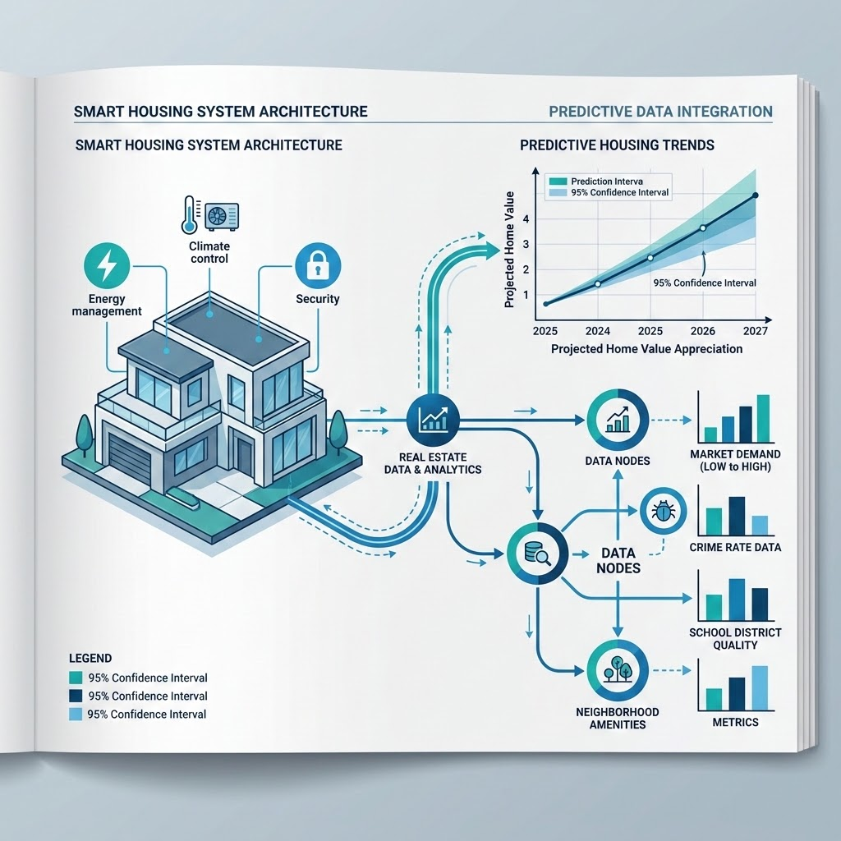
AI/ML - Based House Price Prediction & Property Recommendation System
Successful data preparation lays the groundwork for accurate price predictions and smart property recommendations.
EXPECTED FINAL OUTCOMES
FOUNDATION & ANALYSIS
Project Summary
• We have successfully completed the foundational data preparation and Exploratory Data Analysis phases.
• The dataset is now fully optimized and ready for the intensive machine learning model development phase.
Deployment of a high-accuracy price prediction engine tailored to the Bengaluru real estate market.
Integration of a smart recommendation system that matches users with ideal properties based on their specific constraints and preferences.
Smart Real Estate System Architecture

