Slide 1
AI/ML-Based House Price Prediction
Progress Report 3 — Feature Engineering & Machine Learning Models
1
Team Members
Ravi Patel · IU2341050103
Kenil Patel · IU2341050105
Vishnu Jikadara · IU2341050114
2
Project Guide
Dhwani Hakani Ma'am
Indus Institute of Technology and Engineering
3
Subject & Submission
CE0727 — Software Group Project
Submission: 25 July 2026
This report covers Feature Engineering, Train-Test Split, Feature Scaling, Model Training, and Model Evaluation.

Slide 2
Feature Engineering
We transformed the cleaned dataset (9,688 rows × 8 columns) into a machine learning-ready representation with 190 features. Each step was applied systematically to maximize predictive signal.
Pipeline Steps
Outcome
Input Shape
Drop Unnecessary Columns
9,688 rows × 8 columns (raw cleaned dataset)
Removed availability — not relevant to price prediction.
Output Shape
Group Rare Locations
9,688 rows × 190 columns — fully encoded and ML-ready
811 unique locations → reduced to 183 by grouping entries with ≤10 records as 'other'.
Location Reduction
One-Hot Encoding
811 raw locations → 183 meaningful categories after grouping rare entries
Converted area_type & location into numerical format using pd.get_dummies().
Encoding Method
Binary dummy variables via pd.get_dummies() — no ordinal assumption imposed
Separate Features & Target
X = 189 input features · y = price (target variable).

Slide 3
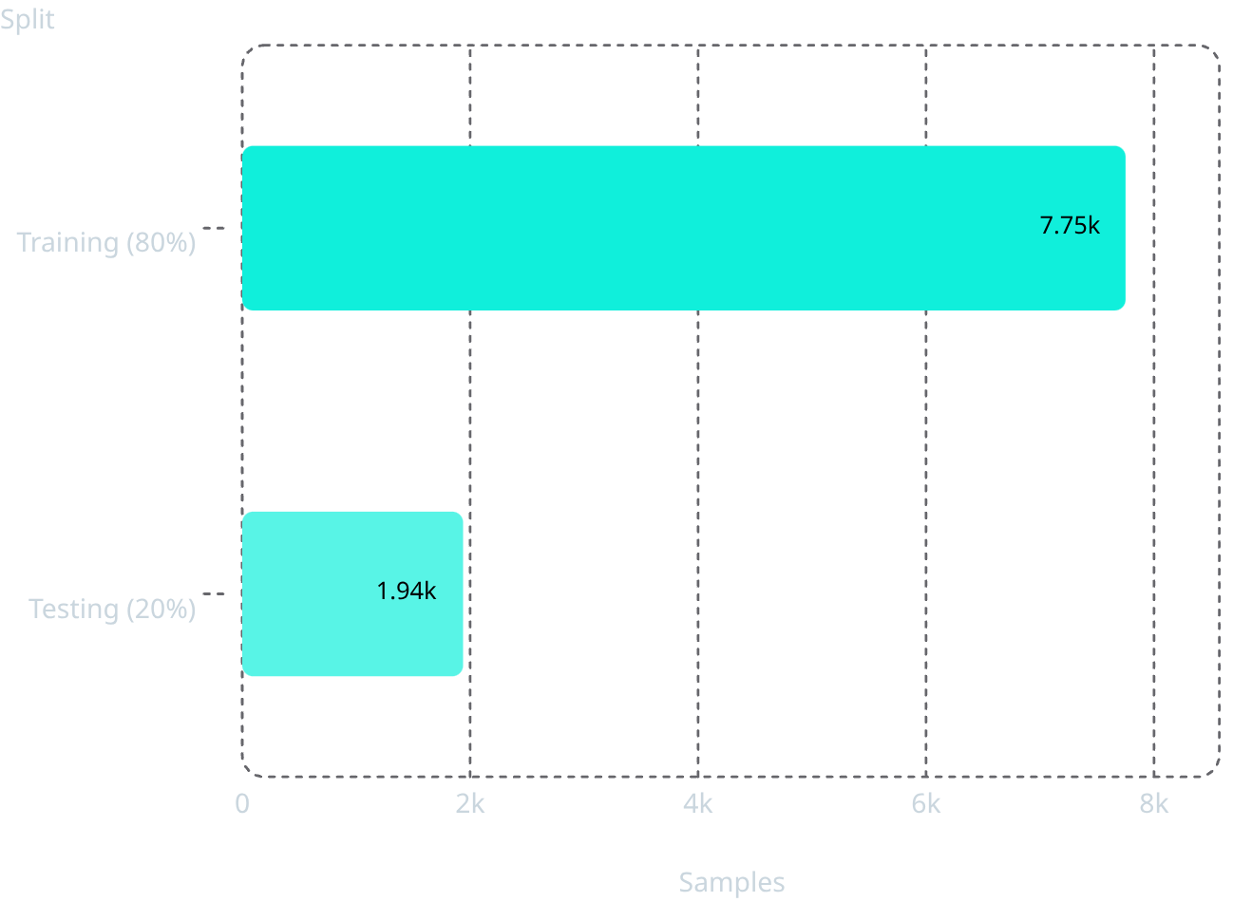

Dataset Preparation
The feature-engineered dataset was divided into training and testing sets to enable rigorous, unbiased model evaluation. Feature scaling was then applied and all artifacts were persisted.
Train / Test Split — Sample Distribution
Feature Scaling & Artifacts
StandardScaler Applied
Normalizes numerical features to zero mean and unit variance — critical for Linear Regression sensitivity to feature magnitudes.
Scaler Persisted
scaler.pkl saved for consistent transformation during real-time inference — prevents training-serving skew.
Datasets Saved
X_train.csv · X_test.csv · y_train.csv · y_test.csv — reproducible splits for future experiments.
The 80/20 split ensures the model learns from a large corpus while being evaluated on completely unseen data, preventing data leakage.
All four saved CSV files share identical random seeds (random_state=42) ensuring full reproducibility across training runs.

Slide 4
Machine Learning Models
Four regression algorithms were implemented and trained on identical X_train / y_train splits, enabling a fair, head-to-head performance comparison.
Linear Regression
Decision Tree Regressor
Baseline model trained on scaled features. Assumes a linear relationship between input features and price. Interpretable coefficients allow feature importance analysis.
Captures non-linear relationships without requiring feature scaling. Configured with random_state=42 for reproducibility. Prone to overfitting on deep trees.
Random Forest Regressor
XGBoost Regressor (Optional)
Ensemble of 100 decision trees (n_estimators=100). Reduces overfitting via bootstrap aggregation and feature randomization. Robust to outliers.
Gradient boosting framework with built-in regularization (L1/L2). High-performance prediction with early stopping capability. Results pending.
All models trained using identical X_train / y_train splits to ensure an unbiased, apples-to-apples performance comparison.

Slide 5
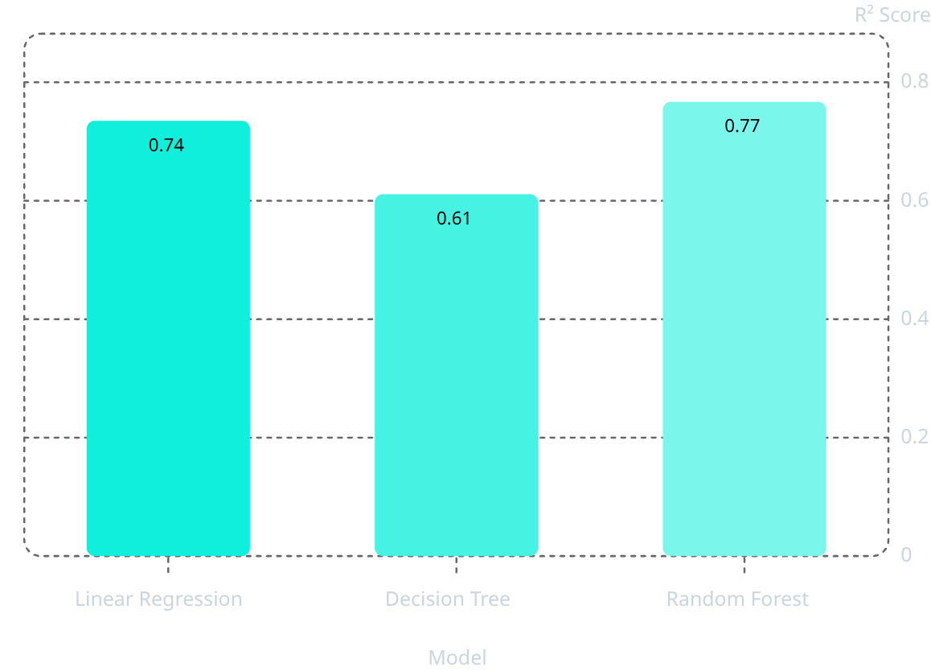

Model Evaluation
Evaluation Metrics Used
Model Comparison Results
R² Score
MAE
Model
R² Score
Verdict
Proportion of variance explained. Higher = better. Range: 0–1.
Mean Absolute Error — average magnitude of prediction errors in price units.
Linear Regression
0.735
Strong baseline
Decision Tree
0.611
Overfitting risk
RMSE
Random Forest
0.767
✅ Best Model
Root Mean Squared Error — penalizes large errors; interpretable in original price units.
✅ Best Model Selected
Scaler Persisted
R² Score Comparison
Random Forest — highest R² (0.767), lowest MAE & RMSE. Saved as best_ml_model.pkl.
scaler.pkl saved alongside the model for deployment-ready inference pipeline.
Random Forest (R² = 0.767) outperforms all other models and is selected as the primary model for the project.

Slide 6

Progress Report 3 — Summary
✅ Completed Tasks
PR3 Deliverables
✅ Feature Engineering & Column Selection
best_ml_model.pkl
scaler.pkl
Trained Random Forest model — deployment-ready
Fitted StandardScaler for inference consistency
✅ One-Hot Encoding (area_type & location)
✅ Feature Scaling (StandardScaler)
Evaluation Results
Engineered Dataset
R², MAE, RMSE comparison across all models
9,688 × 190 feature-encoded dataset (CSV)
✅ Train/Test Split (80% / 20%)
✅ Linear Regression Model
✅ Decision Tree Regressor
38%
✅ Random Forest Regressor
✅ Model Comparison & Best Model Selection
Project Complete
35–40% overall project progress achieved by end of PR3.
✅ Model Saved as best_ml_model.pkl

Slide 7

Next Progress Report (PR4)
Topic: Deep Learning Model — Expected Submission: 08 August 2026 · Expected Progress: 55–60% Completion
Upcoming Work
ANN Architecture (Planned)
Prepare Deep Learning Pipeline
Reformat and normalize data specifically for neural network input layers.
Build ANN (TensorFlow / Keras)
Design an Artificial Neural Network with input, hidden, and output layers for regression.
Hyperparameter Tuning
Expected PR4 Deliverables
Optimize epochs, batch size, and learning rate for best generalization performance.
Trained ANN Model
Performance Comparison Table
Keras model saved in .h5 or SavedModel format for deployment
Compare ANN vs ML Models
ANN vs ML models — R², MAE, RMSE side-by-side with final model recommendation
Benchmark ANN against Random Forest & Linear Regression; select overall best model.

Slide 8

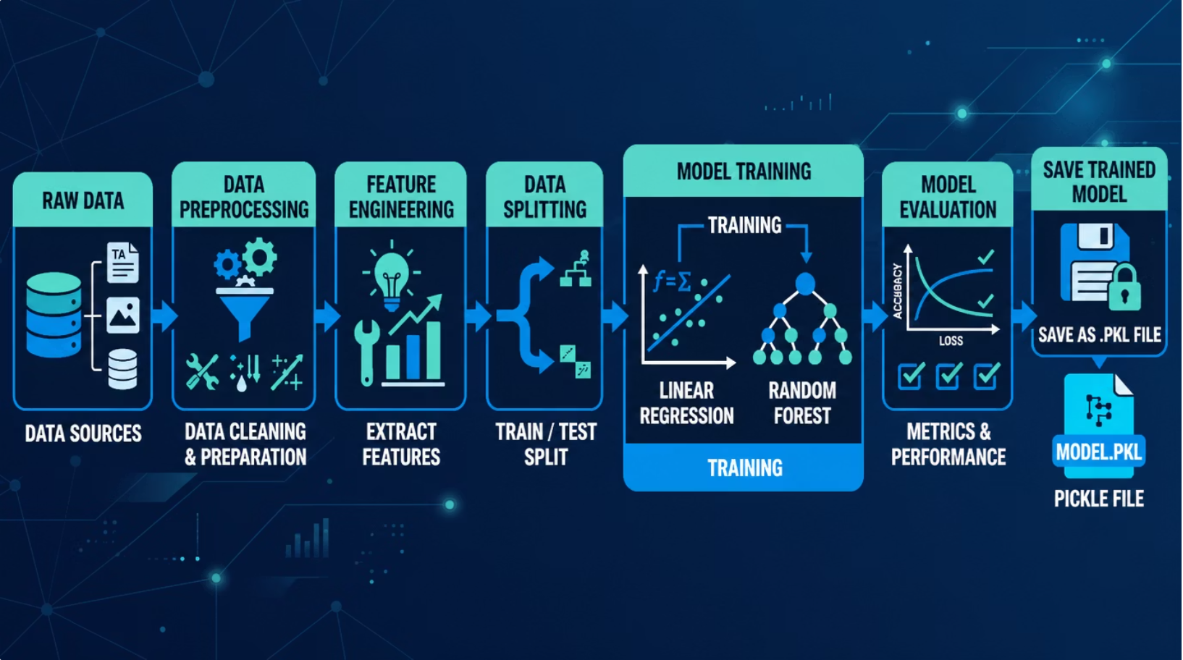
PR3 Technical Roadmap
End-to-end pipeline from raw data to saved ML model — all 8 steps completed in PR3.
Load Data
Feature Eng
Train/Test
Scale
Train
Random Forest (R² = 0.767) emerged as the best-performing model and was persisted as best_ml_model.pkl alongside scaler.pkl for deployment.

