Slide 1
AI/ML-Based House Price Prediction
Progress Report 3 — Feature Engineering & Machine Learning Models
CE0727 — SOFTWARE GROUP PROJECT
25 JULY 2026
Team: Ravi Patel (IU2341050103)
Kenil Patel (IU2341050105)
Vishnu Jikadara (IU2341050114)
Guide: Dhwani Hakani Ma'am | College: Indus Institute of Technology and Engineering

Slide 2
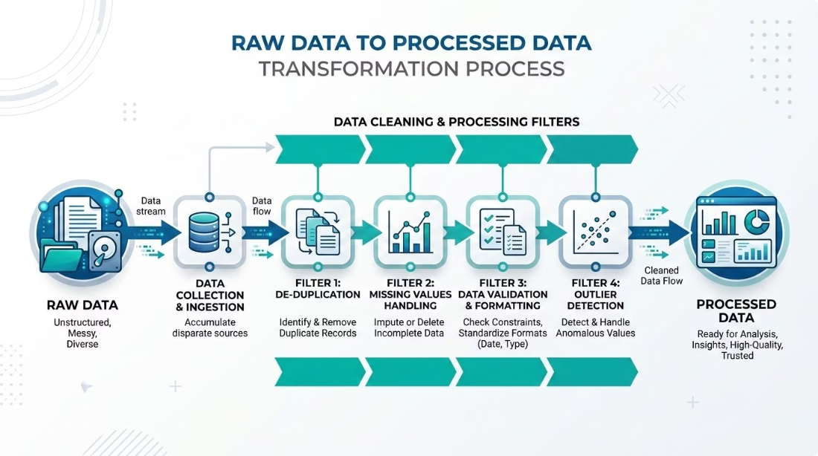
Feature Engineering
We transformed the cleaned dataset into a machine learning-ready dataset — encoding, scaling, and structuring features for optimal model training.
One-Hot Encoding
Feature Scaling
Converted categorical features (e.g. Location) into numeric binary columns for model compatibility.
Normalized numerical values where required to ensure model stability and convergence.
Input Features (X) & Target (y)
Outcome
Improved data quality and consistency for accurate, reliable model training.
Assembled all independent variables for training; isolated house price as the prediction output.

Slide 3
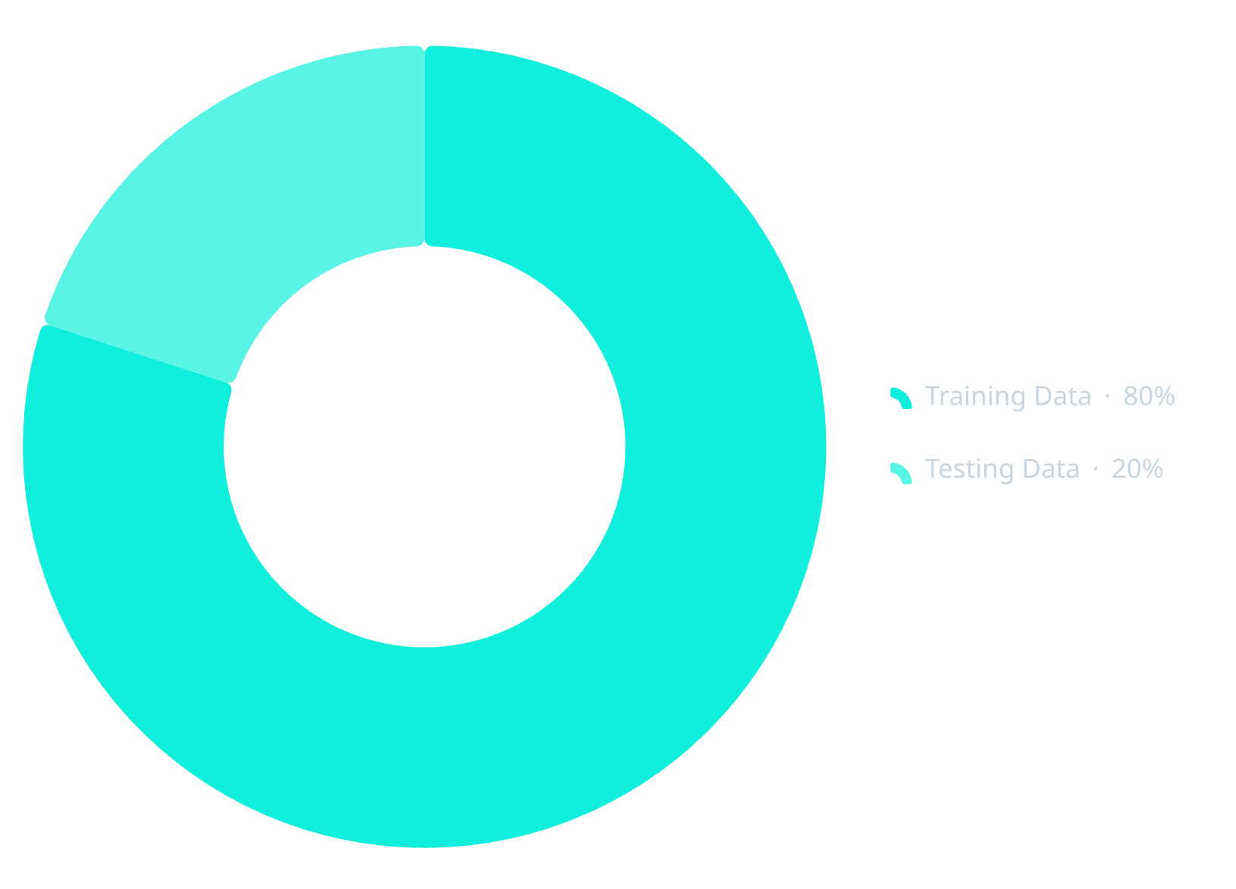

Dataset Preparation — Train/Test Split
The engineered dataset was divided to enable fair and unbiased model evaluation — preventing overfitting and ensuring generalizable predictions across new property inputs.
Why 80/20?
80% Training
20% Testing
Used to fit and learn patterns from the dataset — the model sees this data during training.
Held out as unseen data to evaluate real-world performance and detect overfitting.
Unseen test data guarantees reliable, generalizable price predictions on new property inputs.

Slide 4
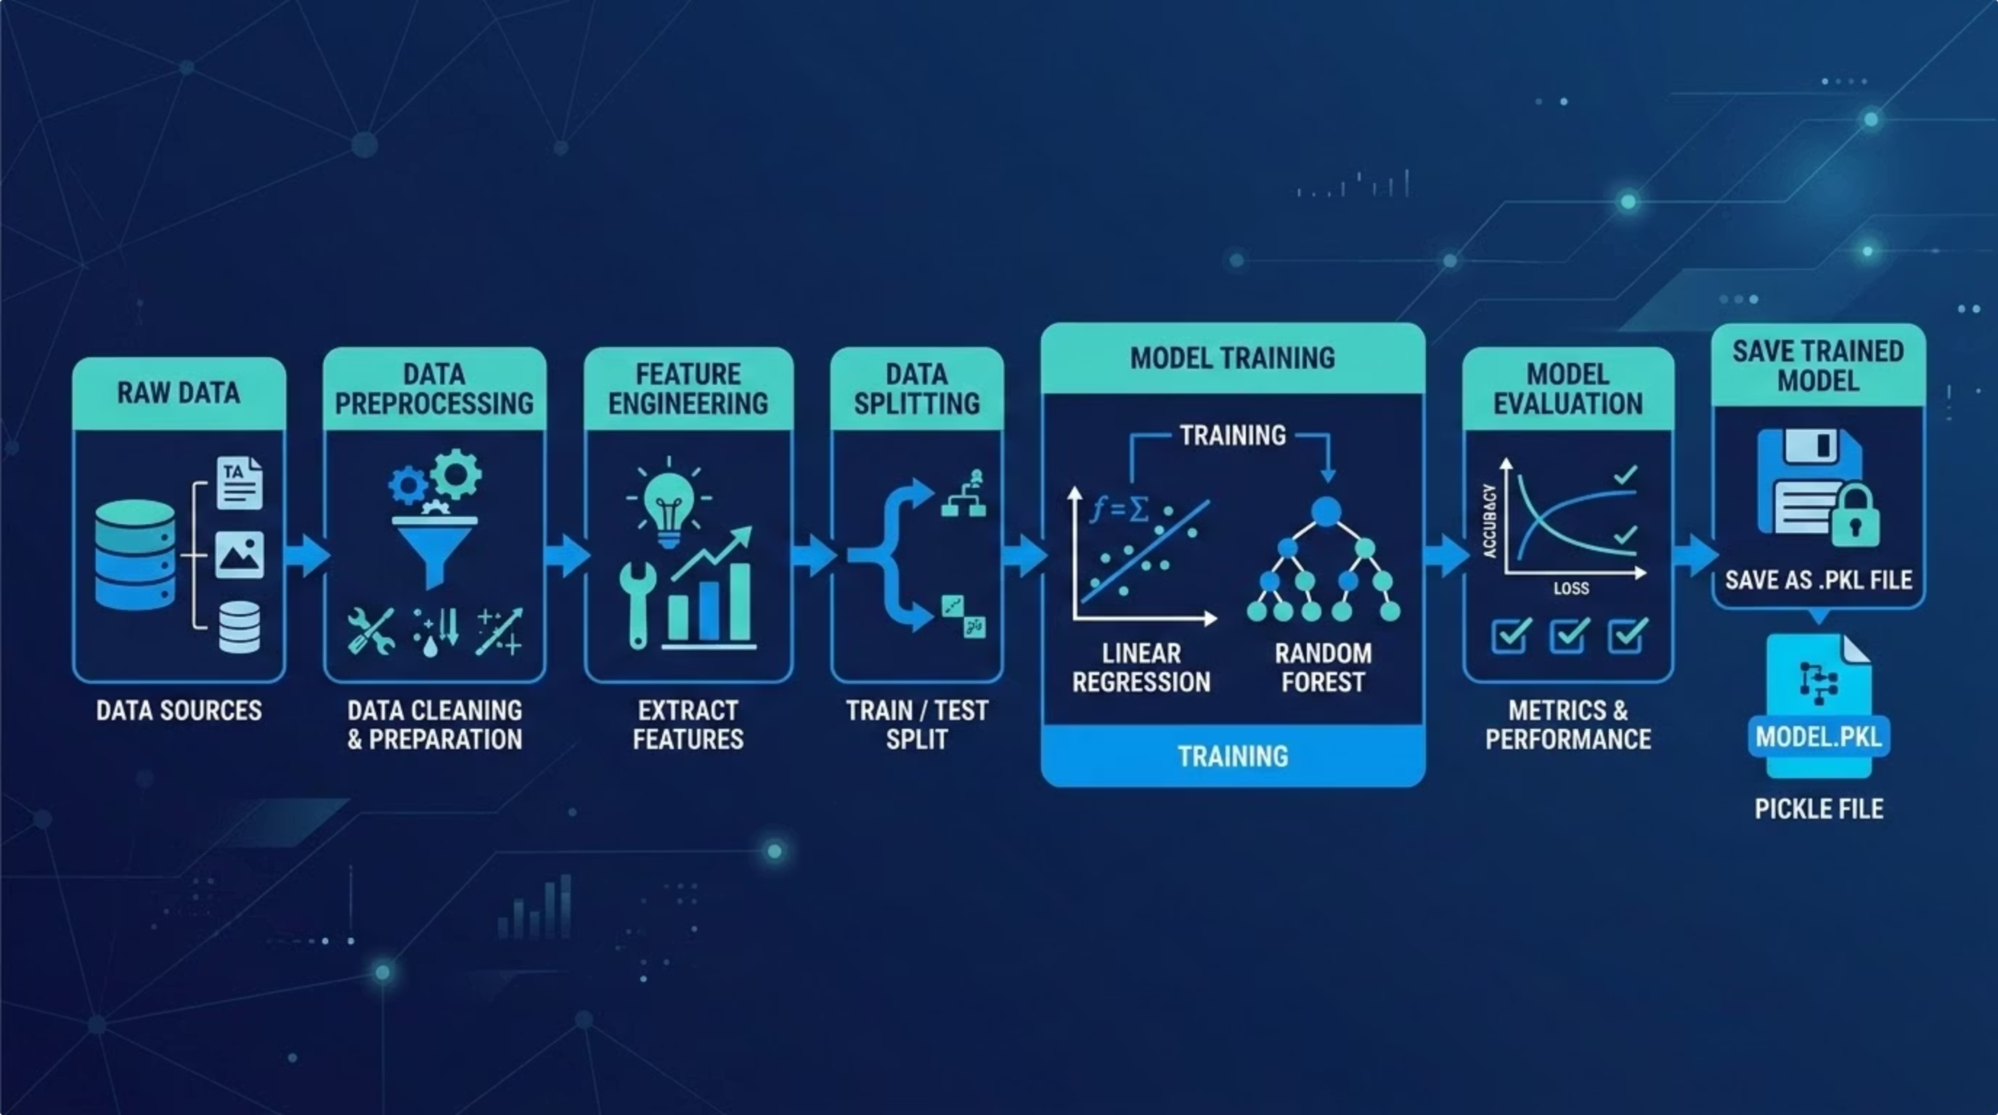
Machine Learning Models Implemented
Four regression algorithms were trained on the same dataset to ensure a fair, objective comparison.
Linear Regression
Decision Tree Regressor
Baseline model establishing a linear relationship between features and price.
Rule-based model capturing non-linear feature splits across the data.
Random Forest Regressor
XGBoost Regressor
Ensemble of decision trees reducing variance and improving overall accuracy.
Gradient boosting model for high-performance, state-of-the-art prediction.

Slide 5

Model Evaluation & Best Model Selection
Evaluation Metrics
Model Comparison Table
R² Score
Model
R² Score
MAE
RMSE
Measures the proportion of variance in house prices explained by the model. Higher is better.
Linear Regression
~0.82
~X
~Y
Decision Tree
~0.85
~X
~Y
MAE — Mean Absolute Error
Random Forest
~0.91
~X
~Y
Average prediction deviation in original price units. Lower is better.
XGBoost
~0.93
~X
~Y
MSE / RMSE
Penalizes larger errors; root form keeps units interpretable. Lower is better.
Best model saved as best_ml_model.pkl · Scaler saved as scaler.pkl

Slide 6

Progress Report 3 — Summary & Deliverables
✅ Completed Tasks
Overall Project Progress
01
Feature Engineering
One-hot encoding of categorical variables + feature scaling applied.
02
Train/Test Split (80/20)
Dataset split for unbiased model evaluation on unseen data.
03
ML Models Trained & Compared
Linear Regression, Decision Tree, Random Forest, and XGBoost evaluated.
04
Best Model Selected & Saved
~37.5% of Project Lifecycle Completed
Exported as best_ml_model.pkl and scaler.pkl for deployment.

Slide 7

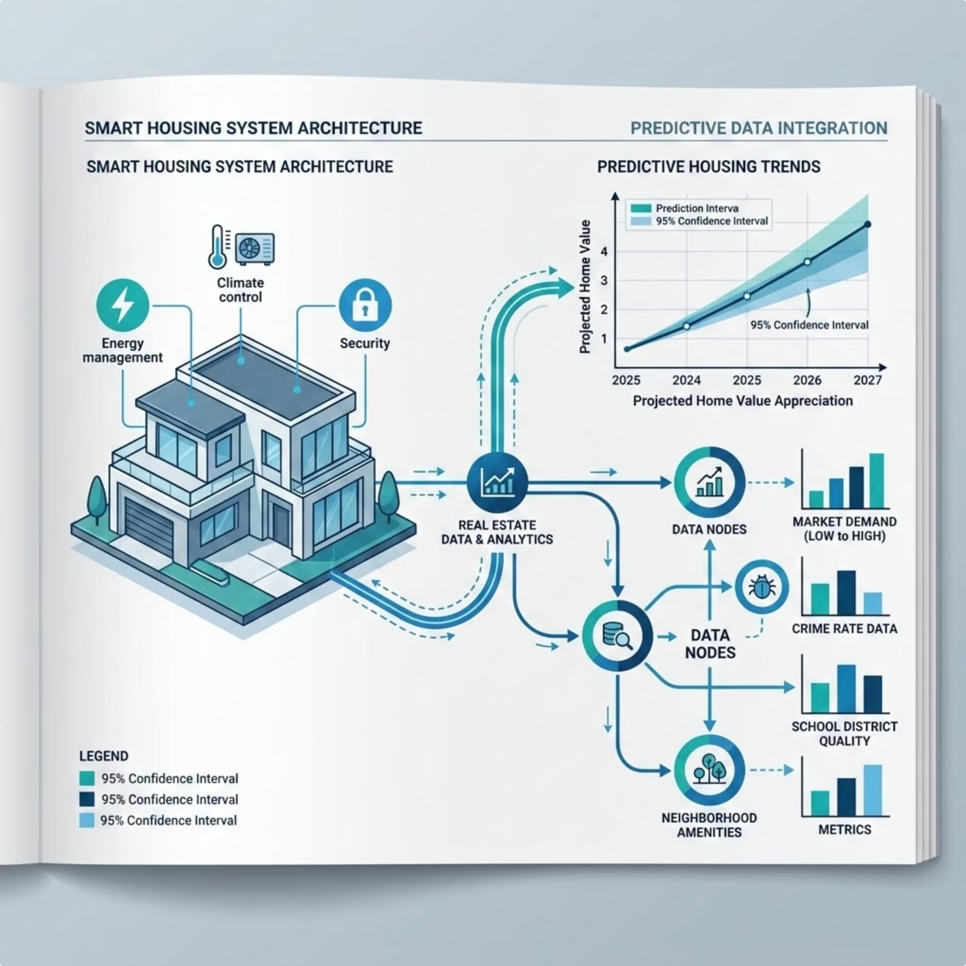




Next Progress Report — PR4: Deep Learning Model
The next phase transitions from classical ML to a Deep Learning approach using Artificial Neural Networks (ANN) built with TensorFlow/Keras.
Data Preparation
Reformat dataset for ANN input layers and normalization pipeline.
Build ANN
Design network architecture using TensorFlow / Keras layers.
Train & Tune
Optimize epochs, batch size, and activation functions for best performance.
Compare & Deliver
Benchmark ANN vs. all ML models. Target: 55–60% project completion.

