Slide 1
AI/ML-Based House Price Prediction
Progress Report 4 — Deep Learning Model
1
Team Members
Ravi Patel · IU2341050103
Kenil Patel · IU2341050105
Vishnu Jikadara · IU2341050114
2
Project Guide
Dhwani Hakani Ma'am
Indus Institute of Technology and Engineering
3
Subject & Submission
CE0727 — Software Group Project
Submission: 8 Aug 2026
This report covers Feature Engineering, Train-Test Split, Feature Scaling, Model Training, and Model Evaluation.

Slide 2
PR4 Objectives & Work Completed
Objectives
Work Completed
Build Artificial Neural Network
Improve prediction accuracy
Prepared dataset for Deep Learning
Designed ANN using TensorFlow/Keras
Trained ANN
Tuned epochs and batch size
Compared ANN with ML models
Selected best-performing model

Slide 3
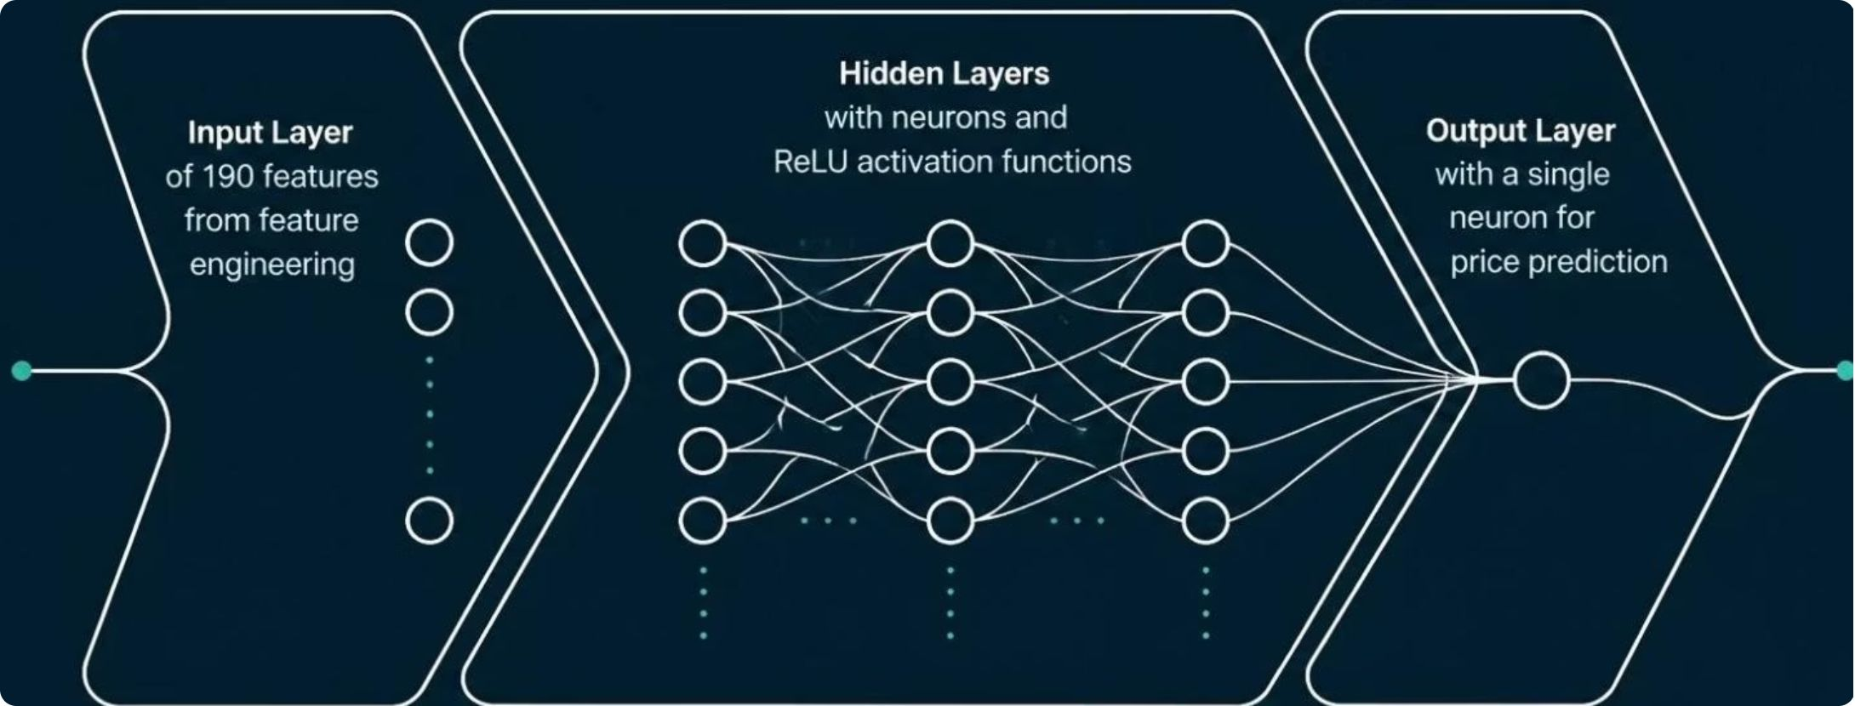
Artificial Neural Network Architecture
Layer Configuration
Input Layer
190 features from feature engineering
Hidden Layers
Multiple neurons with ReLU activation functions
Output Layer
Single neuron for price prediction

Slide 4
Training & Hyperparameter Tuning
Training Configuration
Tuning Results
Optimizer
Loss Function
Epochs
Batch Size
Adam
Mean Squared Error (MSE)
50 → 100 (optimized)
16 → 32 (optimized)
Learning Rate
Early Stopping
Batch Size
Epochs
32
100
0.001 (adaptive)
Enabled to prevent overfitting
Validation Split
20%

Slide 5
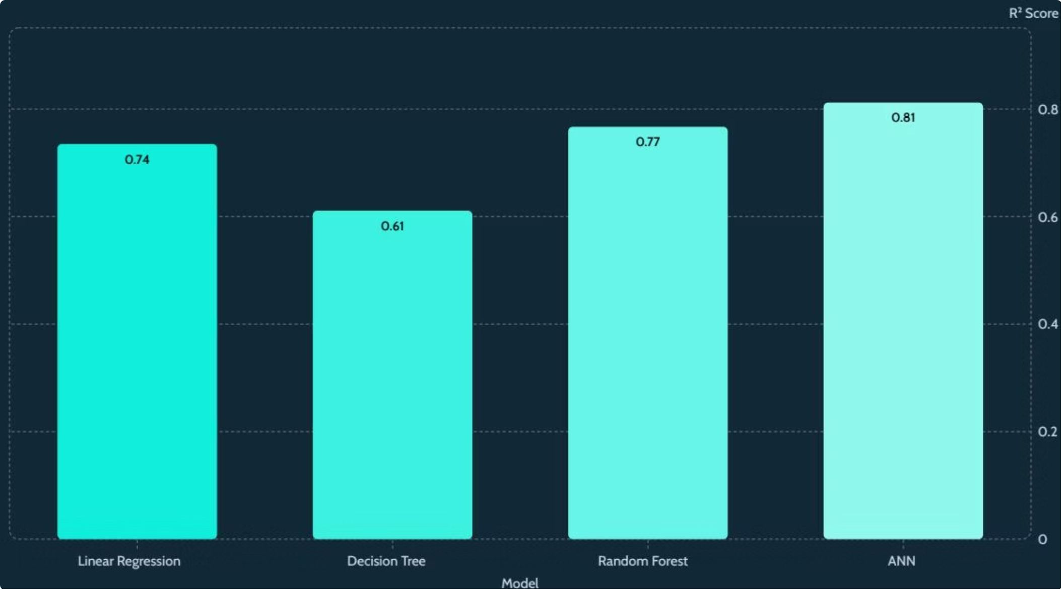
Model Performance Comparison: ANN vs ML Models
R² Score Results
0.81
0.77
ANN
Random Forest
Best performing model
Top ML baseline
0.74
0.61
Linear Regression
Decision Tree
ANN achieved the highest R² score of 0.812, outperforming all traditional ML models.
The deep learning approach successfully captured complex non-linear patterns in the house price data.

Slide 6
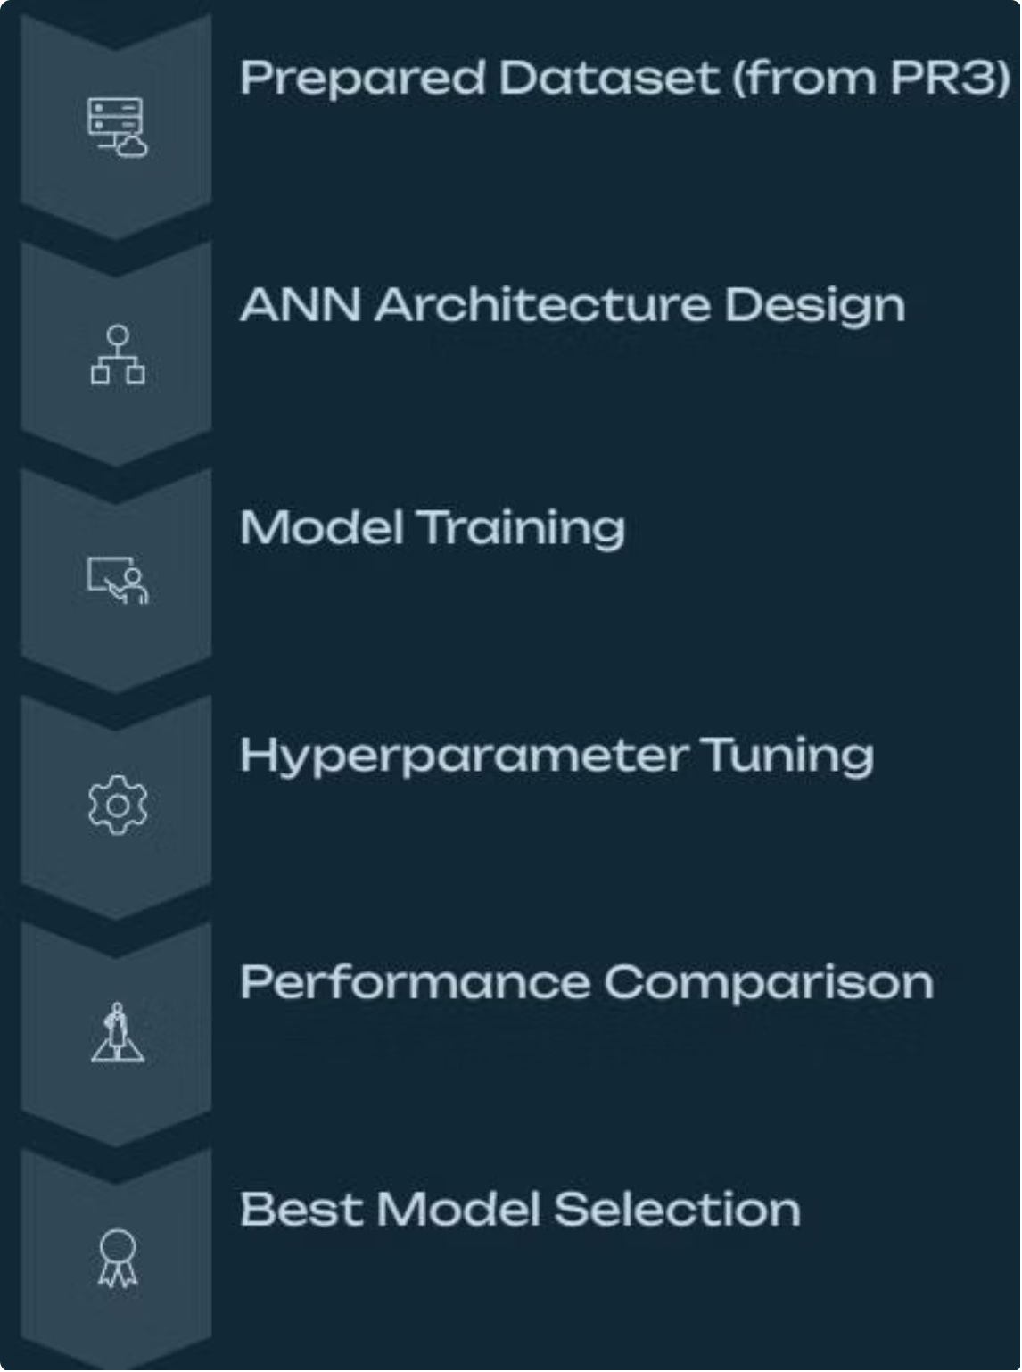
PR4 Methodology: End-to-End Deep Learning Pipeline
01
Prepared Dataset
Carried forward from PR3
02
ANN Architecture Design
Defined layers, neurons, and activations
03
Model Training
Trained on prepared dataset using TensorFlow/Keras
04
Hyperparameter Tuning
Optimized epochs, batch size, and learning rate
05
Performance Comparison
Benchmarked ANN against all ML models
06
Best Model Selection
ANN selected as the final model

Slide 7
Progress Report 4 — Summary
Completed Tasks
Deliverables
✓ Prepared dataset for Deep Learning
Trained ANN Model
Performance Comparison Table
✓ Designed ANN using TensorFlow/Keras
best_ann_model.pkl
ANN vs ML models
✓ Trained ANN model
Model Evaluation Report
✓ Tuned epochs and batch size
Detailed analysis of all models
✓ Compared ANN with ML models
✓ Selected best-performing model (ANN R² = 0.812)

Slide 8

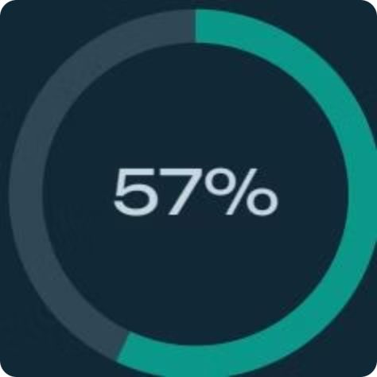
Overall Progress: 55–60% Project Completed
57%
Overall Completion
57% of the overall project has been completed as of Progress Report 4.
PR1–PR3
PR4
PR5+
Data collection, preprocessing & ML models
Deep Learning — ANN model built & evaluated
Flask web application & deployment

Slide 9

Next Progress Report (PR5): Flask Web Application
Upcoming Work
Expected Deliverables
01
Working Local Website
Develop Web Interface
Functional web application for house price prediction
Build HTML pages with CSS styling and user input form
02
Flask Backend Code
Integrate Model with Flask
Python code integrating the trained model
Load trained model and connect ML model with Flask backend
03
HTML/CSS Templates
Prediction Page
Frontend structure and styling
Display house price predictions from user inputs
Expected Progress: 75–80% Completion
04
Local Testing
Verify full end-to-end functionality locally

