Slide 1
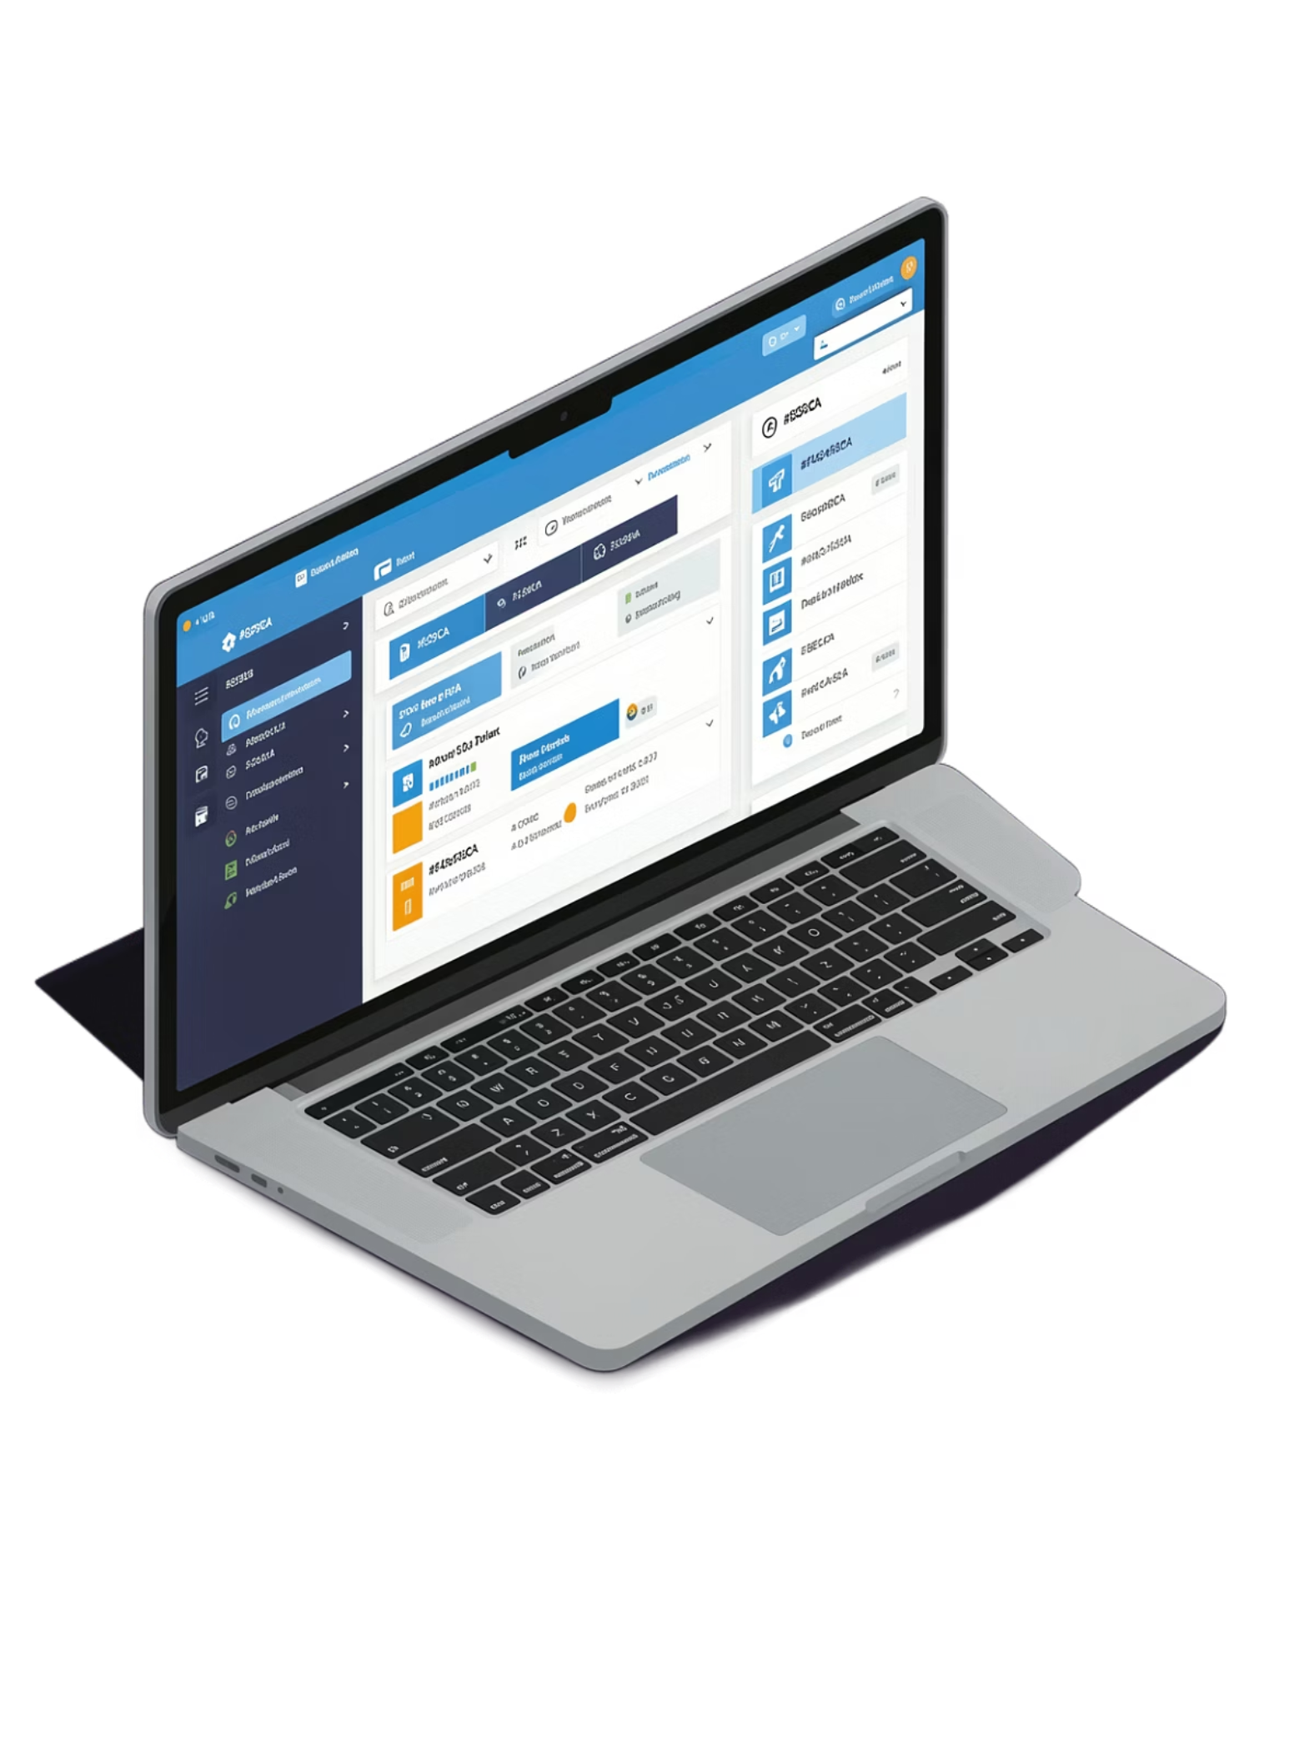
Progress Report 5 — Flask Web Application
Topic: Flask Web Application Development & Local Deployment
CE0727 — SOFTWARE GROUP PROJECT
SUBMISSION: 22 AUGUST 2026

Slide 2

Team Members & Project Details
Project Guide: Dhwani Hakani Ma'am
College: Indus Institute of Technology and Engineering
Subject: CE0727 — Software Group Project
Ravi Patel
Kenil Patel
Vishnu Jikadara
IU2341050103
IU2341050105
IU2341050114

Slide 3
PR5 Objectives & Work Completed
Objectives
Work Completed
Develop responsive web interface with HTML & CSS
Flask project structure setup
HTML form with input fields (sqft, bathrooms, balcony, BHK)
CSS styling for responsive design
Model loading & scaler integration
Feature engineering pipeline in Flask
Prediction logic implementation
Input validation & error messages
Local testing & debugging
Integrate trained ANN model with Flask backend
Create user input form for property details
Display real-time price predictions
Implement input validation & error handling

Slide 4
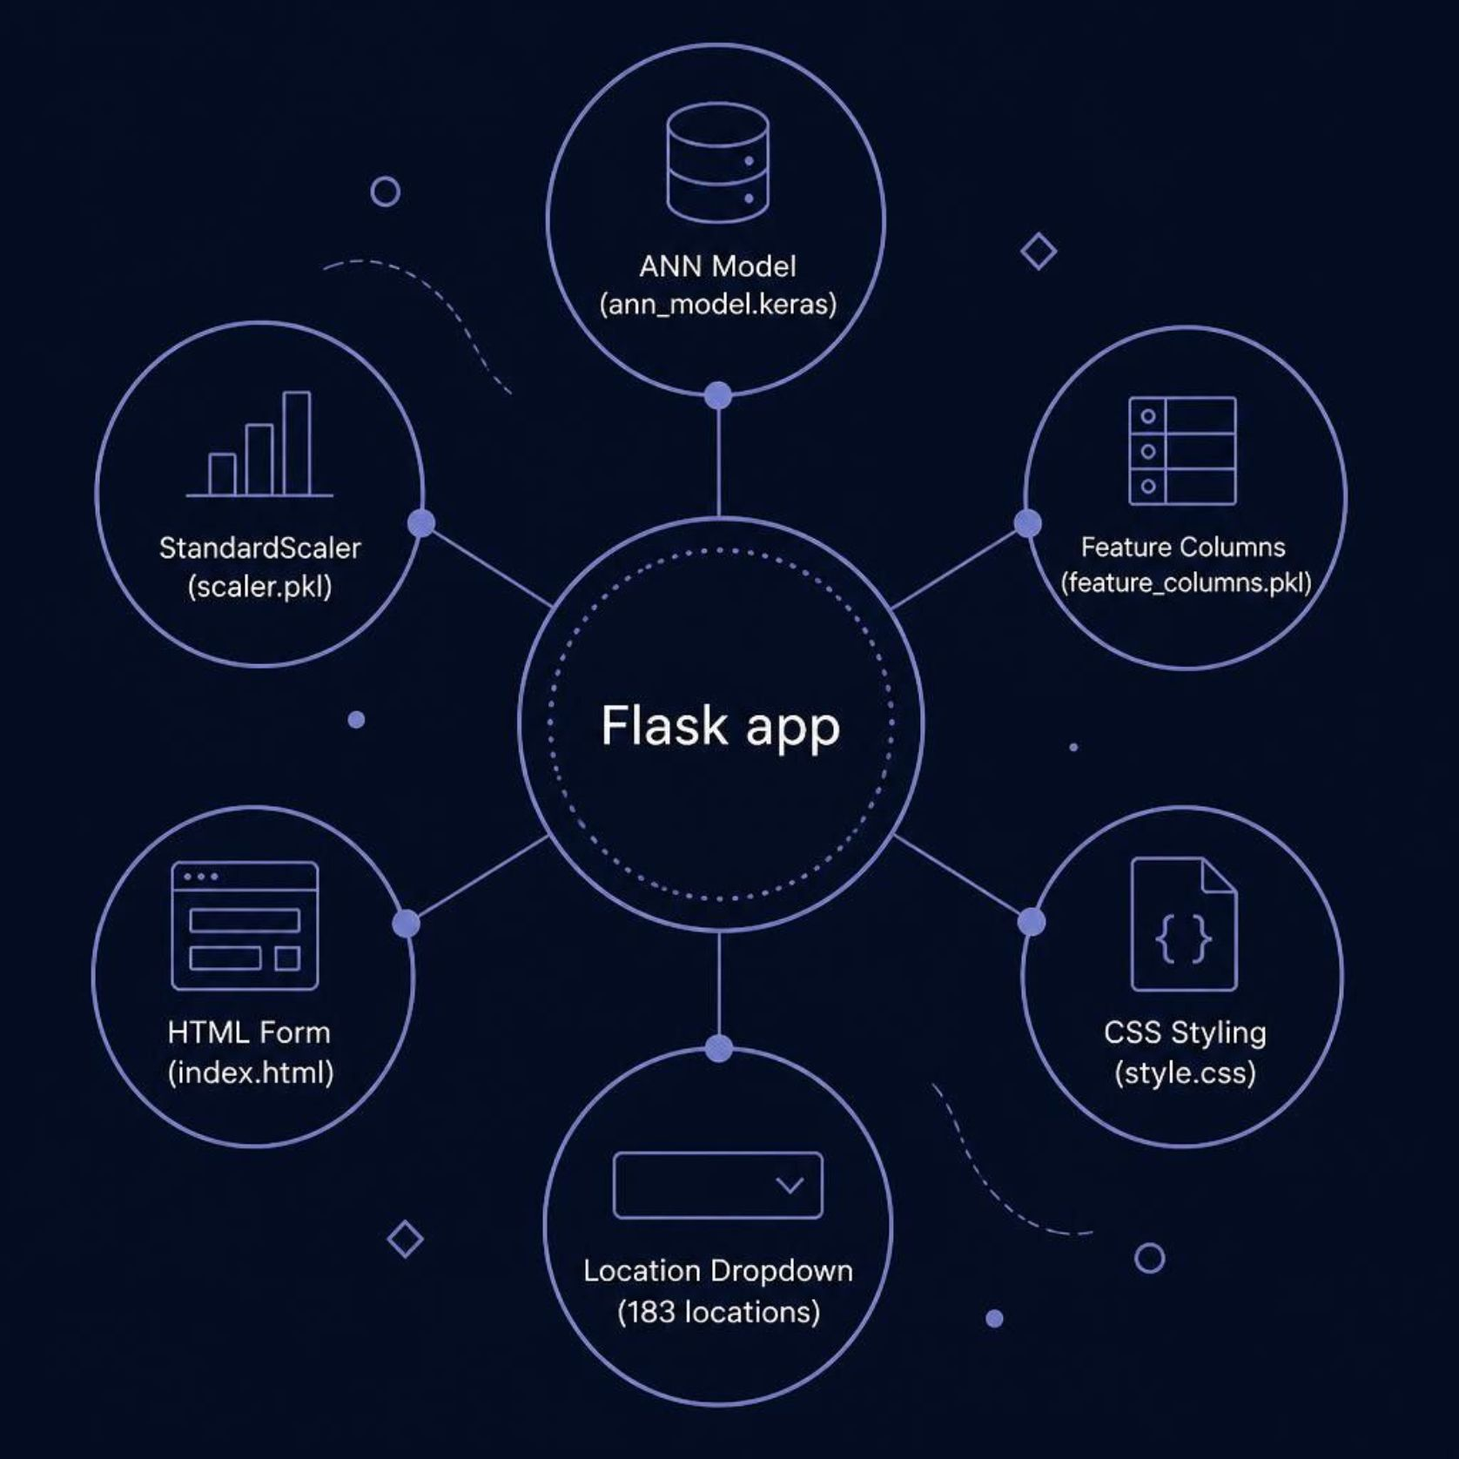
Flask Application Architecture
Backend Components
Model Loading: Load trained ANN model (ann_model.keras)
Scaler Integration: Load StandardScaler (scaler.pkl) for feature normalization
Feature Columns: Load feature list (feature_columns.pkl) for 189-feature input construction
Location Extraction: Parse location columns from feature set for dropdown menu
Frontend Components
HTML Form: Input fields for total_sqft, bath, balcony, bhk
Area Type Selector: Dropdown with Super built-up Area, Built-up Area, Plot Area
Location Search: Datalist with autocomplete for all available locations
Prediction Display: Shows predicted price in Lakhs (₹)

Slide 5
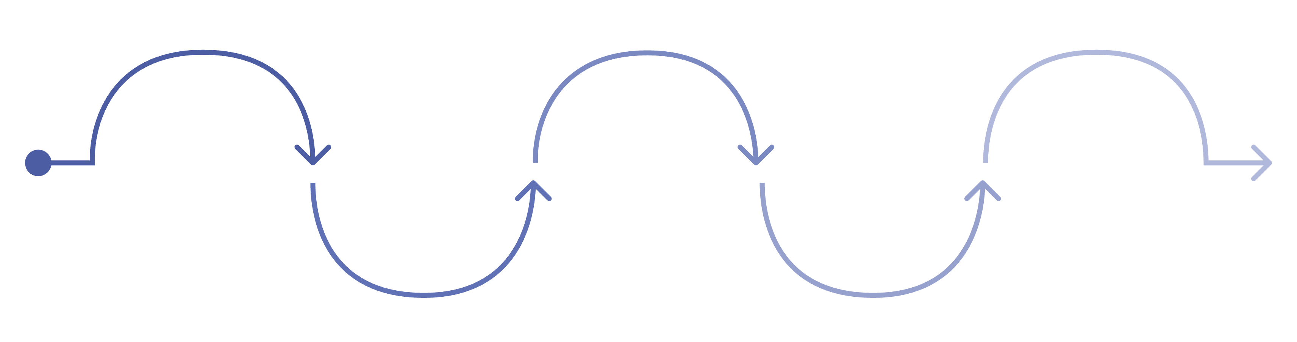
Input Processing Pipeline
User Input
Validation
Feature Vector
Encoding
Numerics
Capture form fields
Check inputs and formats
Area & location one-hot
sqft, bath, balcony, bhk
Build 189-length vector
The nine-step pipeline ensures every user submission is validated, encoded, scaled, and passed through the ANN model to deliver a clean, real-time price prediction displayed directly in the browser.

Slide 6
Code Implementation Highlights
Flask Routes
Key Functions
Model Loading: Load keras model and pickle files on app startup
Location Parsing: Extract unique locations from feature_columns for datalist
Input Validation: Return error message if inputs fail validation checks
Feature Engineering: Dynamically construct 189-feature input vector
Prediction: Call model.predict() with verbose=0 for clean output
GET /
POST /
Render home page with populated location dropdown
Process form submission, validate inputs, generate & return prediction

Slide 7
Deliverables
Working Local Website
Flask Backend — app.py
HTML Templates
Fully functional Flask application running on localhost with end-to-end prediction flow
Model integration, feature engineering pipeline, and prediction logic
index.html with responsive property input form and prediction result display
CSS Styling
Model Integration
style.css with clean, professional, responsive design for desktop and mobile
Trained ANN model connected to web interface via feature pipeline

Slide 8

Testing & Validation
Test Cases & Results
Valid Inputs
Invalid Inputs
Location Autocomplete
Form submission → Correct price prediction displayed ✓
Negative values / zero sqft → Error message shown ✓
All 183 locations searchable via datalist ✓
Area Type Selection
Real-Time Inference
Responsive Design
All three area types functional ✓
ANN model predictions generated on-demand ✓
Works on desktop and mobile browsers ✓

Slide 9
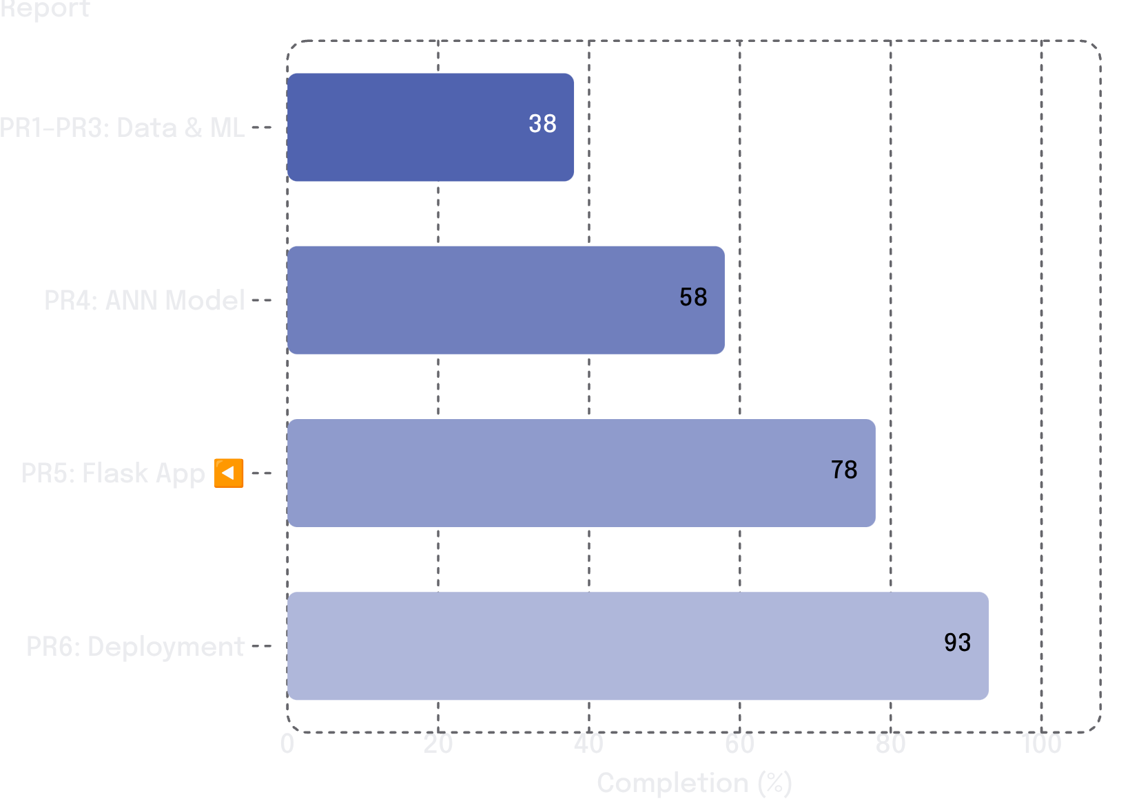
Progress Summary
PR5 Completed Tasks
Overall Project Trajectory
✓ Flask project structure
✓ HTML form with input validation
✓ CSS responsive styling
✓ Model & scaler loading
✓ Feature engineering pipeline
✓ Prediction logic
✓ Error handling
✓ Local testing

Slide 10

Next: PR6 — Deployment & Documentation
Upcoming Work
Expected Deliverables
01
Live website URL (deployed on cloud)
GitHub repository with full source code
README with setup & usage instructions
requirements.txt with all dependencies
Deployment configuration files
Deploy application on Render/Heroku cloud platform
02
Create GitHub repository with complete source code
03
Expected Progress: 90–95% Completion
Expected Submission: 12 September 2026
Write comprehensive README documentation
04
Generate requirements.txt and Procfile for cloud deployment
05
Implement online testing & bug fixes

