Slide 1
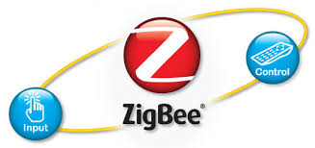
Wireless Status Display on the Classroom
By Jagir Mehta
Ravi Patel
External Guide : Prerna Paliwal
Notes:
4/22/2015
1

Slide 2
Contents
System Overview
System Block Diagram
Software GUI Diagrams
ZigBee as communication media
External Interface
Applications
References
2

Slide 3
System Overview
The overview generally consists of the purpose, objective and benefits of the Wireless status display outside the class room.
To display status of the class room outside it, We will create a stand-by Application that will keep Database of schedule of everyday. This Application will send this data via Zig-bee to the LCD Display which is wired connected to the Development Board.
This system is Beneficial as it manages available projectors, sound system & free class rooms in an efficient way.
This project uses an Arduino Development Board which receives message coming from server via Zig-bee & passes it serially to LCD display Board. And It changes message after some time to follow schedule of whole day.
3

Slide 4
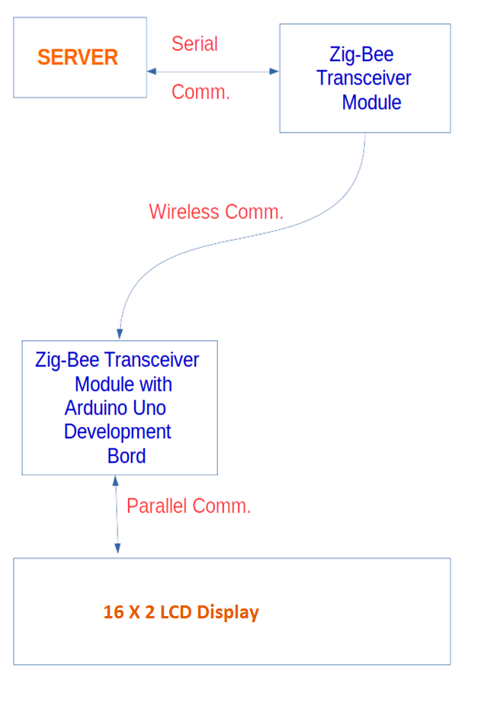
System Block Diagram
4

Slide 5
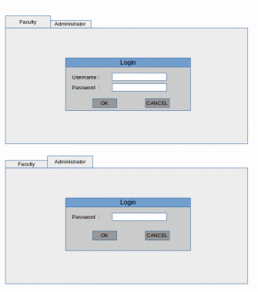
GUI Blocks

Slide 6
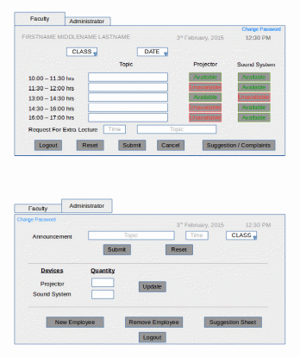

Slide 7
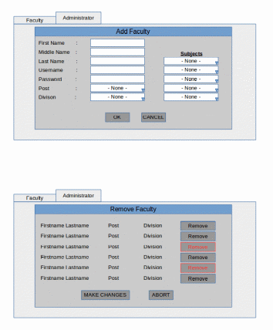

Slide 8

ZigBee as Communication media
What is ZigBee ???
ZigBee is the wireless language that everyday devices use to connect to one another.
ZigBee is a specification for small, low power radios based on IEEE 802.15.4 – 2003 Wireless Personal Area Networks standard.
The main applications for 802.15.4 are aimed at control and monitoring applications.

Slide 9
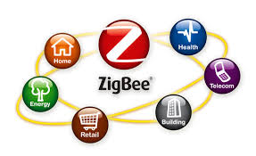
Features of ZigBee
Low cost
Ultra-low power consumption(Key feature)
Cheap and easy installation
Flexible and extendable networks
Integrated intelligence for network set-up and message routing
The three RF bands have different data rates: 20, 40 and 250 kbps (with increasing frequency).
In an open area, a range of over 100 metres can typically be achieved,
In a building, a range of 30 metres can typically be achieved

Slide 10
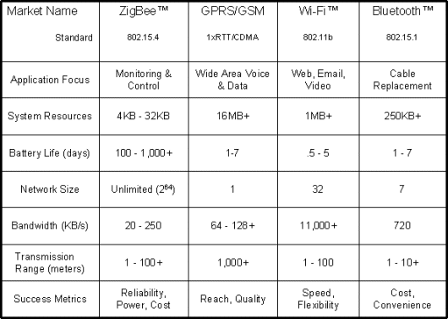
Compression

Slide 11
External User Interface
User Interface:
The user interface will be a stand-by application where the user will be handling the inputs to the Wireless Display. It is here where the allocation of available resources as well as scheduling of display text will happen.
Hardware Interface :
The system has an LCD Display connected to the micro controller which reads and then displays the data transmitted by the Server. The Server has a Zig-Bee module attached with it to communicate with the wireless displays.
The Wireless status display system would be an LCD Display which would show messages to indicate the status e.g. lecture going in the class, availability of the class for another lecture, Date, Time, Announcements etc.
Software Interface:
The Software used will be a C# programmed Windows application capable of running on Windows vista and later.

Slide 12
Scope
This System will be used in various Institutes. In future we will add few more functionality in this project. Likewise Automatic update in schedule, we will put more no of Displays and connect it to a single server & manage the schedule of all displays with a single server.
The cost of implementation includes a onetime cost of Arduino board, Zig-Bee Module and a LCD Display Board.
In future this system can be expand as touch screen display and also two-way display to Display about announcement in-side the class.

Slide 13
Application
Wireless status display is used in any kind of Educational or Industrial firm to show the status of in side closed room without interrupting it.As well as to display announcement to particular class if it required.
This system is also used to manage resources like projectors, sound-system, boards etc.
This system also useful in hospitals to display for occupied devices, to show operation is on- going, to display which doctor is in the operation theater etc.

Slide 14
References
http://www.zigbee.org/what-is-zigbee/
http://www.engineersgarage.com/articles/what-is-zigbee-technology?page=3
http://en.wikipedia.org/wiki/ZigBee
http://www.digi.com/products/wireless-wired-embedded-solutions/zigbee-rf-modules/xctu

Slide 15
THANK YOU...

