Slide 1



LOGNIFY
ONE PLATFORM FOR ALL YOUR OBSERVABILITY NEEDS

Slide 2

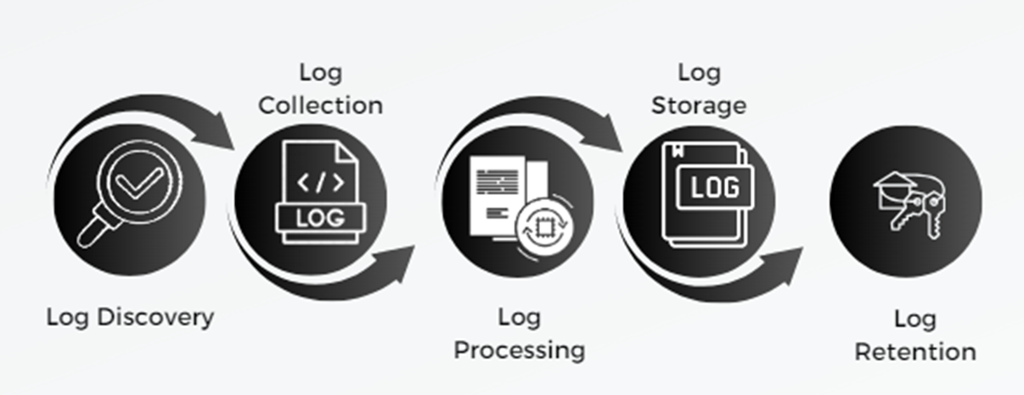
LOG LIFE CYCLE

Slide 3
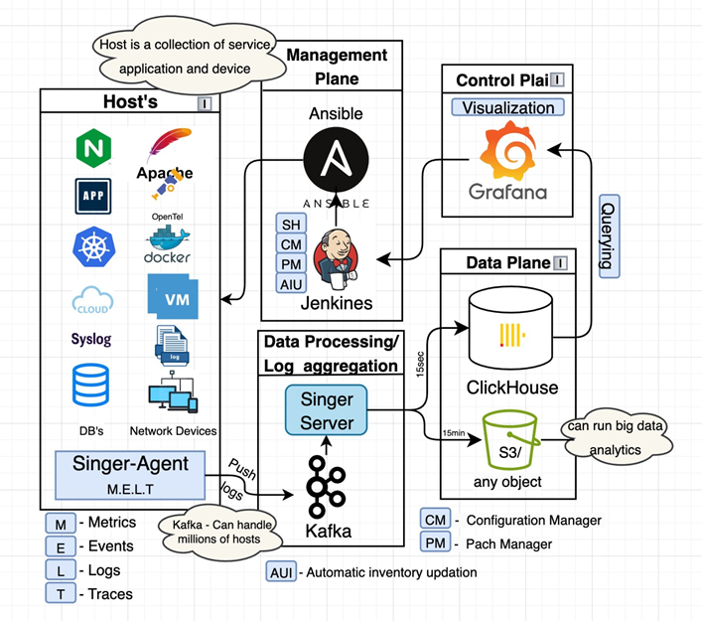
ARCHITECTURE

Slide 4
LIST OF SERVICES
LIST OF SERVICES
Web login
Dashboard
Alerting and notification
Website health check
Ldap/ad-security
Encryption
Singer cron (Task scheduler)

Slide 5
LIST OF SERVICES(Management)
LIST OF SERVICES
Ansible Semaphore
Installation and configuration
Security
Backup and recovery
Resource management
Patch Management
2.Jenkins
Automation of tasks
Updation
Deletion

Slide 6

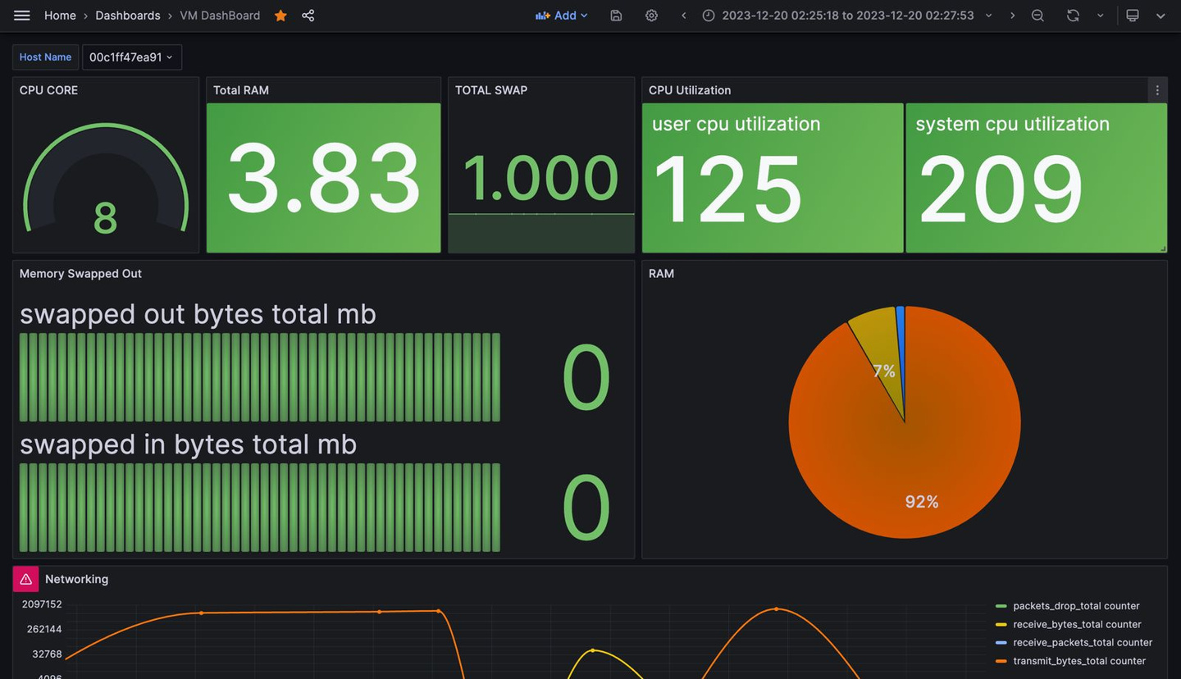
USER INTERFACE
Log metrics are visualized using Graphana.
CPU utilization, total ram and many other features regarding the log data are visualized
GRAPHANA

Slide 7
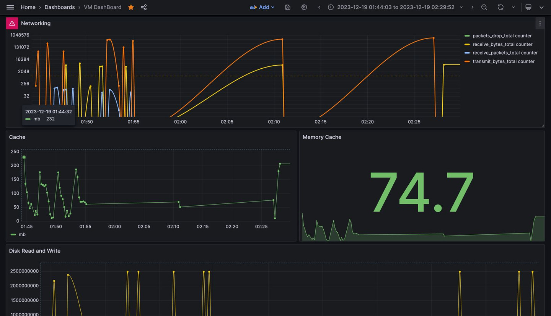
USER INTERFACE
Networking and cache stats are also visible using the graphana interface
GRAPHANA

Slide 8
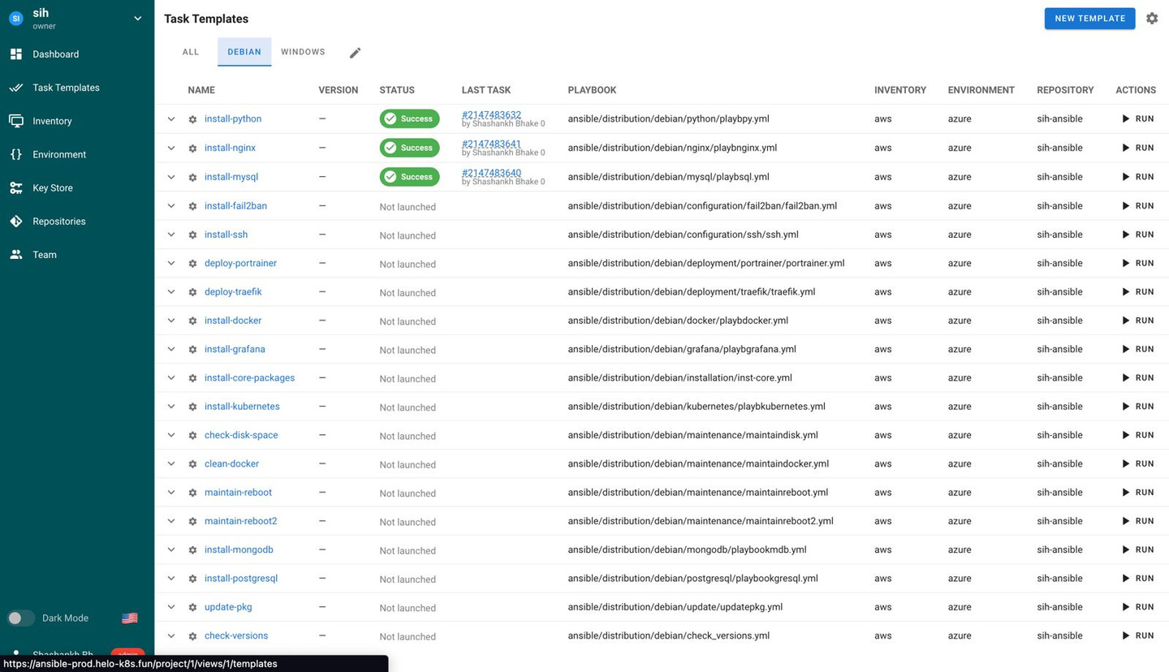
ANSIBLE SEMAPHORE UI
One click server updates .

Slide 9
THANK YOU

