Slide 1

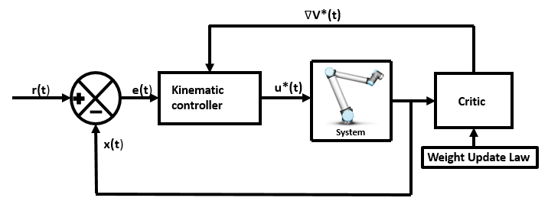
Adaptive Critic Based Optimal Kinematic Control for a Robot Manipulator
Aiswarya Menon and Ravi Prakash
Electrical Department, Indian Institute of Technology Kanpur, India
Laxmidhar Behera
Electrical Department, Indian Institute of Technology Kanpur, India
Optimal kinematic control of robot manipulator following task space trajectory is addressed using SNAC framework.
Critic weight update law proposed ensures convergence to the desired optimal cost analytically.
Stability and performance of the closed loop kinematic control has been guaranteed using Lyapunov approach.
Proposed scheme is validated in simulations and experimentally executed using a real 6DOF UR10 manipulator.
Kinematic control scheme for a robot manipulator using adaptive critic method

