Slide 1
LIBRARY MANAGEMENT SYSTEM
DONE as a part of Python Data Science program by Edyoda.
BY,
CRG {CUBE18}

Slide 2
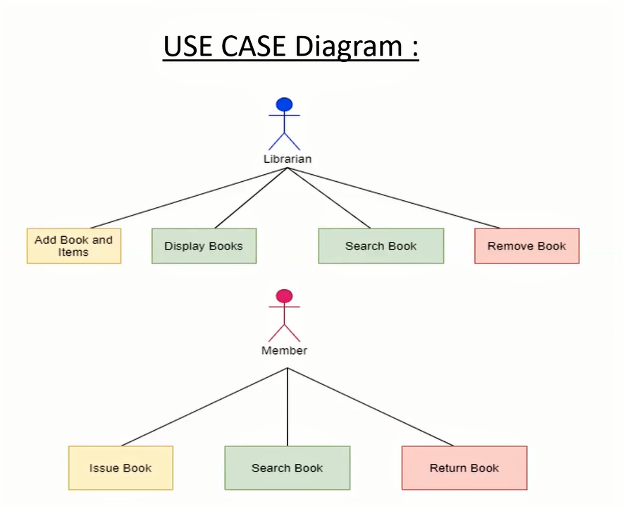
USECASE Diagram

Slide 3
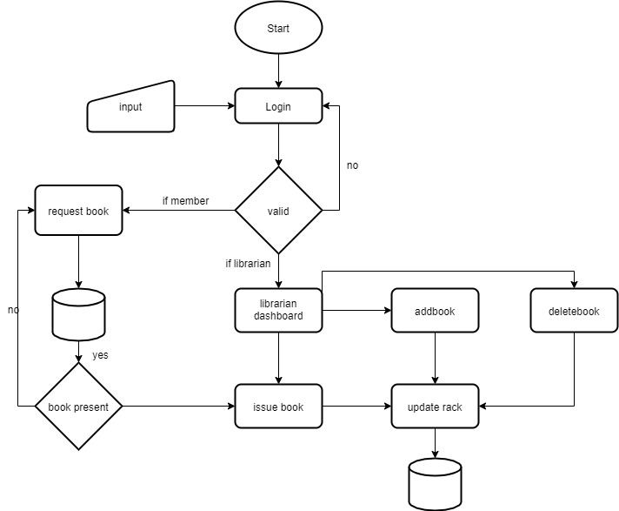
Flow chart

Slide 4
THANK YOU

