Slide 1

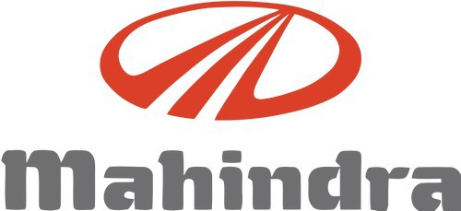
MAHINDRA&MAHINDRA
By- RAVI PRAKASH(2K20/ME/210)
DEEPAK KUMAR(2K20/ME/75)
SUBMITTED TO- Dr. ARCHANA SINGH

Slide 2

Contents
Overview of Company
History
Common size Statements
Trend Analysis
Cashflow Statement.
Ratio Analysis
Swot Analysis
References

Slide 3
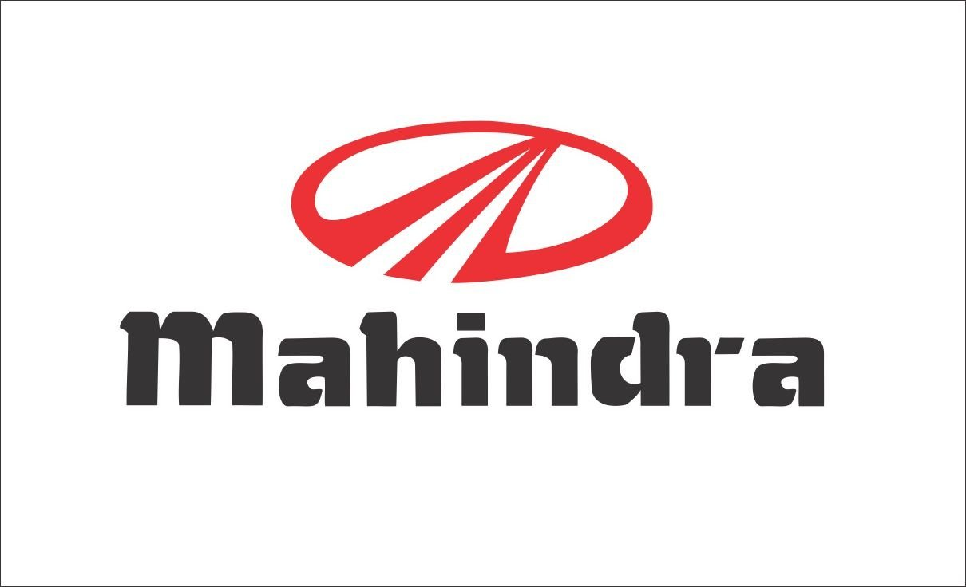
Overview
Mahindra & Mahindra Ltd. is an India-based mobility products and farm solutions provider. The company’s segments include automotive, farm equipment, financial services, real estate, hospitality and others. Automotive segment comprises of sale of automobiles, spares, mobility solutions and construction equipment. Its farm equipment segment comprises of sale of tractors, implements and spares. Financial services segment comprises of offering financial products ranging from retail and other loans, housing finance, mutual funds and insurance broking services. Real estate segment comprises of projects, project management and development, and operating of commercial complexes. Its hospitality segment comprises of sale of timeshare and vacation ownership. Its others segment include after-market, defense and steel trading. It provides taxi service through its subsidiary Meru travel solutions Pvt. Ltd.

Slide 4
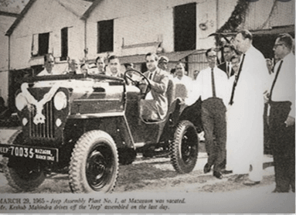
History
Mahindra & Mahindra was founded as a steel trading company on 2 October 1945 in Ludhiana as Mahindra & Muhammed by brothers Kailash Chandra Mahindra and Jagdish Chandra Mahindra along with Malik Ghulam Muhammad (1895-1956). Anand Mahindra, the present Chairman of Mahindra Group, is the grandson of Jagdish Chandra Mahindra. After India gained independence and Pakistan was formed, Muhammad emigrated to Pakistan. He acquired Pakistani citizenship and became the first finance minister of Pakistan. He served as Governor-General of Pakistan from 1951 to 1956.

Slide 5
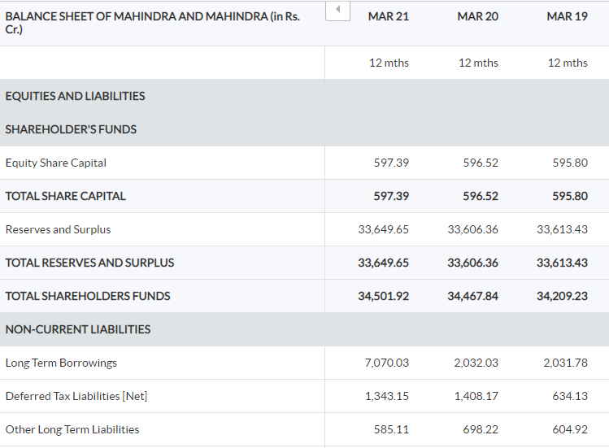
1.Standalone balance sheet

Slide 6
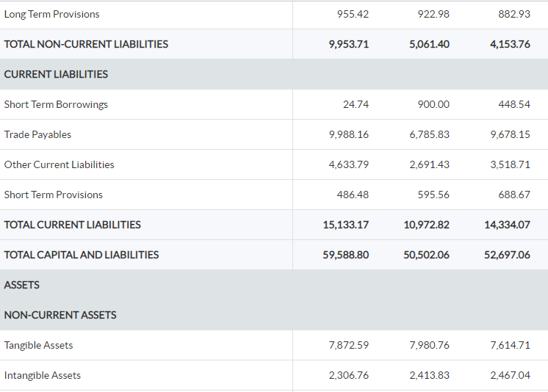

Slide 7
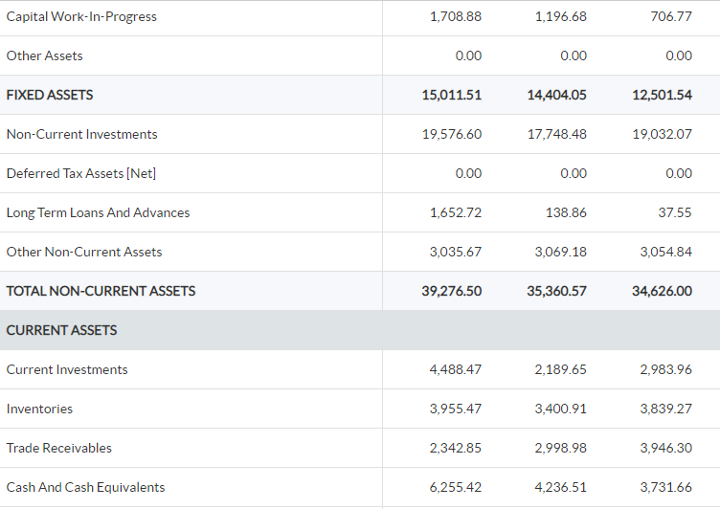
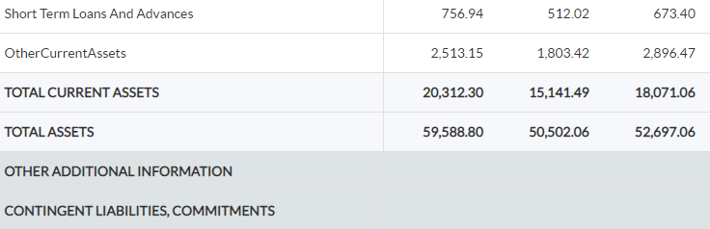

Slide 8
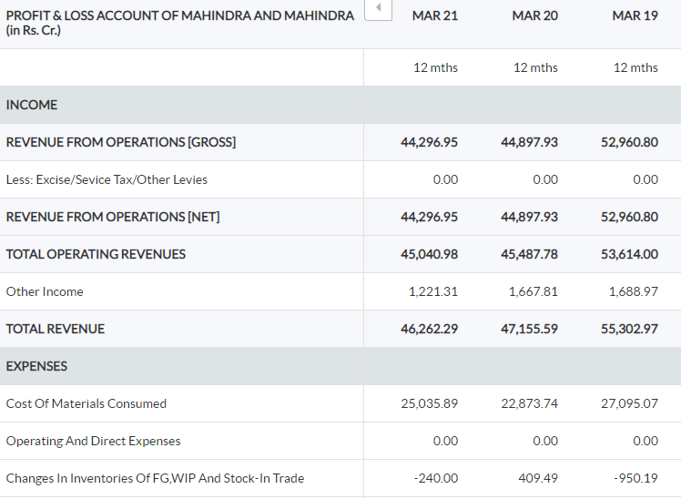
2. Standalone P&L STATEMENT

Slide 9
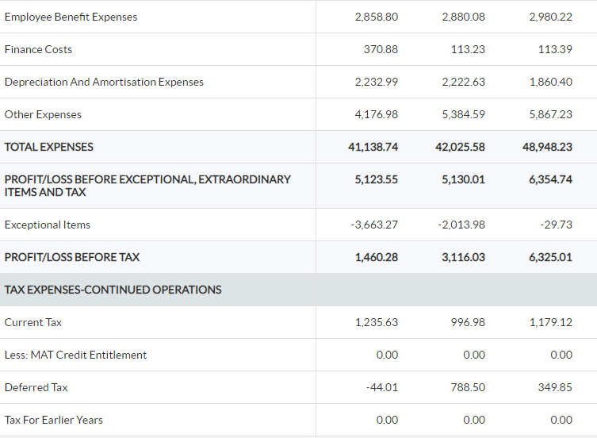
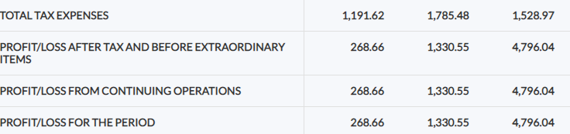

Slide 10
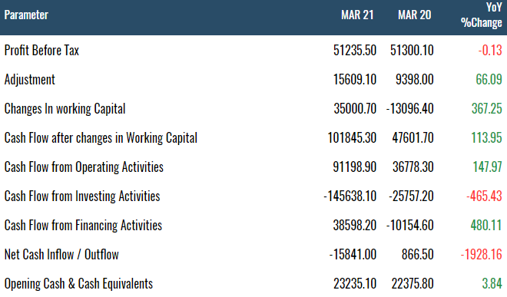
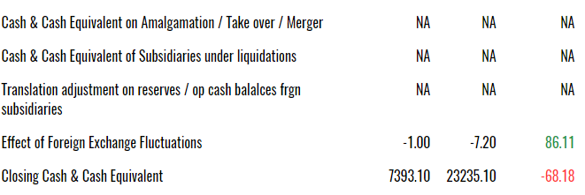
3.Standalone CASHFLOW STATEMENT

Slide 11
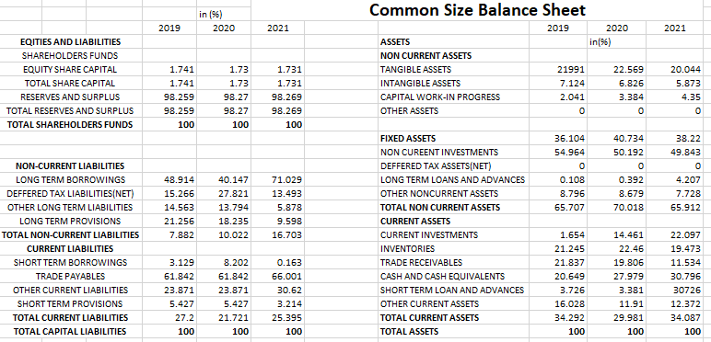
1.Common size Statements

Slide 12
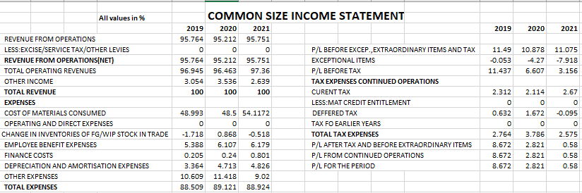

Slide 13
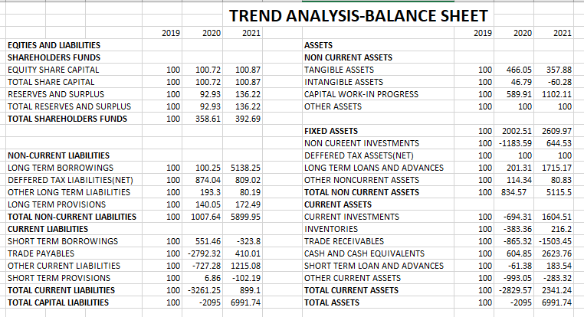
2.Trend Analysis

Slide 14
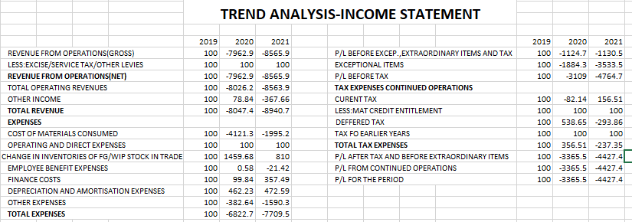

Slide 15
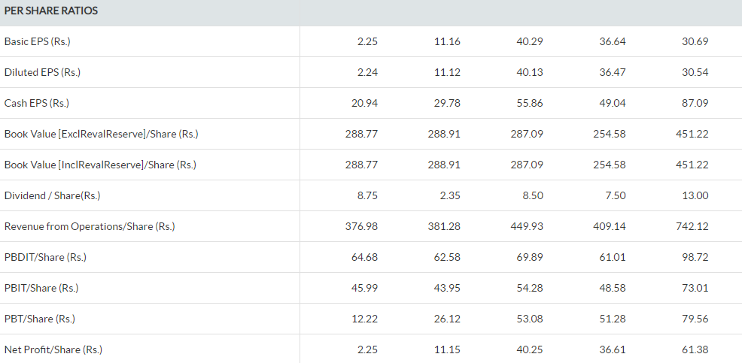
ratios Analysis

Slide 16
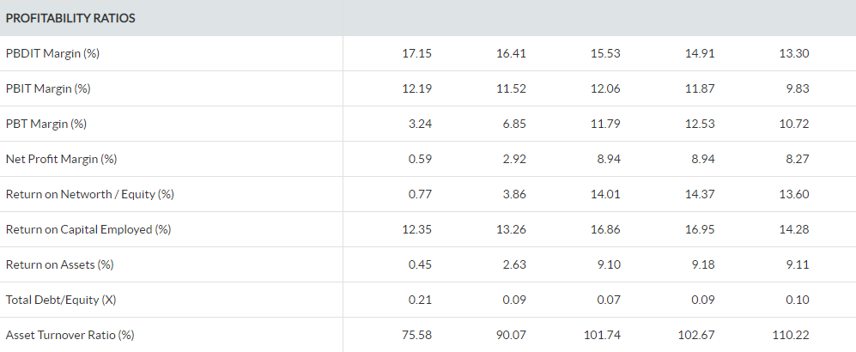
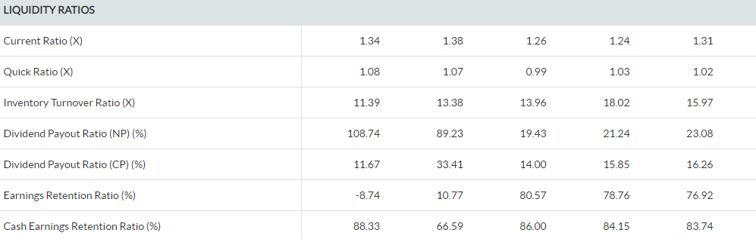

Slide 17
RESULTS-RATIO ANALYSIS
The current ratio of company increased from 1.31 in year ended march 2017 to 1.34 in year ended march 2021, which indicates the ability of the company to generate cash increased and there is only 0.03 units difference in quick ratio between both years.
There is a drastic decrease in return on assets i.e. from 9.11% in year 2017 to 0.45% in the year 2021 which indicates that the company’s total assets have decreased over last 5 years.
There is a decrease in Inventory turnover ratio i.e. from 15.97 In year 2017 to 11.39 in year 2021.
There is a decrease in asset turnover ratio i.e. from 110.22 in year 2017 to 75.58 in year 2021 which indicates that the company used its assets more effectively.
There is an increase in dividend payout ratio from 23.08 in year 2017 to 108.74 in year 2021 which indicates that shareholders are getting good returns on the investments as company’s earnings after tax increased over years.

Slide 18
Swot Analysis
Mahindra and Mahindra Limited is the flagship of the large Mahindra Group which is a conglomerate of over 14 different businesses. M&M is the world’s largest tractor manufacturer and is one of the largest producers of commercial as well as passenger vehicle in India.
Strength in the SWOT Analysis of Mahindra & Mahindra Ltd
Market leader in multiple automotive segments: Mahindra & Mahindra has leading market share in a tractor as well as in the utility vehicles segment. Also, the company has strong market share in the commercial vehicle as well as passenger vehicle segment. Strong market share provides a competitive advantage to the company and allows the company to focus on innovation.

Slide 19
Strong Research & Development (R&D): M&M has a highly focused R&D department constantly focusing on developing new products and technologies. M&M majorly focuses on Value addition and Value engineering (VAVE) approach, designing modularity, use of alternate materials etc.
Excellent products according to Indian road conditions: Mahindra & Mahindra’s SUVs are suited perfectly to Indian road conditions especially, Mahindra Scorpio which has been an outstanding performer for many years.
Low after sale cost: M&M has a competitive advantage on after sale cost since it is lower than the industry average and also have high availability of spare parts to different parts of the country.

Slide 20
Weaknesses in the SWOT Analysis of Mahindra & Mahindra Ltd. :
Geographic dependence: M&M is depended for the majority of its revenue (over 60%) from India, which would affect its business in case of any economic slowdown or high inflation.
Overdependence on Automotive industry: M&M’s major part of revenues come from its automotive business which makes it vulnerable to any breakthrough in the industry or slowdown in the market.
Product Recalls affects brand image: M&M has had to recall many of its products in the recent past. For instance, In February 2015, M&M recalled XUV500 manufactured before July 2014. Such incidents affect the brand image of the company and consequently affect sales.

Slide 21
Opportunities in the SWOT Analysis of Mahindra & Mahindra Ltd.
Growth in Indian automotive industry: The Indian automotive industry is growing year on year with over 12% growth from the previous 3 years. The industry is expected to grow at a CAGR of 13% in the next 4 years. This growth can be beneficial for M&M.
Increasing Demand for Hybrid Electric Vehicles: There is an increasing demand for Hybrid Electric Vehicles (HEVs) around the world. The demand for HEVs is expected to grow at a CAGR of 19% in the next 3 years. M&M has a strong portfolio of HCVs and is set to be benefited by the growing demand.
Emerging nations: M&M should look forward to tapping the emerging nations around the world which have high potential. M&M should build over its global footprint to tap the emerging markets.

Slide 22
Threats in the SWOT Analysis of Mahindra & Mahindra Ltd.
Competition in the automotive industry: M&M faces intense competition from various automotive companies such as Tata Motors, Ford, Volvo and General Motors etc. This can affect M&M’s market share and put pressure to constantly innovate on M&M.
Competition in other businesses put pressure on M&M: Mahindra group faces strong competition in other businesses as well. For example, its IT business faces competition from IT giants such as Infosys. This reduces market share and increases competitive pressure.

Slide 23
References
https://www.moneycontrol.com/financials/mahindramahindra/balance-sheetVI/MM
https://www.moneycontrol.com/financials/mahindramahindra/profit-lossVI/MM
https://www.financialexpress.com/market/stock-market/mahindra-mahindra-ltd-stock-price/financials-cash-flow/

Slide 24
THANK YOU!

