Slide 1

OBJECTIVE
To contribute to the success of a business by utilizing data analysis techniques, specifically focusing on time series analysis, to provide valuable insights and accurate sales forecasting.

Slide 2
DESCRIPTION
The objective can be broken into the following detailed components:
Dashboard Creation: Identify the KPI’s, design an intuitive and visually appealing dashboard, add interactive visualizations and filtering capabilities to allow users to explore the data at various levels of granularity.
Data Analysis : Provide valuable insights to business entities regarding the effectiveness of their sales strategies through visualization and charts.
Sales Forecasting : Leverage historic data and apply time series analysis to generate sales forecasts for next 15 days.
Actionable Insights and Recommendation: End goal is to share valuable insights and actionable information that can drive strategic decision-making and support the supermarket’s goals for growth, efficiency, and customer satisfaction.

Slide 3
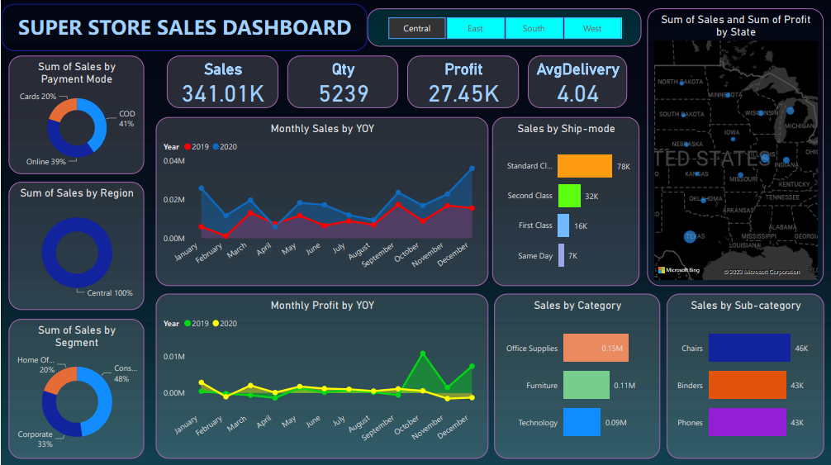

Slide 4
INSIGHTS
Incorporated data analysis techniques, specializing in time series analysis, to deliver valuable insights, accurate sales forecasting, and interactive dashboard creation, driving business success.

