Slide 1
Hijacking Web 2.0 Sites with SSLstrip and Slowloris
Hands-on Training
Sam Bowne and RSnake

Slide 2
Contact
Sam Bowne
Computer Networking and Information Technology
City College San Francisco
Email: sbowne@ccsf.edu
Web: samsclass.info

Slide 3
Two Attacks
sslstrip – Steals passwords from mixed-mode Web login pages
Slowloris – Denial of Service – Stops Apache Web servers

Slide 4
sslstrip

Slide 5
The 15 Most Popular Web 2.0 Sites
1. YouTube HTTPS
2. Wikipedia HTTP
3. Craigslist HTTPS
4. Photobucket HTTP
5. Flickr HTTPS
6. WordPress MIXED
7. Twitter MIXED
8. IMDB HTTPS

Slide 6
The 15 Most Popular Web 2.0 Sites
9. Digg HTTP
10. eHow HTTPS
11. TypePad HTTPS
12. topix HTTP
13. LiveJournal Obfuscated HTTP
14. deviantART MIXED
15. Technorati HTTPS
  From http://www.ebizmba.com/articles/user-generated-content

Slide 7
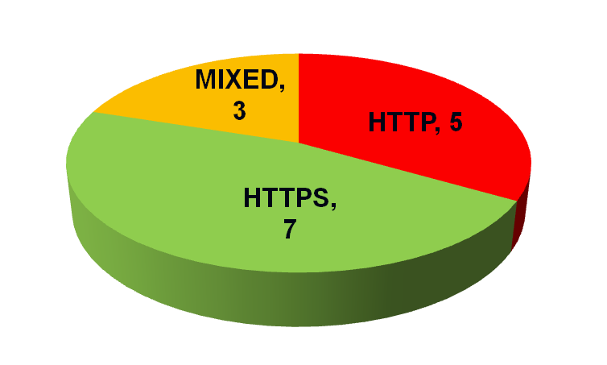
Password Stealing
Medium
ssltrip
Easy
Wall of Sheep
Hard
Spoofing Certificates

Slide 8
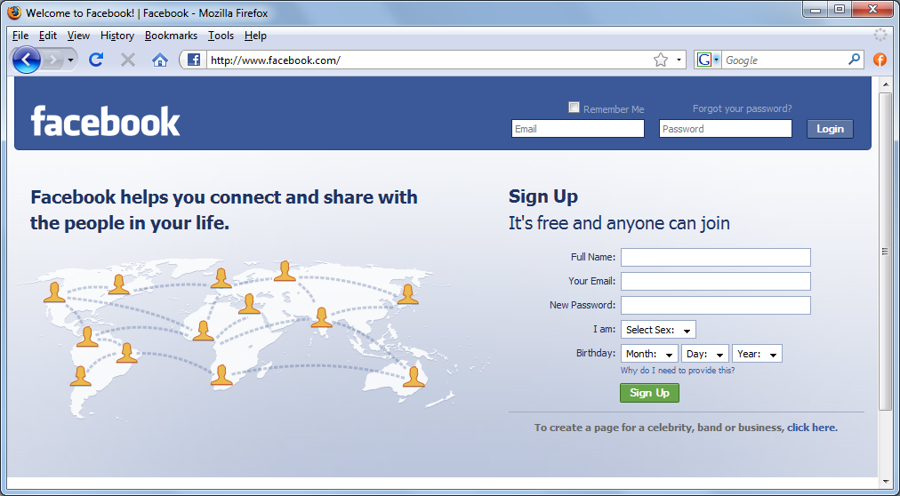
Mixed Mode
HTTP Page with an HTTPS Logon Button

Slide 9


sslstrip Proxy Changes HTTPS to HTTP
To Internet
HTTPS
Attacker:
sslstrip Proxy
in the
Middle
HTTP
Target
Using
Facebook

Slide 10
Ways to Get in the Middle

Slide 11
Physical Insertion in a Wired Network
To Internet
Attacker
Target

Slide 12
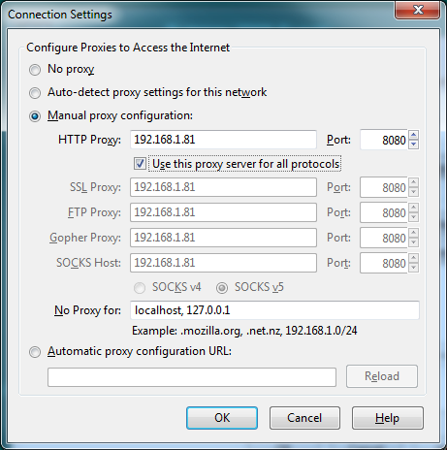
Configuring Proxy Server in the Browser

Slide 13
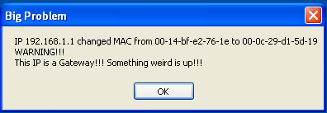
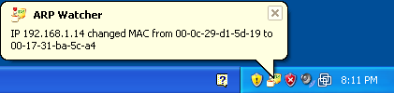
ARP Poisoning
Redirects Traffic at Layer 2
Sends a lot of false ARP packets on the LAN
Can be easily detected
DeCaffienateID by IronGeek
  http://k78.sl.pt

Slide 14
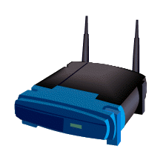
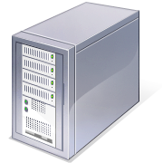
ARP Request and Reply
Client wants to find Gateway
ARP Request: Who has 192.168.2.1?
ARP Reply:
  MAC: 00-30-bd-02-ed-7b has 192.168.2.1
ARP Request
ARP Reply
Client
Gateway
Facebook.com

Slide 15
ARP Poisoning
Attacker
ARP Replies: I am the Gateway
Forwarded & Altered Traffic
Traffic to Facebook
Client
Gateway
Facebook.com

Slide 16
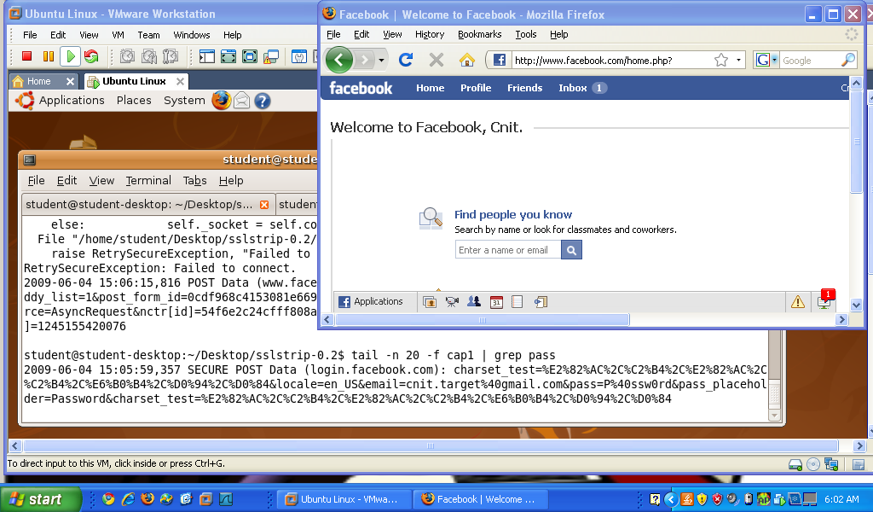
Demonstration

Slide 17
slowloris

Slide 18
OSI Model
OSI Model | DoS Attack
7 Application | Slowloris – Incomplete HTTP Requests
6 Presentation
5 Session
4 Transport | SYN Flood – Incomplete TCP Handshakes
3 Network
2 Data Link
1 Physical | Cut a cable

Slide 19
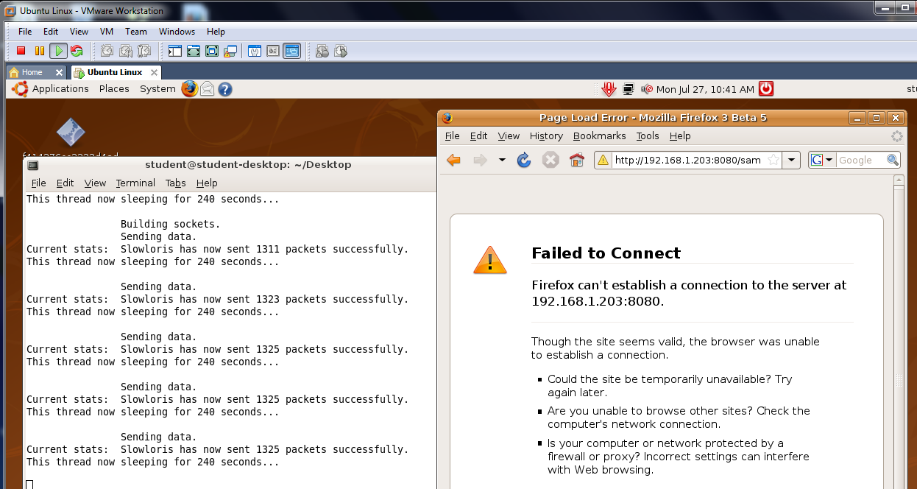
Demonstration

Slide 20
Do it Yourself
You need a laptop with
  Windows host OS
  VMware Player or Workstation
  Linux Virtual Machine (available on the USB Hard Drives in the room)
Instructions available at
  http://samsclass.info/defcon.html

