Slide 1
Aetna System Design Problem
RaviRaj Mulasa

Slide 2
Problem
Design a Live Chat Support System for Digital Members. The system will allow members and potential customers to interact with a chatbot for common inquiries and escalate to live agents for more complex issues. The goal is to provide efficient customer support while ensuring a seamless experience for users.
Use any cloud provider of choice, recommended to use AWS stack.

Slide 3
Before we proceed
If Images are too small in the Slide to view/interpret, I have included all Images as SVG in the Zip.
Please check the respective image in case the graphic is not clear or difficult to view.

Slide 4
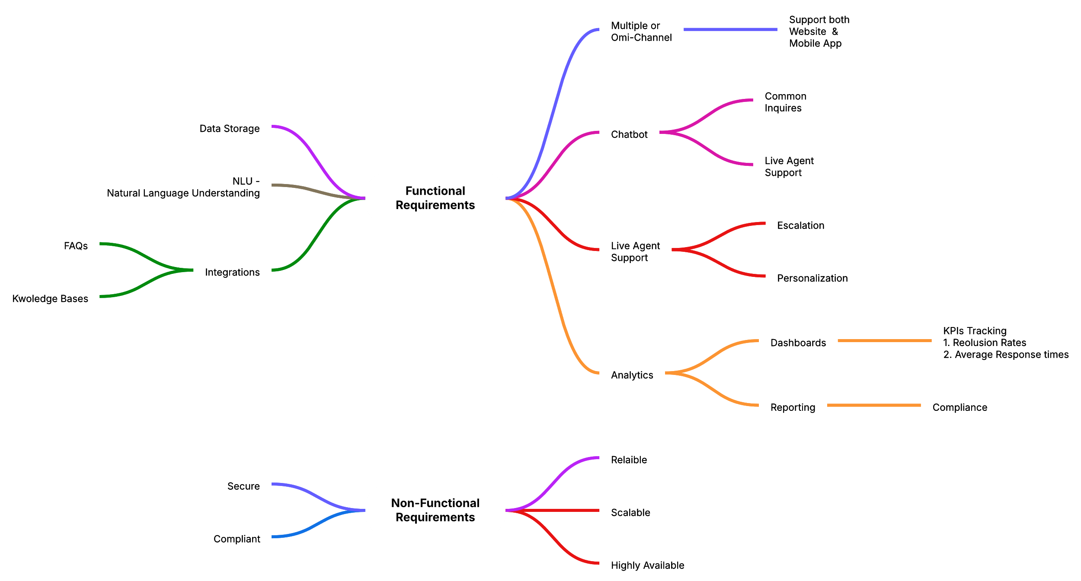
Functional(Non-Functional) Requirements

Slide 5
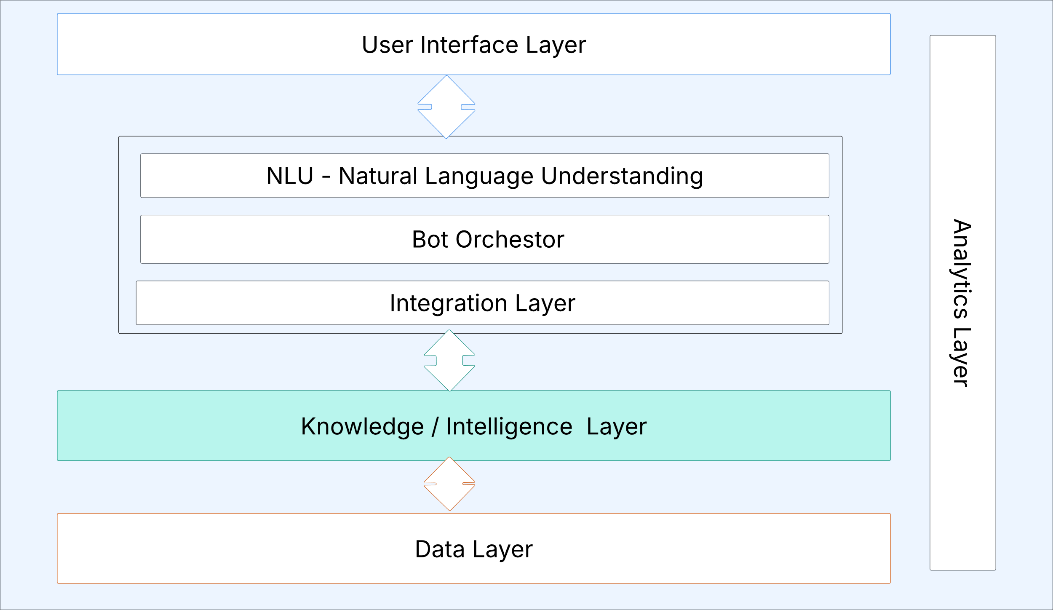
High Level Architecture

Slide 6
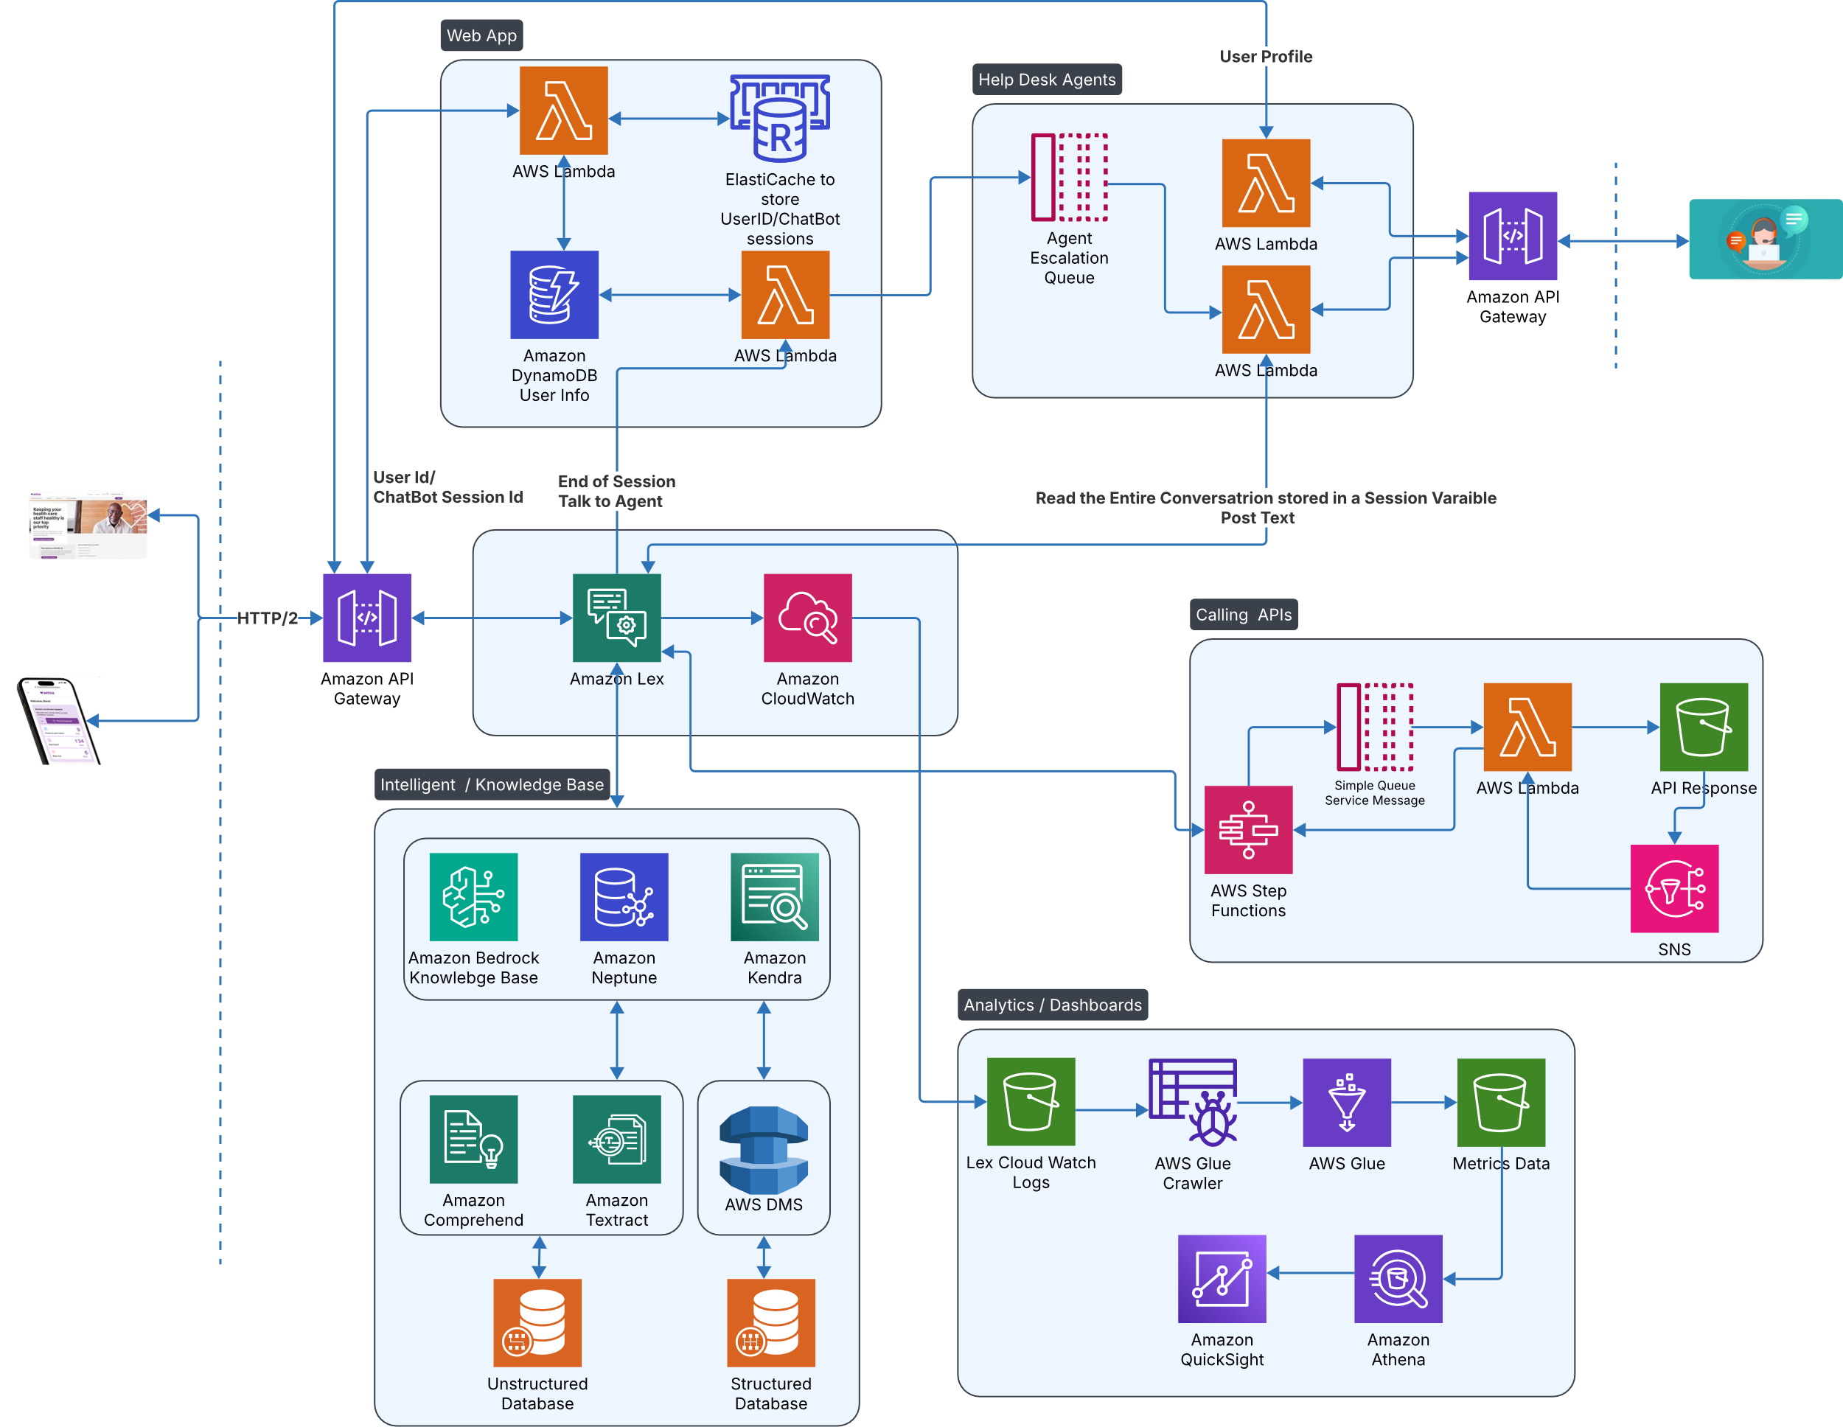
Design

Slide 7
Non-Functional Requirements
Secure
We encrypt all S3 buckets.
Lex Conversations are encrypted both in transit and at rest.
All HTTP traffic is encrypted.
Compliant
Lex Cloud watch logs are analyzed
To create Compliance dashboards.
Sensitive information and Profane language.
KPIs / Metrics tracking and monitoring.

Slide 8
Non-Functional Requirements
Scalable
Serverless architecture.
Horizontally with increase in traffic.
Async processing is separated from soft real-time chat messages.
Reliable / Highly Available
Modularized – Contain failure to some part of the system.
We are backed by the AWS SLAs.

