Slide 1
Credit Card Fraud Detection
mlearn410 – Applied Machine Learning

Slide 2
Task, why is Interesting ?
Build a classifier to predict genuine / fraudulent transaction.
The dataset is highly unbalanced, the positive class (frauds) account for 0.172% of all transactions.

Slide 3
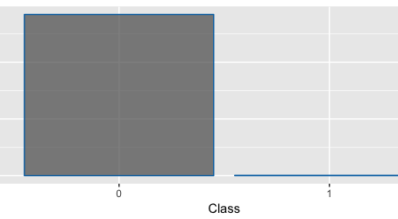
Task, why is Interesting ?

Slide 4
SMOTE > Handling imbalanced data.
SMOTE – Synthetic Minority Over-sampling TEchnique
Creates synthetic samples from the minor class instead of creating copies.

Slide 5
ROSE > Handling imbalanced data.
ROSE– Random Over-Sampling Examples
Artificial balanced samples are generated according to a smoothed bootstrap approach.

Slide 6
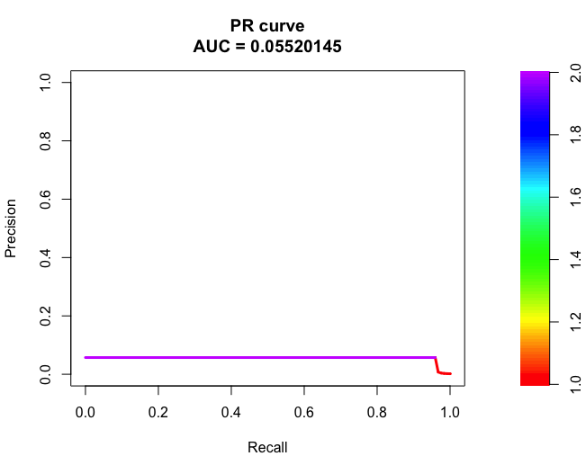
SMOTE > Random Forest.

Slide 7
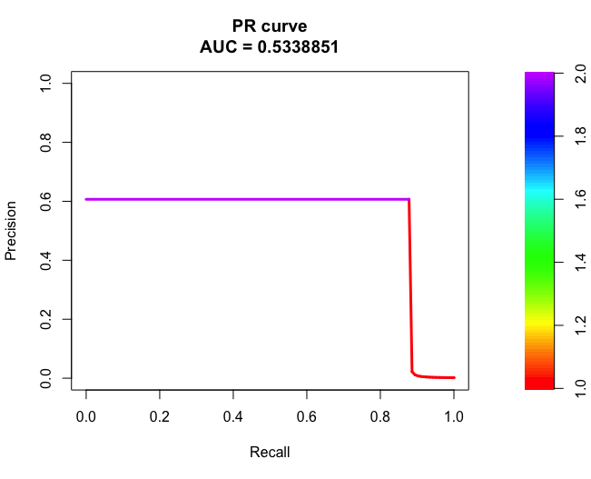
ROSE > Random Forest.

Slide 8
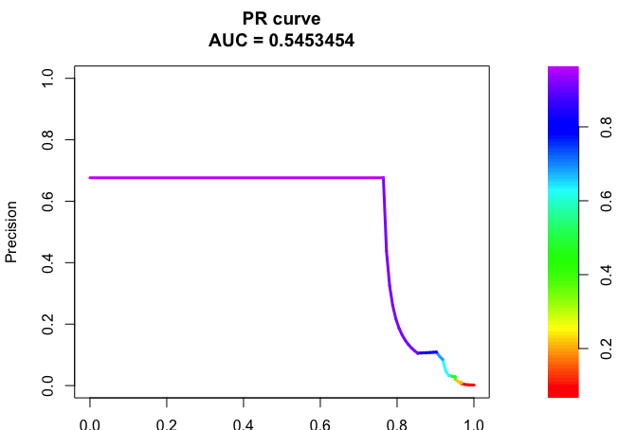
SMOTE > Gradient Boosting.

Slide 9
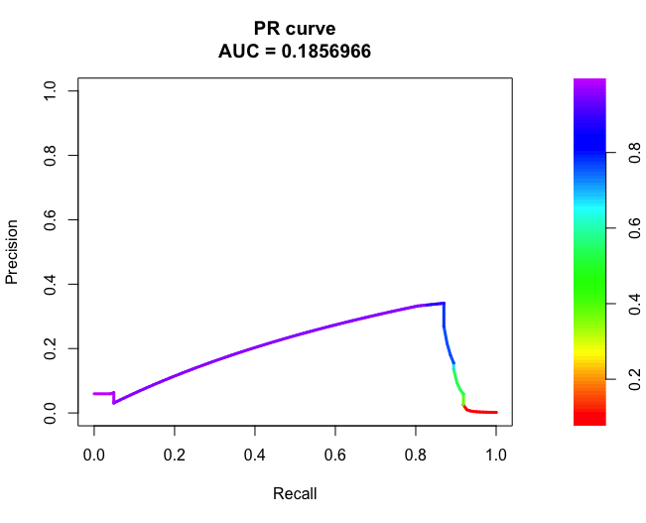
ROSE > Gradient Boosting.

