Slide 1
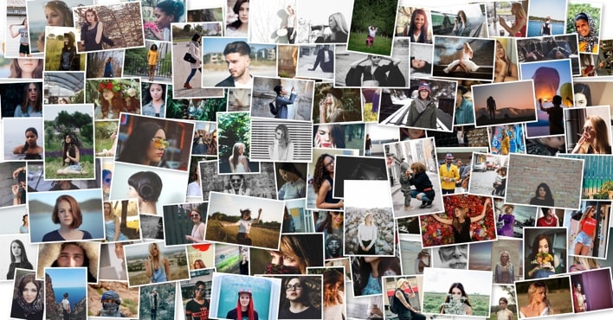
PHOTO CLASSIFIER
BATCH NO -14
K. RAVIRAJ (22B91A5474)
P. HITESH (22B91AA54A5)
P. HEMA SAI (22B91A54A9)

Slide 2
PROBLEM STATEMENT
To automatically organize a large collection of photos by detecting, clustering, and grouping images of the same person into separate categories

Slide 3
ABSTRACT
This project is about creating a system that can sort and recognize photos into different groups. We use OpenCV, a tool that helps process and analyze images. The system looks at the photos to find important features like edges and colors. Then, it uses a machine learning model, like a type of program that learns from data, to figure out which group the photo belongs to. This can be used for things like recognizing faces or identifying objects in pictures.

Slide 4
DATASET
In this model, we have used the images of celebrities.
Several pictures of the same individuals with varying expressions, angles, and lighting conditions to test the effectiveness of feature extraction.
Images should include variations such as different backgrounds, lighting conditions, and partial occlusions (e.g., glasses or hats).

Slide 5
TECHNOLOGIES USED
OpenCV: OpenCV also know as open-source-computer vision library is used for reading images
Face_recognition: This library is used to detect faces and extract embeddings for clustering.
DBSCAN: A density based clustering algorithm used in clustering faces.
OS module: Used for managing the file paths, directories and organization of the files after clustering.
Shutil: Used mainly for moving and copying operations on images into respective folders after clustering.

Slide 6
SYSTEM ARCHITECTURE
Input:
User uploads pictures
Processing:
Detecting face and extracting it’s embeddings using face_recognition library
Clustering of pictures using DBSCAN
Saving similarly clustered faces into separate folders
Output:
Folders containing similar faces (clustered).

Slide 7
SOURCE CODE
import os
import cv2
import numpy as np
import face_recognition
from sklearn.cluster import DBSCAN
import shutil
# Load images from a directory
def load_images(image_dir):
images = []
image_paths = []
for filename in os.listdir(image_dir):
path = os.path.join(image_dir, filename)
img = cv2.imread(path)
if img is not None:
images.append(img)
image_paths.append(path)
return images, image_paths

Slide 8
# Detect faces & extract embeddings
def get_face_embeddings(image_paths):
encodings = []
valid_paths = []
for path in image_paths:
img = face_recognition.load_image_file(path)
face_encodings = face_recognition.face_encodings(img)
if face_encodings: # Ensure a face is detected
encodings.append(face_encodings[0])
valid_paths.append(path)
return encodings, valid_paths

Slide 9
# Cluster faces using DBSCAN
def cluster_faces(encodings):
# clustering = DBSCAN(eps=0.5, min_samples=2, metric="euclidean").fit(encodings)
clustering = DBSCAN(eps=0.46, min_samples=2, metric="euclidean").fit(encodings)
return clustering.labels_
def save_clustered_faces(image_paths, labels, output_dir):
os.makedirs(output_dir, exist_ok=True)
for path, label in zip(image_paths, labels):
person_folder = os.path.join(output_dir, f"person_{label}")
os.makedirs(person_folder, exist_ok=True)
shutil.copy(path, person_folder)

Slide 10
image_dir = "input_photos"
output_dir = "classified_faces"
images, image_paths = load_images(image_dir)
encodings, valid_paths = get_face_embeddings(image_paths)
labels = cluster_faces(encodings)
save_clustered_faces(valid_paths, labels, output_dir)
print("Photos classified successfully!")

Slide 11
CONCLUSION
This project successfully created a system that can sort and recognize photos into different groups. The system looks at the photos to find important features like edges and colors. Then, it uses a machine learning model, like a type of program that learns from data, to figure out which group the photo belongs to. This can be used for things like recognizing faces or identifying objects in pictures.

Slide 12
THANK YOU

