Slide 1


Maverick Home Center
Team 13 - Mavericks
CSE 5325-004: Software Engineering 2: Management, Maintenance, and Quality assurance.
Under the guidance of:
Dr. A.C. Sahoo
Aditya Vikram Bhat - 1002014494
Akash Biswas - 1002055500
Amit Gupta - 1002066302
Ravi Rajpurohit - 1002079916

Slide 2
INTRODUCTION
Maverick Home Center is a one-stop solution for buying and selling used items around The University of Texas at Arlington Campus.
It is designed for the students and by the students, ensuring that you shop and sell with trust.
If you want to get rid of items you don’t need anymore, or if you are looking for a specific product with affordable pricing, Maverick Home Center has got your back!
There are multiple platforms out there for selling and buying used items for Eg. - eBay, Facebook Marketplace, Etsy, and Ebid.
But the vital problem with the global marketplace is that anyone can masquerade as a buyer or a seller which could potentially scam other users.
This would eventually lead to the loss of trust in the system.

Slide 3
Iterations
Iteration 1:
Setting up project
Firebase connectivity
Crashlytics Setup
Iteration 2:
Login Screen
Sign Up Screen
Verify Email Screen
Iteration 3:
Create Product Listing
View Products
Buy Product

Slide 4

System Design

Slide 5
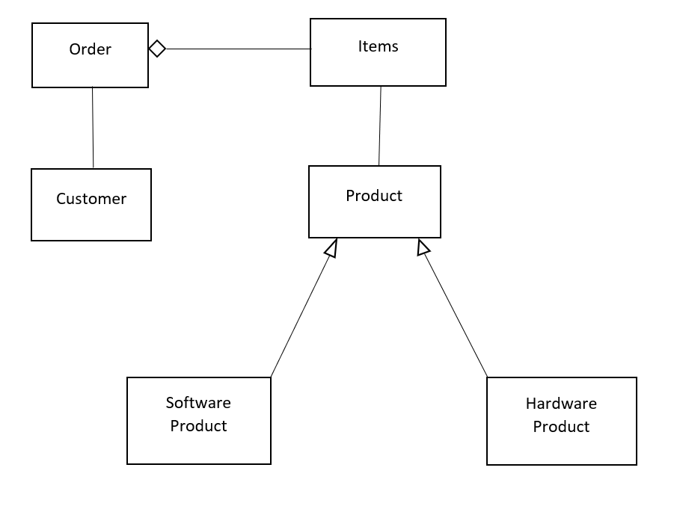
System Design

Slide 6
Database Structure
"-NGv-gU3gHFT42UsryyL": {
"availability": "InStock",
"category": "Miscellaneous",
"condition": "New",
"create_date": 1668511090629,
"description": "12",
"image_url": [
"gs://mavmarketplace-78435.appspot.com/products/e6eeabe12acb9f9b7750fc4f0aa67d5e_1668511087977_uRXI3Ioyzkam99h9cB66COnN1t63"
],
"name": "Product 1",
"price": "12",
"product_id": "-NGv-gU3gHFT42UsryyL",
"seller_id": "uRXI3Ioyzkam99h9cB66COnN1t63"
}
"V6JJA0bbo8UD3eUoltWXFZBipcN2": {
"address": {
"city": "Test",
"line_1": "asdsa",
"line_2": "dsfdfsdfdsf",
"state": "Texas",
"zip": "12312"
},
"first_name": "Jatin",
"last_name": "Shrivastava",
"phone_number": "1231231231",
"uta_id": "1234567890"
}

Slide 7
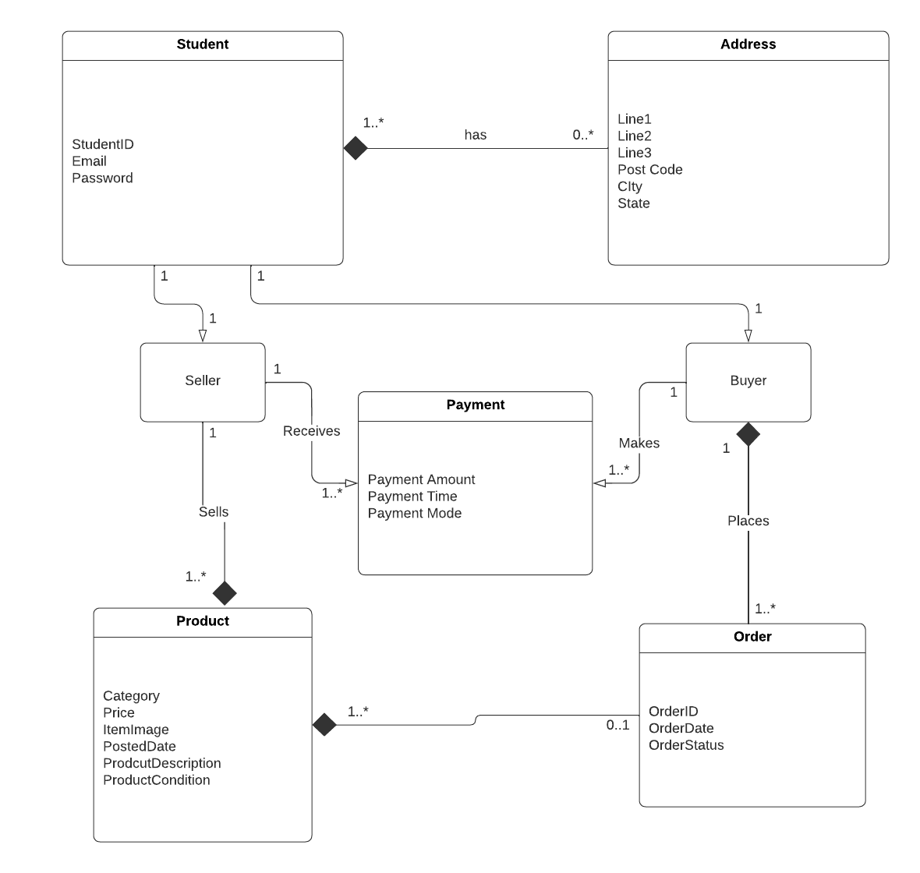
Domain Model

Slide 8
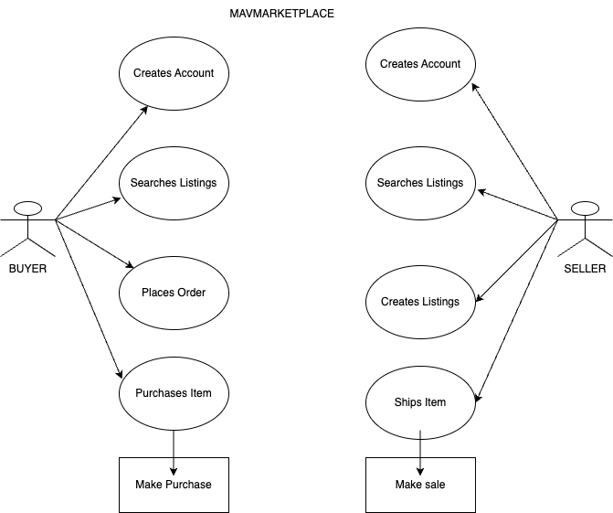
Actor System Model

Slide 9
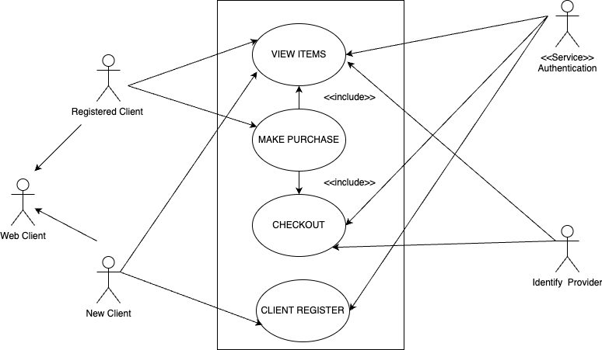
Use Case Diagram

Slide 10

Technologies used
Frontend Technology:
Flutter
Java/ Kotlin
Backend Technology:
Firebase by Google

Slide 11

Functionalities
https://www.figma.com/proto/O6r4kGmcp6jf9GCLFoMkx8/Project%3A-MavMarketplace?page-id=0%3A1&node-id=1%3A213&viewport=-1849%2C1143%2C0.76&scaling=scale-down&starting-point-node-id=1%3A213

Slide 12

Challenges faced
UI.
Performance.
Firebase
R/W Operations.
Libraries.
Database

Slide 13
Firebase
Setting up connection.
Database.
Storage (app logo, images and graphics).
Authentication (user credentials).
Firebase – real time database is used.

Slide 14

Database
Creating/Designing Database schema.
Consistency.

Slide 15
R/W operations
Read/Write product data to the database.
Sometimes the right read/write operations are not executed, and the data is not updated correctly.

Slide 16

Flutter Libraries
Finding the right libraries.

Slide 17

Performance
Product details and confirmation page.

Slide 18

UI Design
Easy to use.
Ease of access.

