Slide 1
GasCore+
Iteration 2
Team 5
Team Members: Abbinav H. Burhanuddin C. Dhairya C. Ritesh M.
CSE 6324-001

Slide 2

Project Plan
Features Plan
Change Gas Gauge and Manticore libraries to run on WSL
Integrate Manticore API with Gas Gauge .
Incorporate Manticore Features (Python Code) with Gas Gauge Features (Python Code) for GasCore+ Base.
[1]

Slide 3

Project Plan
Apps Differences
Slither: Incorporates Static Analysis
GasCore+: Incorporate Static Analysis, Dynamic Analysis and Symbolic Execution from Gas Gauge and Manticore.
[2]

Slide 4
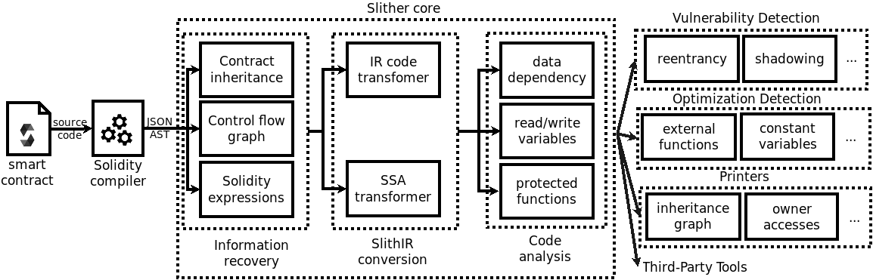
Project Plan
Apps Differences
[3]

Slide 5

Project Plan
Top 5 Risks
Incorporating Manticore Features with Gas Gauge Features.
RE: 6 extra hours
Integrating Manticore and Gas Gauge libraries to be compatible with WSL.
RE: 3 extra hours
Understanding Manticore API
RE: 3 extra hours
Running Smart Contracts through GasCore+.
RE: 2.8 extra hours
Team Members’ Scheduling Issues.
RE: 1.8 extra hours
[4]

Slide 6

Specification and Design
Gas Gauge
What is Gas Gauge and how does Gas Gauge help in finding the vulnerabilities?
Working of Gas Gauge
Output of Gas Gauge
Manticore
How does Manticore help in finding the vulnerabilities?
Manticore-Verifier
Output of Manticore & Manticore-Verifier
[6]

Slide 7

Specification and Design
Features Implemented
Integration of Gas Gauge and Manticore-Verifier
Integrated the Manticore API
Created a Manticore EVM to aid with our integration
Future Features
Complete Integration of main Manticore functionality
Ability to test below Manticore-Verifier functionalities by creating custom Contracts
User Contracts
Stop Conditions
[7]

Slide 8
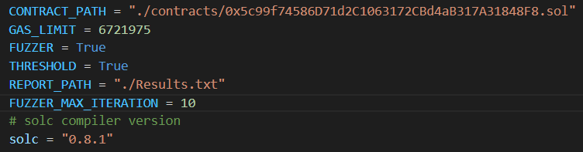
Specification and Design
Input

Slide 9
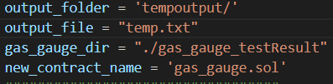
Specification and Design
Output

Slide 10
Code and Tests
Configuration Changes Done:
Modifying Slither Version to ensure both Gas Guage and Manticore can coexist.
Upgrading Crytic-Compile version to run both apps.
Integrating Manticore within Gas Gauge:
Initiating a MantiCore EVM by importing Manticore API library within Gas Gauge.
Creating an user account and balance
Utilizing the user account to create a solidity contract.
Utilizing symbolic_value to add constraints and conditions.

Slide 11
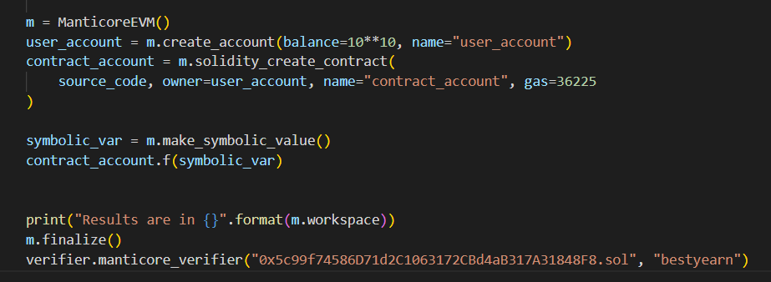
Code and Tests

Slide 12
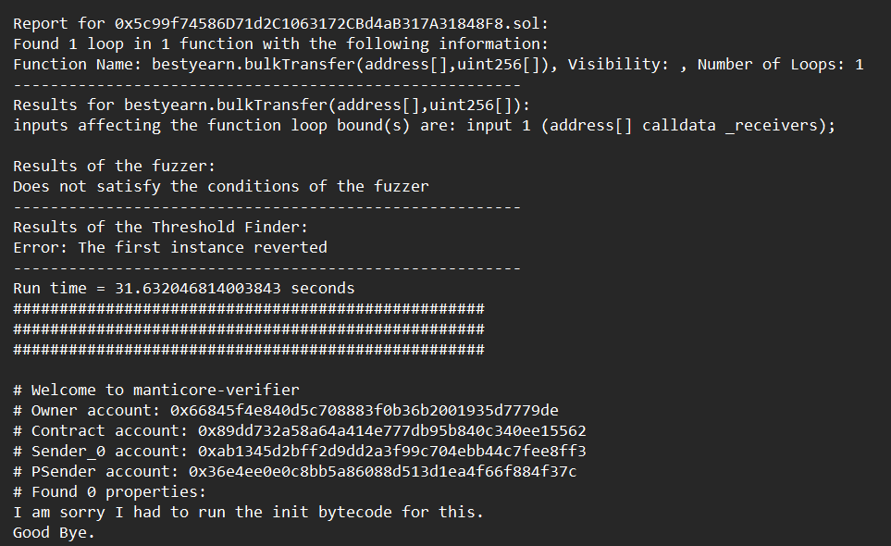
Code and Tests

Slide 13

Customer and Users
Reached out to Shovon for clarification of Manticore Features.
Advised us to focus on core Manticore features
Reached out to TA Mohammad for documentation about Gas Gauge.
Explained to the Team about the 3 phases of Gas Gauge Algorithm.
Reached out to Shovon for an update on Gas Gauge/Manticore specific Smart Contracts.
Created our own smart contracts for testing instead of waiting for a response.
[5]

Slide 14
References
[1] manticore.png (256×202) (raw.githubusercontent.com) Accessed 10/2022
[2] slither/logo.png at master · crytic/slither · GitHub Accessed 10/2022
[3] Slither: The Leading Static Analyzer for Smart Contracts | Trail of Bits Blog Accessed 10/2022
[4] Risk Management | City of Punta Gorda, FL (punta-gorda.fl.us) Accessed 10/2022
[5] Customer Delight Clipart - End Users Png, Transparent Png , Transparent Png Image - PNGitem Accessed 10/2022
[6]https://insight-quality.com/what-are-product-specifications, Accessed 16/22 [7]https://www.goodreturns.in/personal-finance/investment/top-7-reasons-to-invest-in-mutual-funds/articlecontent-pf15106-1143058.html, Accessed 16/22
[8]https://github.com/trailofbits/manticore/wiki/Tutorial:-Running-under-Manticore, Accessed-13/22
[9]https://manticore.readthedocs.io/en/latest/evm.html?highlight=create_account, Accessed - 13/22

Slide 15
Thank you
Questions?

