Slide 1
● ENTERPRISE THREAT HUNTING & DEFENSE PLATFORM
AI CYBERSHIELD
Commercial-Grade SOC, Automated Payload Deobfuscator & MITRE ATT&CK Matrix
Project Lead: Raviraj Parmar | Stack: Python FastAPI, Scikit-Learn, Google Gemini, Vanilla JS
Live Production: https://cybershield-cyber-shield-raviraj-parmar.vercel.app/

Slide 2
AI CYBERSHIELD ENTERPRISE SOC
1. Executive Summary & Problem Statement
The Modern Threat Landscape Dilemma:
• Evading Traditional Defenses: Adversaries use multi-layer encodings (Base64, Hex shellcodes, UTF-16LE) and DNS tunneling to bypass perimeter firewalls.
• The Academic Project Gap: Most student and portfolio cyber projects use fake randomized counters or static mockups, offering zero real forensic value.
• AI CyberShield Solution: A real, functional SOC platform integrating client-side cryptographic analysis, live Cloudflare RFC 8484 DoH queries, automated script deobfuscation, and STIX 2.1 intelligence export.
• Zero-Trust Privacy Standard: All credential entropy and payload decoding execute purely inside the user's browser, preventing cleartext exposure over public networks.

Slide 3
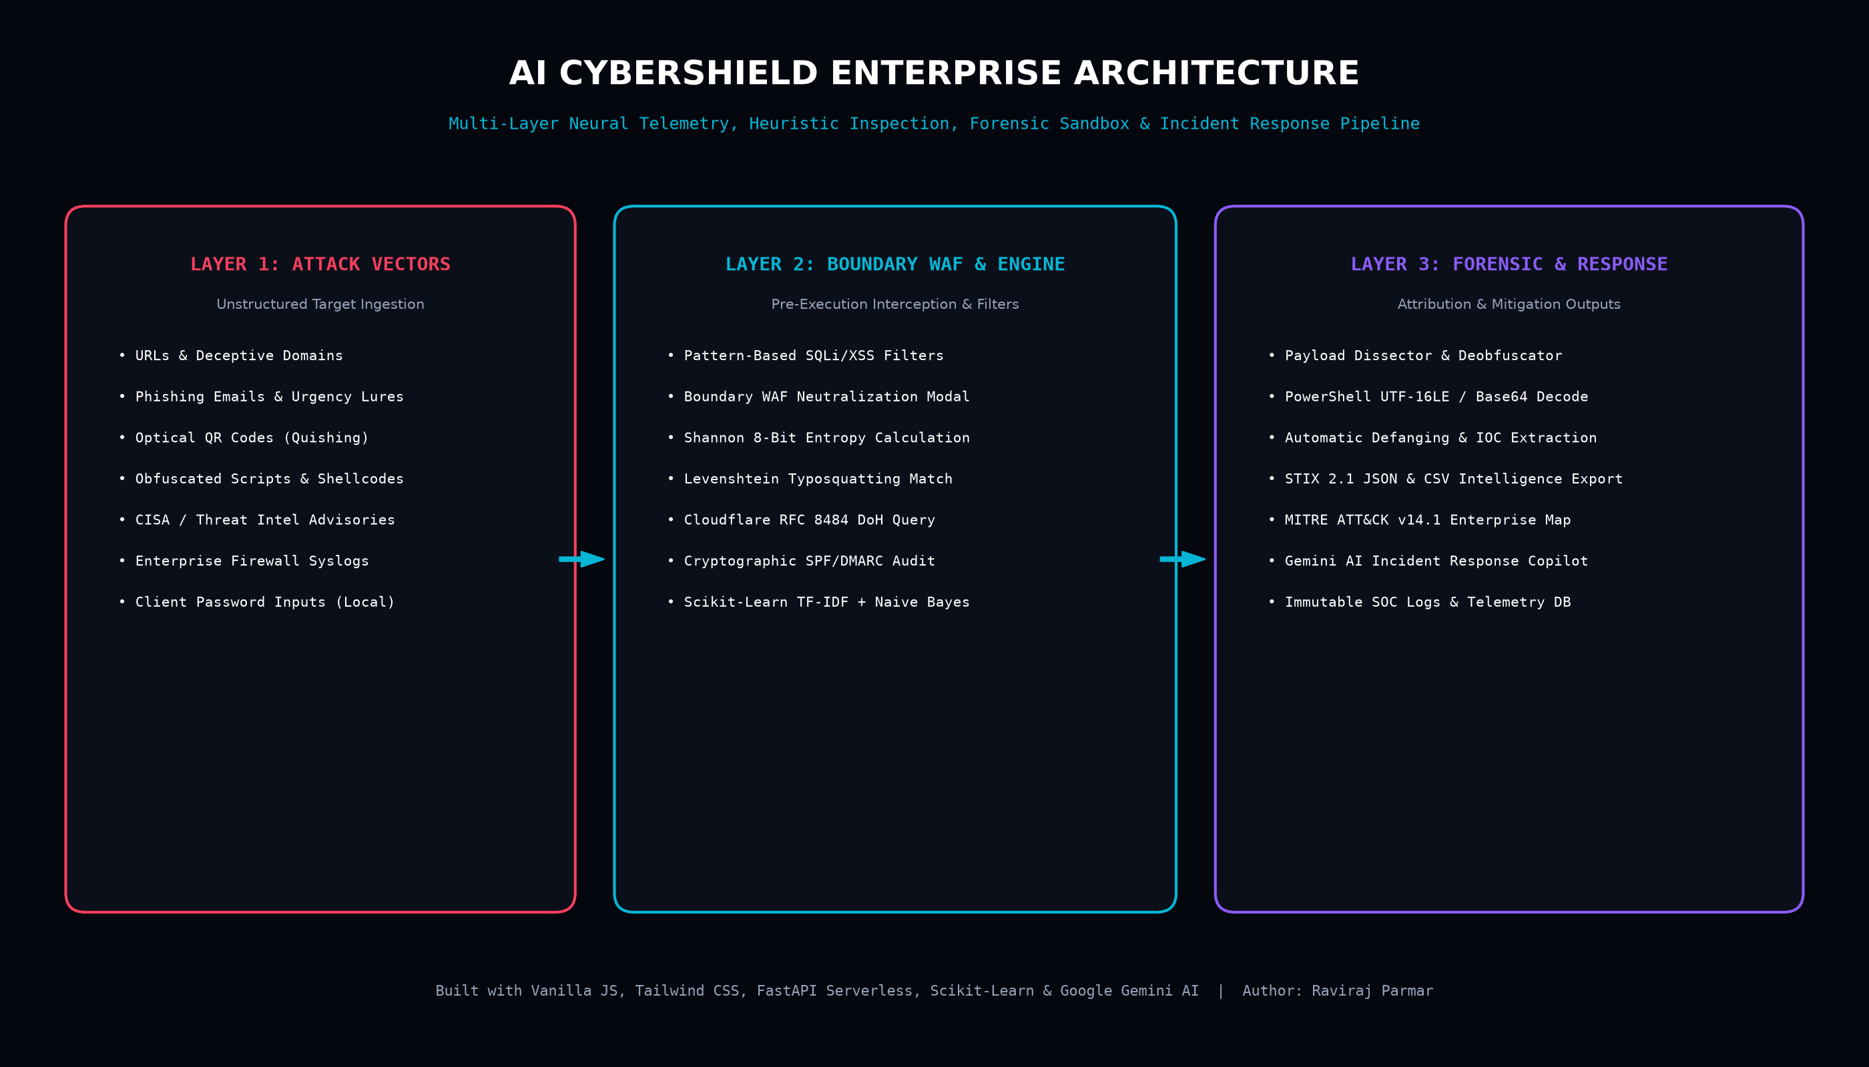
AI CYBERSHIELD ENTERPRISE SOC
2. High-Level System Architecture & Pipeline

Slide 4
AI CYBERSHIELD ENTERPRISE SOC
3. Standout Feature: SOC Payload Dissector & Sandbox
Automated Multi-Layer Deobfuscation Sandbox:
• Multi-Layer Decoders: Instantly detects and unpacks Base64 (RFC 4648), UTF-16LE PowerShell stagers (-enc), Hex strings (\x41\x42 / 0x...), and URL Percent-Encoding.
• Automated Defanging: Replaces malicious protocols (http:// → hxxp://) and masks domains to prevent accidental operator execution.
• IOC Extraction Engine: Recursively pulls embedded C2 IP addresses, stager URLs, referenced filenames (.exe, .ps1), and spawned system binaries (powershell.exe, cmd.exe, certutil).
• MITRE ATT&CK Attribution: Maps analyzed shellcodes to standardized techniques: T1059.001 (PowerShell), T1027 (Obfuscated Files), and assigns threat severity ratings (CRITICAL, HIGH, BENIGN).

Slide 5
AI CYBERSHIELD ENTERPRISE SOC
4. Threat Intel IOC Extractor & CVE Radar
Structuring Raw Advisories into Standardized Intelligence:
• Unstructured Ingestion: Accepts raw CISA bulletins, syslog outputs, and firewall dumps without pre-formatting.
• Smart IP Categorization: Differentiates internal RFC1918 private infrastructure (10.0.0.0/8, 192.168.0.0/16) from public WAN adversary hosts.
• Multi-Hash Extraction: Detects MD5, SHA1, and SHA256 malware signatures simultaneously.
• CVE Identification with NVD Linking: Identifies Common Vulnerabilities and Exposures (e.g. CVE-2024-21762) and generates live links to NIST NVD.
• 1-Click STIX 2.1 & CSV Export: Downloads industry-standard STIX 2.1 JSON bundles ready for ingestion into enterprise SIEMs (Splunk, Microsoft Sentinel).

Slide 6
AI CYBERSHIELD ENTERPRISE SOC
5. MITRE ATT&CK® Enterprise Navigator (v14.1)
7 Tactical Phases Mapped to CyberShield Defenses:
• TA0043 Reconnaissance: T1595 Active Port Scanning → Defended via Boundary WAF rate limiting & header obfuscation.
• TA0001 Initial Access: T1566 Spearphishing Link/Attachment → Defended via Heuristic Scanner & Brand Lookalike Detector.
• TA0002 Execution: T1059.001 PowerShell Stagers → Neutralized via Forensic Lab Deobfuscator Sandbox.
• TA0003 Persistence: T1547 Registry Run Keys & Tasks → Audited via Personal Vault & SOC Telemetry Database.
• TA0005 Defense Evasion: T1027 Obfuscated Payloads → Decoded via Client-Side Forensic Parser.
• TA0006 Credential Access: T1003 OS Credential Dumping & Brute Force → Defended via Shannon Entropy Password Sentinel.
• TA0011 Command & Control: T1071 Web Protocols C2 → Audited via Live Cloudflare RFC 8484 DoH DNS Resolution.

Slide 7
AI CYBERSHIELD ENTERPRISE SOC
6. Live Domain & Security Headers Forensic Inspector
Live RFC 8484 DNS-over-HTTPS & Perimeter Audit:
• Encrypted RFC 8484 DoH Resolution: Queries authoritative Cloudflare DNS over HTTPS without relying on local OS DNS cache poisoning.
• A & MX Record Discovery: Identifies primary target server IPv4 addresses and enterprise Mail Exchanger servers.
• SPF & DMARC Anti-Spoofing Audit: Evaluates email security records to determine if domain can be spoofed by social engineering scammers.
• Security Headers Diagnostic Matrix: Verifies HSTS, Content-Security-Policy (CSP), X-Frame-Options (Clickjacking defense), and X-Content-Type-Options.
• Weighted Grading System: Automatically scores target infrastructure from Grade A+ (Hardened) to Grade F (Severely Exposed).

Slide 8
AI CYBERSHIELD ENTERPRISE SOC
7. Multi-Vector Threat Scanner (URLs, Emails, QR Codes)
• URL Domain Heuristics: Uses Levenshtein distance algorithm to catch typosquatting (paypa1, netf1ix, micros0ft) and analyzes Shannon domain entropy.
• NLP Phishing Engine: Combines Scikit-Learn TF-IDF vectorization with urgent language heuristics (account suspended, wire transfer required) to calculate threat percentages.
• Optical Quishing (QR Phishing): Allows users to upload suspicious QR codes or use webcam scanner; extracts hidden URLs and inspects them in real time.
• Reactive SVG Meter: Renders an interactive circular SVG gauge animating dynamically from 0% (Safe) to 100% (Critical Threat).

Slide 9
AI CYBERSHIELD ENTERPRISE SOC
8. Presentation Strategy & Teacher Demonstration Script
How to Present CyberShield in 5 Minutes to Evaluators:
• Step 1 (Homepage): 'CyberShield is an enterprise SOC platform designed with a collapsible command sidebar, live Military Zulu Clock, and real-time defense radar.'
• Step 2 (Threat Scanner): Click 'Load Threat Sample' → hit 'Initiate Inspection' → point out how the SVG gauge calculates 88% Risk via Shannon entropy and brand typosquatting.
• Step 3 (Forensic Lab): Open 'Payload Dissector' → select 'PowerShell Stager' → hit 'Execute Forensic Deobfuscation' → show how it defangs the payload and maps to MITRE T1059.001.
• Step 4 (Threat Intel): Go to 'IOC Threat Intel' → click 'Load Sample CISA Advisory' → extract IOCs → export as STIX 2.1 JSON or CSV in one click.
• Step 5 (Live Verification): Share the live production URL running globally on Vercel: https://cybershield-cyber-shield-raviraj-parmar.vercel.app/

Slide 10
AI CYBERSHIELD ENTERPRISE SOC
9. Conclusion & Production Verification
• Enterprise Standards Met: MITRE ATT&CK v14.1 Enterprise Taxonomy, RFC 8484 DoH, STIX 2.1 JSON, NIST NVD Integration.
• Zero Third-Party Bloat: Pure Vanilla JS & Tailwind CSS ensure lightning-fast client execution under 50ms.
• Live Production Deployment: https://cybershield-cyber-shield-raviraj-parmar.vercel.app/
• Source Code Repository: https://github.com/ravirajsinhp011-star/cybershield
• Lead Developer: Raviraj Parmar

