Slide 1
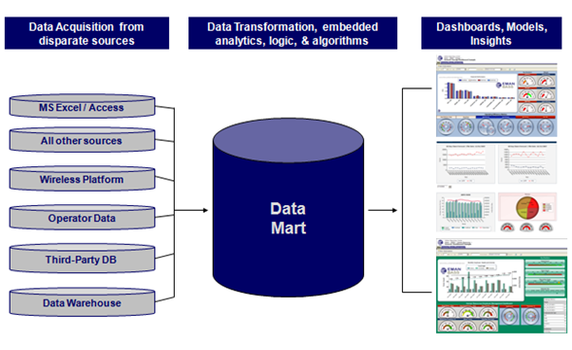
SALES ORDER DATA MART AND BUSINESS INTELLIGENCE SOLUTION
Guide By Dr. Natarajan S Manoranjan Aithal K
Professor Ravi Raju K
Department Of IS&E 8th Sem BE(ISE)
PESIT

Slide 2
Aim of Project
Build Data Mart for processing Sales Order Information using Informatica PowerCenter 9.0.1
Generate Dash Board Reports using Microstrategy for the end user to analyze data
Implement the following Data Mining Algorithms as the Business Intelligence Solutions
FP Growth Algorithm
Bayesian Classification Algorithm

Slide 3
Sales Order Background
An enterprise profitability depends on clear picture of product sales and delivery.
Sales module functionality allows us to understand product sales in terms of volume and value, by examining how much of the product are sold and how much they are sold for.
The sales order is the entry point in the sales order process, and is the record ,of a customer placing an order with the organization for the supply of goods or services.
The analysis of the sales performance allows us to examine data at a high level(across many sales orders),or down to the detail of a single line item on one sales order.

Slide 4
Data Warehouse and Data Mart
A data warehouse is a repository of information collected from multiple sources, stored under a unified schema, and that usually resides in a single site.( Scope: Enterprise-wide)
The data mart , on the other hand, is a department subset of the data warehouse.
( Scope: Department-wide)
A data mart can be defined as a repository to answer very specific questions for a specific group of data consumers such as organizational divisions of marketing, sales, operations, finances, collections and others.

Slide 5
Data Warehouse Design Approaches
There are two paradigms for designing a data warehouse. They are:-
William Inmon’s paradigm
Ralph Kimball’s paradigm

Slide 6
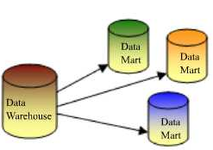
William Inmom’s paradigm
Data warehouse is one part of the overall business intelligence system.
An enterprise has one data warehouse, and data marts source their information from the data warehouse which results in a top down approach.

Slide 7
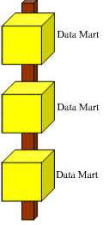
Ralph Kimball’s paradigm
Data warehouse is the conglomerate of all data marts within the enterprise.
Information is always stored in the dimensional model.
This is an bottom up approach.

Slide 8
Kimball vs. Inmon
In reality, the data warehouse in most enterprises are closer to Ralph Kimball's idea. This is because most data warehouses started out as a departmental effort, and hence they originated as a data mart.
Due to the ease of implementation of Kimball’s philosophy with the advantage of quicker returns, data marts are built first.

Slide 9
Dimensional Modeling
The most common modeling paradigms for building a data mart are
Star schema where there is a fact table and each dimension is represented by only one table, that is, the dimension tables are not normalized.
Snowflake schema is a variant of the star schema model, where some dimensions are normalized, thereby further splitting the dimension tables in to additional tables.

Slide 10
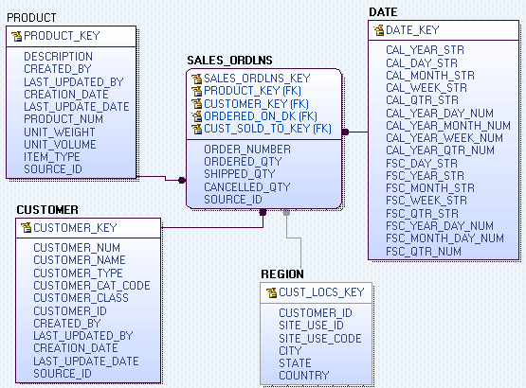
Star Schema

Slide 11
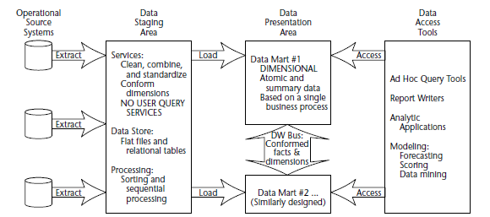
Components Of Data Warehouse

Slide 12
Use of Staging Area
The Data Staging Area is a temporary location where data from source systems is copied.
A staging area is mainly required in a Data Warehousing Architecture for timing reasons.
Due to varying business cycles, data processing cycles, hardware and network resource limitations and geographical factors, it is not feasible to extract all the data from all Operational databases at exactly the same time. Hence data staging area is used.

Slide 13
Data Load Schedule and Dependency
Data is loaded first in to staging area.
In the staging area, the fact table data is loaded first and then the dimensions data are loaded.
When data is loaded form the staging area to the presentation area, dimensions data are loaded first and then the fact data is loaded.

Slide 14
Surrogate Keys
Integers that are assigned sequentially as needed to populate facts and dimensions.
One of the primary benefits of surrogate keys is that they buffer the Data Warehousing environment from operational changes.
Surrogate keys provide the warehouse with the mechanism to differentiate between two separate instances of the same operational no.
There would be advantages in performance as surrogate keys are just integers

Slide 15
Slowly Changing Dimensions
Type 1 : Overwrite The Value
Type 2 : Add a Dimension Row
Type 3 : Add a Dimension Column

Slide 16
PowerCenter Platform
PowerCenter provides an environment that allows us to load data into a centralized location, such as a data warehouse or operational data store (ODS).
We can extract data from multiple sources, transform the data according to business logic we build in the client application, and load the transformed data into file and relational targets.

Slide 17
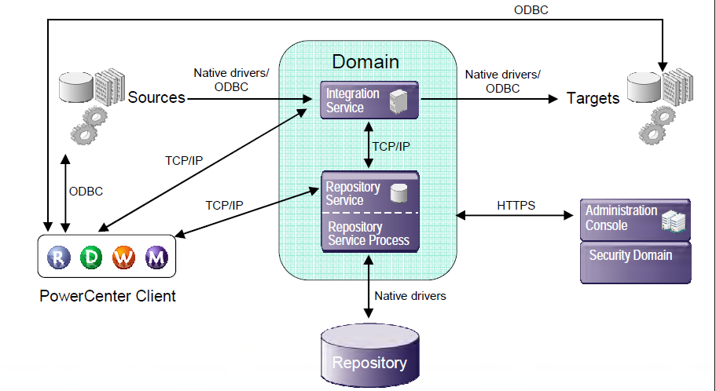
PowerCenter Architecture

Slide 18
Microstrategy
MicroStrategy, Inc. is a business intelligence (BI), enterprise reporting, dashboard, and OLAP (on-line analytical processing) software vendor.
MicroStrategy's software allows reporting and analysis of data stored in a relational database, multidimensional database, or flat data file.
BI software helps companies understand and make sense of the data they collect, in order to make more strategic business decisions.

Slide 19
Microstrategy Architecture

Slide 20
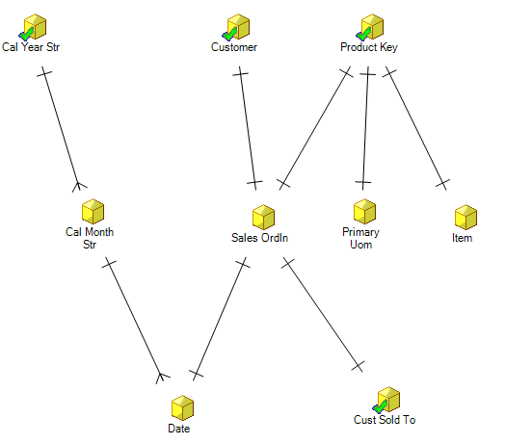
MicroStrategy Attribute Hierarchy

Slide 21
Business Intelligence Reports
No of Orders:- The report should describe the number of orders, the total ordered amount and the percentage difference between them for any specified year, month and customer.
No of Bookings:- The report should describe the number of bookings, the total booked amount and the percentage difference between them for any specified year, month and customer.
Orders to Booking Close Rate:- The report should describe the number of orders, number of bookings and the orders to bookings closure rate for any specified year and month.
Product Metric:- The report should describe the product type, unit of measure, number of orders, and number of unique customers, top customer and rank by sales volume for any specified product.

Slide 22
Data Mining
Data Mining is the process of finding correlations or patterns among dozens of fields in large relational databases.
It can be used for analyzing data from different perspectives and summarizing it into useful information - information that can be used to increase revenue, cut costs, or both.
Notes:
In today’s world, the need to understand large, complex, information-rich data sets is common to virtually all fields of business, science, and engineering. The ability to extract useful knowledge hidden in these data and to act on that knowledge is becoming increasingly important in today's competitive world. The entire process of applying a computer-based methodology, including new techniques, for discovering knowledge from data is called data mining.

Slide 23
Goals of Data Mining
The two primary goals of data mining tend to be prediction and description.
Description focuses on finding patterns describing the data that can be interpreted by humans.
Prediction involves using some variables or fields in the data set to predict unknown or future values of other variables of interest.

Slide 24
Frequent Item Sets
Frequent patterns are patterns (such as item sets, subsequences, or substructures) that appear in a data set frequently.
Frequent Item sets can be derived using an Apriori -like approach, which is based on the Apriori heuristic- if any length k pattern is not frequent in the database, its length (k + 1) super-pattern can never be frequent.

Slide 25
Drawbacks of Apriori approach
In situations with a large number of frequent patterns, long patterns, or quite low minimum support thresholds, an Apriori-like algorithm suffers from the following two nontrivial costs:
It is costly to handle a huge number of candidate sets.
It is tedious to repeatedly scan the database and check a large set of candidates by pattern matching, which is especially true for mining long patterns.

Slide 26
FP-Growth Algorithm
Transaction ID | Items bought | (Ordered) frequent items
100 | f, a, c, d, g, i,m,p | f, c, a,m, p
200 | a, b, c, f, l,m,o | f, c, a, b,m
300 | b, f, h, j,o | f, b
400 | b, c, k, s,p | c, b, p
500 | a, f, c, e, l, p,m,n | f, c, a,m, p

Slide 27
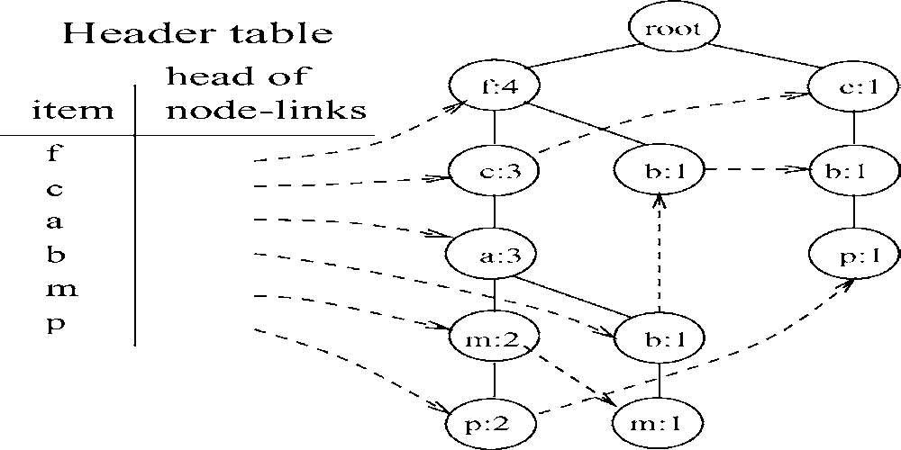
FP-Tree Construction

Slide 28
Mining FP-Tree
Item | Conditional pattern-base | Conditional FP-tree
p | {( f cam:2), (cb:1)} | {(c:3)}|p
m | {( f ca:2), (fcab:1)} | {( f :3, c:3, a:3)}|m
b | {( f ca:1), ( f :1), (c:1)} | ∅
a | {( f c:3)} | {( f :3, c:3)}|a
c | {( f :3)} | {( f :3)}|c
f | ∅ | ∅

Slide 29
FP-Tree Implementation
In our implementation the initial FP-tree is built from a main memory representation of the (preprocessed) transaction database as a simple list of integer arrays.
This list is sorted lexicographically .
The sorted list can easily be turned into an FP-tree with a straightforward recursive procedure: at recursion depth k, the k-th item in each transaction is used to split the database into sections, one for each item.

Slide 30
Bayesian Classification
Bayesian classifiers are statistical classifiers. They can predict class membership probabilities, such as the probability that a given tuple belongs to a particular class which is based on the Bayes theorem.
Naïve Bayesian classifiers assume that the effect of an attribute value on a given class is independent of the values of the other attributes. This assumption is called class conditional independence.

Slide 31


Bayes Theorem
Suppose that there are m classes, C1, C2, …. , Cm.
Given a tuple, X, the classifier will predict that X belongs to the class having the highest posterior probability, conditioned on X. That is, the naïve Bayesian classifier predicts that tuple X belongs to the class Ci if and only if
P( Ci | X ) > P( Cj | X ) for 1 <= j <= m, j != i
By Bayes Theorem

Slide 32
Four Scenarios for Bayesian Classification
The first and second prototype involves predicting the buying patterns of the given customer in the test set by classifying the training data on the months or quarters of the year.
The third prototype ranks the products bought by a particular customer and hence predicts which product he may be buying next.
The fourth prototype predicts whether a given customer in the test set buys a laptop or not depending on the data in the training set.

Slide 33
Conclusion
Technologies related to data mainly consist of data warehousing, business intelligence using dashboards and data mining. We have implemented all the above mentioned technologies in this project.

Slide 34
Future Enhancements
We would try to include more dimensions to the existing data mart to make it address complex scenarios. As more dimensions are added, the Business Intelligence module can also be improved by adding on different reports and dashboards.
In data mining, we would like to implement different classification and prediction algorithms and compare the efficiencies of these algorithms analyzing the same data set.

Slide 35
Bibliography
JIAWEI HAN, JIAN PEI, YIWEN YIN and RUNYING MAO, “Mining Frequent Patterns without Candidate Generation: A Frequent-Pattern Tree Approach”, 2004.
Cristian Bolgert, “An Implementation of the FP-growth Algorithm”, 2005.
Erik G. and Learned-Miller, “Supervised Learning and Bayesian Classification”, University of Massachusetts, Amherst, February 7, 2011
www.microstrategy.com
www.informatica.com

Slide 36
Thank You

