Slide 1

IILM UNIVERSITY GREATER NOIDA
STUDENT DETAILS
Name
Ravi Raj
Enrollment No.
25SCS1003003613
Program
B.Tech CSE
Specialisation
AI/ML
Semester
3rd Semester
Academic
2025-29
1

Slide 2
WEB DEVELOPMENT INTERNSHIP
INTERNSHIP PRESENTATION
Organization
Prodigy InfoTech
Role: Web Development Intern
15 July 2026 – 15 August 2026
2

Slide 3
INTERNSHIP OVERVIEW
Organization
Role
Prodigy InfoTech
Web Development Intern
Duration
Domain
15 July 2026 – 15 August 2026
Practical web development using HTML, CSS and JavaScript, with
emphasis on responsive and interactive applications.
Work Completed
Five web projects covering responsive design, JavaScript applications, games, portfolio development and weather data integration.
3

Slide 4
OBJECTIVES
• Gain practical experience in front-end web development.
• Strengthen understanding of HTML, CSS and JavaScript.
• Build responsive and user-friendly web pages.
• Implement interactive functionality using JavaScript.
• Understand basic API integration through a weather application.
• Improve problem-solving, debugging and project-building skills.
4

Slide 5
TECHNOLOGIES & TOOLS USED
HTML5
CSS3
JavaScript
Structure of web pages and application
elements.
Styling, layout and responsive design.
Interactivity, logic and dynamic behaviour.
VS Code
GitHub
Weather API
Primary code editor used for development.
Repository storage and versioned project
management.
Fetches weather information for the
weather application.
5

Slide 6
PROJECTS COMPLETED
01
Responsive Landing Page
02
Stopwatch Web Application
03
Tic-Tac-Toe Web Application
04
Personal Portfolio Website
05
Weather Application
6

Slide 7
RESPONSIVE LANDING PAGE
PROJECT 01
• Designed a responsive landing page using HTML, CSS and JavaScript.
• Included navigation and multiple content sections.
• Focused on a clean, user-friendly layout.
• Made the page adaptable to different screen sizes.
7

Slide 8
STOPWATCH WEB APPLICATION
PROJECT 02
• Developed an interactive stopwatch using JavaScript.
• Implemented Start, Stop, Reset, Pause and Lap functionality.
• Used JavaScript timing and event handling.
• Improved understanding of interactive web application logic.
8

Slide 9
TIC-TAC-TOE WEB APPLICATION
PROJECT 03
• Created an interactive Tic-Tac-Toe game using HTML, CSS and JavaScript.
• Implemented turn-based game logic and also add for single user, player vs AI.
• Added winner checking and game reset functionality.
• Focused on simple and engaging user interaction.
9

Slide 10
PERSONAL PORTFOLIO WEBSITE
PROJECT 04
• Designed a personal portfolio website using HTML, CSS and JavaScript.
• Included About, Skills, Projects, Education and Contact sections.
• Added responsive navigation and interactive page behaviour.
• Created the portfolio to present academic and technical work professionally.
10

Slide 11
WEATHER APPLICATION
PROJECT 05
• Developed a weather application using a Weather API.
• Allows users to search for weather by city.
• Displays current weather information such as temperature and conditions.
• Practised basic API integration and dynamic data display.
11

Slide 12
KEY LEARNINGS
• Improved practical skills in HTML, CSS and JavaScript.
• Learned to create responsive and interactive web pages.
• Understood JavaScript logic, events and application behaviour.
• Gained basic experience with API integration through the Weather Application.
• Practised using GitHub for project repositories and versioned work.
• Improved debugging, problem-solving and confidence in web development.
12

Slide 13
INTERNSHIP OUTCOME
Technical Growth
The internship strengthened practical understanding of front-end development and provided experience applying HTML, CSS and JavaScript
to project-based tasks.
Professional Growth
Working through multiple projects improved the ability to plan, build, test and refine web applications.
Overall Outcome
The internship provided valuable hands-on exposure to web development and strengthened the foundation for further learning in Cloud
Computing, DevOps and modern technologies.
13

Slide 14
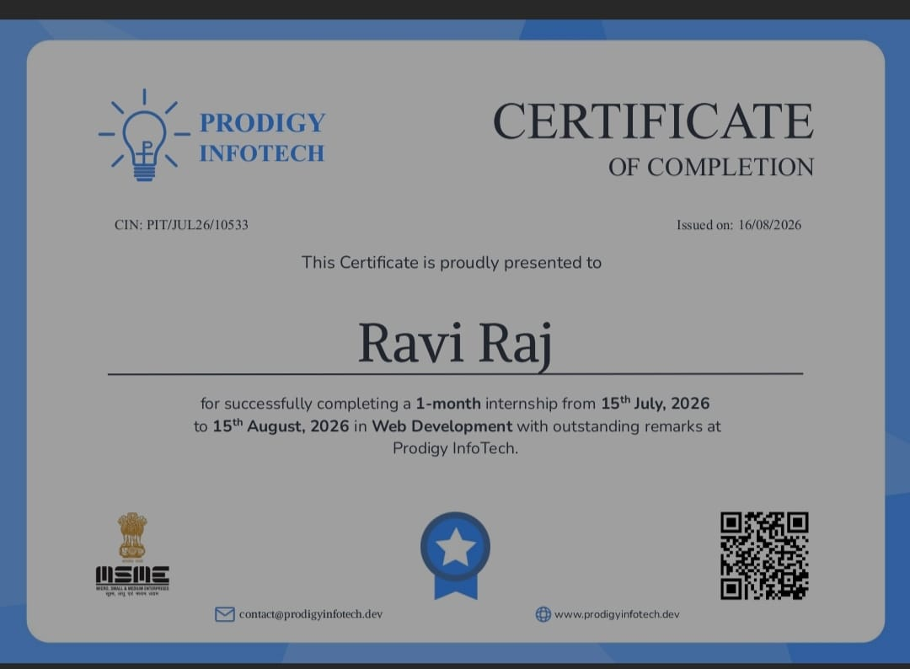
INTERNSHIP COMPLETION CERTIFICATE
14

Slide 15
THANK YOU
Ravi Raj
B.Tech CSE | AI/ML Specialisation
Web Development Internship | Prodigy InfoTech
IILM University

