Slide 1
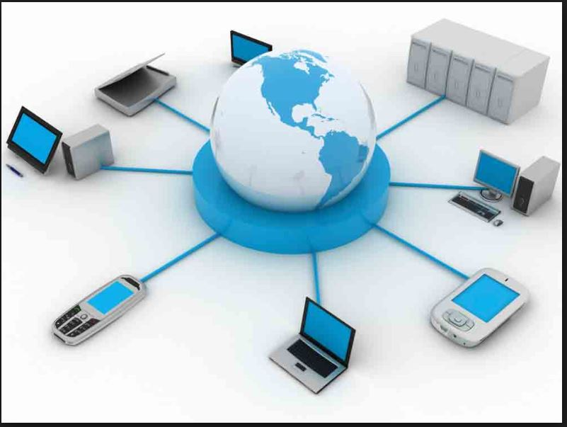
Information System Security

Slide 2
Information System
Information system is an integrated set of components for collecting, storing, and processing data and for providing information, knowledge, and digital products.
The information stored and distributed by information system help in decision making and controlling the organization.
Business firms and other organizations rely on information systems to carry out and manage their operations, interact with their customers and suppliers, and compete in the marketplace.

Slide 3
Types of Information System
There are several types of information systems, including the following common types:
Operations support systems, including transaction processing systems
Management information systems
Decision support systems
Executive information systems

Slide 4
Functions of Information Systems
Information systems support business functions such as administrative functions common to most organizations.
Finance- FMIS(Financial Management Information System)
Manufacturing- ERP(Enterprise Resource Planning)
Human resource- HR information systems
Marketing and sales- CRM(Customer Relationship Management)
Major companies such as Amazon, ebay, Google, Alibaba etc. are built around information systems.
Individuals rely on information systems- socializing, study, shopping, banking, and entertainment.

Slide 5
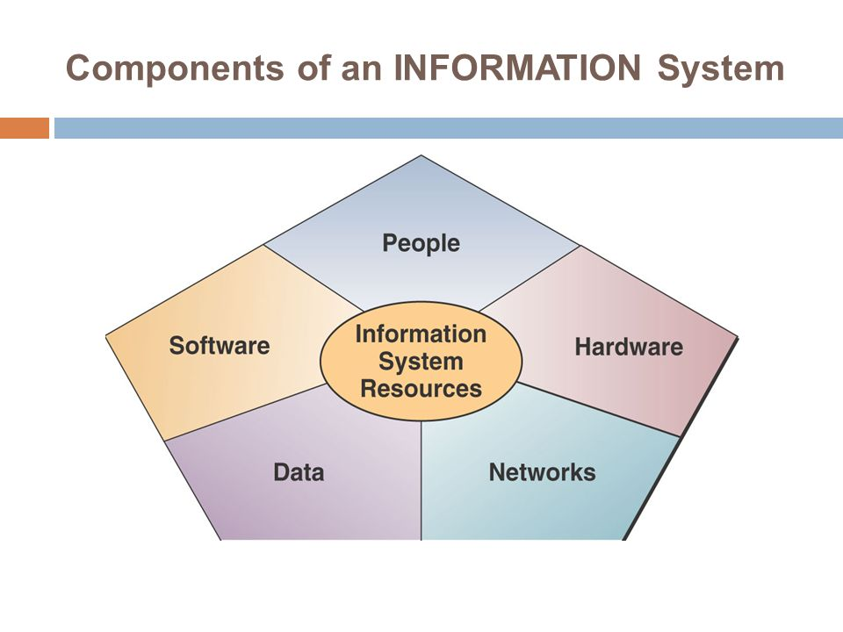
Components Of Information Systems

Slide 6
Hardware
These are the devices like the monitor, processor, printer and keyboard, all of which work together to accept, process, show data and information.
The cost of hardware has steadily and rapidly decreased, while processing speed and storage capacity have increased vastly.

Slide 7
Software
Software is a set of instructions that tells the hardware what to do.
When programmers create software programs, what they are really doing is simply typing out lists of instructions that tell the hardware what to do.
There are several categories of software, with the two main categories being operating-system software and application software.

Slide 8
Data
The raw material of information systems. Data can be:
  Alphanumeric data: composed of numbers and alphabetical and other characters.
  Text data: consisting of sentences and paragraphs used in written communications.
  Image data: such as graphic shapes and figures.
  Audio data: the human voice and other sounds

Slide 9
Network
Telecommunications networks like the Internet have become essential to the successful operations of all types of organizations and their computer-based information systems. Communications networks are a fundamental resource component of all information systems. It includes:
  Communication media: Examples include twisted pair wire, coaxial cable, fiber-optic cable, microwave systems, and communication satellite systems.
  Network Support: This includes people, hardware, software, and data resources that directly support the operation and use of a communications network. Examples include communications control software such as network operating systems and Internet packages.

Slide 10
People
Required for the operation of all information systems. These people resources include end users and IS specialists.
  End users (also called users or clients) are people who use an information system or the information it produces. They can be accountants, salespersons, engineers, clerks, customers, or managers. Most of us are information system end users.
  IS Specialists are people who develop and operate information systems. They include systems analysts, programmers, computer operators, and other managerial technical, and clerical IS personnel.

Slide 11
IMPORTANCE OF INFORMATION SYSTEMS
Communication – with help of information technologies the instant messaging, emails, voice and video calls becomes quicker, cheaper and much efficient.
Globalization and cultural gap – by implementing information systems we can easily share the information and knowledge, communicate and maintain relationships between different countries, languages and cultures.
Availability – information systems has made it possible for businesses to be open 24×7 all over the globe.
Creation of new types of jobs – Most of the jobs nowadays are information- intensive i.e. based on handling large amount of information. Examples: training, teaching, accountants, lawyers etc.
Cost effectiveness and productivity – the IS application promotes more efficient operation of the company and also improves the supply of information to decision-makers. IS has a positive impact on productivity.

Slide 12
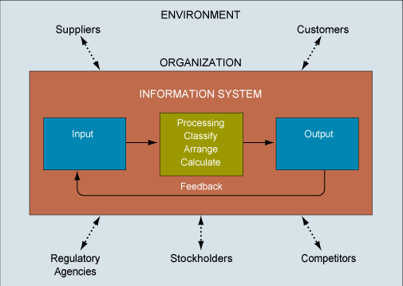
INTERDEPENDENCE BETWEEN ORGANIZATIONS AND IS

Slide 13
INFORMATION SYSTEMS SECURITY AND THREATS
Information systems plays a crucial role, so it is required to keep them safe and secure.
Data contained in IS should not be allowed to accessed by unauthorized people.
Threats:
-use of internet opens the door for external encroachment
-data stored on hard disk of computer without precautions can be read, copied or modified when connected to internet
-misuse of information systems by employees may cause loss of productivity, loss of revenue, legal liabilities etc.

Slide 14
Threats
Information system is vulnerable to various threats.
A threat is an object, person or other entity that represents a constant danger to an information system or some other asset.
In other words, a threat is a possible danger that might exploit a vulnerability.
A threat can be either
Intentional i.e. hacking: an individual cracker or a criminal organization or
Accidental e.g. the possibility of a computer malfunctioning, or the possibility of a natural disaster such as an earthquake, a fire, or a tornado etc.

Slide 15
Threat
A threat is an illegal activity that can damages Information System.Such as Loss of information,Data corruption.
Information Damage,Information Leakage,Information change or modification
Threat can be
Accidental threat
Intentional threat

Slide 16
Accidental Threat:No Third party involve
E.g:power cut,hard disk crash

Slide 17
Intentional Threat:Third party involvement
E.g: Telephone call record
Whatsapp messages read

Slide 18
Intentional Threat
Attack
Passive Attack Active Attack

Slide 19
Passive Attack:Passive Attack is a network attack in which a system is monitored,analyse or observed the information over the network
Passive attack may be the
Release of message content
Traffic analysis

Slide 20
Active Attack:An active attack attempt to alter system resources or affect their operations.
Masquerade:
Modification Of message
Repudiation
Replay
Denial Of Services

Slide 21
Privacy Threat
A privacy threat, in the context of computer security, refers to anything that has the potential to cause serious harm to a private information,privacy or secrecy.

Slide 22
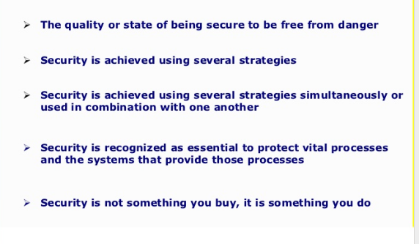
Security

Slide 23
Security Threat
When the information is leaked from the network or leaked under the network is termed as security threat and due to this information is disturbed .
A security threat usually takes a toll on the databases of the companies, leading to significant financial losses and confidential information leakage. Data breaches is one of the most common problems experienced by the companies. The threats can be caused by both internal or external forces

Slide 24
Types of Security threats
Internal Security Threat
External Security Threat
Unstructured Security Threat
Structured Security Threat

Slide 25
Internal Security Threat
When the information is being leaked inside the network is Internal security threat.
60% of security threats are due to the internal security threat.

Slide 26
External Security Threat
When the information is being leaked outside the network is External security threat.
This threat is detected by the IDS(Intrusion Detection System).

Slide 27
Unstructured Security Threat
This type of threat is Created by an inexperienced indiviual or the information leaked from the network by an inexperienced individual.
Unstructured threats often involve unfocused assaults on one or more network systems, often by individuals with limited or developing skills. The systems being attacked and infected are probably unknown to the perpetrator. These attacks are often the result of people with limited integrity and too much time on their hands. Malicious intent might or might not exist, but there is always indifference to the resulting damage caused to others.

Slide 28
Structured Security Threat
This type of threat is Created by an experienced indiviual or the information leaked from the network by an experienced individual.
Structured threats are more focused by one or more individuals with higher-level skills actively working to compromise a system. The targeted system could have been detected through some random search process, or it might have been selected specifically. The attackers are typically knowledgeable about network designs, security, access procedures, and hacking tools, and they have the ability to create scripts or applications to further their objectives.

Slide 29
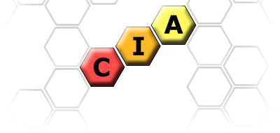
INFORMATION SECURITY
Information is an asset to all individuals and businesses.
Information Security refers to the protection of these assets in order to achieve C - I - A as the following diagram:

Slide 30
Information system security
Information systems security, more commonly referred to as INFOSEC, refers to the processes and methodologies involved with keeping information confidential, available, and assuring its integrity.
In other words, Information security means protecting information (data) and information systems from unauthorized access, use, disclosure, disruption, modification, or destruction.
Information systems security does not just deal with computer information, but also protecting data and information in all of its forms, such as telephone conversations.
For example, a message could be modified during transmission by someone intercepting it before it reaches the intended recipient. Good cryptography tools can help mitigate this security threat.

Slide 31
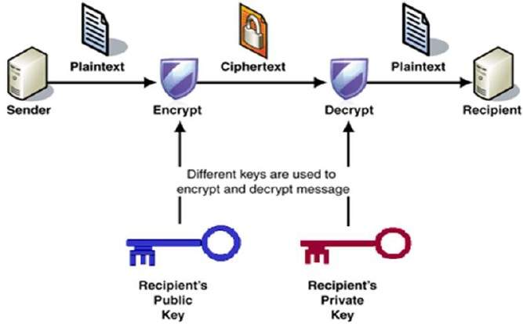
ENCRYPTION

Slide 32
It also refers to:
Access controls, which prevent unauthorized personnel from entering or accessing a system.
Protecting information no matter where that information is, i.e. in transit (such as in an email) or in a storage area.
The detection and remediation of security breaches, as well as documenting those events.

Slide 33
Security Related Basic Terms
Electronic Security
Non-repudiation
Electronic signature
Encryption
Cipher
Cryptanalysis
Cryptography
Denial of service(DoS) attacks.
Interception
Spoofing
Steganography.

Slide 34
IMPORTANT TERMS
Electronic security
  refers to any electronic equipment that could perform security operations like surveillance, access control, alarming or an intrusion control. Example:
    CCTV Surveillance Security System
    Fire Detection/Alarming System
    Access Control/Attendance System
Non-repudiation
  Method by which sender of data is provided with a proof of delivery and recipient is assured of sender’s identity.
  Neither sender nor recipient can deny having processed the data.
  Connected with the concept of electronic signature.
Electronic signature
  Operates on a message to assure message source authenticity and integrity and source non repudiation.

Slide 35
Encryption
  Modification of data for security purpose prior to its transmission so that it is not comprehensible without the decoding method.
  the process of converting information or data into a code, especially to prevent unauthorized access
Cipher
  The modified data obtained after encryption.
Cryptanalysis
  Being able to break the cipher so that encrypted message can be read.
Cryptography
  Cryptography is associated with the process of converting ordinary plain text into unintelligible text and vice-versa.
  It is a method of storing and transmitting data in a particular form so that only those for whom it is intended can read and process it.

Slide 36
Denial of service(DoS) attack
  A network based attack in which the attacker intends to flood your accounts with large quantities of e-mail.
  By using huge e-mail attachments and file transfers the attacker targets to fill up your hard drive storage space.
Spoofing
  A spoofing attack is when a malicious party impersonates another device or user on a network in order to launch attacks against network hosts, steal data, spread malware or bypass access controls.
Steganography
  The art of hiding existence of a message.
  Ensures confidentiality and integrity of data.
  Example: In a digital image, the least significant bit of each word can be used to comprise a message without causing any significant change in the image.

Slide 37
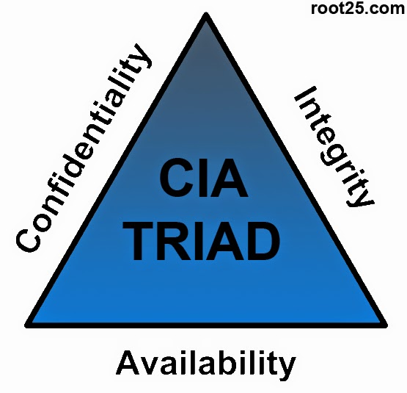
Three Pillars of Information Security (CIA)

Slide 38
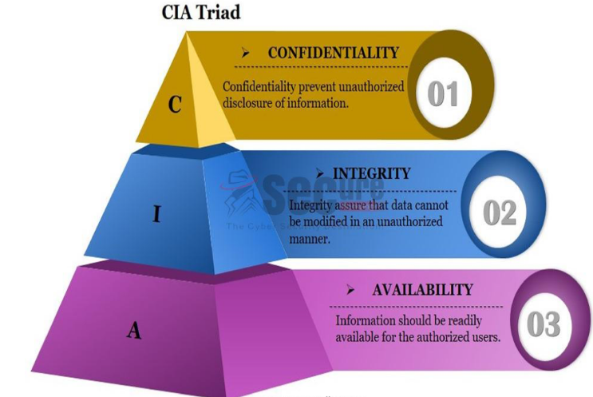
CIA Triangle

Slide 39
Confidentiality
When protecting information, we want to be able to restrict access to those who are allowed to see it; everyone else should be disallowed from learning anything about its contents. This is the essence of confidentiality.
Example: ID and passwords to authenticate authorized users.
Permitting someone to look over your shoulder at your computer screen while you have confidential data displayed on it could be a breach of confidentiality.

Slide 40
Confidentiality
If a laptop computer containing sensitive information about a company's employees is stolen or sold, it could result in a breach of confidentiality.
Federal law requires that universities restrict access to private student information. The university must be sure that only those who are authorized have access to view the grade records.

Slide 41
Integrity
Integrity is the assurance that the information being accessed has not been altered and truly represents what is intended.
Example: Checksums for the verification of integrity.
Information integrity means information truly represents its intended meaning. Information can lose its integrity through malicious intent, such as when someone who is not authorized makes a change to intentionally misrepresent something
Integrity can also be lost unintentionally, such as when a computer power surge corrupts a file or someone authorized to make a change accidentally deletes a file or enters incorrect information.

Slide 42
Integrity
Integrity is lost when a computer virus infects a computer
when an employee is able to modify his own salary in a payroll database
when an unauthorized user vandalizes a web site
when someone is able to cast a very large number of votes in an online poll

Slide 43
Availability
For any information system to serve its purpose, the information must be available when it is needed.
This means the computing systems used to store and process the information, the security controls used to protect it, and the communication channels used to access it must be functioning correctly.
High availablility systems aim to remain available at all times, preventing service disruptions due to power outages, hardware failures, and system upgrades.
Ensuring availability also involves preventing denial of service attacks, such as a flood of incoming messages to the target system, essentially forcing it to shut down.

Slide 44
Other terms related to IS
Identification: Identification is the ability to identify uniquely a user of a system or an application that is running in the system
Authentication: Authentication is the ability to prove that a user or application is genuinely who that person or what that application claims to be.
Accountability: A system’s ability to determine the actions and behaviour of a single individual within a system, and to identify that particular individual.
Authorization: It is the function of specifying access rights/privileges to resources related to information security.
Privacy: The safeguarding of personal data is the objective i.e. data about individuals such as contact information, health, financial, and family information; these individuals could be employees, customers and other stakeholders

Slide 45
Information Classification
Data classification is the act of placing data into categories that will dictate the level of internal controls to protect that data against theft, compromise, and inappropriate use.
Information security is best managed when data is classified.
Organizations classify information into different categories for security purposes.
Benefits of information security:
Demonstration towards an organization’s commitment to security protections.
Identification of sensitivity of information.
Supports the tenets of CIA as it pertains to data.
Identification of which protection applies to which information.

Slide 46
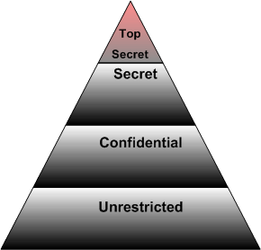
INFORMATION CLASSIFICATION
Unclassified
Sensitive but unclassified
Confidential
Secret
Top secret

Slide 47
Levels of information classification
Unclassified: The information that is neither sensitive nor classified.
Sensitive but classified(SBU): Information that has been designated as minor secret, but may not create serious damage if disclosed.
Confidential: Information that is designated to be a confidential nature. The disclosure can lead to some damage to national security.
Secret: Information that is designated to be a secret in nature. The disclosure can lead to serious damage to national security.
Top secret: The highest level of information classification. Its disclosure will cause exceptionally grave damage to the country’s national security.

Slide 48
Need-to-know based information classification
Public: Information that is similar to the unclassified information. The unauthorized disclosure, alteration or destruction of this data would results in little or no risk to the company.
Sensitive: Information requiring the higher level of security controls. The unauthorized disclosure, alteration or destruction of that data could cause a significant level of risk to the company. Confidentiality and integrity need to be taken care of.
Private: Information that is personal in nature and is intended for company use only. Disclosure of this data can adversely effect the company or its employees.

Slide 49
Information Classification: Various Roles
The roles and responsibilities of all participants in the information classification program must be clearly defined.
Owner: Executive or manager of an organization.
The owner has the final corporate responsibility for data protection, and under the concept of due care the owner may be liable for negligence because of the failure to protect these data.
Responsibilities of Owner:
Making original decision as to what level of classification the information requires based on the business needs for the protection of the data.
Reviewing the classification assignments periodically and making alterations as the business needs change.
Delegating the responsibilities of the data protection duties to custodian.

Slide 50
Information Classification: Various Roles
Custodian: has operational responsibility for the physical and electronic security of the information.
Responsibilities of custodian:
Running regular backups and routinely testing the validity of backup data.
Performing the data restoration from the backups when necessary.

Slide 51
Criteria for classification of data and information
Value
Age
Useful life
Personal information

Slide 52
Information Classification: Various Roles
User: they can be operator. They can be system employee or external party that routinely uses the information as a part of their job. They can also be considered consumers of the data.
Responsibilities of User:
It is mandatory for users to follow the operating procedures that are defined in a organization’s security policy and they must adhere to the published guidelines for their use.
Users must take due care to preserve the information’s security during their work.
They must prevent ‘open view’ from occurring.
Users must use the company’s computing resources only for company purposes and not for personal use.

