Slide 1
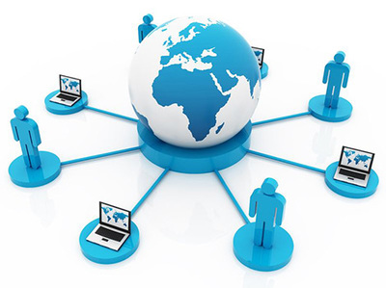
CHAPTER 1
INFORMATION SYSTEMS

Slide 2
INFORMATION SYSTEMS
An information system (IS) is an organized system for the collection, organization, storage and communication of information.
Example:Mobilephones,laptops,documemts are the examples of information system in which we store or organise our information.

Slide 3
Meaning Of Information Systems(IS)
An information system (IS) is a set of interrelated components that collect, process, store and distribute information to support decision making and control in an organization.
The components of Information system (IS) include hardware, software, network, database and human resource that interact to produce information.
A computer information system is a system that is composed of people and computers that processes or interprets information.

Slide 4
Meaning of Information System
IS accept data from their environment and manipulate data to produce information that is used to solve a problem or address a business need.
In earlier days, majority of information system were manual systems.
These days, IS is mostly computerized, software intensive systems.

Slide 5
Manual V/S Computerized syallubus
DISADVANTAGES OF MANUAL SYSTEM:
  Time Taking Process
  Difficult to handle
  More possibilities of errors
  ADVANTAGES OF COMPUTERIZED SYSTEM
    Time Saving
    Proper Management
    Easy to handle
    Less possibilities of errors

Slide 6
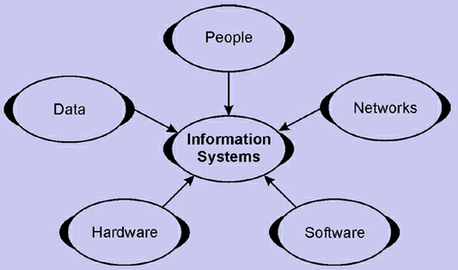
INFORMATION SYSTEMS COMPONENTS

Slide 7
People: required for the operation of all information systems. These people resources include end users and IS specialists.
  End users (also called users or clients) are people who use an information system or the information it produces. They can be accountants, salespersons, engineers, clerks, customers, or managers. Most of us are information system end users.
  IS Specialists are people who develop and operate information systems. They include systems analysts, programmers, computer operators, and other managerial technical, and clerical IS personnel.

Slide 8
Hardware: The concept of Hardware resources includes all physical devices and materials used in information processing. Example of hardware in computer-based information systems are:
  Computer systems: consist of central processing units containing microprocessors, and variety of interconnected peripheral devices.
  Computer peripherals: devices such as a keyboard or electronic mouse for input of data and commands, a video screen or printer for output of information, and magnetic or optical disks for storage of data resources.

Slide 9
Software: includes all sets of information processing instructions. This includes the sets of operating instructions called programs, which direct and control computer hardware as well as the sets of information processing instructions needed by people, called procedures. The following are the examples of software resources:
  System Software such as an operating system program,
  Application Software which are programs that direct processing for a particular use of computers by end users.
  Procedures which are operating instructions for the people who will use an information system.

Slide 10
Data: the raw material of information systems. Data can be:
  Alphanumeric data: composed of numbers and alphabetical and other characters.
  Text data: consisting of sentences and paragraphs used in written communications.
  Image data: such as graphic shapes and figures.
  Audio data: the human voice and other sounds.

Slide 11
Network: Telecommunications networks like the Internet have become essential to the successful operations of all types of organizations and their computer-based information systems. Communications networks are a fundamental resource component of all information systems. It includes:
  Communication media: Examples include twisted pair wire, coaxial cable, fiber-optic cable, microwave systems, and communication satellite systems.
  Network Support: This includes people, hardware, software, and data resources that directly support the operation and use of a communications network. Examples include communications control software such as network operating systems and Internet packages.

Slide 12
FUNCTIONS OF INFORMATION SYSTEMS
IS consists of data, hardware, software, procedures and people.
The major functions are: Input, storage, processing, control, output.
IS are developed to support specific business functions. For example:
Finance- FMIS(Financial Management Information System)
Manufacturing- ERP(Enterprise Resource Planning)
Human resource- HR information systems
Marketing and sales- CRM(Customer Relationship Management)

Slide 13
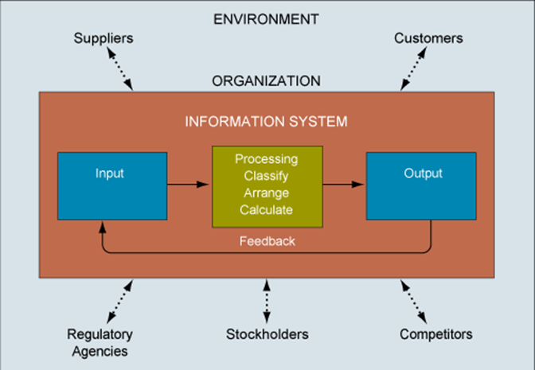
FUNCTIONS OF INFORMATION SYSTEMS

Slide 14
IMPORTANCE OF INFORMATION SYSTEMS
Communication – with help of information technologies the instant messaging, emails, voice and video calls becomes quicker, cheaper and much efficient.
Globalization and cultural gap – by implementing information systems we can easily share the information, knowledge, communication and relationships between different countries, languages and cultures.
Availability – information systems has made it possible for businesses to be open 24×7 all over the globe.
Creation of new types of jobs – Most of the jobs nowadays are information- intensive i.e. based on handling large amount of information. Examples: training, teaching, accountants, lawyers etc.
Cost effectiveness and productivity – the IS application promotes more efficient operation of the company and also improves the supply of information to decision-makers. IS has a positive impact on productivity.

Slide 15
Importance Of Information Systems
Operations Management: All operations are done efficiently .
Decision-Making: Help to make profitable decisions for any organization.
Record-Keeping: All data is saved and kept for any reference.
Main purpose: To turn raw data into useful information that can be used for decision making in an organization.

Slide 16
Major Roles Of Information System (IS) in IT
Three major roles of the business applications of information systems include:
• Support Business Processes – involves dealing with information systems that support the business processes and operations in a business.
• Support Decision Making – help decision makers to make better decisions and attempt to gain a competitive advantage.
• Support Competitive Advantage – help decision makers to gain a strategic advantage over competitors requires innovative use of information technology

Slide 17
INFORMATION SYSTEMS SECURITY AND THREATS
Information systems plays a crucial role, so it is required to keep them safe and secure.
Data contained in IS should not be allowed to accessed by unauthorized people.
Threats:
-use of internet opens the door for external encroachment
-data stored on hard disk of computer without precautions can be read, copied or modified when connected to internet
-misuse of information systems by employees may cause loss of productivity, loss of revenue, legal liabilities etc.

Slide 18
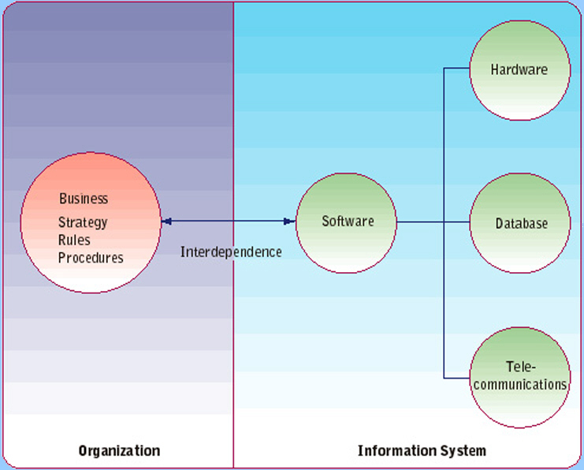
INTERDEPENDENCE BETWEEN ORGANIZATIONS AND IS

Slide 19
TYPES OF INFORMATION SYSTEM
A typical organization is divided into operational, middle, and upper level.
Understanding the various levels of an organization is essential to understand the information required by the users who operate at their respective levels.

Slide 20
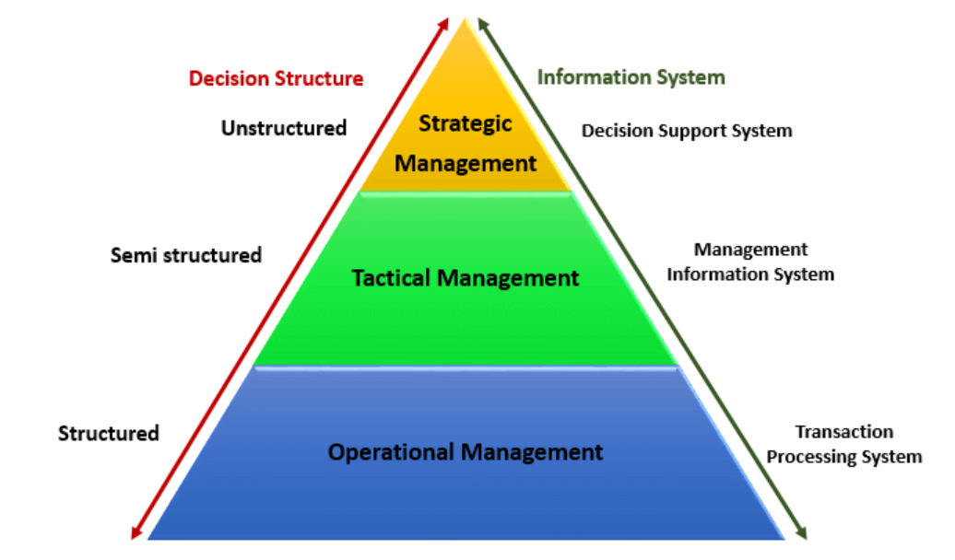
Pyramid Diagram of Organizational levels and information requirements

Slide 21
The operational level is concerned with performing day to day business transactions of the organization.
Examples of users at this level of management include cashiers at a point of sale, bank tellers, nurses in a hospital, customer care staff, etc.
The organization level is dominated by middle-level managers, heads of departments, supervisors, etc. The users at this level usually oversee the activities of the users at the operational management level.

Slide 22
As an example, a tactical manager can check the credit limit and payments history of a customer and decide to make an exception to raise the credit limit for a particular customer.
Strategic Management Level
This is the most senior level in an organization. The users at this level make unstructured decisions. Senior level managers are concerned with the long-term planning of the organization

Slide 23
TYPES OF INFORMATION SYSTEM
There are 4 Types of Information Systems as mentioned below:
Transaction Processing Systems(TPS)
Management Information Systems(MIS)
Decision Support Systems(DSS)
Expert system(ES)

Slide 24
Transaction Processing System
Transaction Processing System are information system that processes data resulting from the occurrences of business transactions
Their objectives are to provide transaction in order to update records and generate reports i.e to perform store keeping function
The transaction is performed in two ways: Batching processing and Online transaction processing.
Example: Bill system, payroll system, Stock control system.

Slide 25
In a batch processing system, transaction data is accumulated over a period of time and processed periodically.
Real-time(online) processing systems process transaction data immediately after they are generated and can provide immediate output to end users.

Slide 26
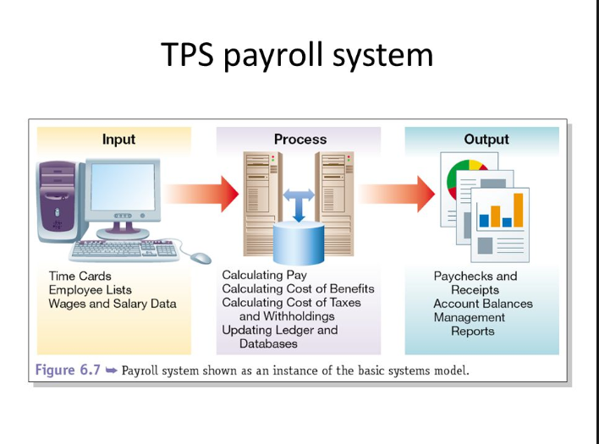

Slide 27
Management Information System
Management Information System is designed to take relatively raw data available through a Transaction Processing System and convert them into a summarized and aggregated form for the manager, usually in a report format. It reports tending to be used by middle management and operational supervisors.
Many different types of report are produced in MIS. Some of the reports are a summary report, on-demand report, ad-hoc reports and an exception report.
Example: Sales management systems, Human resource management system.

Slide 28
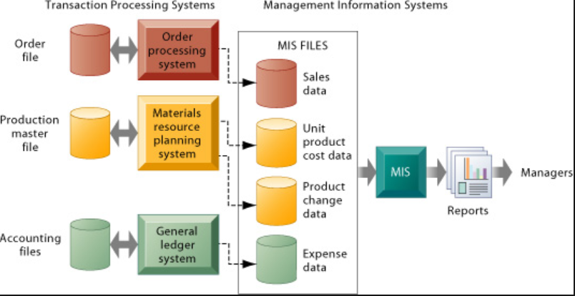

Slide 29
Decision Support System
Decision Support System is an interactive information system that provides information, models and data manipulation tools to help in making the decision in a semi-structured and unstructured situation.
Decision Support System comprises tools and techniques to help in gathering relevant information and analyze the options and alternatives, the end user is more involved in creating DSS than an MIS.
Example: Financial planning systems, Bank loan management systems.

Slide 30
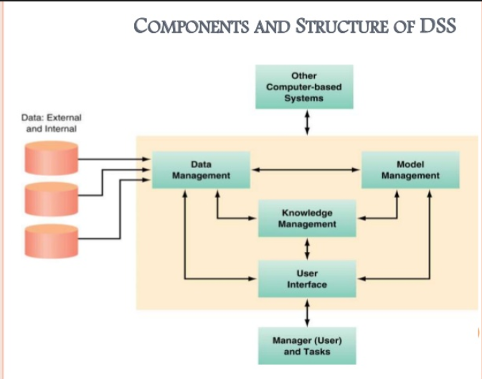

Slide 31
Experts systems
Experts systems include expertise in order to aid managers in diagnosing problems or in problem-solving. These systems are based on the principles of artificial intelligence research.
Experts Systems is a knowledge-based information system. It uses its knowledge to act as an expert consultant to users.
Knowledgebase and software modules are the components of an expert system. These modules perform inference on the knowledge and offer answers to a user’s question

Slide 32
THREATS
Information system is vulnerable to various threats.
A threat is an object, person or other entity that represents a constant danger to an information system or some other asset.
In other words, a threat is a possible danger that might exploit a vulnerability.
A threat can be either
Intentional i.e. hacking: an individual cracker or a criminal organization or
Accidental e.g. the possibility of a computer malfunctioning, or the possibility of a natural disaster such as an earthquake, a fire, or a tornado etc.

Slide 33
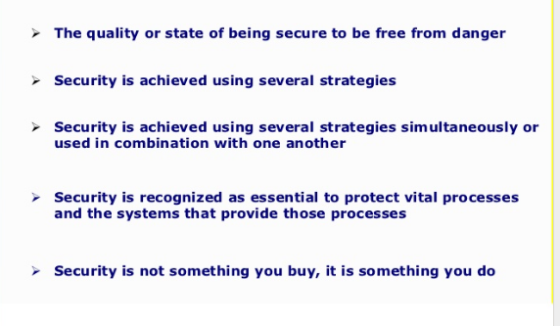
SECURITY

Slide 34
SECURITY THREAT
When the information is leaked from the network or leaked under the network is termed as security threat and due to this information is disturbed .
A security threat usually takes a toll on the databases of the companies, leading to significant financial losses and confidential information leakage. Data breaches is one of the most common problems experienced by the companies. The threats can be caused by both internal or external forces

Slide 35
TYPES OF SECURITY THREAT
Internal Security Threat
External Security Threat
Unstructured Security Threat
Structured Security Threat

Slide 36
INTERNAL SECURITY THREAT
When the information is being leaked inside the network is Internal security threat.
60% of security threats are due to the internal security threat.

Slide 37
EXTERNAL SECURITY THREAT
When the information is being leaked outside the network is External security threat.
This threat is detected by the IDS(Intrusion Detection System).

Slide 38
UNSTRUCTURED THREATS
This type of threat is Created by an inexperienced indiviual or the information leaked from the network by an inexperienced individual.
Unstructured threats often involve unfocused assaults on one or more network systems, often by individuals with limited or developing skills. The systems being attacked and infected are probably unknown to the perpetrator. These attacks are often the result of people with limited integrity and too much time on their hands. Malicious intent might or might not exist, but there is always indifference to the resulting damage caused to others.

Slide 39
STRUCTURED SECURITY THREAT
This type of threat is Created by an experienced indiviual or the information leaked from the network by an experienced individual.
Structured threats are more focused by one or more individuals with higher-level skills actively working to compromise a system. The targeted system could have been detected through some random search process, or it might have been selected specifically. The attackers are typically knowledgeable about network designs, security, access procedures, and hacking tools, and they have the ability to create scripts or applications to further their objectives.

Slide 40
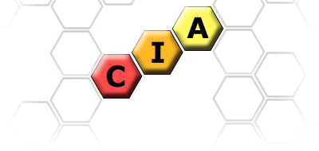
INFORMATION SECURITY
Information is an asset to all individuals and businesses.
Information Security refers to the protection of these assets in order to achieve C - I - A as the following diagram:

Slide 41
INFORMATION SYSTEM SECURITY
Information systems security, more commonly referred to as INFOSEC, refers to the processes and methodologies involved with keeping information confidential, available, and assuring its integrity.
In other words, Information security means protecting information (data) and information systems from unauthorized access, use, disclosure, disruption, modification, or destruction.
Information systems security does not just deal with computer information, but also protecting data and information in all of its forms, such as telephone conversations.
For example, a message could be modified during transmission by someone intercepting it before it reaches the intended recipient. Good cryptography tools can help mitigate this security threat.

Slide 42
It also refers to:
Access controls, which prevent unauthorized personnel from entering or accessing a system.
Protecting information no matter where that information is, i.e. in transit (such as in an email) or in a storage area.
The detection and remediation of security breaches, as well as documenting those events.

Slide 43
Security Related Terms
Electronic Security
Non-repudiation
Electronic signature
Encryption
Cipher
Cryptanalysis
Cryptography
Denial of service(DoS) attacks.
Interception
Spoofing
Steganography.

Slide 44
Important Terms
Electronic security
  refers to any electronic equipment that could perform security operations like surveillance, access control, alarming or an intrusion control. Example:
    CCTV Surveillance Security System
    Fire Detection/Alarming System
    Access Control/Attendance System
Non-repudiation
  Method by which sender of data is provided with a proof of delivery and recipient is assured of sender’s identity.
  Neither sender nor recipient can deny having processed the data.
  Connected with the concept of electronic signature.
Electronic signature
  Operates on a message to assure message source authenticity and integrity and source non repudiation.

Slide 45
Encryption
  Modification of data for security purpose prior to its transmission so that it is not comprehensible without the decoding method.
  the process of converting information or data into a code, especially to prevent unauthorized access
Cipher
  The modified data obtained after encryption.
Cryptanalysis
  Being able to break the cipher so that encrypted message can be read.
Cryptography
  Cryptography is associated with the process of converting ordinary plain text into unintelligible text and vice-versa.
  It is a method of storing and transmitting data in a particular form so that only those for whom it is intended can read and process it.

Slide 46
Denial of service(DoS) attack
  A network based attack in which the attacker intends to flood your accounts with large quantities of e-mail.
  By using huge e-mail attachments and file transfers the attacker targets to fill up your hard drive storage space.
Spoofing(hide their own identity and do some crime)
  A spoofing attack is when a malicious party impersonates another device or user on a network in order to launch attacks against network hosts, steal data, spread malware or bypass access controls.
Steganography(covered/secret writing)
  The art of hiding existence of a message.
  Ensures confidentiality and integrity of data.
  Example: In a digital image, the least significant bit of each word can be used to comprise a message without causing any significant change in the image.
Sniffing:Copying the data while travelling.

Slide 47
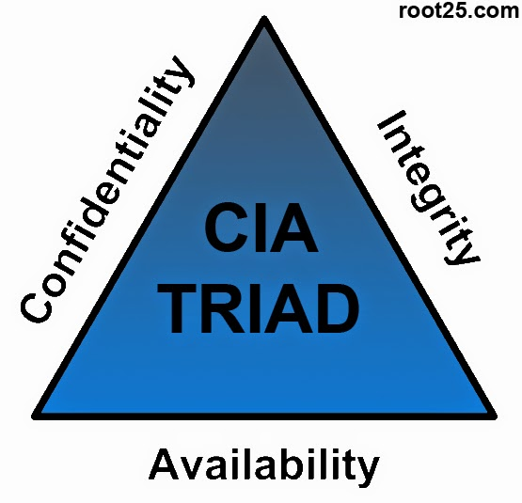
Three Pillars Of Information Security

Slide 48
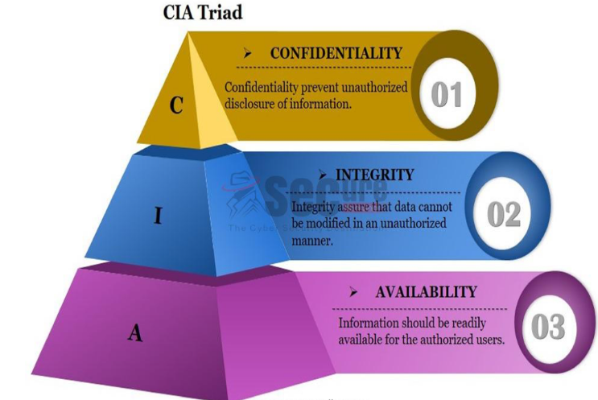
CIA Triangle

Slide 49
Confidentiality
When protecting information, we want to be able to restrict access to those who are allowed to see it; everyone else should be disallowed from learning anything about its contents. This is the essence of confidentiality.
Example: ID and passwords to authenticate authorized users.
Permitting someone to look over your shoulder at your computer screen while you have confidential data displayed on it could be a breach of confidentiality.

Slide 50
Confidentiality
If a laptop computer containing sensitive information about a company's employees is stolen or sold, it could result in a breach of confidentiality.
Federal law requires that universities restrict access to private student information. The university must be sure that only those who are authorized have access to view the grade records.

Slide 51
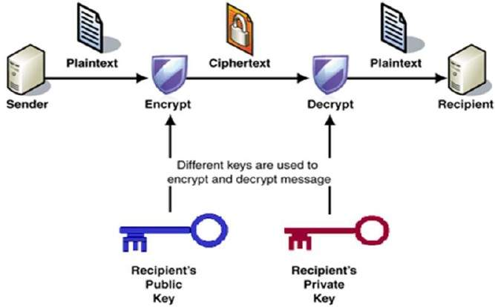
ENCRYPTION

Slide 52
SYMMETRIC KEY CRYPTOGRAPHY
In symmetric key we use the same key for both encryption and decryption of your data or message.
DES(56 bits)
3DES(192 bits)
AES(128,192,256 bits)
Biggest challenge: Key exchange
Solution:Diffie hellman algorithm

Slide 53
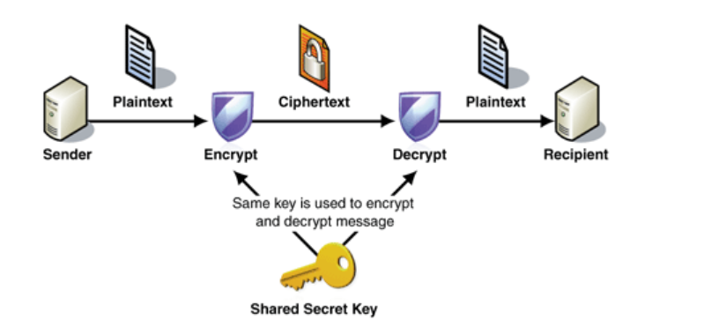
Symmetric Key

Slide 54
Question: if there are ten nodes in network ,
then how many symmetric keys we need?

Slide 55
ASYMMETRIC KEY CRYPTOGRAPHY
In asymmetric key we use not one key but a pair of keys: a private one and a public one.
Also called as “public key cryptography”.
Main algorithm used is RSA(Rivest–Shamir–Adleman)

Slide 56
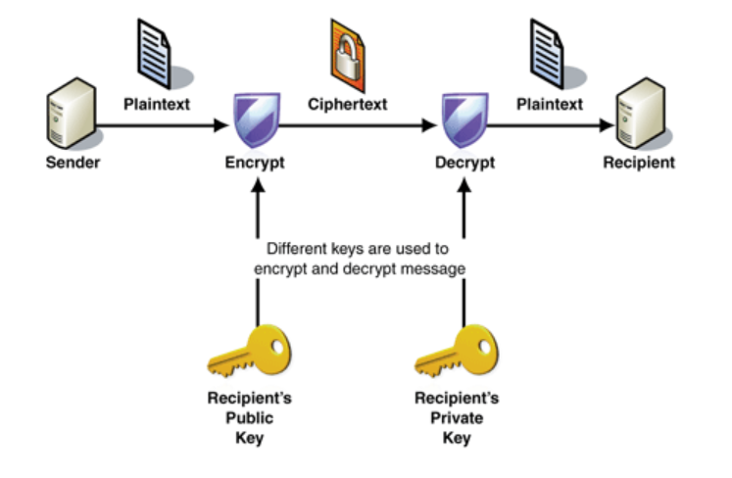
Asymmetric key

Slide 57
Four ways in which public key and private key could be used for cryptography where A is sender and B is receiver.
  Public(A)-----------------------Private(A)
  Private(B)----------------------Public(B)
  Private(A)----------------------Public(A)
  Public(B)-----------------------Private(B)

Slide 58
RSA Algorithm
Choose two different large random prime numbers.
Calculate n=p*q
Calculate Ø(n)=(p-1)*(q-1)
Choose e such that 1<e< Ø(n),e is co-prime to Ø(n) i.e. gcd(e, Ø(n))=1
Calculate d such that de=1 mod Ø(n)
(e---public key,d----private key)s

Slide 59
In RSA cryptosystem a particular A uses two prime numbers p=13 and q=17 to generate his public and private keys. If the public key of A is 35 ,Then the private key is?

Slide 60
Integrity
Integrity is the assurance that the information being accessed has not been altered and truly represents what is intended.
Example: Checksums for the verification of integrity.
Information integrity means information truly represents its intended meaning. Information can lose its integrity through malicious intent, such as when someone who is not authorized makes a change to intentionally misrepresent something
Integrity can also be lost unintentionally, such as when a computer power surge corrupts a file or someone authorized to make a change accidentally deletes a file or enters incorrect information.

Slide 61
Integrity
Integrity is lost when a computer virus infects a computer
when an employee is able to modify his own salary in a payroll database
when an unauthorized user vandalizes a web site
when someone is able to cast a very large number of votes in an online poll

Slide 62
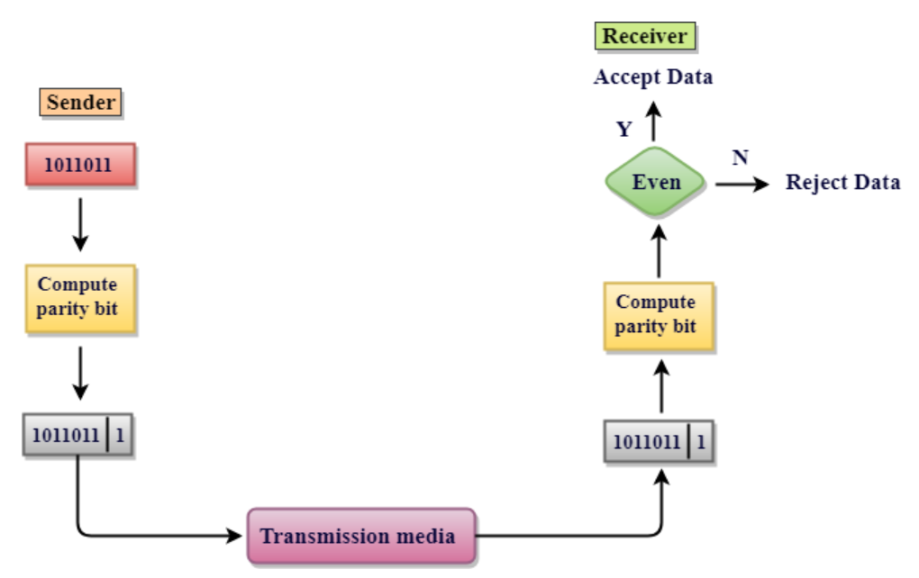
CHECKSUM

Slide 63
Availability
For any information system to serve its purpose, the information must be available when it is needed.
This means the computing systems used to store and process the information, the security controls used to protect it, and the communication channels used to access it must be functioning correctly.
High availability systems aim to remain available at all times, preventing service disruptions due to power outages, hardware failures, and system upgrades.
Ensuring availability also involves preventing denial of service attacks, such as a flood of incoming messages to the target system, essentially forcing it to shut down.

Slide 64
Other Terms Related To IS
Identification: Identification is the ability to identify uniquely a user of a system or an application that is running in the system
Authentication: Authentication is the ability to prove that a user or application is genuinely who that person or what that application claims to be.
Accountability: A system’s ability to determine the actions and behaviour of a single individual within a system, and to identify that particular individual.
Authorization: It is the function of specifying access rights/privileges to resources related to information security.
Privacy: The safeguarding of personal data is the objective i.e. data about individuals such as contact information, health, financial, and family information; these individuals could be employees, customers and other stakeholders

Slide 65
Information Classification
Data classification is the act of placing data into categories that will dictate the level of internal controls to protect that data against theft, compromise, and inappropriate use.
Information security is best managed when data is classified.
Organizations classify information into different categories for security purposes.

Slide 66
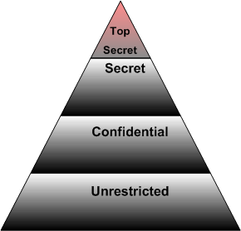
INFORMATION CLASSIFICATION
Unclassified
Sensitive but unclassified
Confidential
Secret
Top secret

Slide 67
Levels of information classification
Unclassified: The information that is neither sensitive nor classified.
Sensitive but unclassified(SBU): Information that has been designated as minor secret, but may not create serious damage if disclosed.
Confidential: Information that is designated to be a confidential nature. The disclosure can lead to some damage to national security.
Secret: Information that is designated to be a secret in nature. The disclosure can lead to serious damage to national security.
Top secret: The highest level of information classification. Its disclosure will cause exceptionally grave damage to the country’s national security.

Slide 68
Need-to-know based information classification
Public: Information that is similar to the unclassified information. The unauthorized disclosure, alteration or destruction of this data would results in little or no risk to the company.
Sensitive: Information requiring the higher level of security controls. The unauthorized disclosure, alteration or destruction of that data could cause a significant level of risk to the company. Confidentiality and integrity need to be taken care of.
Private: Information that is personal in nature and is intended for company use only. Disclosure of this data can adversely effect the company or its employees.

Slide 69
Information Classification: Various Roles
The roles and responsibilities of all participants in the information classification program must be clearly defined.
Owner: Executive or manager of an organization.
The owner has the final corporate responsibility for data protection, and under the concept of due care the owner may be liable for negligence because of the failure to protect these data.
Responsibilities of Owner:
Making original decision as to what level of classification the information requires based on the business needs for the protection of the data.
Reviewing the classification assignments periodically and making alterations as the business needs change.
Delegating the responsibilities of the data protection duties to custodian.

Slide 70
Information Classification: Various Roles
Custodian: has operational responsibility for the physical and electronic security of the information.
Responsibilities of custodian:
Running regular backups and routinely testing the validity of backup data.
Performing the data restoration from the backups when necessary.

Slide 71
Criteria for classification of data and information
Value
Age
Useful life
Personal information

Slide 72
Information Classification: Various Roles
User: they can be operator. They can be system employee or external party that routinely uses the information as a part of their job. They can also be considered consumers of the data.
Responsibilities of User:
It is mandatory for users to follow the operating procedures that are defined in a organization’s security policy and they must adhere to the published guidelines for their use.
Users must take due care to preserve the information’s security during their work.
They must prevent ‘open view’ from occurring.
Users must use the company’s computing resources only for company purposes and not for personal use.

Slide 73
Types of Attack
Active attacks are the attacks in which the attacker tries to modify the information or creates a false message. The prevention of these attacks is quite difficult because of a broad range of potential physical, network and software vulnerabilities. Instead of prevention, it emphasizes on the detection of the attack and recovery from any disruption or delay caused by it.
Passive attacks are the attacks where the attacker indulges in unauthorized eavesdropping, just monitoring the transmission or gathering information. unlike active attack, the passive attack is hard to detect because it doesn’t involve any alteration in the data or system resources

Slide 74
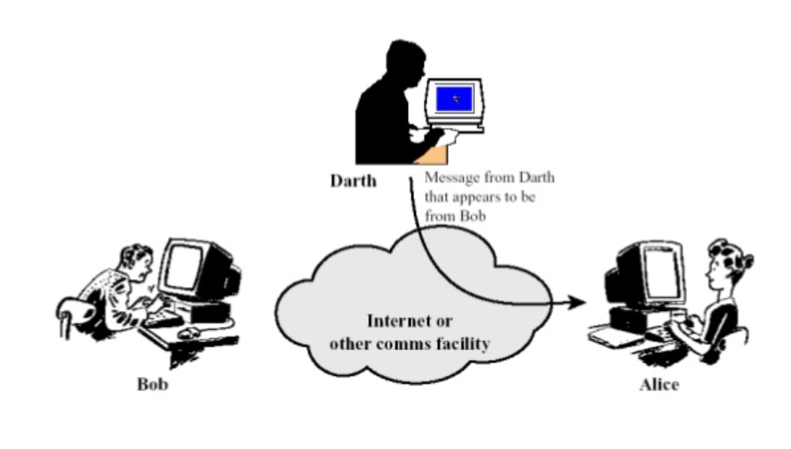
Types of Active Attack
Masquerade –
Masquerade attack takes place when one entity pretends to be different entity.

Slide 75
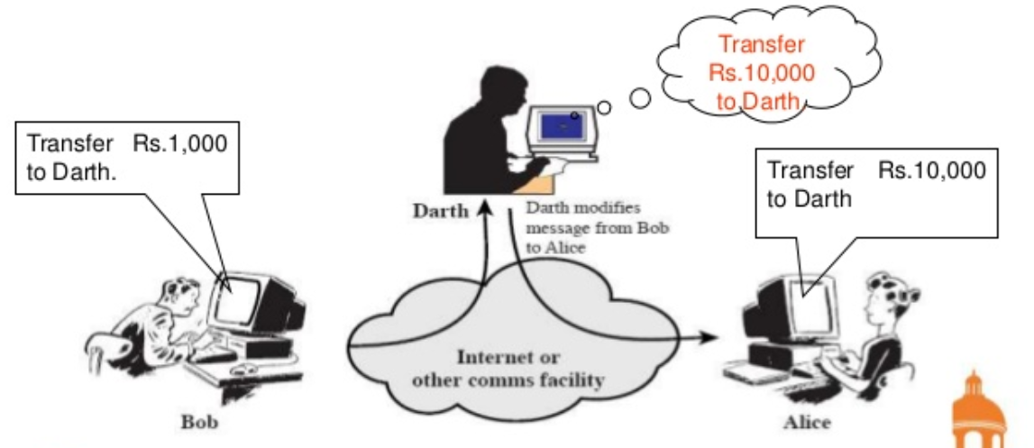
Modification of messages –
It means that some portion of a message is altered or that message is delayed or reordered to produce an unauthorised effect.

Slide 76
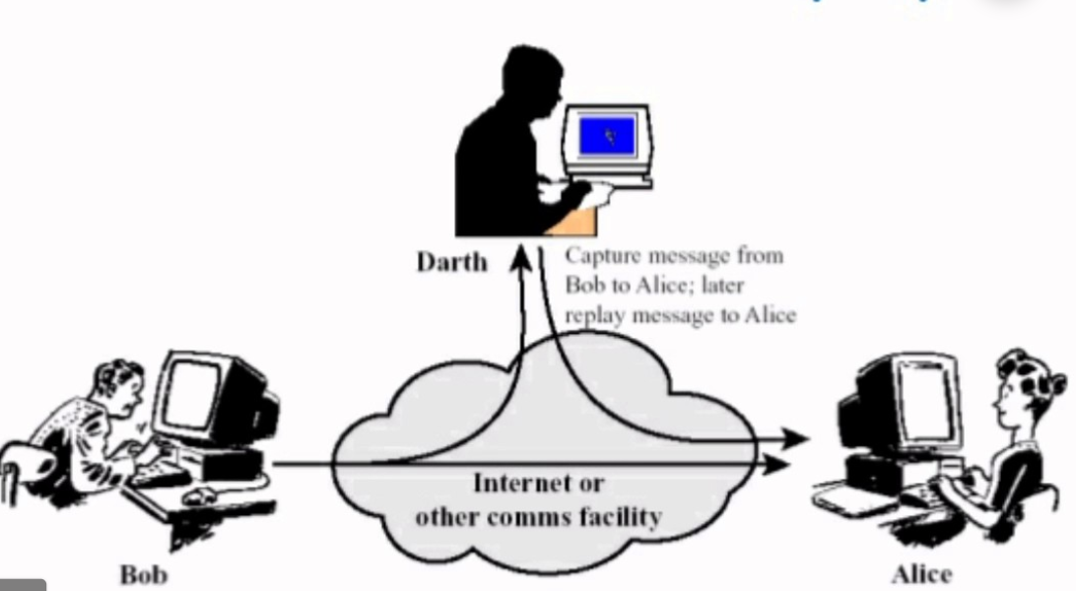
Replay –
It involves the passive capture of a message and its subsequent the transmission to produce an authorized effect.

Slide 77
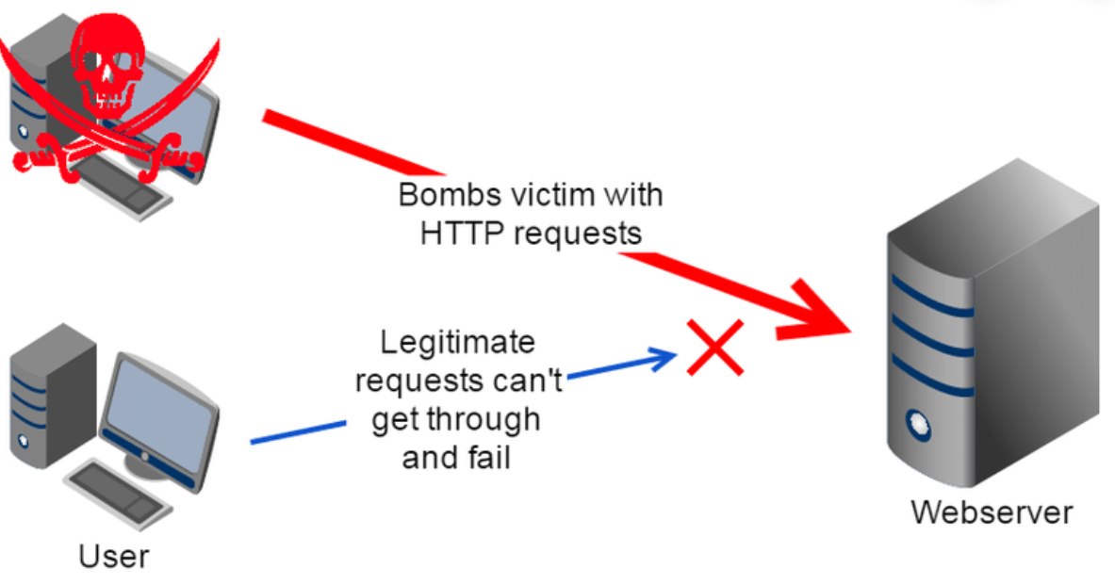
Denial of Service –
It prevents normal use of communication facilities. This attack may have a specific target.

Slide 78
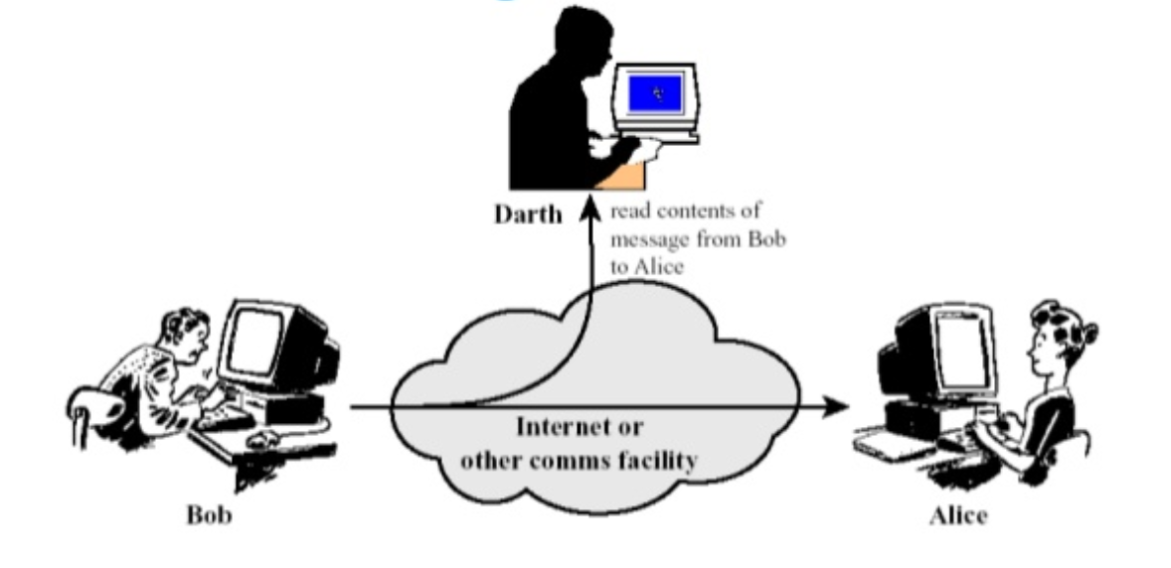
Types of Passive Attack
The release of message content –
Telephonic conversation, an electronic mail message or a transferred file may contain sensitive or confidential information.

Slide 79
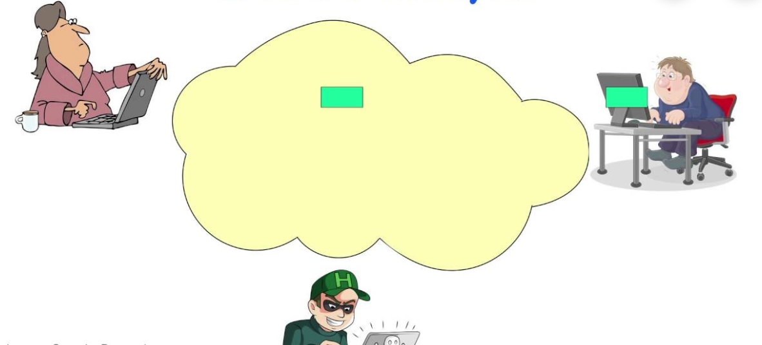
Traffic Analysis: The opponent could determine the location and identity of communicating host and could observe the frequency and length of messages being exchanged.

Slide 80
THANKS

