Slide 1
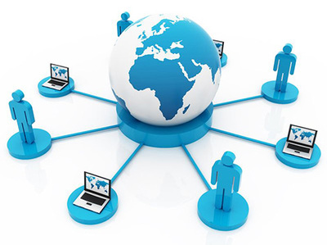
CHAPTER 1
INFORMATION SYSTEMS

Slide 2
INFORMATION SYSTEMS
An information system (IS) is an organized system for the collection, organization, storage and communication of information.
Example:Mobilephones,laptops,documemts are the examples of information system in which we store or organise our information.

Slide 3
Meaning Of Information Systems(IS)
An information system (IS) is a set of interrelated components that collect, process, store and distribute information to support decision making and control in an organization.
The components of Information system (IS) include hardware, software, network, database and human resource that interact to produce information.
A computer information system is a system that is composed of people and computers that processes or interprets information.

Slide 4
Meaning of Information System
IS accept data from their environment and manipulate data to produce information that is used to solve a problem or address a business need.
In earlier days, majority of information system were manual systems.
These days, IS is mostly computerized, software intensive systems.

Slide 5
Manual V/S Computerized syallubus
DISADVANTAGES OF MANUAL SYSTEM:
  Time Taking Process
  Difficult to handle
  More possibilities of errors
  ADVANTAGES OF COMPUTERIZED SYSTEM
    Time Saving
    Proper Management
    Easy to handle
    Less possibilities of errors

Slide 6
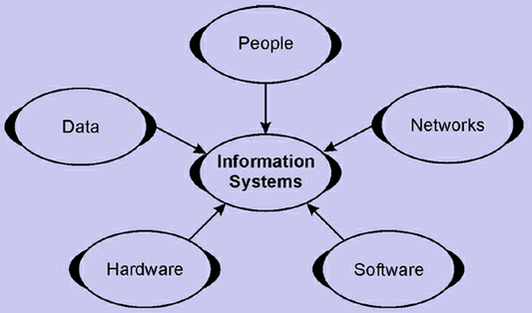
INFORMATION SYSTEMS COMPONENTS

Slide 7
People: required for the operation of all information systems. These people resources include end users and IS specialists.
  End users (also called users or clients) are people who use an information system or the information it produces. They can be accountants, salespersons, engineers, clerks, customers, or managers. Most of us are information system end users.
  IS Specialists are people who develop and operate information systems. They include systems analysts, programmers, computer operators, and other managerial technical, and clerical IS personnel.

Slide 8
Hardware: The concept of Hardware resources includes all physical devices and materials used in information processing. Example of hardware in computer-based information systems are:
  Computer systems: consist of central processing units containing microprocessors, and variety of interconnected peripheral devices.
  Computer peripherals: devices such as a keyboard or electronic mouse for input of data and commands, a video screen or printer for output of information, and magnetic or optical disks for storage of data resources.

Slide 9
Software: includes all sets of information processing instructions. This includes the sets of operating instructions called programs, which direct and control computer hardware as well as the sets of information processing instructions needed by people, called procedures. The following are the examples of software resources:
  System Software such as an operating system program,
  Application Software which are programs that direct processing for a particular use of computers by end users.
  Procedures which are operating instructions for the people who will use an information system.

Slide 10
Data: the raw material of information systems. Data can be:
  Alphanumeric data: composed of numbers and alphabetical and other characters.
  Text data: consisting of sentences and paragraphs used in written communications.
  Image data: such as graphic shapes and figures.
  Audio data: the human voice and other sounds.

Slide 11
Network: Telecommunications networks like the Internet have become essential to the successful operations of all types of organizations and their computer-based information systems. Communications networks are a fundamental resource component of all information systems. It includes:
  Communication media: Examples include twisted pair wire, coaxial cable, fiber-optic cable, microwave systems, and communication satellite systems.
  Network Support: This includes people, hardware, software, and data resources that directly support the operation and use of a communications network. Examples include communications control software such as network operating systems and Internet packages.

Slide 12
FUNCTIONS OF INFORMATION SYSTEMS
IS consists of data, hardware, software, procedures and people.
The major functions are: Input, storage, processing, control, output.
IS are developed to support specific business functions. For example:
Finance- FMIS(Financial Management Information System)
Manufacturing- ERP(Enterprise Resource Planning)
Human resource- HR information systems
Marketing and sales- CRM(Customer Relationship Management)

Slide 13
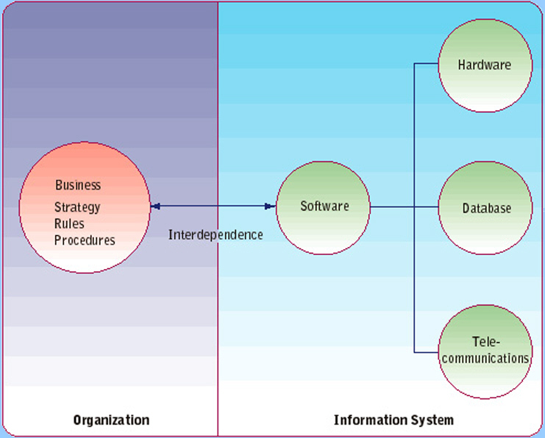
FUNCTIONS OF INFORMATION SYSTEMS

Slide 14
IMPORTANCE OF INFORMATION SYSTEMS
Communication – with help of information technologies the instant messaging, emails, voice and video calls becomes quicker, cheaper and much efficient.
Globalization and cultural gap – by implementing information systems we can easily share the information, knowledge, communication and relationships between different countries, languages and cultures.
Availability – information systems has made it possible for businesses to be open 24×7 all over the globe.
Creation of new types of jobs – Most of the jobs nowadays are information- intensive i.e. based on handling large amount of information. Examples: training, teaching, accountants, lawyers etc.
Cost effectiveness and productivity – the IS application promotes more efficient operation of the company and also improves the supply of information to decision-makers. IS has a positive impact on productivity.

Slide 15
Importance Of Information Systems
Operations Management: All operations are done efficiently .
Decision-Making: Help to make profitable decisions for any organization.
Record-Keeping: All data is saved and kept for any reference.
Main purpose: To turn raw data into useful information that can be used for decision making in an organization.

Slide 16
Major Roles Of Information System (IS) in IT
Three major roles of the business applications of information systems include:
• Support Business Processes – involves dealing with information systems that support the business processes and operations in a business.
• Support Decision Making – help decision makers to make better decisions and attempt to gain a competitive advantage.
• Support Competitive Advantage – help decision makers to gain a strategic advantage over competitors requires innovative use of information technology

Slide 17
INFORMATION SYSTEMS SECURITY AND THREATS
Information systems plays a crucial role, so it is required to keep them safe and secure.
Data contained in IS should not be allowed to accessed by unauthorized people.
Threats:
-use of internet opens the door for external encroachment
-data stored on hard disk of computer without precautions can be read, copied or modified when connected to internet
-misuse of information systems by employees may cause loss of productivity, loss of revenue, legal liabilities etc.

Slide 18
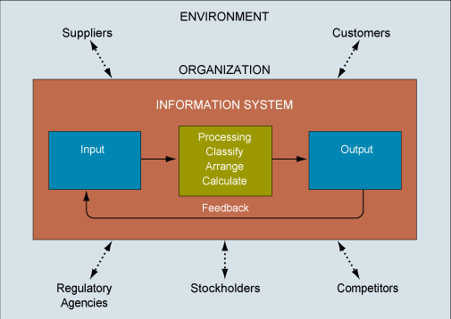
INTERDEPENDENCE BETWEEN ORGANIZATIONS AND IS

Slide 19
INFORMATION SYSTEMS SECURITY
Trademark, copyright, patent, trade secrets
Software licensing issues
Data privacy under legal framework
InfoSec and Control frameworks such as Control Objective for Information and related Technology(COBIT)
International Organization for Standardization (ISO)
Evidence of digital forensic practices and ethics
Computer frauds and abuse acts boundaries for illegal access to computers
Electronic surveillance and cyber crimes

Slide 20
THANKS

