Slide 1
UNIT 4

Slide 2
Terminology
Model is a high level construct representing processes, variables and relationships. Thus, model is an abstract, conceptual construct without providing specific guidance on or practices for implementation.
A framework is defined as a support structure in which another software project can be organized or developed.
While a model is abstract and conceptual, a framework is linked to demonstrable work.
Furthermore, frameworks set assumptions and practices that are designed to directly impact implementations. In contrast, models provide the general guidance for achieving the goals, but without getting into the details of practice and procedures.

Slide 3
Methodology
A methodology is a codified set of recommended practices, sometimes accompanied by training materials, formal educational programs, worksheets and diagramming tools.

Slide 4
Standards
A standard is a published document that contains a technical specification or other precise criterion designed to be used consistently as a rule, guideline or definition.
Standards help to make life simpler and to increase the reliability and effectiveness of many goods and services that we use.
They are the summary of best practices and are created by bringing together the experiences and expertise of all interested parties- the producers, sellers, buyers, users and regulators of a particular material, product, process or service.
An important point to note is that standards are designed for voluntary use and do not impose any regulations.
However, laws and regulations may refer to certain standards, and make compliance with them compulsory.

Slide 5
Standard
A security standard is like any other standard within any other industry.
A standard is “a published specification that establishes a common language, and contains a technical specification or other precise criteria and is designed to be used consistently, as a rule, a guideline, or a definition”. Further, according to ISO, standards “contribute to making life simpler, and to increasing the reliability and effectiveness of the goods and services we use”.
In essence a STANDARD is a common set of rules, definitions and agreed “regulations” that all parties can refer to for common reference.

Slide 6
Security Policy
SECURITY POLICY is a set of policies issued by an organization to ensure that all information technology users within the domain of the organization or its networks comply with rules and guidelines related to the security of the information stored digitally at any point in the network or within the organization's boundaries of authority.

Slide 7
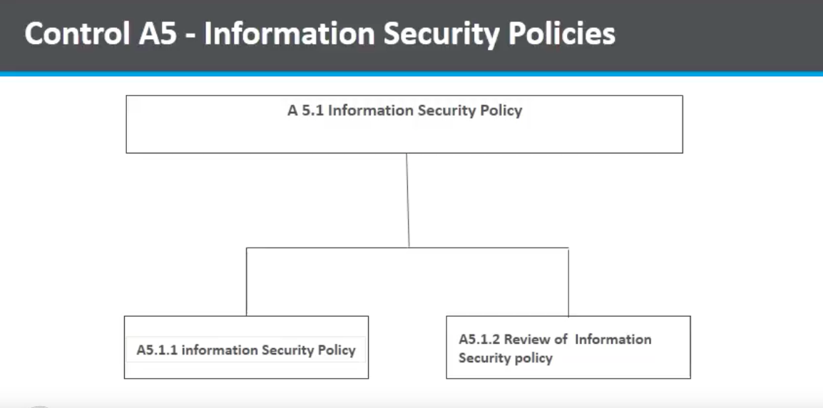

Slide 8
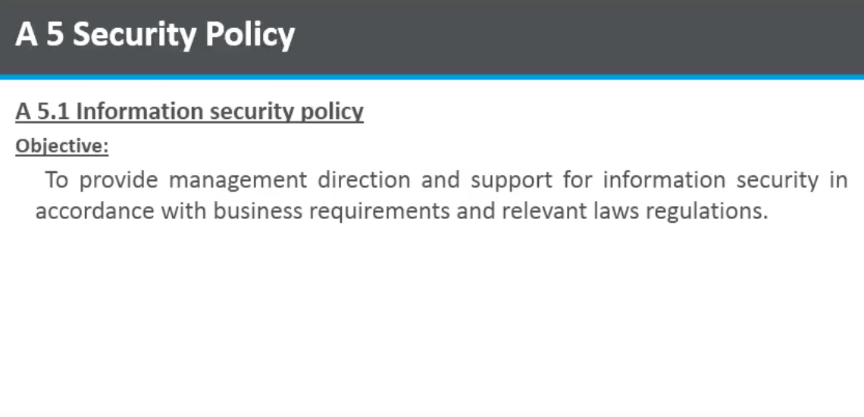

Slide 9
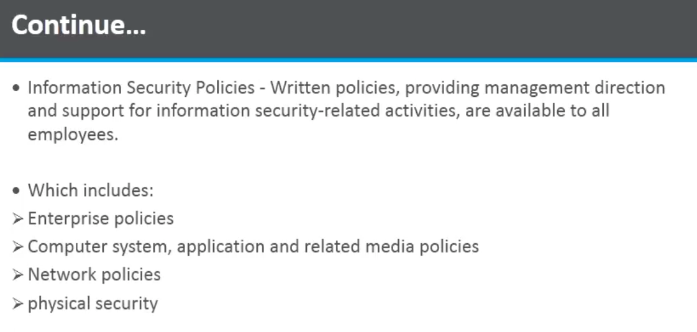

Slide 10
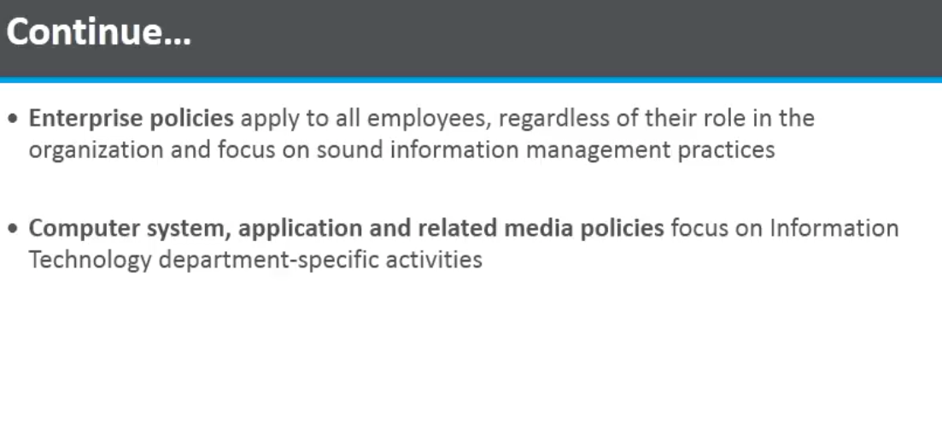

Slide 11
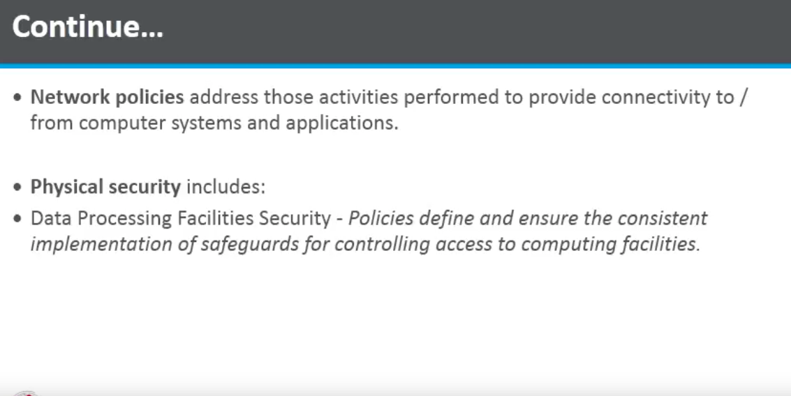

Slide 12
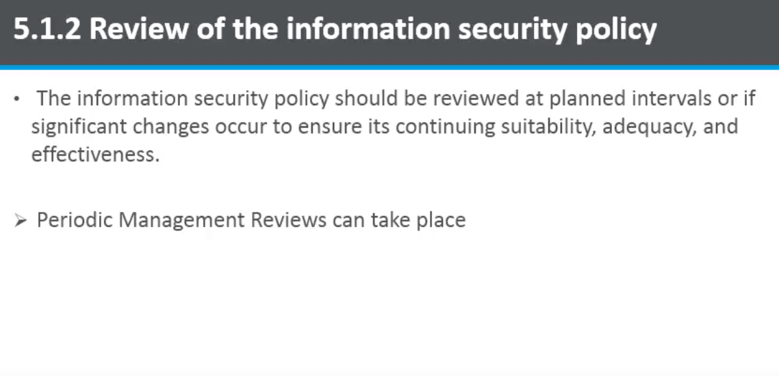

Slide 13
ISO 27001
ISO 27001 (formally known as ISO/IEC 17799:2005) is a specification for an information security management system (ISMS).
An ISMS is a framework of policies and procedures that includes all legal, physical and technical controls involved in an organisation's information risk management processes.
According to its documentation, ISO 27001 was developed to "provide a model for establishing, implementing, operating, monitoring, reviewing, maintaining and improving an information security management system."

Slide 14
ISO27001
It is an ISM standard.
Its purpose is to help organizations to establish and maintain the ISMS.
It is the set of requirements that must be met if you want your ISMS to be formally certified.
Being ISO 27001 approved is a certification which shows that the business has defined and implemented effective security process.

Slide 15
ISO 27001 uses a topdown, risk-based approach and is technology-neutral.
The specification defines a six-part planning process:
Define a security policy.
Define the scope of the ISMS.
Conduct a risk assessment.
Manage identified risks.
Select control objectives and controls to be implemented.
Prepare a statement of applicability.

Slide 16
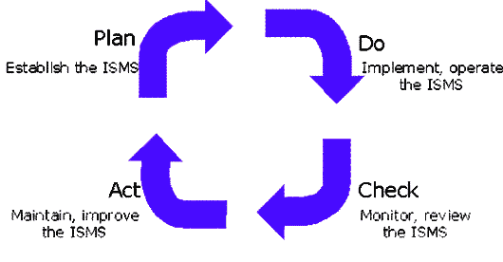
PDCA Approach

Slide 17
PLAN-Establish content
Define ISMS scope
Define policy
Identify risks
Assess risks
Select control objectives

Slide 18
2. DO-Implement and operate
Implement risk treatment plan
Deploy controls

Slide 19
3. CHECK- Monitor and review
Monitor processes
Regular reviews
Internal audits* (audit trail)

Slide 20
`
4. ACT-Maintain and improve
Implement improvements
Corrective actions
Preventive actions
Communicate with stakeholders

Slide 21
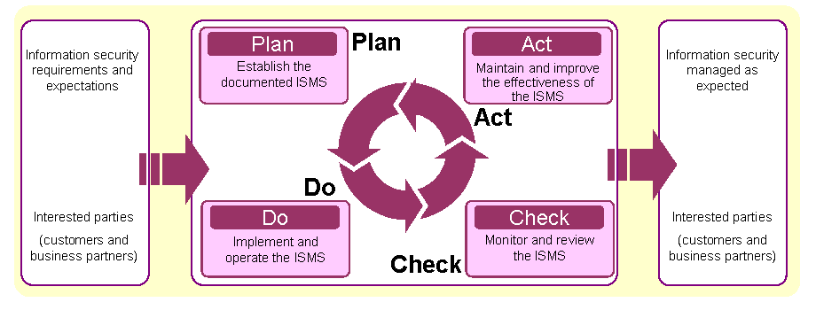
Implementation context of PDCA cycle in ISO 270001

Slide 22
ISO 27001 is designed to help organizations establish and maintain effective information security controls through continual improvements.
Developed in october, 2005 by International standards Organization, ISO 27001 implements principles of the Organization for Economic Cooperation and Development(OECD) on governing the security of information and networks.
The standard creates a road map for the secure design, implementation, management and maintenance of IT processes in the organization.

Slide 23
COBIT
COBIT stands for Control Objectives for Information and related technology.
COBIT is a framework for developing, implementing, monitoring and improving information technology (IT) governance and management practices.
The COBIT framework is published by the IT Governance Institute and the Information Systems Audit and Control Association (ISACA).
The goal of the framework is to provide a common language for business executives to communicate with each other about goals, objectives and results.

Slide 24
The original version, published in 1996, focused largely on auditing. The latest version, published in 2013, emphasizes the value that information governance can provide to a business' success.
It also provides quite a bit of advice about enterprise risk management.
Supports managers and allows balancing technical issues, business risks and control requirements.
Ensures quality, control and reliability of information systems in organization

Slide 25
Components of COBIT5
Framework: The main framework of COBIT guides organizations through best practices and standardization surrounding IT processes and infrastructure. The goal is to align IT with the overall business goals by getting IT on the same page as the rest of the company and to help other executives and senior managers better understand IT objectives.
Process descriptions: COBIT includes language that anyone in the organization will understand — so that CEOs, CFOs, CIOs and other key players will easily understand terminology, processes and descriptions. It can help establish a solid ground for communication between IT and outside departments.
Control objectives: This section offers an overview of high-level requirements that can help develop and improve every IT process, allowing businesses to adapt these to their own needs and goals.

Slide 26
Management guidelines: The COBIT guide offers best practices for establishing objectives, process and assigning task items or responsibilities across the organization. It also gives guidance on measuring performance and how the framework can integrate with other IT management frameworks.
Maturity models: COBIT maturity models help businesses assess the maturity of their organization, understand how the process will grow with the organization and identify any potential problems that might arise down the line.

Slide 27
The name COBIT originally stood for "Control Objectives for Information and Related Technology," but the spelled-out version of the name was dropped in favor of the acronym in the fifth iteration of the framework.
COBIT 5 is based on five key principles for governance and management of enterprise IT:
Principle 1: Meeting Stakeholder Needs
Principle 2: Covering the Enterprise End-to-End
Principle 3: Applying a Single, Integrated Framework
Principle 4: Enabling a Holistic Approach
Principle 5: Separating Governance From Management

Slide 28
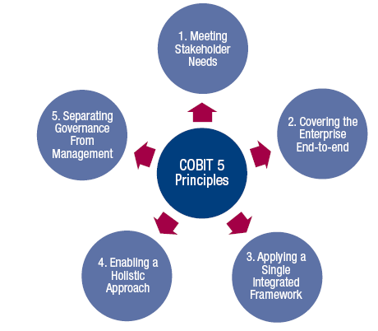
COBIT 5 Principles
Source: COBIT® 5, figure 2. © 2012 ISACA® All rights reserved.

Slide 29
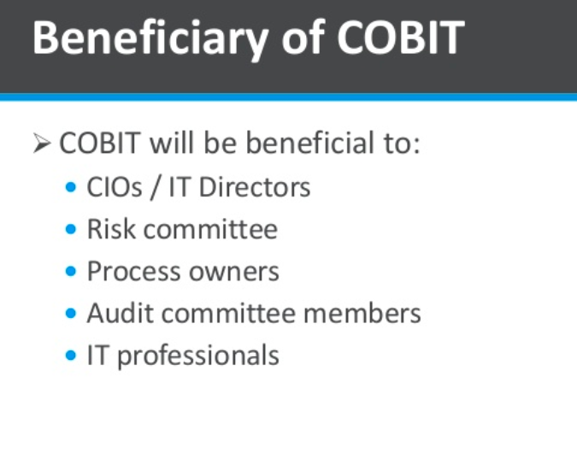

Slide 30
THE FRAMEWORK ALSO IDENTIFIES SEVEN ASPECTS OF GOVERNANCE THAT NEED TO BE IN PLACE IN ORDER TO SUPPORT THE FIVE PRINCIPLES :
PRINCIPLES, POLICIES AND FRAMEWORKS
PROCESSES
ORGANIZATIONAL STRUCTURES
CULTURE, ETHICS AND BEHAVIOR
INFORMATION
SERVICES, INFRASTRUCTURE AND APPLICATIONS
PEOPLE, SKILLS AND COMPETENCIES

Slide 31
SSE-CMM
(Systems Security Engineering and Capability Maturity Model)

Slide 32
Overview
The SSE-CMM describes the essential characteristics of an organization's security engineering process that must exist to ensure good security engineering.
It is developed based on the premise that if you can guarantee the quality of the processes that are used by the organization, then you can guarantee the quality of the products and services generated by the processes.
SSE-CMM focus on process definition and improvement as a core value.
SSE-CMM looks at the occurrence of security defects or incidents, and seeks to identify the flaw in the related process so as to remediate the flaw, thus removing the overall defect.

Slide 33
Basic Concepts
Process Process is a sequence of steps performed for a given purpose. It is the system of tasks, supporting tools, and people involved in the production and evolution of some end result (e.g., product, system, or service).
Base Practices (BP) & Generic Practices (GP)
Base practices are practices that collectively define security engineering. Examples of BPs are Identify Natural Threats, Assess Threat Likelihood, Capture Security View of System Operation, etc.
Generic practices are basically process management practices. Examples of GPs are Planning Performance, Tracking Performance, Ensure Training, etc.
Process Area Process areas are groups of practices, when taken together, achieve a common purpose.

Slide 34
Process Capability
Process capability refers to an organization's potential.
It is a range within which an organization is expected to perform. For example, in a software development project, one statistical metric to measure the process capability is to collect the # of software defects and plot the percentage of defects per thousand lines of source code. If you use the same team of developers and repeat roughly the same set of processes in your software development, your next project will have a comparable process capability, ie, in this case, the percentage of defects per thousand lines of source code will fall within a similar range of variation.
Process Maturity Process maturity indicates the extent to which a specific process is explicitly defined, managed, measured, controlled, and effective. Process maturity indicates the potential for growth in process capability.

Slide 35
Capability Maturity Model
A CMM is a framework for evolving an engineering organization from an less organized, less effective state to a highly structured and highly effective state.
Use of such a model is a means for organizations to bring their practices under statistical process control in order to increase their process capability with regard to cost, productivity, schedule, and quality.

Slide 36
Benefits of adopting the CMM framework
1. Improving Predictability The first improvement expected as an organization matures is predictability. For instance, Level 1 organizations often miss their originally scheduled delivery dates by a wide margin, whereas organizations at a higher CMM level should be able to predict the outcome of cost and schedule of a project with higher accuracy.
2. Improving Control The second improvement expected as an organization matures is control. As an organization’s CMM level increases, the organization will be able to establish revised targets more accurately. For example, if the business has asked for some new features and functions for a software application, the software development team will be able to more accurately determine how many more days of work will be needed.
3. Improving Process Effectiveness The third improvement expected as an organization matures is process effectiveness. As an organization matures, costs decrease, development time becomes shorter, and productivity and quality increase. In a Level 1 organization, development time can be quite long because of the amount of rework that must be performed to correct mistakes. In contrast, organizations at a higher maturity level can obtain shortened overall development times via increased process effectiveness and reduction of costly rework.

Slide 37
SSE-CMM Levels
Capability Level 1 – Initial-Performed Informally
Base practices of the process area are generally performed.
The performance of these base practices may not be rigorously planned and tracked.
Performance depends on individual knowledge and effort.
Work products of the process area testify to their performance.
Individuals within the organization recognize that an action should be performed, and there is general agreement that this action is performed as and when required.
There are identifiable work products for the process.

Slide 38
Capability Level 2 – Repeatable-Planned and Tracked
Performance of the base practices in the process area is planned and tracked.
Performance according to specified procedures is verified.
Work products conform to specified standards and requirements.
Measurement is used to track process area performance, thus enabling the organization to manage its activities based on actual performance.
The primary distinction from Level 1, Performed Informally, is that the performance of the process is planned and managed.

Slide 39
Capability Level 3 – Well Defined
Base practices are performed according to a well-defined process using approved, tailored versions of standard, documented processes.
The primary distinction from Level 2, Planned and Tracked, is that the process is planned and managed using an organization-wide standard process.
Capability Level 4 – Managed- Quantitatively Controlled
Detailed measures of performance are collected and analyzed.
This leads to a quantitative understanding of process capability and an improved ability to predict performance.
Performance is objectively managed, and the quality of work products is quantitatively known.
The primary distinction from the Well Defined level is that the defined process is quantitatively understood and controlled.

Slide 40
Capability Level 5 – Optimizing-Continuously Improving
Quantitative performance goals (targets) for process effectiveness and efficiency are established, based on the business goals of the organization.
Continuous process improvement against these goals is enabled by quantitative feedback from performing the defined processes and from piloting innovative ideas and technologies.
The primary distinction from the quantitatively controlled level is that the defined process and the standard process undergo continuous refinement and improvement, based on a quantitative understanding of the impact of changes to these processes.

Slide 41
Methodologies
IAM
IEM
SIPES

Slide 42
IAM
Information Security (INFOSEC) Assessment Methodology (IAM) is a detailed and systematic method for examining security vulnerabilities from an organizational perspective as opposed to a only a technical perspective.
Often overlooked are the processes, procedures, documentation, and informal activities that directly impact an organization’s overall security posture but that might not necessarily be technical in nature.

Slide 43
The main motive of IAM is to give organizations that provide INFOSEC assessments a repeatable framework for conducting organizational types of assessments as well as provide assessment consumers , appropriate information on what to look for in an assessment provider.
The IAM is also intended to raise awareness of the need for organizational types of assessment versus the purely technical type of assessment.
Three phases:
  Pre-assessment
  On-site activities
  Post assessment

Slide 44
Pre-Assessment
  Determine and manage the customer’s expectations
  Gain an understanding of the organization’s information criticality
  Determine customer’s goals and objectives
  Determine the system boundaries
  Coordinate with customer
  Request documentation
It concludes with a written assessment plan

Slide 45
On-Site Assessment
  This phase represents primary thrust of IAM in that it takes the results of pre-assessment phase, validate those results and perform additional data gathering and validation.
Conduct opening meeting
Gather and validate system information (via interview, system demonstration, and document review)
Analyze assessment information
Develop initial recommendations
  The result of this phase is a report of initial analysis

Slide 46
Post assessment phase
  It concludes the IAM by pulling together all details from previous two phases, combining them into final analysis and report .
Additional review of documentation
Additional expertise (get help understanding what you learned)
Report coordination (and writing)

Slide 47
IEM(INFOSEC Evaluation Methodology)
The IEM is a follow-on methodology to the IAM.
It provides the technical evaluation processes that were intentionally missing from the IAM.
The IEM is a hands-on methodology, meaning you'll be actively interacting with the customer's technical environment.
Whereas the IAM provides us with an understanding of organizational security as it relates to policies and procedures, the IEM offers a comprehensive look into the actual technical security at the organization.

Slide 48
IEM
Three phases:
  Pre evaluation
  On-site evaluation
  Post evaluation

Slide 49
Pre evaluation
Takes IAM pre assessment report as input and then coordinate the rules of engagement for conducting a technical evaluation of systems
Pull information from IAM Pre-Assessment
Coordination with the customer to determine acceptable Rules of Engagement (ROE)**
Give the team an understanding of the perceived system components
Define customer expectations
Define customer constraints or concerns
Legal Requirements
Develop the Technical Evaluation Plan (TEP)
Concludes with a technical evaluation plan.

Slide 50
On site evaluation
Represents bulk of hands-on technical work, performing various discoveries, scans and evaluations.
All findings are manually validated to ensure accuracy.
Post-evaluation
Concludes the methodology in a manner similar to IAM by pulling together all data generated , putting them into a final report that details findings, recommendations and a security road map.

Slide 51
Security Incident Policy Enforcement System (SIPES)
Its purpose is to offer a methodology for defining and executing a Security Incident Policy Enforcement Systems.
This methodology is planned for completeness.
The Security Incident Policy Enforcement System (SIPES) draft displays a relatively abstract method to addressing the difficulty of incident response management.

Slide 52
Security Incident Policy Enforcement System (SIPES)
Though, because of itsstatus as an “Incomplete” work that has not confirmed progress over the past two years, it issupposed that work has not sustained and that this methodology is, actually, obsolete.

