Slide 1
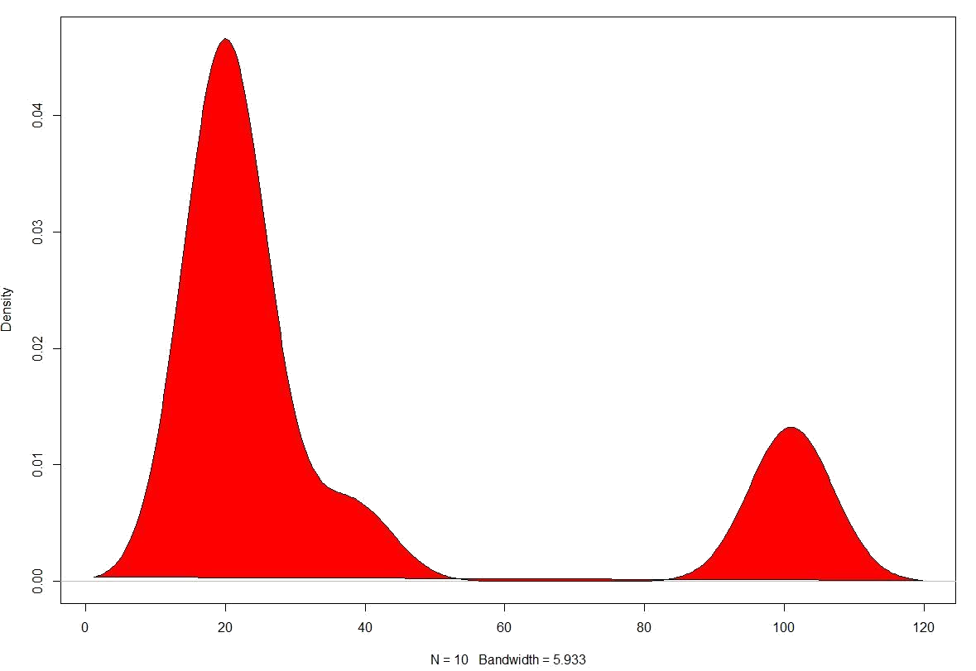
OUTLIERS

Slide 2


Q. What is Outlier?
ANS. An outlier is a data point that DIFFERS SIGNIFICANTLY from other observations

Slide 3

Q. What does DIFFER SIGNIFICANTLY mean?
ANS. The data point that are out of the Range. (IQR)
EXAMPLE:
10, 11, 15, 17, 13, 18, 14, 52
10, 11, 13, 14, 15, 17, 18, 52
OUT OF RANGE
In Terms of
HEIGHT
& AGE

Slide 4
Q. How to detect OUTLIERS?
ANS. For Detecting Outliers we need to study IQR (Inter Quartile Range)
Interquartile Range is the range of values between Quartile1 and Quartile3,
So IQR= Q3-Q1
For Study IQR we must be introduced with Following Terms
Quarters (Data Sample if taken as 100% would be divided among for 4 Quarters each have 25% of Data)
Data needs to be sorted in ascending order
Min value (Least Value in Dataset)
Min value
15
16
18
20
21
23
27
29
32
Quarter 1
(Q1) Quartile 1 (First 25% Data) i.e. Data after sorting in ascending order least values lies in this Quarter.
Q1
Quarter 2
IQR
(Q3-Q1)
27-18 = 9
(Q2) Quartile 2 or Median (First 50% Data)
Median
Quarter 3
(Q3) Quartile 3 (Last 75% Data)
Q3
Quarter 4
Max value (Highest Value in Dataset)
Max value

Slide 5
Q. How to detect OUTLIERS?
ANS. Any Value in Dataset above Q3+ 1.5 * IQR (Inter Quartile Range) OR
Any Value in Dataset below Q1- 1.5 * IQR (Inter Quartile Range)
10, 11, 15, 17, 13, 18, 14, 52
OUTLIER
EXAMPLE:
10, 11, 13, 14, 15, 17, 18, 52
Q2
(14+15)/2 = 14.5
Q1
(11+13)/2 = 12
Q3
(17+18)/2 = 17.5
IQR
Q3-Q1 => 17.5-12 => 5.5
So For OUTLIER if any Value in Given Sample below [12 – 1.5*(5.5)] => 3.75
So For OUTLIER if any Value in Given Sample above [17.5 + 1.5*(5.5)] => 25.75

Slide 6
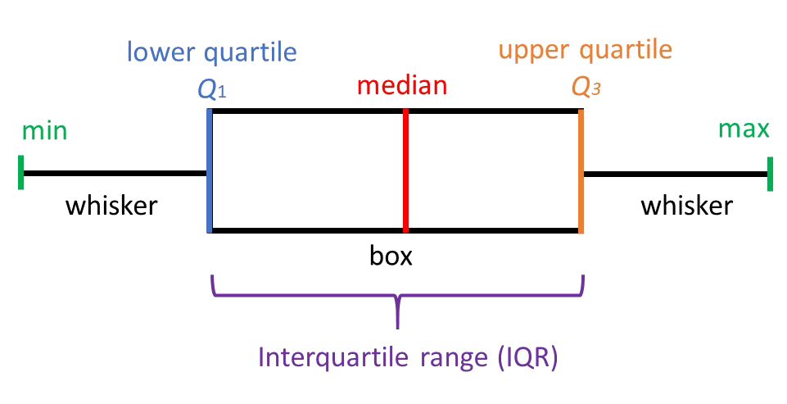
Q. Other way to detect OUTLIERS?
ANS. For Detecting Outliers we can use BOX and WHISKER PLOT
A Box and Whisker Plot is a method for graphically depicting groups of numerical data through their quartiles, it also have lines extending from the boxes (whiskers) indicating variability outside the upper and lower quartiles
required
required
outlier
outlier

Slide 7
Q. How OUTLIERS effects data and analysis?
ANS. Due to Outliers, one can reach to Misleading Hypothesis and Analysis moreover due
to outliers, Mean deviates in high amount whereas Median deviates with less amount.
Problem of Skewness also comes in picture due to outliers
EXAMPLE:
10, 11, 13, 14, 15, 17, 18, 52
Mean of Data with outlier: (10+11+13+14+15+17+18+52)/8 => 18.75
Mean Deviates by 4.75 Units
Mean of Data without outlier: (10+11+13+14+15+17+18)/7 => 14
Median of Data with outlier: (10+11+13+14+15+17+18+52) => 14.5
Median Deviates by 0.5 Units
Median of Data without outlier: (10+11+13+14+15+17+18) => 14

Slide 8
Q. How to handle OUTLIERS
ANS. There are many ways for doing it
10, 11, 13, 14, 15, 17, 18, 52
Use Median instead of Mean, if Outlier is present i.e. Use Median 4.25 for central tendency as when required.
Remove the Values from Dataset that are Outliers i.e. Remove 52 from Dataset
Impute Median at the place of Outlier i.e. Remove 52 and fill the location by median value as 4
Use Regression and Prediction Model and Predict the value then impute with Predicted value
Impute the Value as NA and later on would be handled while handling NA values

