Slide 1
Lecture: Economic cycles
Learning objectives:
To make students understand about cyclical nature of economic growth
To make deeper understanding of how economies go through in long period of time.

Slide 2
Economic Cycle
The economic cycle is the fluctuation of the economy between periods of expansion (growth) and contraction (recession).
Factors such as gross domestic product (GDP), interest rates, total employment, and consumer spending, can help to determine the current stage of the economic cycle.

Slide 3
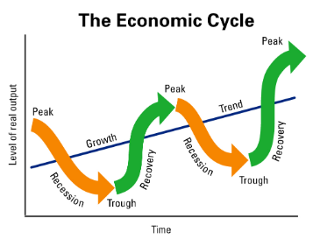

Slide 4
Economic cycle refers to the overall state of the economy going through four stages in a cyclical pattern.
Economic cycles are a major focus of economic research and policy, but the exact causes of a cycle are highly debated among the different schools of economics.
Insight into economic cycles can be very useful for businesses and investors.

Slide 5
The four stages of the economic cycle are also referred to as the business cycle. These four stages are expansion, peak, contraction, and trough.
During the expansion phase, the economy experiences relatively rapid growth, interest rates tend to be low, production increases, and inflationary pressures build.

Slide 6
The peak of a cycle is reached when growth hits its maximum rate.
Peak growth typically creates some imbalances in the economy that need to be corrected.
This correction occurs through a period of contraction when growth slows, employment falls, and prices stagnate.
The trough of the cycle is reached when the economy hits a low point and growth begins to recover.

Slide 7
The Keynesian approach argues that changes in aggregate demand, spurred by inherent instability and volatility in investment demand, is responsible for generating cycles.
When, for whatever reason, business sentiment turns gloomy and investment slows, a self-fulfilling loop of economic malaise can result.
Less spending means less demand, which induces businesses to lay off workers and cut back even further. Unemployed workers mean less consumer spending and the whole economy sours, with no clear solution other than government intervention and economic stimulus, according to the Keynesians.

Slide 8
Businesses and investors also need to manage their strategy over economic cycles, not so much to control them but to survive them and perhaps profit from them.

