Slide 1
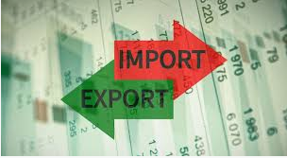
Balance of payments

Slide 2
Balance of payments
The balance of payments (BOP) is a statement of all transactions made between entities in one country and the rest of the world over a defined period of time, such as a quarter or a year.

Slide 3
The balance of payments (BOP), is also referred as balance of international payments.
Summarizes all transactions that a country's individuals, companies, and government bodies complete with individuals, companies, and government bodies outside the country.

Slide 4
These transactions consist of imports and exports of goods, services, and capital, as well as transfer payments, such as foreign aid and remittances.
A country's balance of payments and its net international investment position together constitute its international accounts.

Slide 5
In a BOP transactions are divided into two accounts:
The current account and the capital account.
Current account includes the transactions in goods services, investment income, and current transfers.

Slide 6
The capital account in broader sense includes transactions in financial instruments and central bank reserves.
In a narrow sense, it includes only transactions in financial instruments.

Slide 7
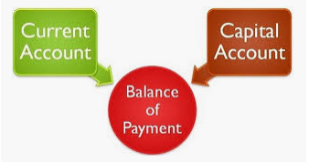

Slide 8
The current account includes a nation's net trade in goods and services, its net earnings on cross-border investments, and its net transfer payments.
The capital account consists of a nation's imports and exports of capital and foreign aid.
The current account is included in calculations of national output, while the capital account is not.

Slide 9
The sum of all transactions recorded in the balance of payments should be zero.
However, exchange rate fluctuations and differences in accounting practices may hinder this in practice.

Slide 10
BOP deficit
A balance of payments deficit means the country imports more goods, services and capital than it exports.
It must borrow from other countries to pay for its imports.

Slide 11
BOP surplus
A balance of payments surplus means the country exports more than it imports. It provides enough capital to pay for all domestic production.
The country might even lend outside its borders.

