Slide 1


Slide 2
MEANING
Leadership is an ability to influence people in such a way that they tend to achieve the goals.
Leadership is an art of getting things done by people in right manner by giving directions and if any discrepancies then solving them.

Slide 3
DEFINITION
"Leadership is accomplishing things that reach beyond solitary abilities by acting — and getting others to act — with a maturity that surpasses limited self-interest." -- John Baker

Slide 4
LEADERSHIP INVOLVES
Establishing a clear vision,
Sharing that vision with others so that they will follow willingly,
Providing the Knowledge and methods to realise that Vision. And,
Coordinating and balancing the conflicting interests of all members and stakeholders.

Slide 5
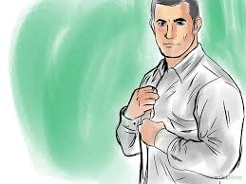
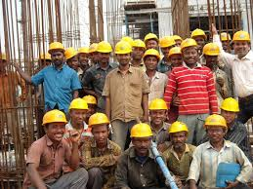
TWO WAY PROCESS
Leaders
His Followers

Slide 6

NATURE OF LEADERSHIP
TRAITIST
APPROACH
SITUATIONAL APPROACH

Slide 7
TRAITS
Openness - People who like to learn new things and enjoy new experiences.
Conscientiousness - People that have a high degree reliability and promptness. Traits include being organized, methodical, and thorough.
Extraversion - Extraverts get their energy from interacting with others, while introverts get their energy from within themselves. Extraversion includes the traits of energetic, talkative, and assertive.
Agreeableness - These individuals are friendly, cooperative, and compassionate. People with low agreeableness may be more distant. Traits include being kind, affectionate, and sympathetic.
Neuroticism - Neuroticism is also sometimes called Emotional Stability. This dimension relates to one’s emotional stability and degree of negative emotions. Traits include being moody and tense.

Slide 8
SITUATIONAL
This approach emphasizes that leadership is specific to a specific situation.
It is a way of behaving exhibited by individuals in differing degrees in different situations.
A leader in one group is not necessarily a leader in another. A leader in the class may not be a leader in the playground.

Slide 9
TYPES OF LEADERSHIP
According to H.T Mazumdar there are three kinds of leadership –
The TRADITIONAL LEADER gets his authority through the traditional status ascribed to him. Thus the Brahmin is the traditional leader of Hindu society.
The BUREAUCRATIC LEADER gets his authority and power through delegation from election or from appointment.
The CHARISMATIC LEADER charm and persuasiveness of the leader. He creates his own authority. He may be a party leader, a religious leader, a social leader or a revolutionary leader.

Slide 10
BASIS | JAPAN | U.S
Employment | Often for life. Layoffs are rare. | Usually short term. Layoffs are often.
Evaluation and promotion | Very slow. Big promotions donot come in first 10 years. | Very fast. If not promoted then people change their jobs.
Career paths | Very general. People move from one place to another and become aware of all areas of operation. | Very specialised. People tend to stay at one place only for the entire life.
Decision making | Carried out via group decision making. | Carried out by the individual manager.
Control mechanism | Very implicit and informal; people rely heavily on trust and goodwill. | Very explicit; people know exactly what to control and how to do it.
Responsibility | Shared collectively. | Assigned to individuals.
Concern for employees | Management’s concern extends to the whole life, business and social, of the worker | Management concerned basically with the individual’s work life only

Slide 11
MINTZBERG ROLES OF A LEADER
FIGUREHEAD :
-Entertaining clients and customers as an official representative of the organisation.
- Making oneself available to outsiders as a representative of the organisation.
- Escorting official visitors

Slide 12
2. SPOKESPERSON
When a leader acts as a spokesperson, the emphasis is on answering inquiries and formally reporting to individuals and groups outside the managers direct organisational unit. He needs to inform the five people about units Plans, Capabilities, Possibilities:
Upper level management
clients or customers
other important outsiders
professional colleagues
general public

Slide 13
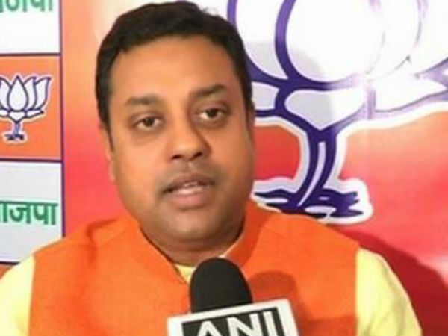
SAMBIT PATRA

Slide 14
NEGOTIATOR
TRYING TO MAKE DEALS WITH OTHERS FOR RESOURSES NEEDED. LIKE-
Bargaining with superiors for funds, facilities, equipment or forms of support
Bargaining with other units in the organisation for the use of staff, facilities, equipment
Bargaining with suppliers and vendors for services, schedules and delivery times.

Slide 15
COACH AND MOTIVATOR
ROLES INCLUDE
Informally recognising the team members’ achievements.
Give feedback concerning ineffective performance
Ensure team members are informed of steps to be followed to improve their performance
Implement rewards and punishments to encourage and sustain good performance

Slide 16
TEAM BUILDER
A KEY ROLE OF A LEADER IS TO BUILD EFFECTIVE TEAM.
Ensure team members are recognized for their accomplishments such as, through letter of appreciation
Initiating activities that contribute to group morale, such as giving parties and sponsoring sports teams.
Holding periodic staff meeting to encourage team members to talk about their accomplishments, problems, and concerns.

Slide 17
TEAM PLAYER
THREE BEHAVIOURS OF TEAM PLAYERS ARE:
Displaying appropriate personal conduct
cooperate with other units
display loyalty to superiors by supporting their plans and decisions fully.

Slide 18
TECHNICAL PROBLEM SOLVER
PARTICULARLY FOR SUPERVISORS AND MIDDLE MANAGERS
Serving as a technical expert a technical expert or advisor
Perform individual contribution tasks like making sales call and repairing machinery.

Slide 19
ENTREPRENEUR
NOT SELF EMPLOYED BUT MANAGER WHAVE SOME RESPONSIBILTY FOR SUGGESTING INNOVATIVE IDEAS. THREE ENTREPRENURIAL LEADERSHIP ROLE ATIVITIES ARE:
Read trade publications, professional journals to track what is happening in the industry.
Talk to customers or others in the organisation to keep aware of changing needs and requirements.
Getting involved in situations outside the unit that could suggest ways to improve the unit’s performance .

Slide 20
STRATEGIC PLANNER
TOP MANAGERS ENGANGE IN STRATEGIC PLANNING , USUALLY ASSISTED BY INPUT FROM OTHERS THROUGHOUT THE ORGANISATION. SPECIFIC ACTIVITIES ARE:
Setting a vision and direction for the organisation.
Helping the Firm deal with the external environment
Helping develop organisational policies.

Slide 21

SKILLS OF A LEADER
Be a visionary
Inspire and motivates others
Displays high integrity and honesty
Solves problem and analysis problem
Drives for result
Communicates powerfully
Builds relationship
Displays professional and technical expertise
Develop others
Innovative

Slide 22

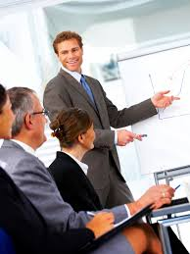
PERSONALITY TRAITS OF EFFECTIVE LEADER
GENERAL PERSONALITY TRAITS:
SELF CONFIDENCE
HUMILITY
TRUSTWORTHINESS
EXTRAVERSION
ASSERTIVENESS
EMOTIONAL STABILITY
ENTHUSIASM
SENSE OF HUMOR
WARMTH

Slide 23
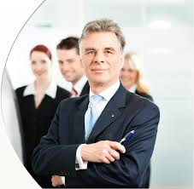
TASK RELATED PERSONALITY TRAITS
PASSION
- For work
- For people
2. EMOTIONAL INTELLEGENCE
- Self awareness
- Self management
- Social awareness
- Relationship management
COURAGE
INTERNAL LOCUS OF CONTROL
FLEXIBILITY AND ADAPTABILITY

Slide 24
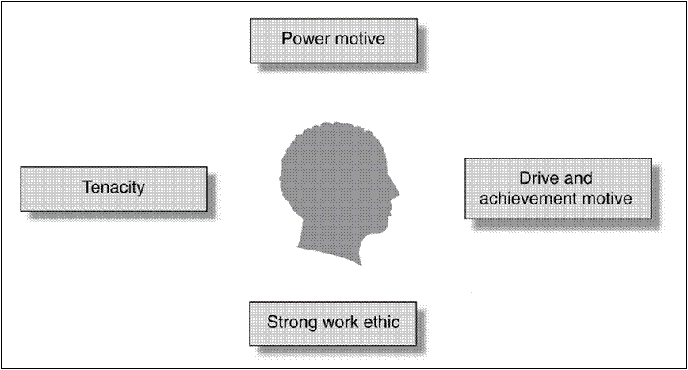
MOTIVES

Slide 25
POWER MOTIVE
Effective leaders have strong need to control resources
Act with vigour & determination to exert power.
Spend time, thinking of ways to alter behaviour and thinking of others.
Care about personal standing with those around them.
Personalized Power Motive:
Leader with such motive seek power to further their own interest
For them power is status symbols ( luxury & money )
Socialized Power Motive:
Achieve organizational goals or vision
Help others & for the benefit of the entire organization

Slide 26

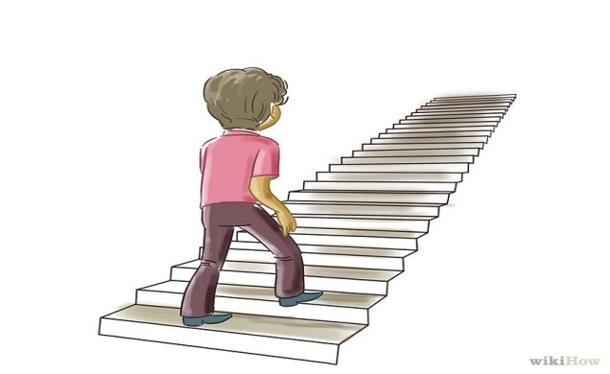
DRIVE & ACHIEVEMENT MOTIVATION
Leaders are known for investing strong efforts in achieving goals.
People with strong Achievement Motivation have consistent desire to:-
- Achieve through one’s own efforts & take responsibility for success or failure.
- Take moderate risks that can be handled through one’s own efforts.

Slide 27


STRONG WORK ETHICS
Effective leaders have strong work ethics.
They have firm belief in the dignity of work
value hard work.
They believe that group task is worthwhile.

Slide 28
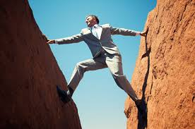
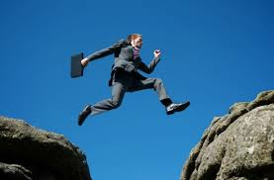
TENACITY
Tenacious leaders are better at overcoming obstacles.
Such leaders have a sense of purpose and a wilful determination to achieve what they want.

