Slide 1
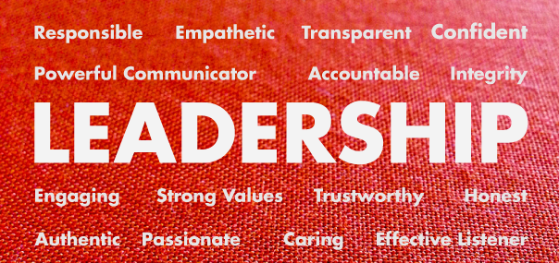

Slide 2


Slide 3
1. AN EFFECTIVE LEADER IS A RISK-TAKER
To bring about the changes, leader needs to take the risk.
How we deal with changes and challenges reflects on who we are and how we will grow as a leader.
Effective leaders recognize that failure is only a temporary setback that gives a clear understanding of what not to do in the future.
“You ultimately fail when you don’t give it a try!”
Demonitisation was a risk taken by Mr. Narendra Modi Govt. Proved to be a failure.

Slide 4

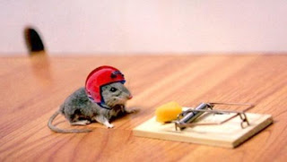
???

Slide 5

2. AN EFFECTIVE LEADER HAS
SELF-CONTROL
Ability to stay calm, even in the worst of conflicts.
The effective leader’s mantra is, “When you lose your temper, you lose.”
You have to decide what your highest priorities are and have the courage – pleasantly, smilingly, non-apologetically – to say ‘no’ to other things.
The enemy of the ‘best’ is often the ‘good.
Self-control will determine what is most important.

Slide 6
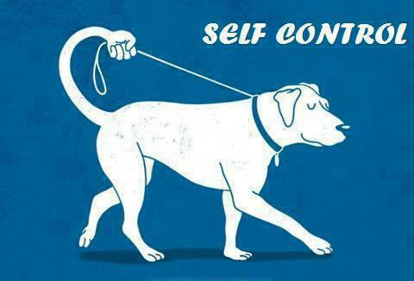
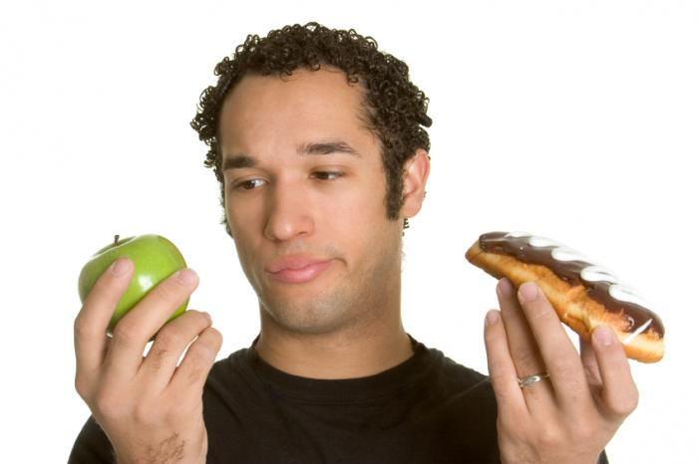
???

Slide 7
3. AN EFFECTIVE LEADER IS A CARING INDIVIDUAL
Leaders should show a caring attitude about the mission of their organization.
However, their concern for each individual team member must take priority over everything else.
An effective leader who cares, is one who maintains eye contact during a conversation.
This type of leader asks many questions and listens more than they talk.
They regularly compliment people in public and private settings.
This type of leader also expresses genuine interest in the lives of those they lead.

Slide 8


???

Slide 9
4. AN EFFECTIVE LEADER IS MODEST
Self-evaluation is a strong characteristic of an effective leader.
A good leader does not have a problem in being evaluated or receiving criticism.
No one enjoys being corrected but an effective leader sees it for what it is as an opportunity for personal growth.

Slide 10
5. AN EFFECTIVE LEADER IS BALANCED
A good leader does not ignore any area of their personal life.
An effective leader understands that to be a balanced leader it is necessary to:
- Rest, and get enough sleep
- Eat a healthy diet
- Exercise on a regular basis
- Work hard on developing healthy social skills and interaction
- Grow personal skills and talents.
Maintains Work- Life Balance.

Slide 11




Slide 12
6. AN EFFECTIVE LEADER IS RESOLUTE
A firm decision to do or not to do something.
The word resolute describes a characteristic of firmness and determination.
This type of person is clear especially in purpose and belief.
A resolute leader can also be characterized by quickness.

Slide 13




Slide 14
7. AN EFFECTIVE LEADER IS MOTIVATIONAL
A motivational leader enjoys their task.
They are optimistic about their purpose.
Change requires taking risks, personal growth and challenges.
A motivational leader does not back down from a challenge but is willing to lead the way as an inspirational leader.

Slide 15



Slide 16
8. AN EFFECTIVE LEADER IS A CLEAR COMMUNICATOR
It is important to understand that communication is not solely conversation.
A good communicator aims to make sure that their message is understood.
The skill of communication is grown upon the skill of listening.
Listening is as important as talking. An effective leader listens more than they talk.

Slide 17
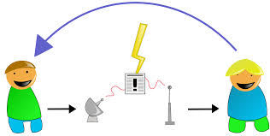


Slide 18
9. AN EFFECTIVE LEADER IS A VISIONARY
A leader must be a dreamer. A productive leader is someone who can see into the future.
The challenge for every visionary leader is not to get so far ahead of the team in what they see that they leave them behind.
Effective leadership has certain, basic, visionary, characteristics.
The aim of a strong leader is to translate their “vision” into reality.

Slide 19


Slide 20

10. AN EFFECTIVE LEADER HAS A SENSE OF HUMOR
Good leaders take their work seriously. However, they do not mind laughing at themselves.
A healthy leader does not have a problem in finding humour in their mistakes or blunders.
A productive leader knows that laughter is good for the soul.
A humorous person can lead a team even through the most challenging times.

Slide 21
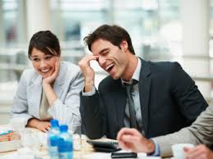
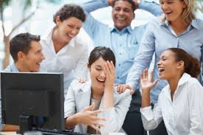

Slide 22
11. AN EFFECTIVE LEADER IS ETHICAL
A strong leader has a strong moral base.
There is no question about their character.
There is nothing more defeatist than a dishonest or lying leader. A strong leader has strong convictions.
It means doing the right thing, even when the right thing isn’t popular or easy to accomplish.
When a leader makes decisions based on core values, then it makes a clear statement that they cannot be bought.
The effective ethical leader leads by example.
Give preference to organizational interest than his personal.

Slide 23

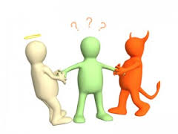

Slide 24
12. AN EFFECTIVE LEADER IS DEDICATED TO THE “CAUSE”
Being an effective leader is not easy. However, it is necessary for the success of any organization or team.
Dedication is key. Being able to convey commitment to a clear purpose and cause is essential.
The strong leader will communicate the “cause” as often as possible.

Slide 25
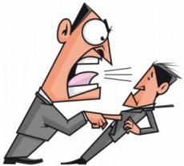

BEHAVIOUR
A response of an individual or group to an action, environment, person, or stimulus.
ATTITUDE
A tendency to respond positively or negatively towards a certain idea, object, person, or situation.

Slide 26

TASK RELATED ATTITUDE AND BEHAVIOUR
The behavior, attitude, or skill which focuses more on the task to be performed than on interpersonal aspect of leadership.

Slide 27

ADAPTABILITY TO THE SITUATION
Accepting the change as the situation demands.

Slide 28

DIRECTION SETTING
In 1993 Louis Gerstner , new chairman suggested that IBM instead of emphazing on manufacturing and selling hardware should concentrate on selling services and software.
Shortly after John Thompson came and suggested that they should concentrate in one direction i.e. Internet security software.

Slide 29

HIGH PERFORMANCE STANDARDS
Effective leader consistently hold group members to high standard of performance.
When performance is measured against these high standards, productivity is likely to increase, since people tend to live up to the expectations of their superiors.
This is PYGMALION EFFECT, and it works un consciously.

Slide 30

RISK TAKING AND BAIS FOR WORK
To bring about constructive changes, a Leader must take and implement risky decisions.
A bias for action is desire to execute a plan, rather than a tendency to create visions without following through on them.
Giving more importance to work.
Not to make sand castle but to actually perform.

Slide 31

HANDS ON GUIDANCE AND FEEDBACK
Technical competence and knowledge of the business are two important characteristics of leader.
Leader needs to provide hand on guidance to team about how to accomplish the task.
Too much guidance of this nature, can be symptom of poor delegation or micromanagement.
This leads to taking Feedback.

Slide 32

STABILITY OF PERFORMANCE
Effective leaders are steady performers, even under heavy workloads and uncertain conditions.
Remaining steady helps team cope with the situation.
When leader is calm, team rests assured that things will workout.

Slide 33


ABILITY TO ASK TOUGH QUESTIONS
The tough questions are the ones which makes the group stop and think.
Stability helps manager appear professional and cool under pressure.

Slide 34


RELATIONSHIP ORIENTED ATTITUDES AND BEHAVIOUR
Relationship with team.
Attitude and behavior which emphasis on having good relationship with the team.

Slide 35

1. ALIGNING PEOPLE AND WORK
Getting people pulling in same direction.
To achieve the vision of the organization, things have to be aligned in that direction.
Once the things are aligned, people can pull together towards a higher purpose.
When the things are aligned, group can work smoothly.
Alignment is easier when the group has agreed upon mission or purpose.

Slide 36
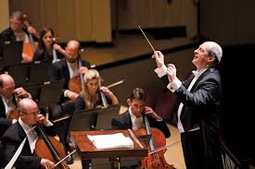
2. CONCERT BUILDING AND COLLABORATION
The leader’s role of concert building involves both:
- Aligning
- Mobilizing in a manner to as an orchestra leader.
The concert builder’s goal is to produce a system that is self evaluating, self correcting, self renewing and ongoing.

Slide 37
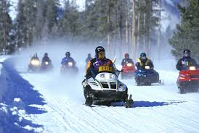
3. CREATING INSPIRATION AND VISIBILTY
Inspiring people usually involves appealing to their emotions and values .
Example: when the head of snowmobile business encourages his employees by saying that they are making the winters more enjoyable for the people who live in regions that accumulate snow.

Slide 38
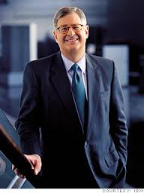
Cont…
Sam Palmisano, CEO of IBM till 2012, inspires people through visibilty.
He interacts people face to face at all levels in the company.
His ability to chat with almost everyone makes him approachable to employees and customers.

Slide 39
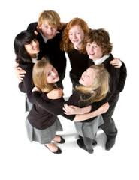
4. SATISFYING HIGHER LEVEL NEEDS
Effective leaders motivate people by satisfying higher levels of need:
- Need for Achievement
- Sense of belongingness
- Need for power

Slide 40
5. EMOTIONAL SUPPORT AND ENCOURAGEMENT
Supportive behaviour towards team increases leadership effectiveness.
Encouraging and praising someone gives feel of good factor.
One of the ways to encourage them is to make them participate in decision making.
Emotional support improves morale and productivity of employees.
Being emotionally supportive comes naturally to the leader who has empathy for people and who is warm person.

Slide 41
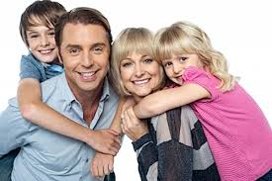


Slide 42

6. PROMOTING PRINCIPLES AND VALUE
Principle is fundamental truth or proposition that serves as the foundation for a system of belief or behaviour or for a chain of reasoning.

Slide 43
7. SERVANT LEADER
Servant leader serves constitutes by working on their behalf to help them achieve their goals, not the leader’s own goal.
He’s a moral leader.
The key aspect of servant leadership:
- Place service before self interest
- Listen first, to express confidence in others.
- Inspire trust by being trustworthy
- Focus on what is feasible to accomplish
- Lend a hand.

