Slide 1


Slide 2


1. PARTICIPATIVE LEADERSHIP
Sharing decision making with group members and working with them side by side has become the generally accepted leadership approach in the modern organization .

Slide 3
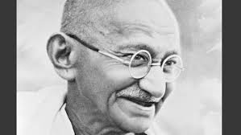

Slide 4
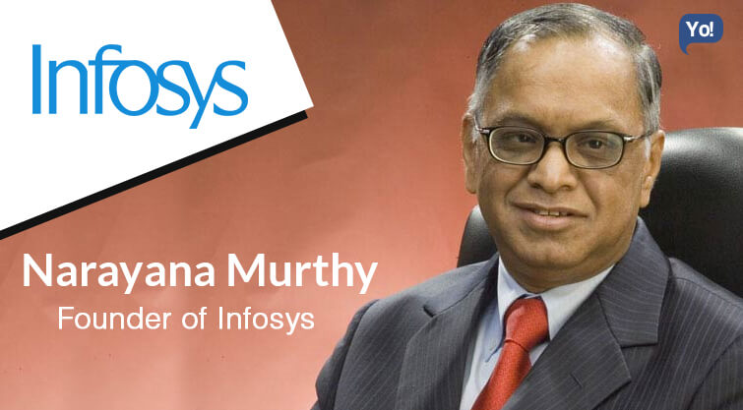

Slide 5
THREE SUB TYPES OF PARTICIPATIVE LEADERSHIP
CONSULTATIVE LEADERS: confer with group members before making a decision. However they retain final authority to make decisions.
CONSENSUS LEADERS: strive for consensus. They encourage group discussion about an issue and then make a decision that reflects general agreement and that group members with support.
DEMOCRATIC LEADERS: confer final authority on the group. They function as collectors of group opinion and take a vote before making a decision.

Slide 6

2. AUTOCRATIC LEADERSHIP
In contrast to participative leaders are autocratic leaders, who retain most of the authority.
They don’t consider group members’ attitude towards a decision.
They are considered task oriented because they place heavy emphasis on getting tasks accomplished.
Typical autocratic behavior include telling people what to do, asserting themselves, serving as a model for team.

Slide 7
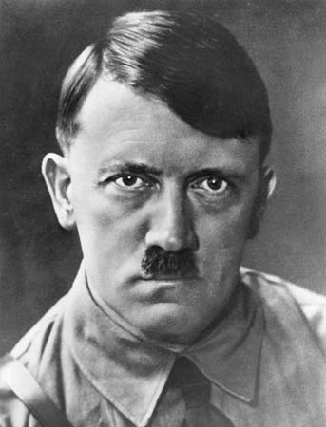

Slide 8
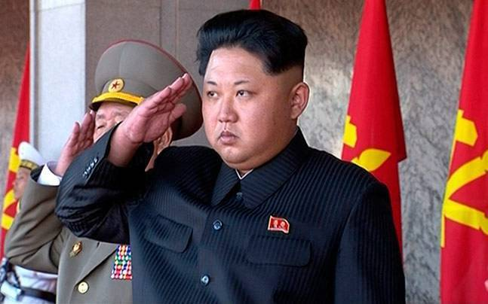
Jim Kong Un

Slide 9

3. ENTREPRENEURIAL LEADERSHIP
Not all business owners, including franchise operators are therefore entrepreneurial leaders.
Entrepreneur is a person who finds and operates an innovative ideas.
An entrepreneur is task oriented and charismatic person.

Slide 10


Slide 11
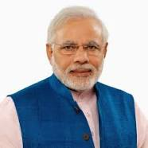

Slide 12


Slide 13


Slide 14
ENTREPRENEURIAL LEADERSHIP STYLE INCORPORATES FOLLOWING BEHAVIOUR
Strong achievement drive and sensible risk taking.
High degree of enthusiasm and creativity.
Tendency to act quickly when opportunity arises.
Contrast hurry combined with impatience.
Visionary perspective combined with tenacity.
Dislike of hierarchy
Eye on the future.

Slide 15
ACTIVITY
FIND OUT THE LEADERSHIP STYLE FOLLOWED BY YOUR FAVOURATE LEADER.

