Slide 1
COMMUNICATION SKILLS

Slide 2
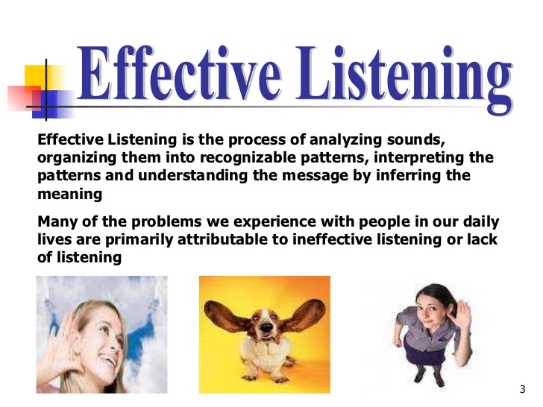

Slide 3
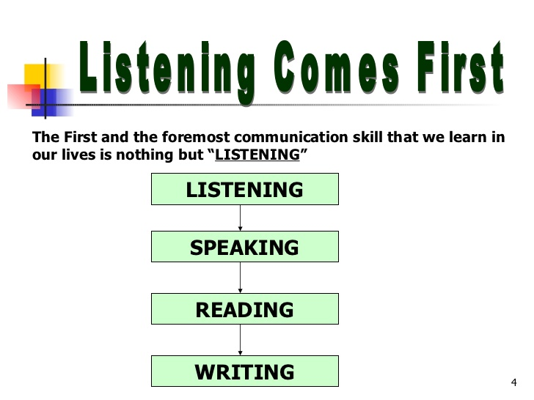
INSPIRATIONAL AND POWERFUL COMMUNICATION
Speaking and Writing

Slide 4
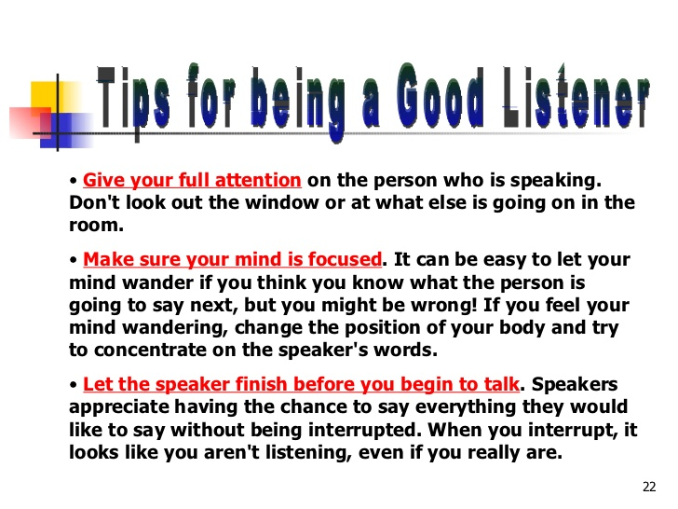

Slide 5
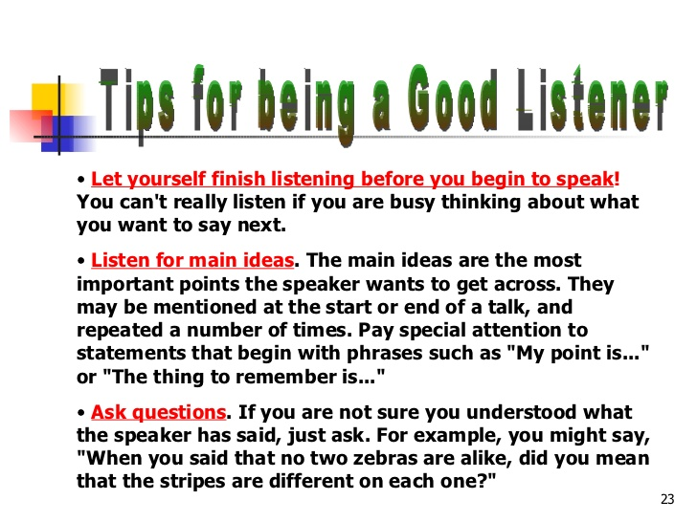

Slide 6
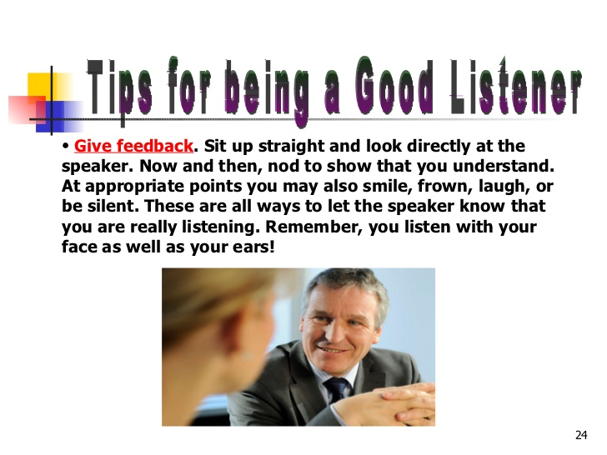

Slide 7
Becoming an Active and effective Listener
1. Pay Attention
Give the speaker your undivided attention, and acknowledge the message. Recognize that non-verbal communication also "speaks" loudly.
Look at the speaker directly.
Put aside distracting thoughts.
Don't mentally prepare a rebuttal!
Avoid being distracted by environmental factors. For example, side conversations.
"Listen" to the speaker's body language

Slide 8
Conti...
2. Show That You're Listening
Use your own body language and gestures to show that you are engaged.
Nod occasionally.
Smile and use other facial expressions.
Encourage the speaker to continue with small verbal comments like yes, and "uh huh."

Slide 9
Conti..
3. Provide Feedback
Our personal filters, assumptions, judgments, and beliefs can distort what we hear. As a listener, your role is to understand what is being said. This may require you to reflect on what is being said and to ask questions.
Reflect on what has been said by paraphrasing. "What I'm hearing is... ," and "Sounds like you are saying... ," are great ways to reflect back.
Ask questions to clarify certain points. "What do you mean when you say... ." "Is this what you mean?“
Summarize the speaker's comments periodically.

Slide 10
Conti...
4. Defer Judgment
Interrupting is a waste of time. It frustrates the speaker and limits full understanding of the message.
Allow the speaker to finish each point before asking questions.
Don't interrupt with counter arguments.
5. Respond Appropriately
Active listening is designed to encourage respect and understanding.
Be candid, open and honest in your response.
Assert your opinions respectfully.
Treat the other person in a way that you think she would want to be treated.

Slide 11

CROSS CULTURAL COMMUNICATION
International Organisation
Multinational Company
Cross cultural organisation.
Glass Ceiling
Workforce Diversity.

Slide 12
OVERCOMING CROSS CULTURAL COMMUNICATION BARRIERS
Be sensitive to the fact that cross cultural communication barrier exist.
Challenge your cultural assumption
Show respect to all workers.
Use straightforward language but speak slowly and clearly.
Look for signs of misunderstanding when your language is not the listener’s native language.
When situation is appropriate, speak the language of the people from another culture.
Observe cross cultural differences in etiquettes
Avoid racial or ethnic identification, except when needed.
Be sensitive to differences of non verbal communication.
Be attentive about individual differences in appearance.

Slide 13


KNOWLEDGE MANAGEMENT

Slide 14
Introduction
Knowledge management is essentially about getting the right knowledge to the right person at the right time.

Slide 15
Implementing knowledge management
Strategy: Knowledge management strategy must be dependent on corporate strategy. The objective is to manage, share, and create relevant knowledge assets that will help meet tactical and strategic requirements.
Organizational Culture: The organizational culture influences the way people interact, the context within which knowledge is created, the resistance they will have towards certain changes, and ultimately the way they share (or the way they do not share) knowledge.
Organizational Processes: The right processes, environments, and systems that enable KM to be implemented in the organization.
Management & Leadership: KM requires competent and experienced leadership at all levels. There are a wide variety of KM-related roles that an organization may or may not need to implement, including a Chief Knowledge Officer, knowledge managers, knowledge brokers and so on. More on this in the section on KM positions and roles.
Technology: The systems, tools, and technologies that fit the organization's requirements - properly designed and implemented.

Slide 16
STRATEGIC LEADERSHIP

Slide 17
Strategic leadership
Strategic leadership refers to a manager’s potential to express a strategic vision for the organization, or a part of the organization, and to motivate and persuade others to acquire that vision.

Slide 18
CHARACTERISTICS OF STRATEGIC LEADERSHIP
Loyalty- Powerful and effective leaders demonstrate their loyalty to their vision by their words and actions.
Keep THEMSELVES updated- Efficient and effective leaders keep themselves updated about what is happening within their organization. They have various formal and informal sources of information in the organization.
Judicious use of power- Strategic leaders makes a very wise use of their power. They must play the power game skillfully and try to develop consent for their ideas rather than forcing their ideas upon others. They must push their ideas gradually.
Have wider perspective/outlook- Strategic leaders just don’t have skills in their narrow specialty but they have a little knowledge about a lot of things.
Motivated- Strategic leaders must have a zeal for work that goes beyond money and power and also they should have an inclination to achieve goals with energy and determination.
Compassion- Strategic leaders must understand the views and feelings of their subordinates, and make decisions after considering them.
Self-control- Strategic leaders must have the potential to control distracting/disturbing moods and desires, i.e., they must think before acting.
Social skills- Strategic leaders must be friendly and social.
Self-awareness- Strategic leaders must have the potential to understand their own moods and emotions, as well as their impact on others.

