Slide 1
Common Diode Applications

Slide 2
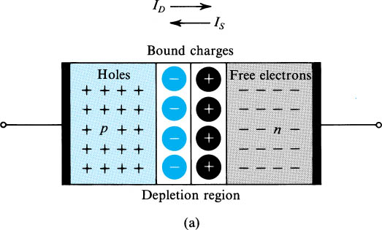
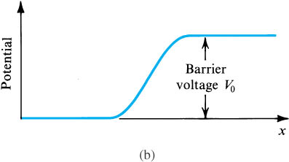
pn Junction Under Open-Circuit Condition
Fig (a) shows the pn junction with no applied voltage (open-circuited terminals).
Fig.(b) shows the potential distribution along an axis perpendicular to the junction.

Slide 3
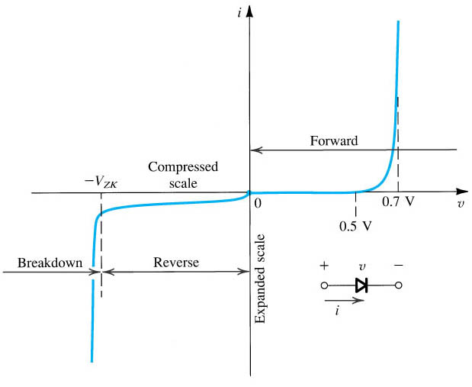
I-V Characteristics
The diode i–v relationship with some scales expanded and others compressed in order to reveal details

Slide 4
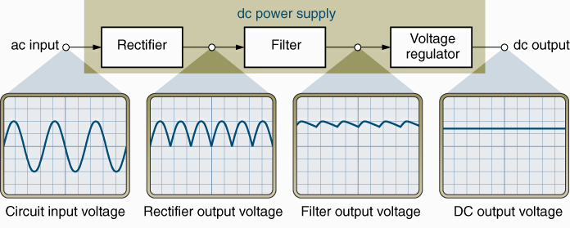
Power Supply
A group of circuits used to convert ac to dc.
  Rectifier – Converts ac to pulsating dc.
  Filter – Reduces variations in the rectifier output.
  Voltage regulator – Maintains a constant dc output voltage.

Slide 5
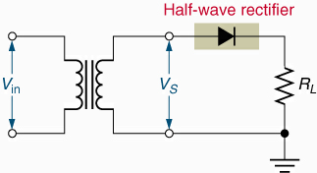
Half-wave Rectifiers
Half-wave rectifier – A diode placed in series between a transformer (or ac line input) and its load.

Slide 6
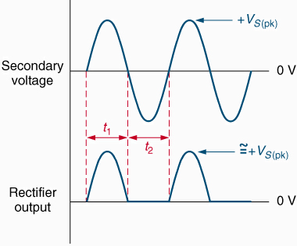
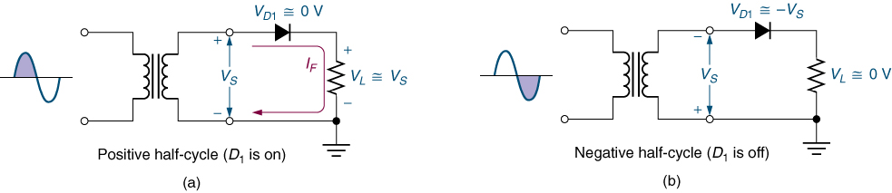
Positive Half-wave Rectifiers
This circuit converts an ac input to a series of positive pulses.

Slide 7
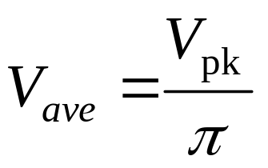
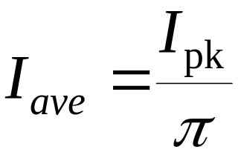
Average Load Voltage and Current
Average voltage (V_{ave}) – The dc equivalent of a voltage waveform.
Average current (I_{ave}) – The dc equivalent of a current waveform.
For the output from a half-wave rectifier:

Slide 8
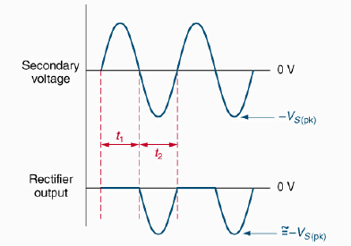
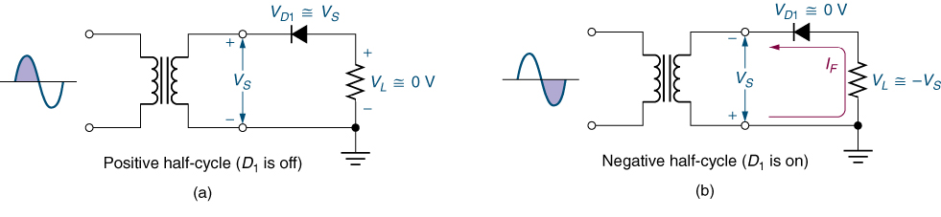
Negative Half-wave Rectifiers
This circuit converts an ac input to a series of negative pulses.

Slide 9
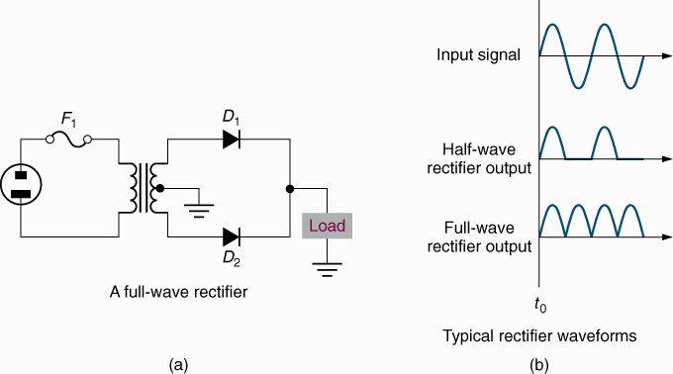
Full-wave Rectifier

Slide 10
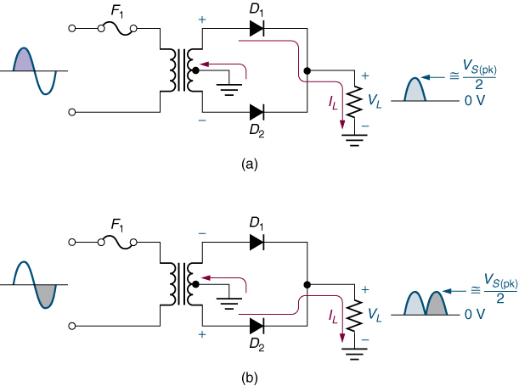
Full-wave Rectifier Operation
Diodes conduct during
alternate half cycles of
the input signal.
V_{L(pk)} is approximately
half the value of V_{S(pk)}.
The circuit produces
two positive half-cycles
for each input cycle.

Slide 11
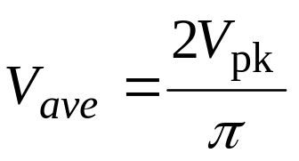
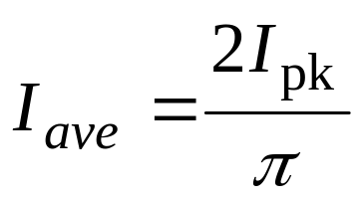
Average Load Voltage and Current
Average voltage (V_{ave}) – The dc equivalent of a voltage waveform.
Average current (I_{ave}) – The dc equivalent of a current waveform.
For the output from a full-wave rectifier:

Slide 12
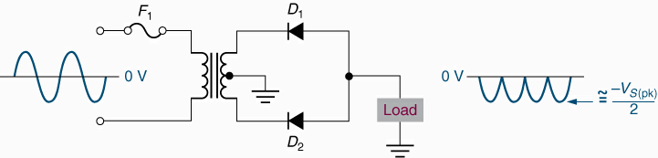
Negative Full-wave Rectifiers
The negative full-wave rectifier converts an ac input to a series of negative pulses.

Slide 13
Filters
A filter reduces the voltage and current variations
in the output from a rectifier.

Slide 14
Voltage Regulators
Voltage regulator – The final circuit in the dc power supply.

Slide 15
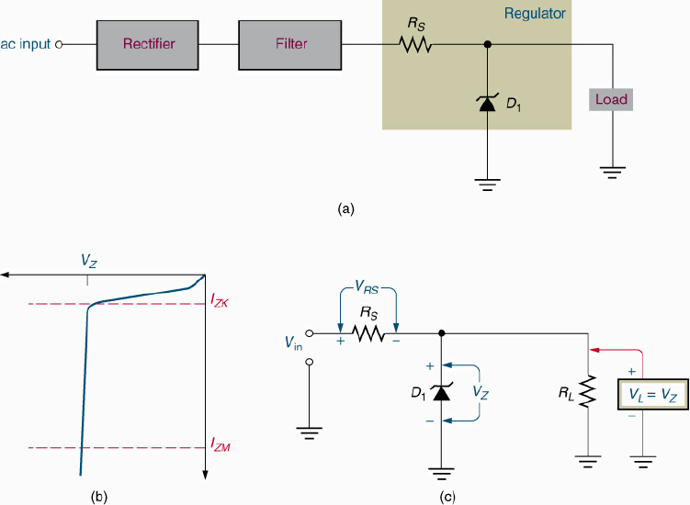
Zener Voltage Regulators

Slide 16
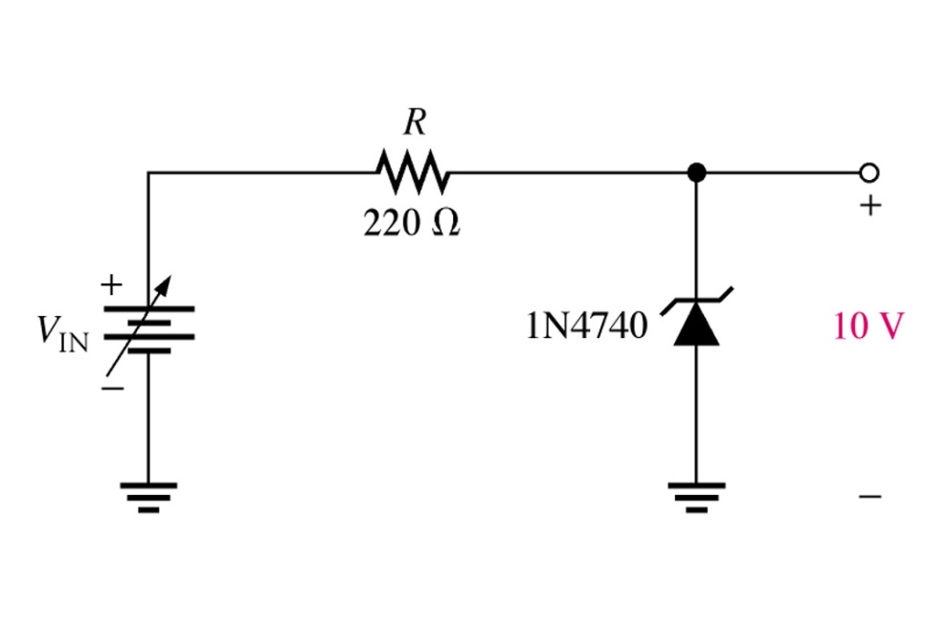
Introduction
The basic function of zener diode is to maintain a specific voltage across its terminals within given limits of line or load change. Typically it is used for providing a stable reference voltage for use in power supplies and other equipment.
This particular zener circuit will work to maintain 10 V across the load.
Notes:
Fig. 3-9 Simple zener diode reg. circuit & label zener terminals

Slide 17
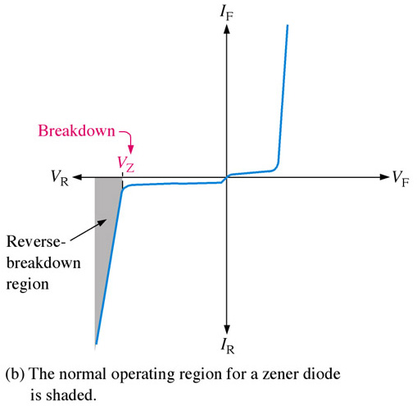
Zener Diodes
A zener diode is much like a normal diode, the exception being is that it is placed in the circuit in reverse bias and operates in reverse breakdown. This typical characteristic curve illustrates the operating range for a zener. Note that its forward characteristics are just like a normal diode.
Notes:
Fig 3-2 b zener curve

Slide 18
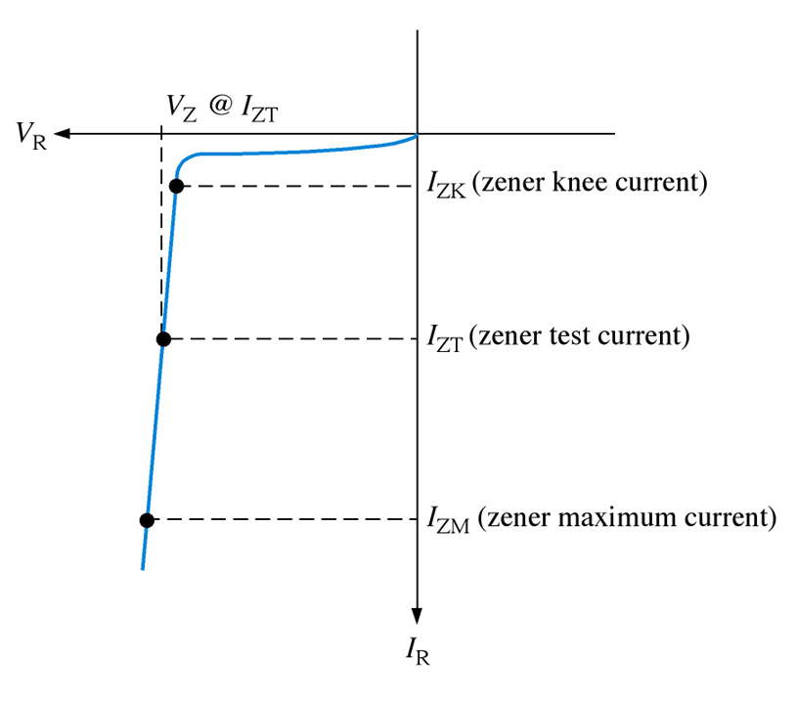

Zener Diodes
The zener diode’s breakdown characteristics are determined by the doping process. Low voltage zeners less than 5V operate in the zener breakdown range. Those designed to operate more than 5 V operate mostly in avalanche breakdown range. Zeners are available with voltage breakdowns of 1.8 V to 200 V.
Zz=
This curve illustrates the minimum and maximum ranges of current operation that the zener can effectively maintain its voltage.
Notes:
Fig 3-3

Slide 19
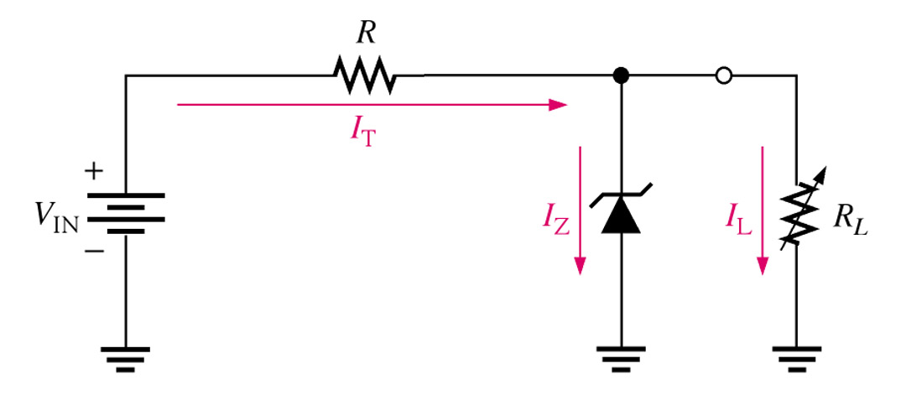
Zener Diode Applications
Regulation
In this simple illustration of zener regulation circuit, the zener diode will “adjust” its impedance based on varying input voltages and loads (R_{L}) to be able to maintain its designated zener voltage. Zener current will increase or decrease directly with voltage input changes. The zener current will increase or decrease inversely with varying loads. Again, the zener has a finite range of operation.
Notes:
Fig. 3-12 Zener Reg.

Slide 20
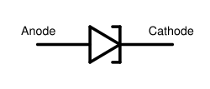
TUNNEL DIODE (Esaki Diode)
E_{V}
It was introduced by Leo Esaki in 1958.
Heavily-doped p-n junction
  Impurity concentration is 1 part in 10^3 as compared to 1 part in 10^8 in p-n junction diode
Width of the depletion layer is very small
(about 100 A).
It is generally made up of Ge and GaAs.
It shows tunneling phenomenon.
Circuit symbol of tunnel diode is :

Slide 21
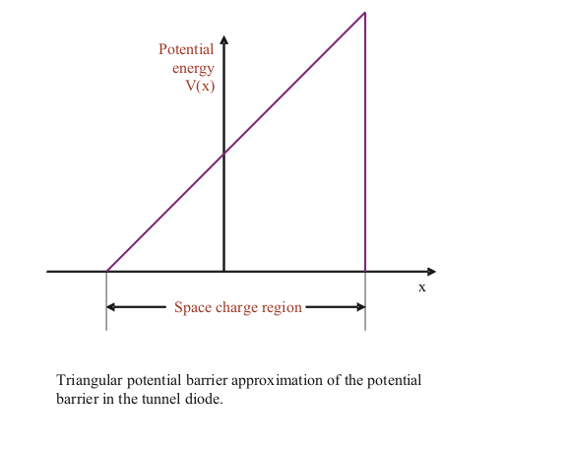
WHAT IS TUNNELING
Classically, carrier must have energy at least equal to potential-barrier height to cross the junction .
But according to Quantum mechanics there is finite probability that it can penetrate through the barrier for a thin width.
This phenomenon is
called tunneling and
hence the Esaki Diode
is know as
Tunnel Diode.

Slide 22
CHARACTERISTIC OF TUNNEL DIODE
Ip
Ip:- Peak Current
Iv :- Valley Current
Vp:- Peak Voltage
Vv:- Valley Voltage
Vf:- Peak Forward
Voltage
Forward Current
- Ve Resistance Region
Iv
Reverse voltage
Vp
Vv
Vf
Forward Voltage
Reverse Current

Slide 23
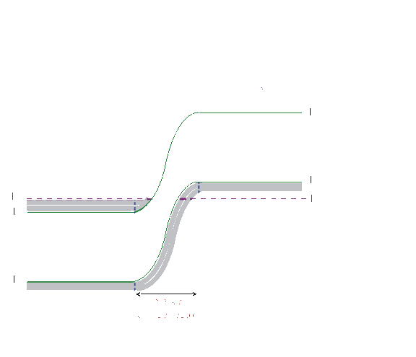
ENERGY BAND DIAGRAM
Energy-band diagram of pn junction in thermal equilibrium in which both the n and p region are degenerately doped.

Slide 24

AT ZERO BIAS
Simplified energy-band diagram and I-V characteristics of the tunnel diode at zero bias.
-Zero current on the I-V diagram;
All energy states are filled below E_{F} on both sides of the junction;

Slide 25

AT SMALL FORWARD VOLTAGE
Simplified energy-band diagram and I-V characteristics of the tunnel diode at a slight forward bias.
Electrons in the conduction band of the n region are directly opposite to the empty states in the valence band of the p region.
So a finite probability that some electrons tunnel directly into the empty states resulting in forward-bias tunneling current.

Slide 26
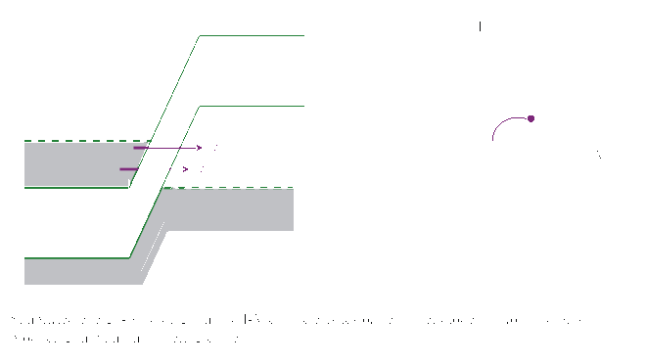
AT MAXIMUM TUNNELING CURENT
Simplified energy-band diagraam and I-V characteristics of the tunnel diode at a forward bias producing maximum tunneling current.
The maximum number of electrons in the n region are opposite to the maximum number of empty states in the p region.
Hence tunneling current is maximum.

Slide 27

AT DECREASING CURRENT REGION
Simplified energy-band diagram and I-V characteristics of the tunnel diode at a higher forward bias producing less tunneling current.
The forward-bias voltage increases so the number of electrons on the n side, directly opposite empty states on the p side decreases.
Hence the tunneling current decreases.

Slide 28
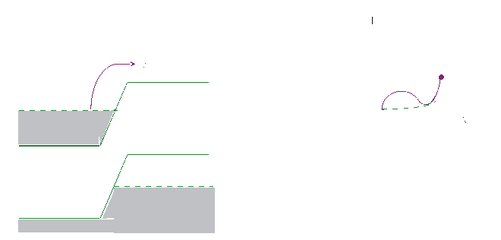
AT HIGHER FORWARD VOLTAGE
Simplified energy-band diagram and I-V characteristics of the tunnel diode at a forward bias for which the diffusion current dominates.
No electrons on the n side are directly opposite to the empty states on the p side.
The tunneling current is zero.
The normal ideal diffusion current exists in the device.

Slide 29
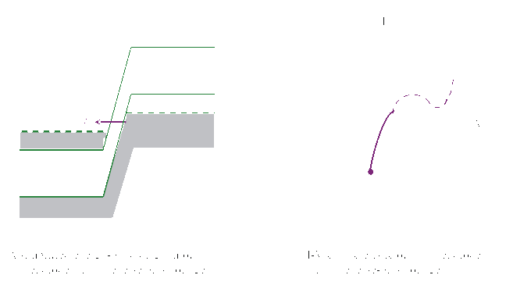
AT REVERSE BIAS VOLTAGE
Electrons in the valence band on the p side are directly opposite to empty states in the conduction band on the n side.
Electrons tunnel directly from the p region into the n region.
The reverse-bias current increases monotonically and rapidly with reverse-bias voltage.

Slide 30
LIGHT EMITTING DIODE (L E D)
Notes:
EBB424 USM SMMRE
Dr Zainovia Lockman L2

Slide 31
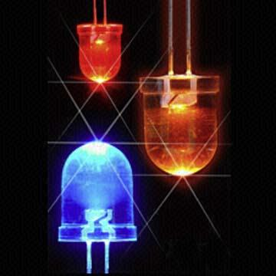
What is LED?
Semiconductors bring quality
to light!
LED are semiconductor p-n junctions that under forward bias conditions can emit radiation by electroluminescence in the UV, visible or infrared regions of the electromagnetic spectrum. The qaunta of light energy released is approximately proportional to the band gap of the semiconductor.

Slide 32
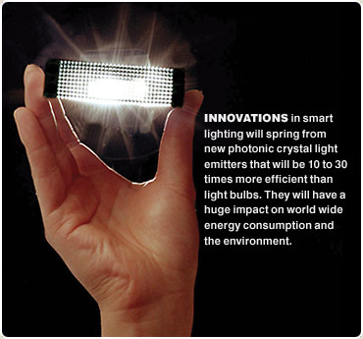

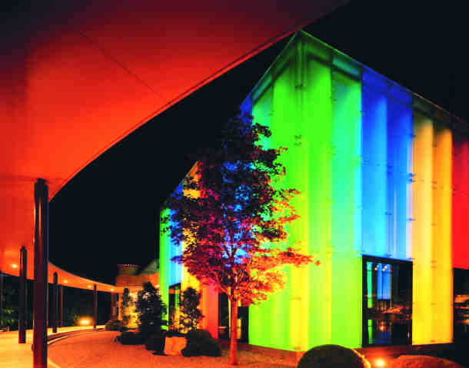

Applications of LEDs

Slide 33
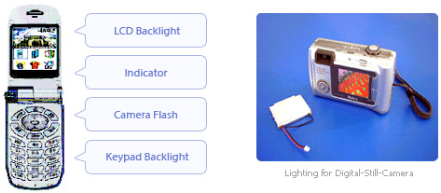
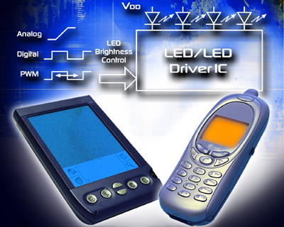
Your fancy telephone, i-pod, palm pilot and digital camera

Slide 34
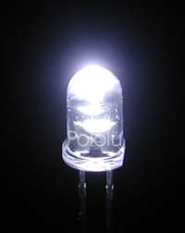
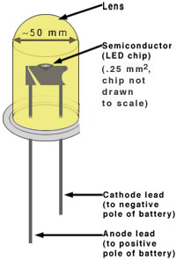
Getting to know LED
Advantages of Light Emitting Diodes (LEDs)
Longevity:
The light emitting element in a diode is a small conductor chip rather than a filament which greatly extends the diode’s life in comparison to an incandescent bulb (10 000 hours life time compared to ~1000 hours for incandescence light bulb)
Efficiency:
Diodes emit almost no heat and run at very low amperes.
Greater Light Intensity:
Since each diode emits its own light
Cost:
Not too bad
Robustness:
Solid state component, not as fragile as incandescence light bulb

Slide 35
Excitation
E
Electron (excited by the biased forward voltage) is in the conduction band
k
Normally the recombination takes place between transition of electrons between the bottom of the conduction band and the top of the valance band (band exterma).
The emission of light is therefore;
hc/λ = E_{c}-E_{v} = E_{g}(only direct band gap allows radiative transition)
Hole is in valance band

Slide 36
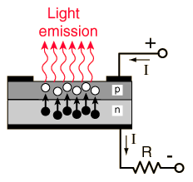
How does it work?
P-n junction
Electrical Contacts
A typical LED needs a p-n junction
There are a lot of electrons and holes at the junction due to excitations
Electrons from n need to be injected to p to promote recombination
Recombination produces light!!
Junction is biased to produce even more e-h and to inject electrons from n to p for recombination to happen

Slide 37
Photodiodes
Due to above requirements, only photodiodes are used as photo detectors in optical communication systems
Positive-Intrinsic-Negative (pin) photodiode
  No internal gain
Avalanche Photo Diode (APD)
  An internal gain of M due to self multiplication
Photodiodes are reverse biased for normal operation

Slide 38
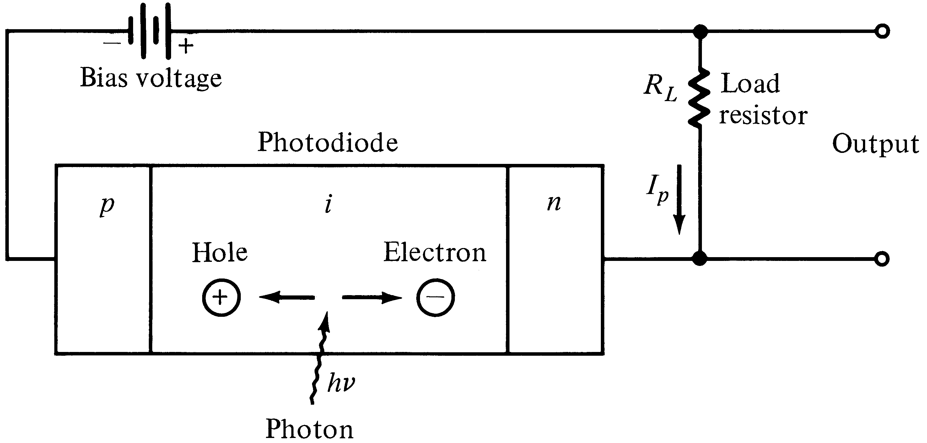
Basic pin photodiode circuit
Incident photons trigger a photocurrent I_{p} in the external circuitry
Photocurrent ∝ Incident Optical Power

Slide 39
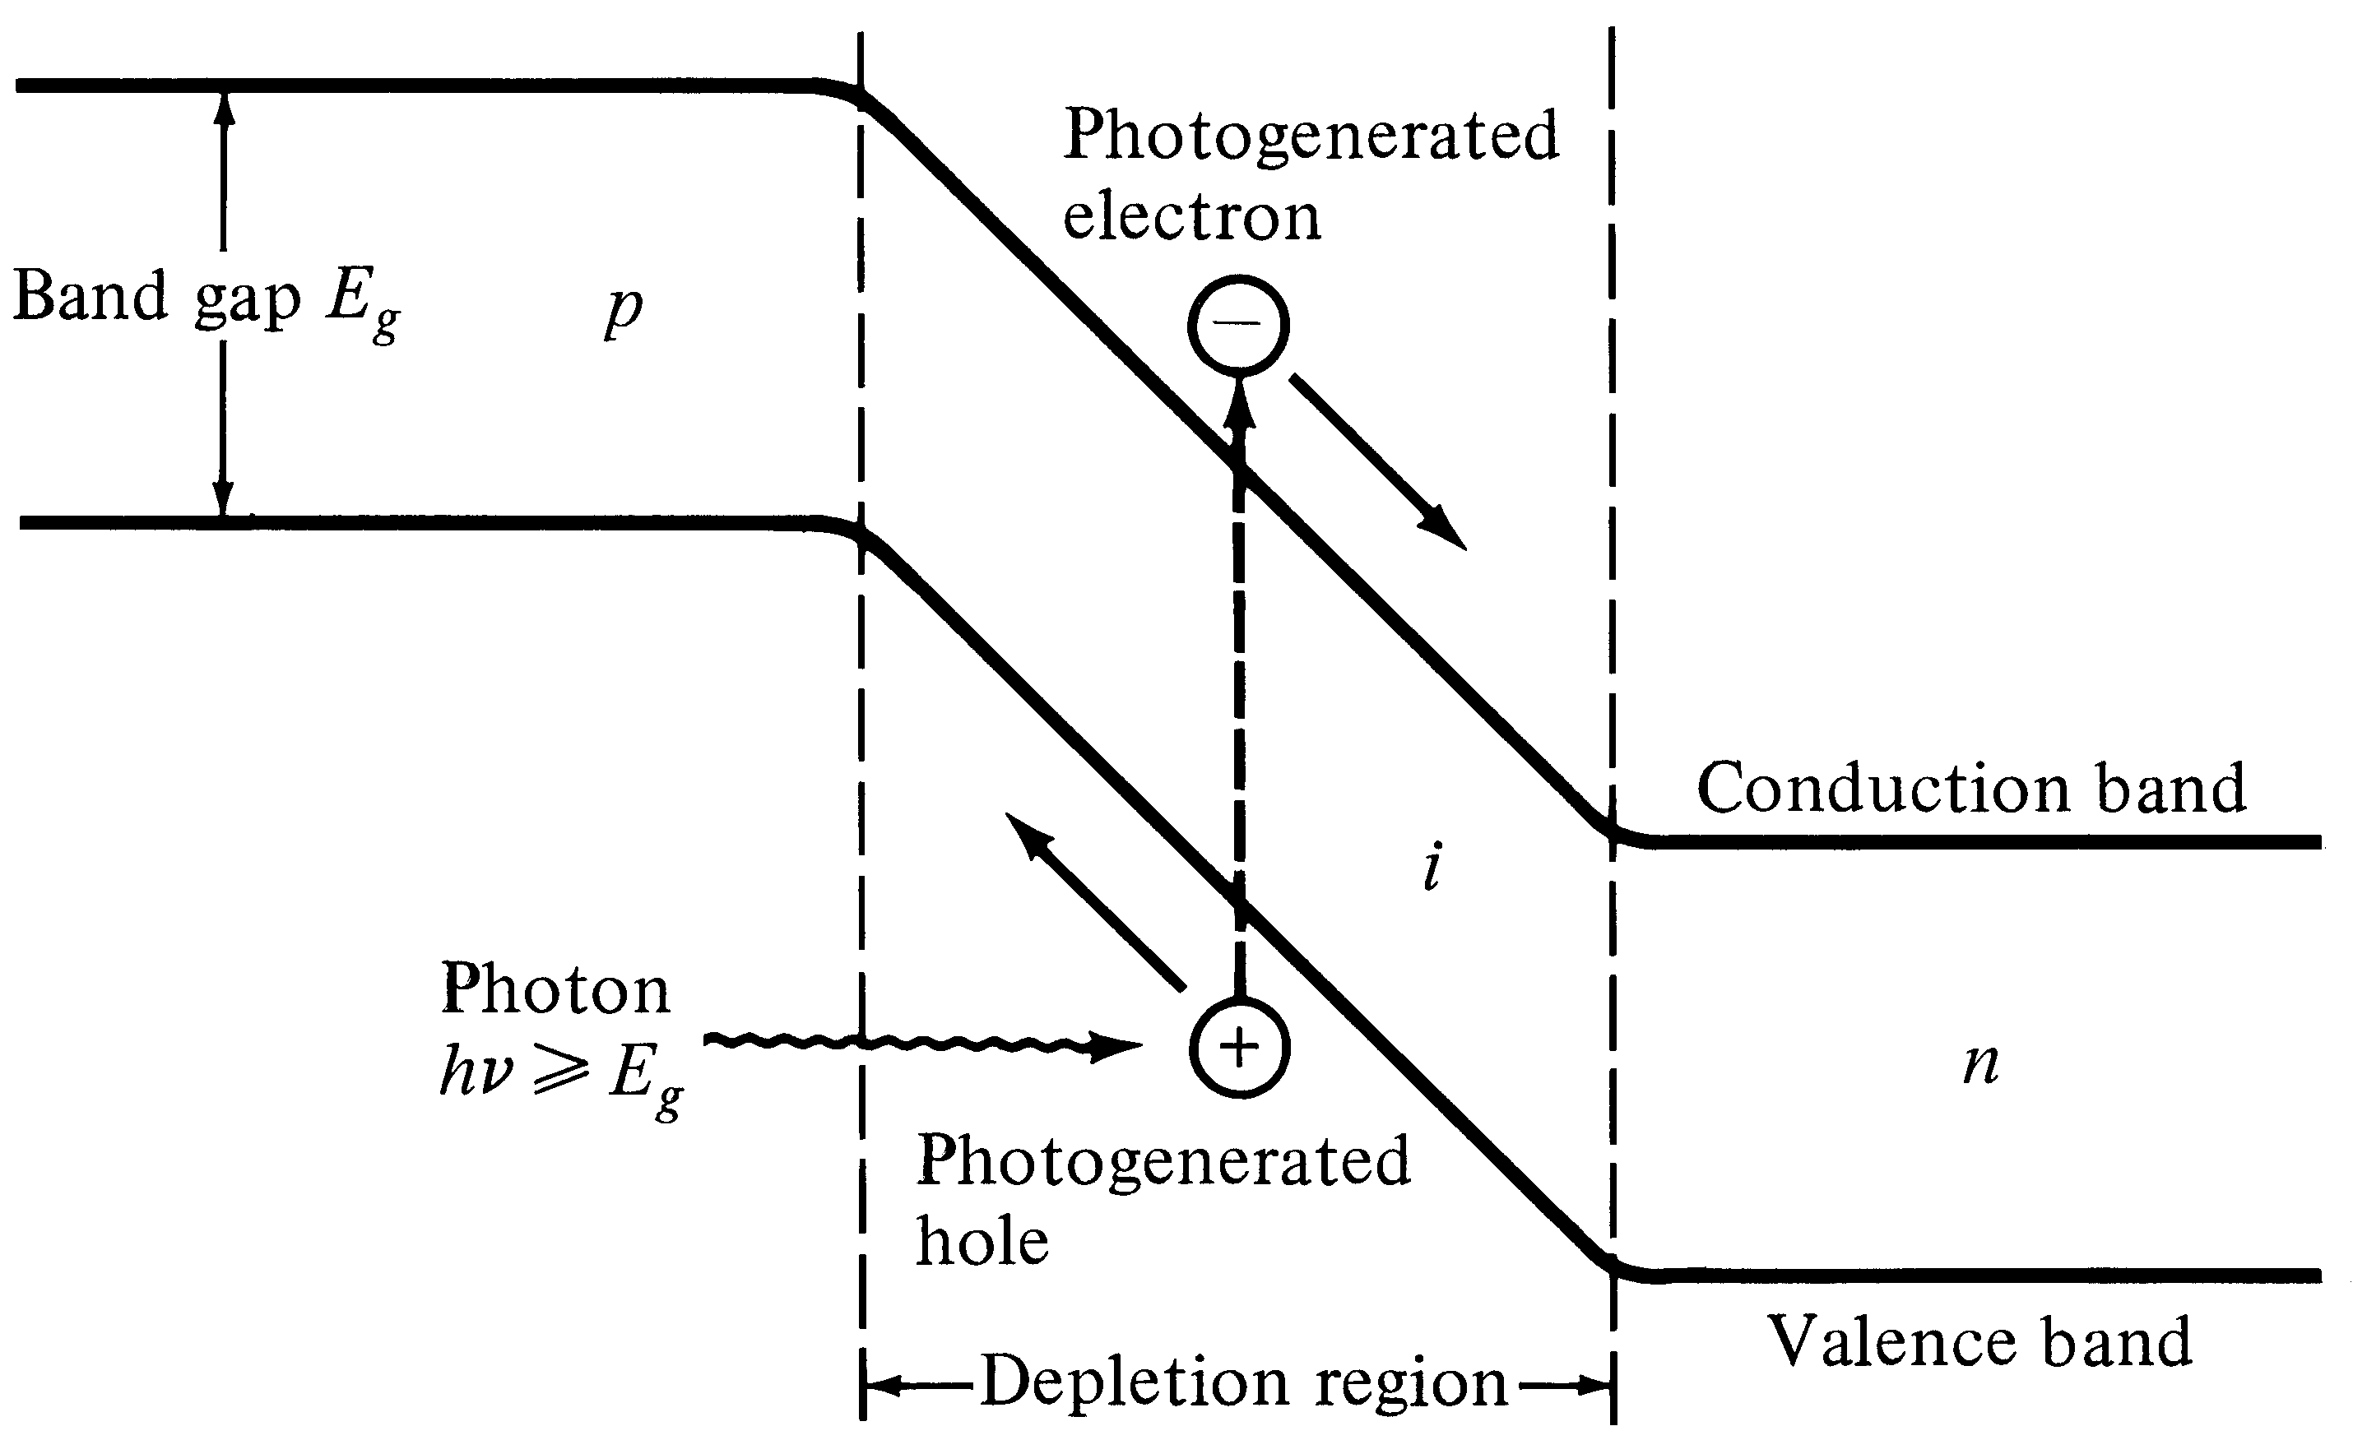
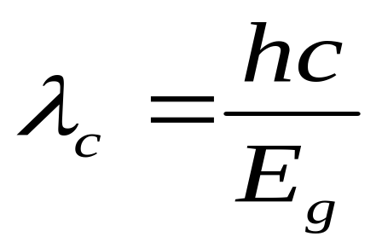
pin energy-band diagram
Cut off wavelength depends on the
bandgap energy
Notes:
2

Slide 40
Working of APD:-
A photon is absorbed in the depletion region, creating a free electron and a free hole. The large electrical forces cause these charges to accelerate, gaining kinetic energy. When fast charges collide with neutral atoms, they create additional electron-hole pairs by using part of their kinetic energy to raise electrons across the energy bandgap. One accelerating charge can generate several secondary charges. The secondary charges can themselves accelerate and create even more electron-hole pairs; this is the process of avalanche multiplication.

Slide 41
APPLICATIONS OF PHOTODETECTORS :-
1. P-N photodiodes are used in similar applications to other photodetectors, such as photoconductors, charge-coupled devices, and photomultiplier tubes.
2. Photodiodes are used in consumer electronics devices such as compact disc players, smoke detectors, and the receivers for remote controls in VCRs and televisions.
3. In other consumer items such as camera light meters, clock radios (the ones that dim the display when it's dark) and street lights, photoconductors are often used rather than photodiodes, although in principle either could be used.
4. Photodiodes are often used for accurate measurement of light intensity in science and industry. They generally have a better, more linear response than photoconductors.

Slide 42
5. They are also widely used in various medical applications, such as detectors for computed tomography (coupled with scintillators) or instruments to analyze samples (immunoassay). They are also used in pulse oximeters.
6. PIN diodes are much faster and more sensitive than ordinary p-n junction diodes, and hence are often used for optical communications and in lighting regulation.
7. P-N photodiodes are not used to measure extremely low light intensities. Instead, if high sensitivity is needed, avalanche photodiodes, intensified charge-coupled devices or photomultipliertubes are used for applications such as astronomy, spectroscopy, night vision equipment and laser range finding.

Slide 43
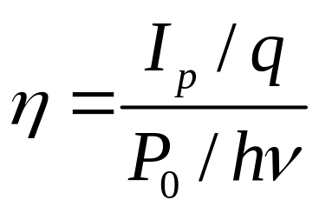
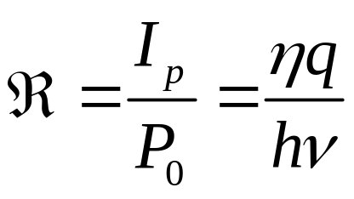
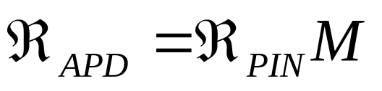
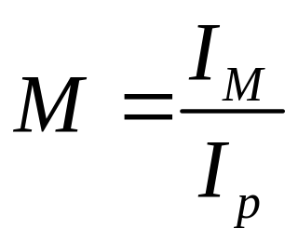
Responsivity (ℜ)
Quantum Efficiency (η) = number of e-h pairs generated / number of incident photons
Avalanche PD’s have an internal gain M
mA/mW
I_{M} : average value of the total multiplied current
M = 1 for PIN diodes

Slide 44
Introduction
Solar cell: Solar cell is a photovoltaic device that converts the light energy into electrical energy based on the principles of photovoltaic effect
Albert Einstein was awarded the 1921 Nobel Prize in physics for his research on the photoelectric effect—a phenomenon central to the generation of electricity through solar cells.
In the early stages, the solar cell was developed only with 4 to 6 % efficiency( because of inadequate materials and problems in focusing the solar radiations). But, after 1989, the solar cells with more than 50% efficiency was developed.

Slide 45
Photovoltaic effect
Light energy
Definition:
The generation of voltage across the PN junction in a semiconductor due to the absorption of light radiation is called photovoltaic effect. The Devices based on this effect is called photovoltaic device.
n-type semiconductor
Electrical Power
p- type semiconductor
p-n junction

Slide 46
Principle, construction and working of Solar cell
Principle: The solar cells are based on the principles of photovoltaic effect.The photovoltaic effect is the photogeneration of charge carriers in a light absorbing materials as a result of absorption of light radiation.
Construction
Solar cell (crystalline Silicon) consists of a n-type semiconductor (emitter) layer and p-type semiconductor layer (base). The two layers are sandwiched and hence there is formation of p-n junction.
The surface is coated with anti-refection coating to avoid the loss of incident light energy due to reflection.

Slide 47
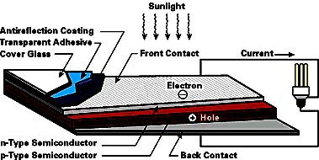

Slide 48
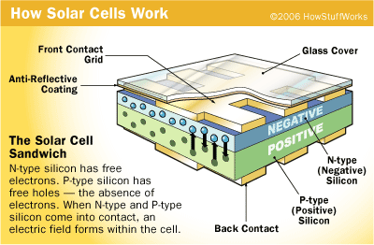

Slide 49
A proper metal contacts are made on the n-type and p-type side of the semiconductor for electrical connection
Working:
When a solar panel exposed to sunlight , the light energies are absorbed by a semiconduction materials.
Due to this absorded enrgy, the electrons are libereted and produce the external DC current.
The DC current is converted into 240-volt AC current using an inverter for different applications.

Slide 50
Advantage, disadvantage and application of Solar cell
Advantage
    It is clean and non-polluting
    It is a renewable energy
    Solar cells do not produce noise and they are totally silent.
    They require very little maintenance
    They are long lasting sources of energy which can be used almost anywhere
    They have long life time
    There are no fuel costs or fuel supply problems

Slide 51
Disadvantage
    Solar power can be obtained in night time
    Soalr cells (or) solar panels are very expensive
    Energy has not be stored in batteries
    Air pollution and whether can affect the production of electricity
    They need large are of land to produce more efficient power supply

