Slide 2

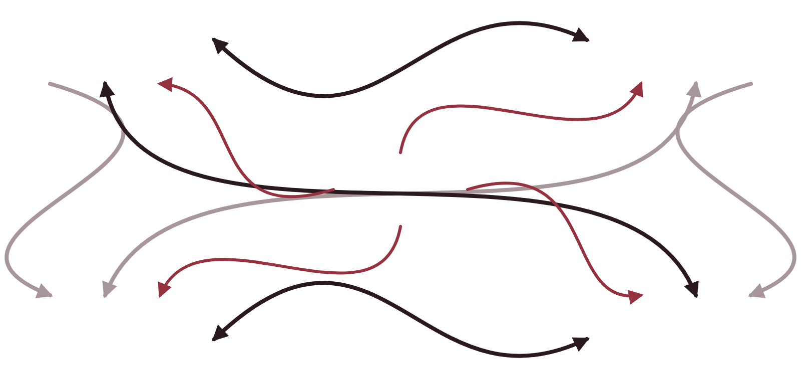







USE CASE 2 · BEFORE AND AFTER
AML investigations: before and after agents
Manual analyst workflow
Before
Agentic workflow
After
Web search
Core systems
Alert
Agent triage
Context enrichment
Draft decision
Human review
Omar
OMAR RECEIVES A READY CASE FILE
Alert summary
Customer & KYC profile
Transaction timeline
Linked parties
Spreadsheets
Word files
Adverse media hits
Draft decision, reasons
High alert fatigue · [__]% false positives · most time spent gathering data
An augmented analyst · time spent on risk judgement · case files arrive ready
Dubai Islamic Bank · Agentic AI in Banking
37
Notes:
Left: Omar's day today. He jumps between web searches, core systems, spreadsheets and Word files, copying and pasting evidence before he can think about risk. Replace the placeholder with our own false-positive rate; industry sources often cite rates well above 90 percent, but use our own data. Right: with an agent, each alert is triaged, enriched with context and given a draft decision, and Omar receives a ready case file. He spends his time on judgement, and he still makes every decision.

Slide 3







USE CASE 2 · AGENT TEAM
Inside the AML alert investigation assistant
Output
Omar chats with the assistant
AML investigator (Omar)
Human + agent
Alert escalated or closed, with a full report and draft STR.
Two linked companies found.
Reviews the preliminary report
Asks follow-up questions in chat
Show me the money flow.
Files the STR via goAML
Report agent
Network agent
PEP agent
History agent
Agents
Drafts the report; rates STR likelihood.
Maps links between parties, with a graph.
Checks people involved for PEP status.
Reviews past alerts, finances and KYC.
Other agents' findings
Graph database
PEP screening
Web search
Alerts
Accounts
KYC
Inputs & tools
Financials
Dubai Islamic Bank · Agentic AI in Banking
39
Notes:
Read it bottom to top. Four specialist agents each pull from their own sources: the history agent reviews past alerts, account details, financial statements and KYC records; the PEP agent checks the people involved; the network agent maps links between parties in a graph database; and the report agent combines everyone's findings into a draft report and rates how likely an STR is. Omar reviews the report, asks follow-up questions in chat, and files any suspicious transaction report himself through goAML, the UAE FIU's reporting system. The agents prepare; the analyst decides and files.

Slide 4











03 · THE IT VIEW · EXAMPLE
Agentic architecture: a financial planner
HOW IT WORKS
Financial planner
Customer: My ID is C009. How are my goals doing?
1 Classify the customer's intent
Orchestrator agent
2 Route to the right specialist agent
3 Agent uses an LLM and its tools
Intent: goal status
Agent: here's your goal status
4 Answer as text, a table or a chart
Car purchase
12.7%
AED 2,530 of 20,000 · by Dec 2027
Budget agent
Finance agent
Goals agent
Budget and spending
Eligibility and risk
Goals and investments
Budget to SQL
Risk model
Goals to SQL
Budget to charts
Eligibility rules
Investment knowledge (RAG)
Budget & transactions data
Policy knowledge bank (RAG)
Visualisation
Spending charts
Application & risk data
Goals & portfolio data
Dubai Islamic Bank · Agentic AI in Banking
25
Notes:
A concrete multi-agent design for a customer-facing financial planner. The orchestrator classifies each request and routes it to one of three specialists: a budget agent for spending summaries and affordability, a finance agent for eligibility, assessment criteria and our finance products, and a goals agent for savings goals and investments. Each specialist reasons with an LLM service and has its own tools and data. The gold path shows this example: the customer asks about goal status, so the goals agent queries the goals database and returns a progress view. Figures shown are illustrative.

