Slide 1
FP&A Digital
Hackathon - 2025
15-Nov-2025

Slide 2




Facility Information & Accessibility
Exits
Clearly marked emergency exits are available at both ends of the floor
Restrooms
Located on the right and left side from the event conducting room
Drinking Water
Water dispensers are placed near the restrooms and cafeteria entrance
Cafeteria
Cafeteria is available on the 5th floor. Snacks can be collected from the area
outside the event room.

Slide 3
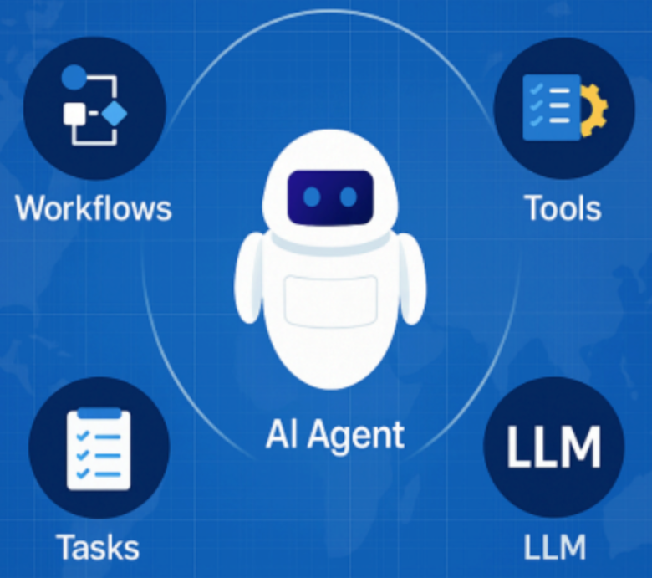
Resource Allocation AI Agent
OBJECTIVE: Design and deploy an Agentic AI system that automates resource management for the Field Service Team by intelligently assigning technicians when service requests are received from hospitals.
BUSINESS CONTEXT:
Philips medical equipment — such as MR OEM and Ultrasound systems — are installed in hospitals worldwide.
Service requests may arise for new installations, annual maintenance, or device malfunctions.
Currently, assigning technicians requires manual intervention.
We aim to build an AI-powered agent that autonomously allocates the right technician to each request based on the required skills, expertise, and availability, eliminating the need for human coordination.
EXPECTED OUTCOME:
Intelligently match service requests with suitable technicians using multi-criteria decision-making (skills, experience, location, availability).
Automate resource allocation by updating the Resource Allocation Excel with assigned technicians in real time.
Streamline field operations, reducing manual effort and improving response times.

Slide 4
AI Agent - Use Case
A Multispecialty hospital is requesting Philips for IGT-D Post-installation Calibration & Acceptance Testing. We need to set up an Al system which finds the right service engineer who is not allocated in any project and specialized in the required services.
The data contains 2 sheets
- Employee Sheet: Contains description about employee and their specialized services
- Current Project: Contains employee tagged with associated project details

Slide 5
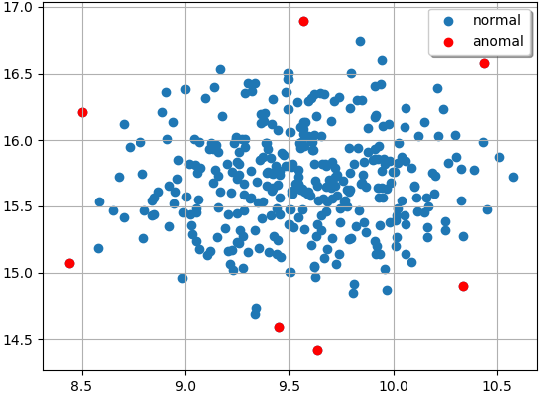

Outlier / Anomaly Detection
OBJECTIVE
The goal is to develop an anomaly detection system that automatically identifies unusual financial entries within the company’s accounting system
What exactly outlier means?
  Imagine you have a team of 10 employees, and most of them earn between ₹50,000 and ₹60,000 per month.
  But one person earns ₹5,00,000 — that salary is much higher than the rest.
  That person’s salary is an outlier — it’s a data point that’s very different from the others.
In simple terms:
“An outlier is something that stands out — it doesn’t fit the normal pattern or trend in the data”
Notes:
Feature clarity for data transactions

Slide 6

Available sheets:
Postings – Transaction level data
Currency_rates – currency conversion rate
Dataset description - description about different columns
Note:
Convert amount into USD format before outlier detection
The dataset you get will not include any label showing whether a record is an outlier or not.
This means you’ll need to analyze the data, find hidden patterns, and build your own logic or model to detect outliers.
Column Name | Description
CompanyCode | Tells which company or branch the record belongs to (like US or Philippines).
DocumentNumber | A unique number given to each financial record or document.
Transaction_ID | A special ID used to track each transaction or event.
PostingDate | The date when the transaction was officially recorded.
DocumentType | Shows what kind of record it is — for example, an invoice, journal entry, or adjustment.
GLAccount | The financial account used for the transaction (like expenses or revenue).
VendorID | The supplier or partner involved in the transaction.
CostCenter | The department or team that spent or received the money.
Department | The larger business area (like IT, HR, or Operations).
Amount | The total money involved in the transaction.
Currency | The currency used (like USD or EUR).
Description | A short note explaining what the transaction is about.
Status | Tells if the transaction is completed, pending, or posted.

Slide 7

Expected Steps to be performed
Preprocess and clean data
Exploratory Data Analysis
Build outlier detection models
Present the results
Expected Outcome
Flag whether a particular transaction amount (USD) is anomaly or not per CompanyCode + DocumentType + Department + GLAccount
Explain the reasonings for the outliers from the Model
Your score will be based on how accurately your model detects the real outliers — the closer your results are to the true labels, the higher your accuracy
Spark your storytelling skills to explain why you think the identified transactions are outliers

Slide 8
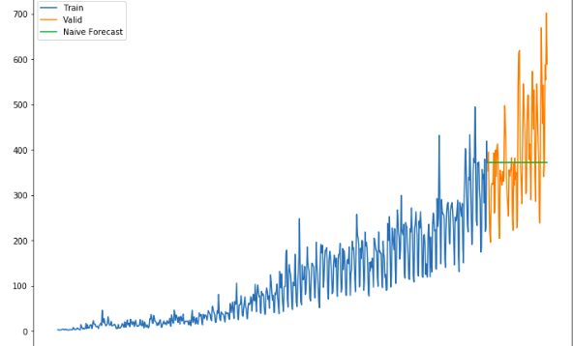
Sales Forecasting
OBJECTIVE:
To forecast future Sales Performance (total revenue) using historical transactional data (units sold, demand per product/region).
DATASET CONTEXT:
This use case is relevant to Financial Planning & Analysis (FP&A) and Demand Forecasting teams.
Sales data across multiple products, geographies, and channels help answer key questions such as:
  What will next quarter’s sales look like for each region and product line?
  How does seasonality (month, year) affect sales?
  Which channels contribute the most revenue?
  Is there any variance at plant level?
  Etc.
EXPECTED OUTCOME:
12-month rolling forecast of revenue

Slide 9
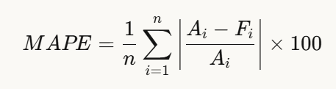
Expected Steps to be performed
Dataset Sheet Information
SalesData – Contains the key information to Forecast Sales
Currency_rates – Contains the Currency conversion values – Base is USD
Note:
Convert amount into USD format before building Sales Forecasting Model
Data Assessment, Preprocessing and Data cleaning
Exploratory Data Analysis
Feature Engineering, Transformation
Modelling and Explainability of Sales Forecast
Presenting the results
A: Actual
F: Forecast
n: No. of Observation
i: Index
Notes:
Do all the transformation done on the training data., also on the test data

Slide 10
Expected Outcome
After building a model using input data., a test dataset will be provided that contains the 2025 data, for which you use the pre-trained model to forecast for the amount.
The predictions for Total value should be done based on “Region → Country → Plant Country → Sales Channel → Product”
Compare the model’s forecast with the actual values., and create a calculation for Relevance Evaluation Metrics (MAPE)
Each team will be assigned a product - Plot that product Actuals (totalamount_local) with Forecast
Your score will be based on how close your model aligns with the actuals — the closer your results are to the forecasts across components, , the higher your accuracy
Notes:
Do all the transformation done on the training data., also on the test data

Slide 11



