Slide 1

POWER BI PROJECT
HR Attrition & Employee Overview Dashboard
Summer Training — Power BI
CGC UNIVERSITY MOHALI
Presented by: Ravish Sharma
B.Tech CSE
Presented by : Course : Guided By : Date :
Ravish Sharma B.Tech – CSE Mrs. Ashima & 02-07-2026
2419361 Mrs. Mandeep

Slide 2
Agenda
Problem Statement & Objective
Dataset Overview
Data Cleaning using Power Query
Data Model
DAX Measures
Dashboard Walkthrough
Key Insights
Challenges & Learnings
Conclusion

Slide 3
Problem Statement & Objective
1. HR team needs a visual solution to analyze employee turnover.
Objectives:
Identify high attrition departments
Analyze age group turnover
Build interactive HR dashboard
Support data-driven decisions

Slide 4
Dataset Overview
Dataset: IBM HR Analytics Dataset
Rows: 1,470 employees
Format: CSV
Key Fields: Age, Department, Attrition, Job Role, Monthly Income, Gender

Slide 5
Dataset Overview
Kaggle
Excel
1470
35
Source
File Type
Rows
Columns
Key Columns Used
Data Quality Steps (Power Query)
Column | Role in Dashboard
Employee Number | Unique identifier for each Employee
Age | Used for age group and attrition analysis
Attrition | Main Target column to analyze employee turnover
Department | Department wise attrition Comparison
Gender | Demographics Analysis
Years At Company | Employee Retention / Experience Analysis
Checked for Duplicate rows
Checked for missing values
Changed Data Type
Renamed Coloumns For Better Undestanding
Created Age Group And Salary Categories
Filtered Invalid Records

Slide 6
Power Query Cleaning
Performed data preparation:
Checked For unnecessary data
Checked missing values
Created Age Group
Created Salary Group columns

Slide 7
DAX Measures
Created measures:
Total Employees
Attrition Count
Attrition Rate
Average Employee Age

Slide 8
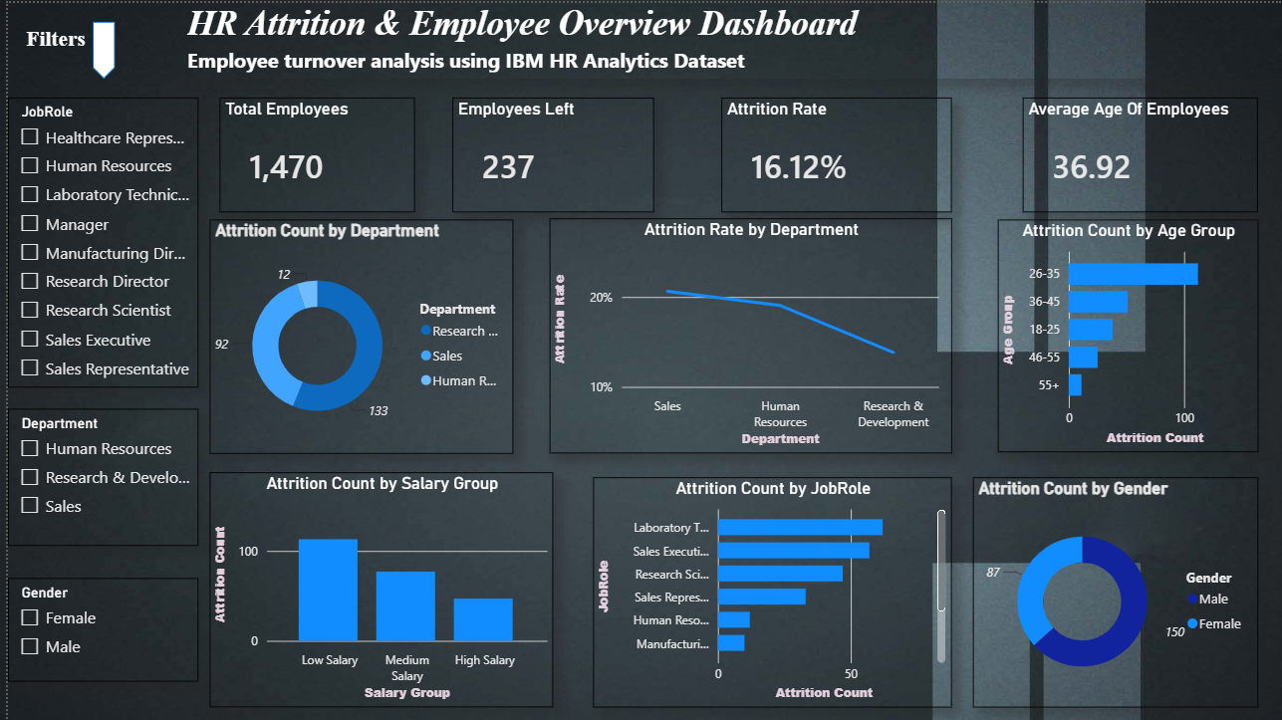
Dashboard — HR Attrition Overview
Visuals on this page
KPI Cards — Employee Count, Attrition Rate , Average Age , Employees Left
Bar Chart — Attrition By Job Role
Column Chart — Attrition By Age Group
[ Screenshot — Overview Page ]
Pie Chart — Attrition By Gender
Donut Chart — Attrition Count By Department
Slicer — Department / Job Role / Gender
Key Insight
“The Dashboard shows that employee attrition is higher in certain departments and job roles. Younger Employee with lower job satisfaction show higher chances of leaving the organization”

Slide 9
Dashboard Walkthrough
Dashboard contains:
KPI Cards
Department Attrition Donut Chart
Age Group Analysis
Job Role Analysis
Salary Impact Analysis
Interactive Slicers

Slide 10
Key Insights
High Employee Turnover in Specific Departments
Attrition is not evenly distributed across departments. Some departments experience higher employee turnover, indicating a need for targeted retention strategies.
Young Employees Show Higher Attrition
The 26–35 age group has the highest attrition count, suggesting early-career employees may have higher job mobility and require better engagement strategies.
Salary Level Impacts Employee Retention
Employees in the low salary group show higher attrition compared to higher salary groups, indicating compensation can be a major factor affecting retention.
Certain Job Roles Have Higher Attrition Risk
Roles such as Sales Executive and Laboratory Technician show comparatively higher employee exits, highlighting positions where HR should focus on retention efforts.
Overall Workforce Stability Analysis
With 1,470 total employees and 237 employees leaving, the dashboard helps HR monitor workforce stability and identify areas needing improvement.

Slide 11
Challenges
Challenges:
Data Cleaning & Preparation
Handling raw HR dataset and ensuring data quality before visualization.
Removing unnecessary data and correcting data formats.
Creating Meaningful DAX Measures
Building accurate calculations for:
Total Employees
Attrition Count
Attrition Rate
Average Employee Age
Designing an Effective Dashboard Layout
Selecting suitable charts and arranging visuals to make insights clear and easy to understand.
Managing Interactive Filters
Creating slicers and ensuring they correctly filter all dashboard visuals.
Data Interpretation
Converting raw employee data into meaningful business insights for HR decision-making.

Slide 12
LEARNING
Key Learnings
Power BI Dashboard Development
Learned how to create interactive dashboards using different visuals and KPIs.
Data Transformation using Power Query
Learned data cleaning, formatting, and preparing datasets for analysis.
DAX & Analytical Thinking
Improved understanding of creating measures and performing calculations in Power BI.
Data Visualization & Storytelling
Learned how to present complex data in a simple and meaningful way.
Business Problem Solving
Learned how analytics can help HR teams identify attrition patterns and improve employee retention strategies.

Slide 13
Conclusion & Q&A
This project successfully created an interactive HR Attrition Dashboard using Power BI to analyze employee turnover patterns. It provides meaningful insights through data visualization and helps HR teams make data-driven decisions for improving employee retention.
Future scope:
Employee attrition prediction
Advanced HR analytics

