Slide 1
MEAN [ Mongo, Express.js, Angular.js, Node.js ]
HOST
Ravi kumar sha
Shaurabh SINGH

Slide 2
Content
About Node.js
Event Driven Programming
Hello World Application
Create http server

Slide 3
NODE.JS?

Slide 4


Slide 5
Node is an event-driven I/O framework for the V8 JavaScript engine. It allow JavaScript to be executed on the server side, and uses V8 JavaScript engine.

Slide 6


Slide 7
EVENT DRIVEN PROGRAMMING

Slide 8
Where event determines the flow of execution. Event are handled by callback which executes when something significant happens. Like when a result of DB is available or when user clicks on a button. Lets see an example,

Slide 9
Consider how a query to a database is completed in typical blocking I/O programming: var result = query('SELECT * FROM posts WHERE id = 1'); do_something_with (result); This query requires that the current thread or process wait until the database layer finishes processing it. In event-driven systems, this query would be performed in this way: query( 'SELECT * FROM posts WHERE id = 1', query_finished, function(result) { do_something_with(result); }); This is an example of event-driven or asynchronous programming. One of the defining feature of Node.js also known as Non-blocking I/O. Therefore, several I/O operations can occur in parallel.

Slide 10
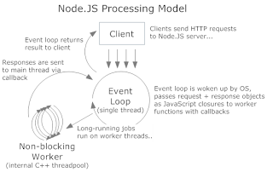

Slide 11


Slide 12
HELLO WORLD APP

Slide 13
Create a file called helloworld.js
console.log(‘Hello World’);
In terminal node helloworld.js

Slide 14


Slide 15
CREATE A HTTP SERVER

Slide 16
// EXPORTING A NODE MODULE
// HTTP IS INBUILT NODE MODULE
var http = require(‘http’);
// EXPORTING A NODE MODULE
http.createServer( function (request, response) {
response.writeHead(200, {‘Content-Type’: ‘text/plain’});
response.write(‘Hello World’);
response.end();
}).listen(8080);
// START THE NODE SERVER
node server.js

