Slide 1
MEAN [ Mongo, Express.js, Angular.js, Node.js ]
HOST
Ravi kumar sha
Shaurabh SINGH

Slide 2
Content
Installation
About Node.js
Event Driven Programming
Hello World Application
Create http server
Node Modules
Middleware
Custom Middleware
Socket.IO

Slide 3
INSTALLATION

Slide 4
Installation is pretty much similar to install any software, simply visit the link below and download a installer of your choice. https://nodejs.org/download/

Slide 5
NODE.JS?

Slide 6


Slide 7
Node is an event-driven I/O framework for the V8 JavaScript engine. It allow JavaScript to be executed on the server side, and uses V8 JavaScript engine.

Slide 8


Slide 9
EVENT DRIVEN PROGRAMMING

Slide 10
Where event determines the flow of execution. Event are handled by callback which executes when something significant happens. Like when a result of DB is available or when user clicks on a button. Lets see an example,

Slide 11

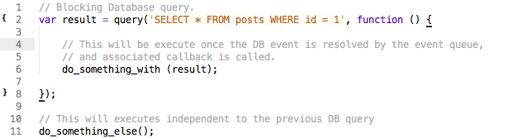
Consider how a query to a database is completed in typical blocking I/O programming: This query requires that the current thread or process wait until the database layer finishes processing it. In event-driven systems, this query would be performed in this way:

Slide 12
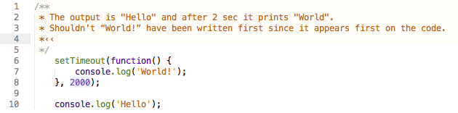
This is an example of event-driven or asynchronous programming. One of the defining feature of Node.js also known as Non-blocking I/O. Therefore, several I/O operations can occur in parallel.
The response to the query may take many thousands of CPU cycles (time taken to resolve on particular task), rendering the entire process unusable during this time. We have utilized the process to serve other client requests instead of just waiting.
Each event generated is stacked in node event queue, node has a event loop were these queue are processed one after another. Event loop then separate each event in order to process them and then call there associated callback. When the callback returned it event loop pick another event. When the event queue is empty, the event loop waits for the new event if there are any pending server calls or server listening or just quits if none.
Example

Slide 13
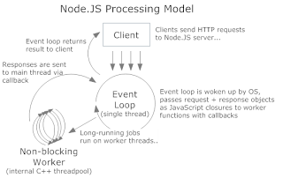

Slide 14


Slide 15
HELLO WORLD APP

Slide 16
Create a file called helloworld.js
console.log(‘Hello World’);
In terminal node helloworld.js

Slide 17


Slide 18
CREATE A HTTP SERVER

Slide 19
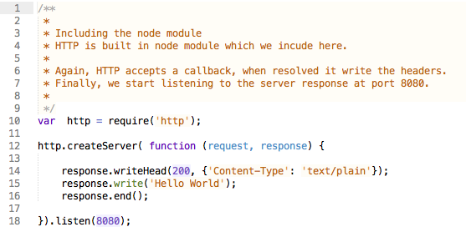

Slide 20
NODE MODULES

Slide 21
Client-side javascript has a bad repo because of the global namespace shared by all, which leads to conflicts and security leaks. Node implements module standard, where each module is separated from other modules, having a separate namespace and exporting only the desired modules.
Modules are loaded only once per process, that is, when you have several require calls to the same module, Node caches the require call if it resolves to the same file. So, how does node resolve a call to “require(‘http’)”? Here is the recipe:
CORE MODULES
There are a list of core modules, which Node includes in the distribution binary. If you require one of those modules, Node just returns that module and the require() ends.
MODULES WITH PATH
If the module path begins with “./” or “/”, Node tries to load the module as a file. If it does not succeed, it tries to load the module as a directory.

Slide 22
MIDDLEWARE

Slide 23
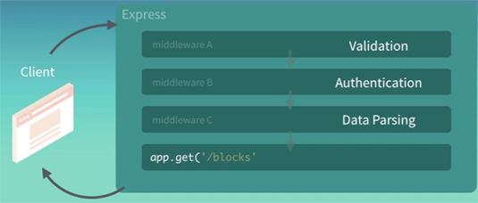
Middleware are functions added to the stack also known as MIDDLEWARE STACK, that have access to request and response object, and they executed sequentially app.use() method is responsible for adding the middleware to the application stack. Whatever is returned from use() method is goes to the stack. Middleware is in between the raw request and the final intended route.
Inside each middleware we can do Validation, Authentication, Data parsing etc.
So each request generated by client passes through all the steps written in the middleware to the application routes. Let see how a middleware looks like

Slide 24
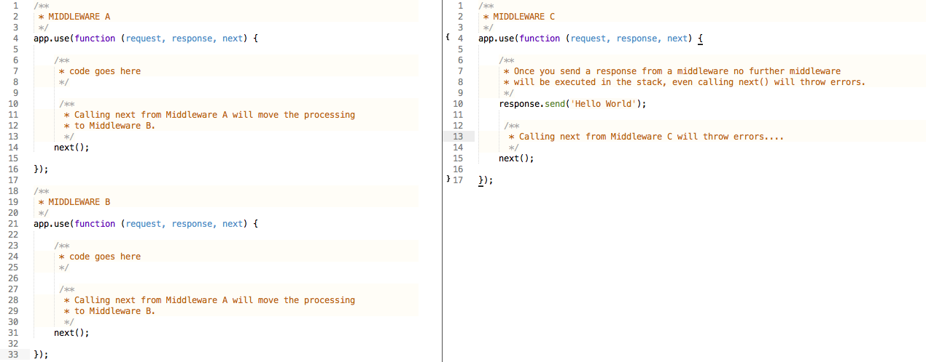

Slide 25
CUSTOM MIDDLEWARE

Slide 26
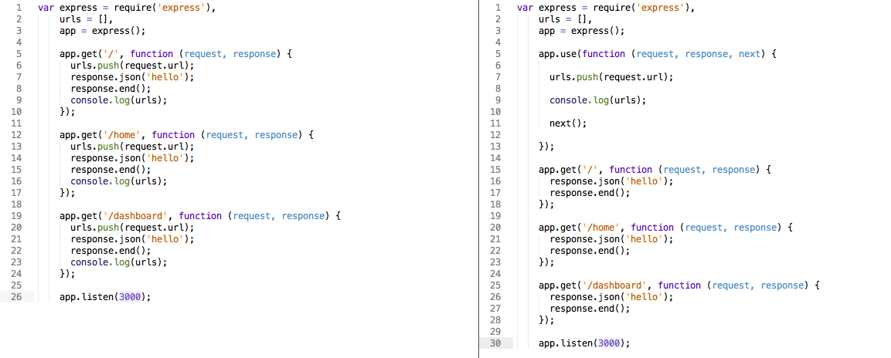
Now, suppose you want to maintain a list of requested url (why the hell you want to do that, no idea), every time there is a new request. You could go to each route and add your logic, or you can use middleware!
Recollect everything we learnt from previous examples, Middleware works as an interceptor between the raw request and the intended route.

Slide 27
SOCKET.IO

Slide 28
Now, suppose you want to maintain a list of requested url (why the hell you want to do that, no idea), every time there is a new request. You could go to each route and add your logic, or you can use middleware!
Recollect everything we learnt from previous examples, Middleware works as an interceptor between the raw request and the intended route.

Slide 29


Slide 30
npm install socket.io --save

