Slide 1
INVESTMENT ASSIGNMENT SUBMISSION
Name: Ravi Sankar Dasari

Slide 2
Investment Analysis For Spark Funds
Business Objective:
The objective is to identify the best sectors, countries, and a suitable investment type for making investments.
Strategies:
Invest where most other investors are investing.
Invest between 5-15 million USD per round of investment.
Invest only in English-speaking countries considering the ease of communication with the companies.
Goals:
To identify the most suitable investment type for the budget range between 5-15 Million USD.
To identify the countries which have been the most heavily invested in the past for the chosen investment type.
To understand the distribution of investments across the main sectors and their respective sub-sectors and companies.

Slide 3
Problem solving methodology
Business Understanding
Data Understanding
Data Preparation
Imputing the missing data
Removing outliers
Merge relevant data
Finally work on interested data
Companies data
Investment data
Sectors classification data
Start
Understand the global trends in investments so that we can take the investment decisions effectively.
Sector Analysis
Country Analysis
Investment type Analysis
Propose the most suitable investment options to Spark Funds
Identifying the countries which have been the most heavily invested in the past.
Invest only in English-speaking countries because of the ease of communication
Compare the typical investment amounts in the venture, seed, angel, private equity etc. which best fits the budget of 5-15 million USD
End
Understanding the distribution of investments across the main sectors and their individual sub-sectors.
End

Slide 4
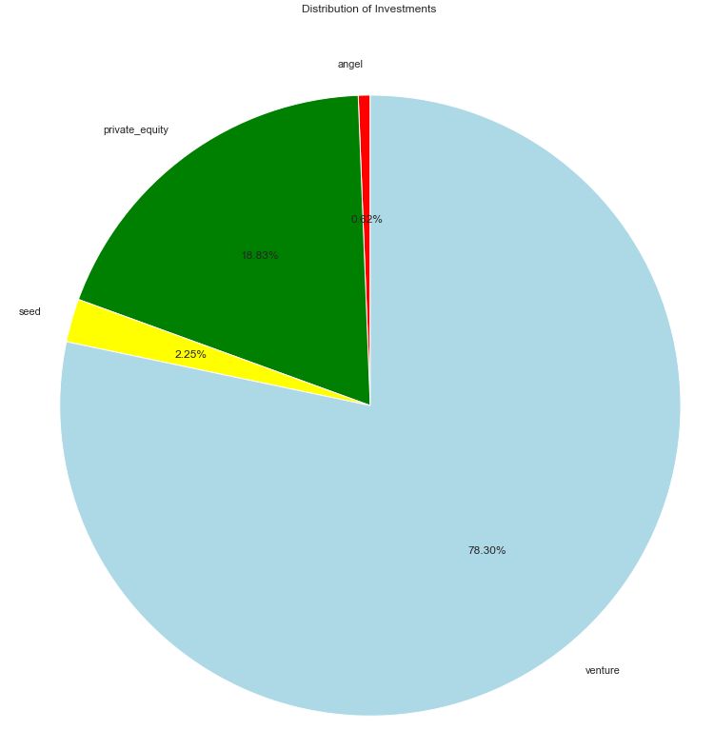
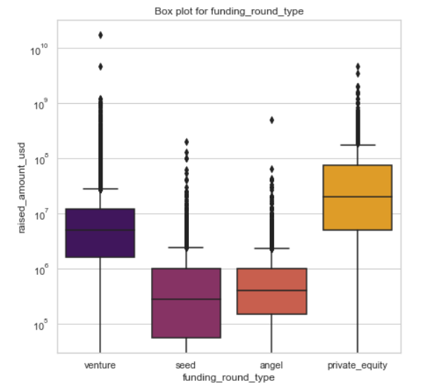
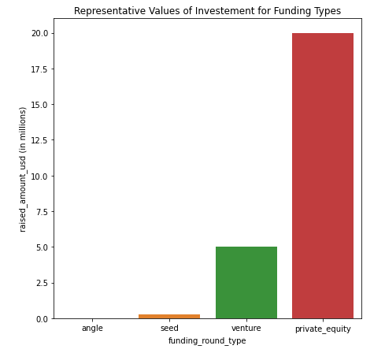
Funding Type Analysis
Funding Round Type | Representative funding amount
Private Equity | 20000000
Venture | 5000000
Angel | 400000
Seed | 275000
The above pie chart depicts that the majority of the investments(78.3%) are put into Venture funding type(among the selected 4 types).
As we can see from the first plot that there are a lot of outliers in the data for the venture/seed/angel/private_equity funding round types. Hence ‘median’ will be most suitable metric which represents the data.
From the second plot, we can clearly see the ‘Venture’ funding type best suits our investment requirement of 5-15 million USD

Slide 5
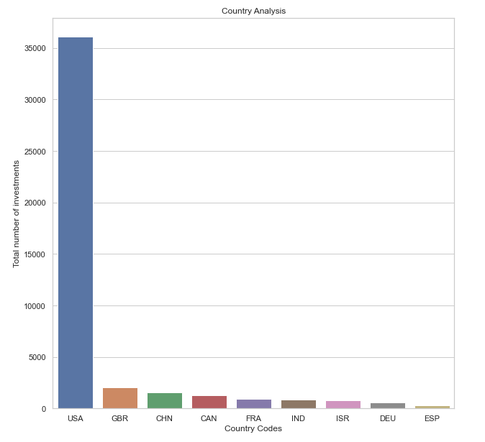
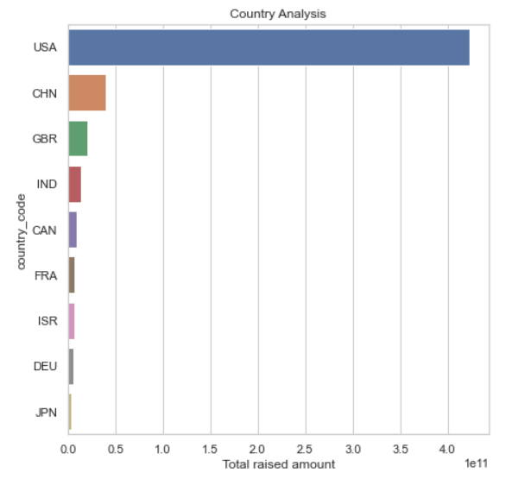
Country Analysis
Country Code | Total raised amount (in USD)
USA | 422,510,842,796.00
CHN | 39,835,418,773.00
GBR | 20,245,627,416.00
IND | 14,391,858,718.00
CAN | 9,583,332,317.00
FRA | 7,259,536,732.00
ISR | 6,907,514,579.00
DEU | 6,346,959,822.00
JPN | 3,363,676,611.00
Based on the number of investments made in the ‘Venture’ funding type, above are the top 9 countries which Spark Funds should be interested in to invest.
Since Spark Funds wants to invest in companies where others are heavily investing, above are the list of top9 countries based on total raised amount in venture funding type.
The top 3 English speaking countries where Spark Funds can invest in are USA, GBR and IND.

Slide 6
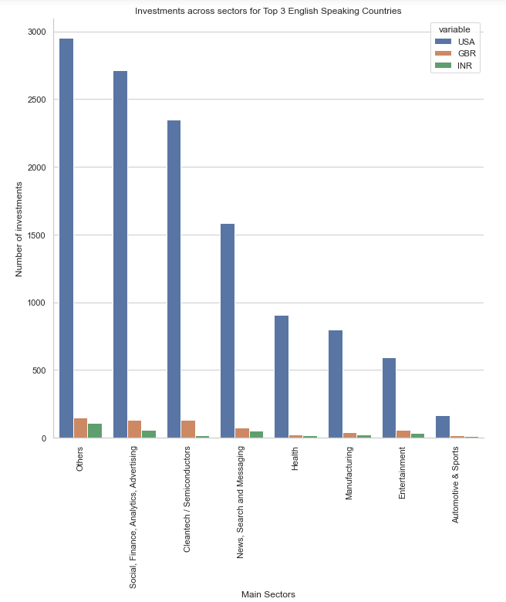
Sector Analysis
Across the main 8 sectors, the investments made by the top 3 countries are as depicted above.
We can clearly identify that Others, Social/Finance/Analytics/Advertising and Cleantech/Semiconductors are the 3 primary sectors where majority of Venture type funding went into.

Slide 7
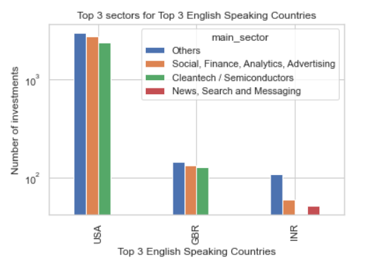
Sector Analysis
Top 3 countries | Top 3 sectors | Main Sector | Number of Investments
USA | # 1 | Others | 2950
 | # 2 | Social, Finance, Analytics, Advertising | 2714
 | # 3 | Cleantech / Semiconductors | 2350
GBR | # 1 | Others | 147
 | # 2 | Social, Finance, Analytics, Advertising | 133
 | # 3 | Cleantech / Semiconductors | 130
IND | # 1 | Others | 110
 | # 2 | Social, Finance, Analytics, Advertising | 60
 | # 3 | News, Search and Messaging | 52
For the Top 3 English speaking countries in the prior analysis, above are the Top 3 main sectors based on the number of investments made.
Others, Social/Finance/Analytics/Advertising, Cleantech/Semiconductors and News/Search/Messaging are the top main sectors to invest in these top 3 countries for Venture funding type.

Slide 8
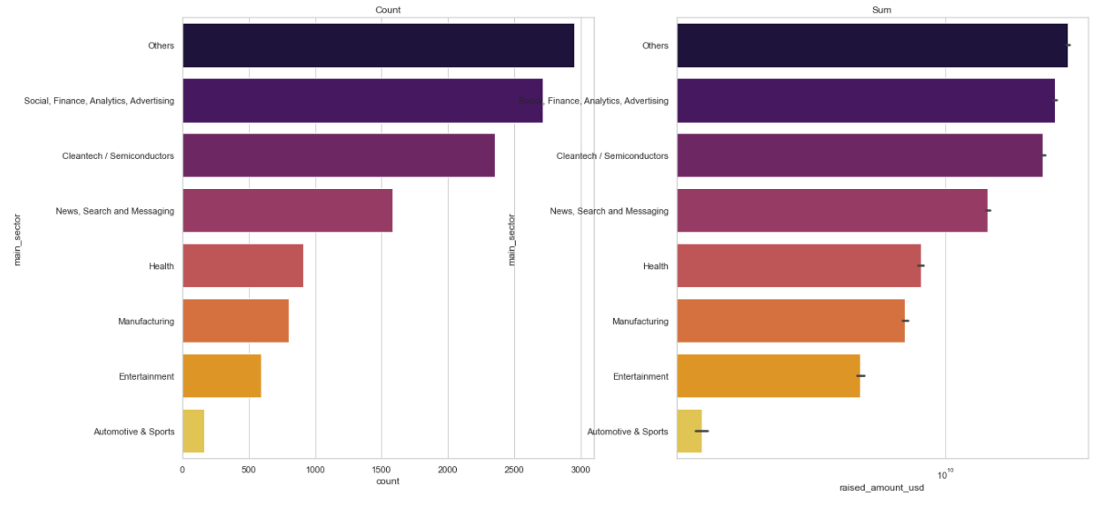
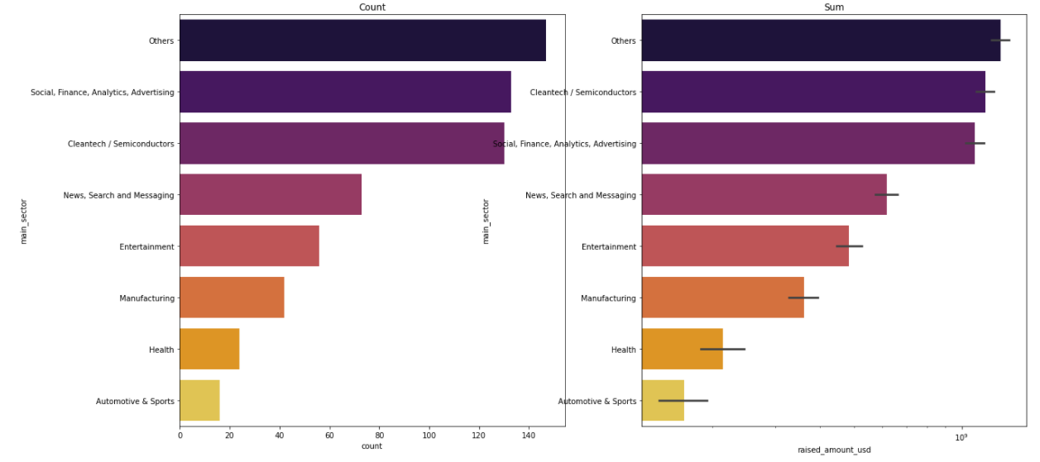
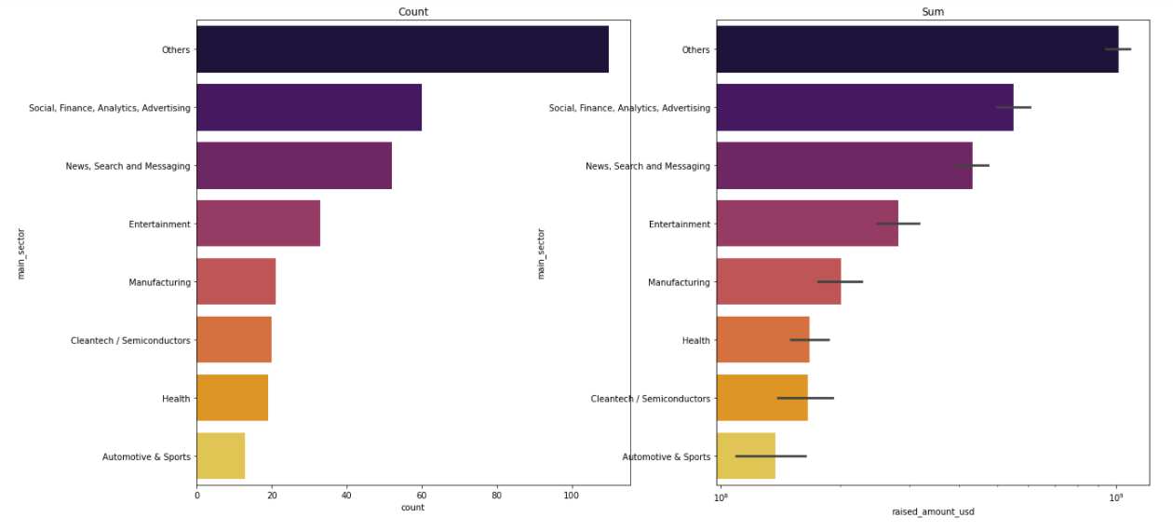
Sector Analysis in Top 3 countries
Sector Analysis for USA
Sector Analysis for GBR
Sector Analysis for IND
Based on the number of investments made Others, Social/Finance/Analytics/Advertising and Cleantech / Semiconductors are the top 3 main sectors in GBR.
Based on the total amount of investments made(sum) Others, Cleantech / Semiconductors and Social/Finance/Analytics/Advertising are the top 3 main sectors in GBR.
Based on the number of investments made Others, Social/Finance/Analytics/Advertising and News/ Search/Messaging are the top 3 main sectors in IND.
Based on the total amount of investments made(sum) Others, Social/Finance/Analytics/Advertising and News/Search/Messaging are the top 3 main sectors in IND.
Based on the number of investments made Others, Social/Finance/Analytics/Advertising and Cleantech / Semiconductors are the top 3 main sectors in USA.
Based on the total amount of investments made(sum) Others, Social/Finance/Analytics/Advertising and Cleantech / Semiconductors are the top 3 main sectors in USA.

Slide 9
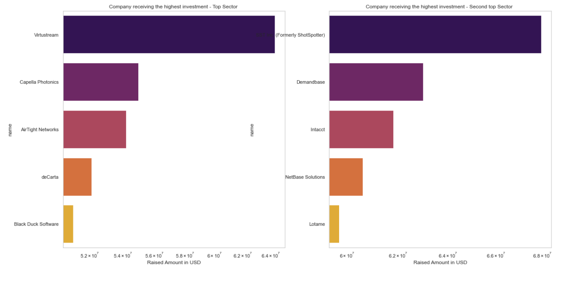
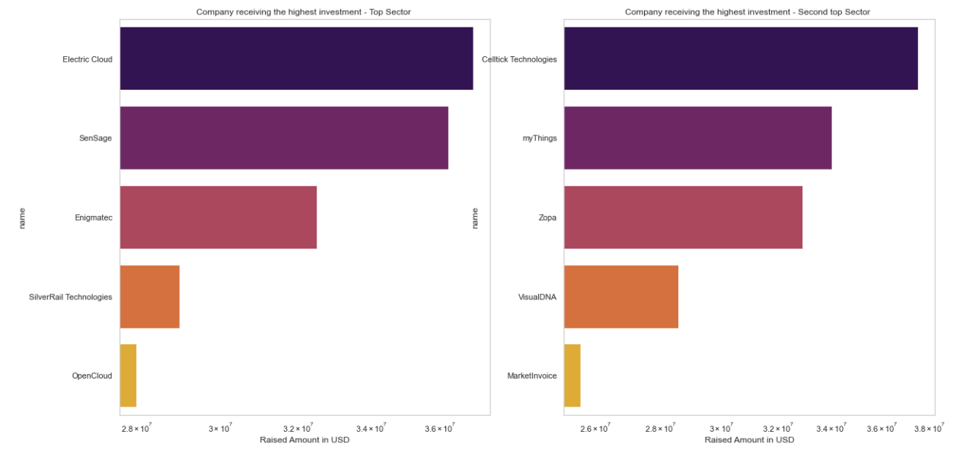
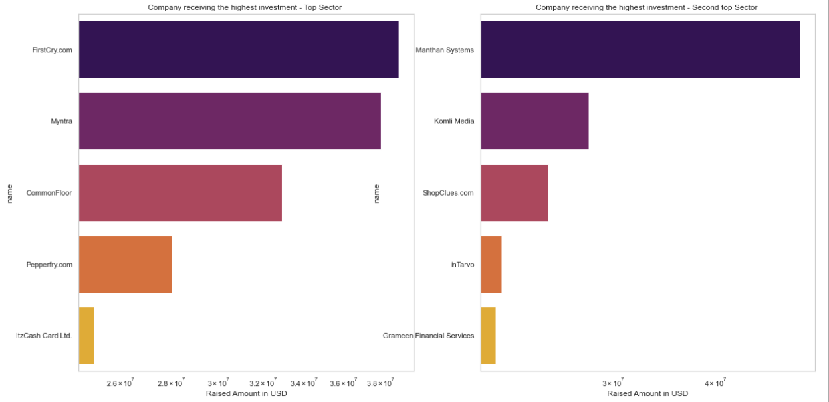
Company Analysis in Top 3 countries in chosen sectors
Company Analysis for USA
Company Analysis for GBR
Company Analysis for IND
For the top sector (Others): Electric Cloud, SenSage and Enigmatec are the highly invested companies in GBR.
For the second top sector (Social/Finance/Analytics/Advertising): Celltick Technologies, myThings and Zopa are the highly invested companies in GBR.
For the top sector (Others): FirstCry.com, Myntra and CommonFloor are the highly invested companies in IND.
For the second top sector (Social/Finance/Analytics/Advertising): Manthan Systems, Komli Media and ShopClues.com are the highly invested companies in IND.
For the top sector (Others): Virtustream, Capella Photonics and AirTight Networks are the highly invested companies in USA.
For the second top sector (Social/Finance/Analytics/Advertising): SST Inc., Demandbase and Intacct are the highly invested companies in USA.

Slide 10
Conclusions
Considering the strategy and objectives of Spark Funds, below can be their investment strategy:
Venture funding type is most suitable investment type for Spark funds, taking into account the 5-15million USD budget per round of investment.
Investing in USA is more ideal based on the total raised amount in venture funding type. GBR and IND are the other top English speaking nations which Spark Funds can consider investing in.
Others, Social/Finance/Analytics/Advertising, Cleantech/Semiconductors and News/Search/Messaging are the top sectors where majority of the investments went into. So, Spark Funds can think of investing in Others and Social/Finance/Analytics/Advertising sectors.
The companies with highest investments in these 2 sectors across all the top countries are suggested in the prior slides. Virtustream came out to be the best company to invest in.

