Slide 1
Youtube Data Analysis

Slide 2

Agenda
YouTube Data Analysis project involves securely managing, streamlining, and performing analysis on the structured and semi-structured data based on the video categories and trending metrics to visualize data insights to answer business questions.
This Photo by Unknown Author is licensed under CC BY

Slide 3

Goals AWS Cloud - Processing vast amounts of data to answer business questions could be challenging on local computers, so need to use the cloud, in this case, we will use AWS. Data Ingestion - Build a mechanism to ingest data into S3. Involves planning a strategy to handle both CSV and JSON files extracted from Kaggle. Staging - Build a staging Layer using the Glue catalog for further processing of JSON and CSV data. Testing - Testing small of CSV and JSON Data with AWS lambda and AWS glue before automating the entire processing layer. ETL ( Extract, Transform, Load ) - Both CSV and JSON Data in raw format should be cleaned and transformed into parquet format using AWS Lambda and AWS Glue.
This Photo by Unknown Author is licensed under CC BY-SA

Slide 4
Automation - Make sure the entire ETL is automated to handle higher throughputs using AWS lambda triggers. Data lake - All the cleaned data from CSV and JSON needs a centralized repo such as S3 to store them to perform further transformations and loading into the warehouse. Analytics - further transformed data should be loaded into Redshift for faster querying and analytics purposes. Reporting - Build a dashboard from Redshift to get insights required for business needs using Amazon Quick Sight. Scalability - As the size of data increases, we need to make sure the architecture built scales it. Monitoring - Use Cloudwatch to monitor logs across all AWS
This Photo by Unknown Author is licensed under CC BY-SA
This Photo by Unknown Author is licensed under CC BY-SA
This Photo by Unknown Author is licensed under CC BY-SA
This Photo by Unknown Author is licensed under CC BY-SA

Slide 5
Services
Amazon S3
Object storage service for storing raw and processed data.
Usage
- Data landing and staging.
- Data lake storage.
- Processed data storage.
AWS IAM
Identity and access management service to control access to AWS resources.
Usage
- Define roles, policies, and permissions.
- Ensure secure and controlled access to data and services.

Slide 6
QuickSight
Business intelligence service for data visualization and analytics.
Usage
- Create interactive dashboards and reports.
- Analyze data and generate insights.
AWS Glue
Data integration service for ETL processes.
Usage
- Data cataloging and crawling.
- ETL job orchestration.
AWS Lambda
Serverless computing service for running code without managing servers.

Slide 7
Usage - Data processing and transformation. - Event-driven data processing using triggers. AWS Athena Interactive query service for analyzing data in Amazon S3. Usage - Run SQL queries on S3 data. - Ad-hoc data analysis and exploration. AWS Redshift Data warehouse service for analytics and reporting. Usage - Store and analyze large datasets. - Faster querying and reporting. AWS CloudWatch Monitoring and logging service for AWS resources and applications. Usage - Monitor system health and performance. - Set up alarms and notifications.

Slide 8
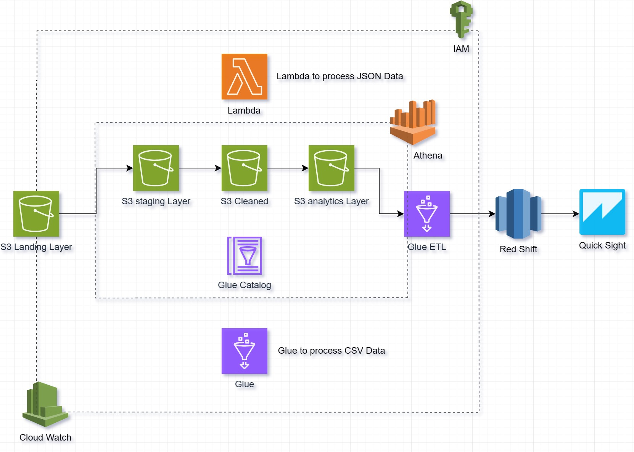
Architecture

Slide 9
Data Flow Landing Layer: - Initial landing zone where raw JSON and CSV YouTube data is uploaded from Kaggle. - Data is segregated into S3 buckets based on regions like Canada, United States, and Great Britain. - Periodically sync Kaggle dataset with respective S3 buckets. - Implement versioning to track changes and updates. Data Validation - Before processing, data integrity checks are performed to ensure data quality and consistency. - Identify and handle any missing or incorrect data. - Use AWS Glue or custom scripts for data validation. - Implement logging to track validation results and any anomalies.

Slide 10
Staging Layer
- Data from the Landing Layer is crawled and cataloged using AWS Glue.
- Provides a consolidated view for testing and validation.
- Schedule Glue crawlers to catalog new data.
- Validate cataloged data against source data for consistency.
Data Transformation & Enrichment
- Data is transformed, cleaned, and enriched to prepare it for analytics.
- Includes tasks like data cleansing, normalization, and adding calculated fields.
- Use AWS Glue or custom scripts for data transformation.
- Implement business logic for data enrichment.

Slide 11
Processing Layer for JSON data
- JSON data is processed using AWS Lambda to convert it into a more efficient parquet format.
- Transformed data is stored in a dedicated Processed S3 bucket.
- Implement error handling in Lambda for any processing failures.
- Leverage Lambda triggers to automate data processing when new data is uploaded into S3 bucket.
Processing Layer for CSV data
- CSV data undergoes ETL processes using AWS Glue to convert it into parquet format.
- Ensures data consistency and efficiency for analytics.
- Optimize Glue ETL jobs for performance.
- Implement data partitioning for faster query performance.

Slide 12
Analytics Layer
Analytical queries are executed using Amazon Athena on the processed data.
- Resulting datasets are stored in analytics-specific S3 buckets.
Optimize Athena queries for performance.
Schedule Glue ETL job to upload analytic into redshift for visualization and faster querying.
Data Visualization
- Visual representation of analytics data using Amazon QuickSight.
- Dashboards and reports are created to provide insights and answer business questions.
- Customize QuickSight dashboards to answer business questions.
- Share dashboards with stakeholders for regular updates and insights.

Slide 13
Identity and Access Management (IAM)
- Securely manage access to AWS services and resources.
- Control who can access which resources and what actions they can perform.
- Set up IAM roles, policies, and permissions for team members.
- Regularly review and update IAM policies to ensure least privilege access.
Monitoring & Logging with CloudWatch
- Monitor logs and metrics across all AWS services.
- Set up alarms and notifications for any anomalies or issues.
Configure CloudWatch to monitor Lambda, Glue, Redshift, and S3 activities.
- Set up dashboards and alarms for key metrics to ensure system health and performance.

Slide 14
Thank you

